Slide 1
UHR preamble signaling
Date: 8/29/2024
Authors:

Slide 2
Introduction
PHY parameters signaled in the preamble are currently (i.e., 11be) distributed between U-SIG and EHT-SIG
Newly defined 11bn PHY parameters need to be accommodated in UHR preamble design
There are some “universal” preamble design constraints:
  Legacy preamble up to U-SIG to be identical to 11be
  U-SIG format to be maintained as in 11be (#symbols/#bits)
  No change in Version Independent fields in U-SIG
Desired design criteria:
  Keep EHT-SIG and UHR-SIG compatible
  No regression in capabilities relative to prior generations
    E.g. NSS support, MCS support, …

Slide 3
Two main questions …
What to signal?
  The following new PHY features have been agreed (in principle):
    2xLDPC
    UEQM (incl. new MCS)
How to signal?
  Examine available bits or options for redefinition of existing bits
    Specifically, in EHT-SIG (contains MCS and coding)
    See upcoming slides

Slide 4
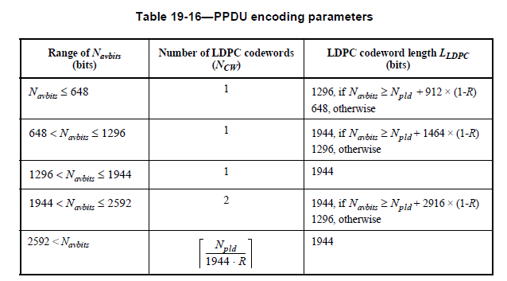

Signaling LDPC
All previous PHY generations signal only a binary choice between BCC or LPDC
  Codeword size is not part of the signaling
  Codeword size is determined as a function of code rate, $N_{avbits}$ and $N_{pld}$:

Slide 5
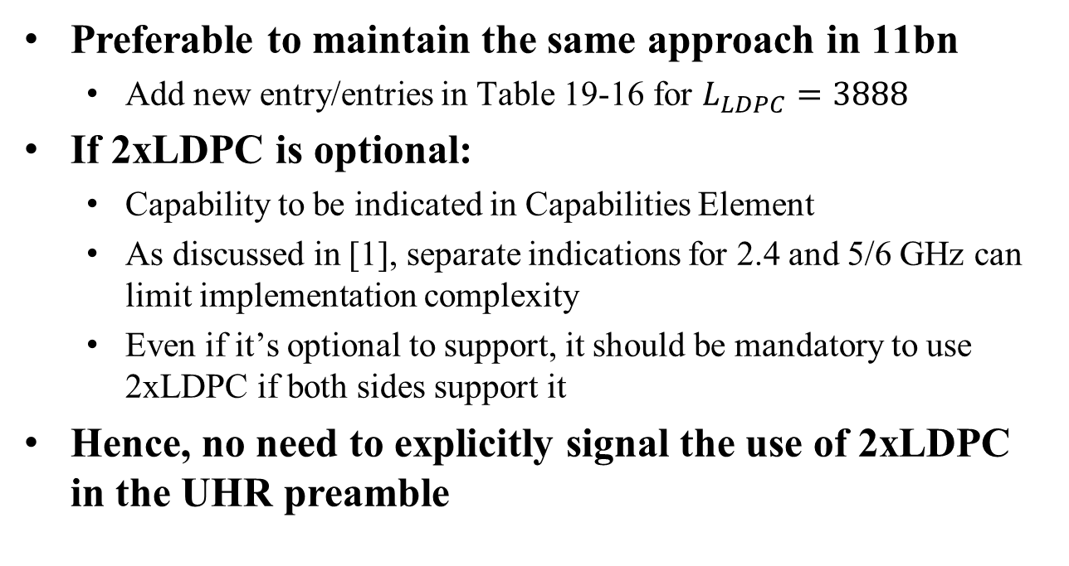
Signaling LDPC (2)
Preferable to maintain the same approach in 11bn
  Add new entry/entries in Table 19-16 for $L_{LDPC}=3888$
If 2xLDPC is optional:
  Capability to be indicated in Capabilities Element
  As discussed in [1], separate indications for 2.4 and 5/6 GHz can limit implementation complexity
  Even if it’s optional to support, it should be mandatory to use 2xLDPC if both sides support it
Hence, no need to explicitly signal the use of 2xLDPC in the UHR preamble

Slide 6
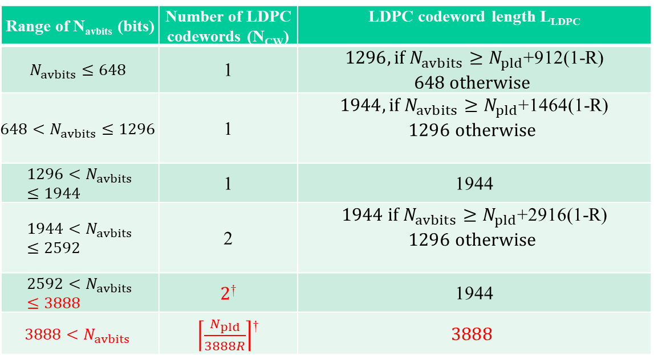
LDPC CW size
Possible extension of Table 19-16:
Range of N_{avbits} (bits) | Number of LDPC codewords (N_{CW}) | LDPC codeword length L_{LDPC}
$$N_{avbits}≤648$$ | 1 | $1296, if N_{avbits}≥N_{pld}$+912(1-R) $$648 otherwise$$
$${648<N}_{avbits}≤1296$$ | 1 | $1944, if N_{avbits}≥N_{pld}$+1464(1-R) $$1296 otherwise$$
$${1296<N}_{avbits}≤1944$$ | 1 | 1944
$${1944<N}_{avbits}≤2592$$ | 2 | $1944 if N_{avbits}≥N_{pld}$+2916(1-R) $$1296 otherwise$$
$${2592<N}_{avbits}≤3888$$ | $2$† | 1944
$${3888<N}_{avbits}$$ | $\left\lceil \frac{N_{pld}}{3888R}\right\rceil$† | $$3888$$
†Other framing settings may be chosen for enhanced reliability – see e.g., [2]

Slide 7
Signaling UEQM (incl. new MCS)
MCS is currently signaled in User Field within the User Specific Field of EHT-SIG
  User Field format for non-MU MIMO
  User Field format for MU MIMO
To evaluate how signaling can be extended, we look at the following:
  Examine the available bits in the User Field as currently defined (11be)
  Discuss ways of using any available bits for signaling of new values

Slide 8

User Field for non-MU MIMO
One Reserved bit available
Moreover, while the NSS field consists of 4 bits, only values 0-7 are allowed (Other values are Validate)
  This gives us one more de facto reserved bit
⇒ Two bits available for additional signaling

Slide 9

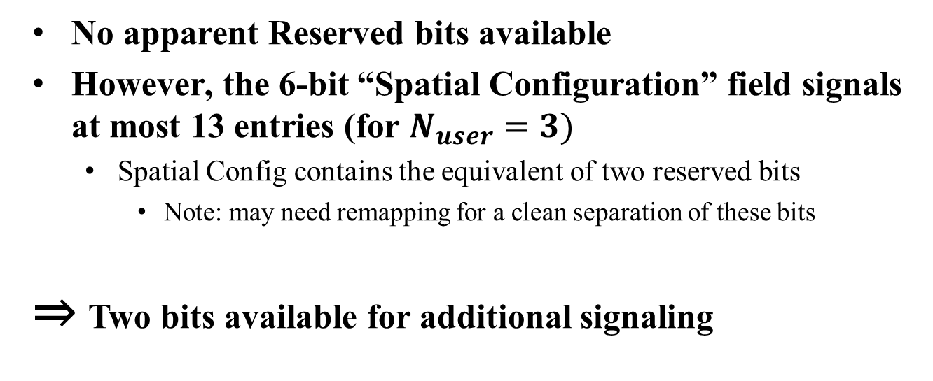
User Field for MU MIMO
No apparent Reserved bits available
However, the 6-bit “Spatial Configuration” field signals at most 13 entries (for $N_{user}=3)$
  Spatial Config contains the equivalent of two reserved bits
    Note: may need remapping for a clean separation of these bits
⇒ Two bits available for additional signaling

Slide 10
Signaling UEQM for non-MU MIMO
One of the reserved bits can be used to signal the use of UEQM
If UEQM is used, the 4 current MCS bits (B11-14) and the 3 current NSS bits (B16-18) can be combined to signal up to 128 possible UEQM/NSS variations (7 bits)
  Define lookup table to map this to specific combination of NSS and MCS
  Flexible enough to accommodate any required pattern
  Similar approach as in 11n
Some NSS values may need more MCS patterns than others
  No need to have same number of MCS for every value of NSS
  E.g., in 802.11n: 6 UEQM for NSS=2, 14 UEQM for NSS=3, 24 UEQM for NSS=4

Slide 11
Illustration of UEQM signaling
Using 7 bits to signal all UEQM (illustration only)

Slide 12
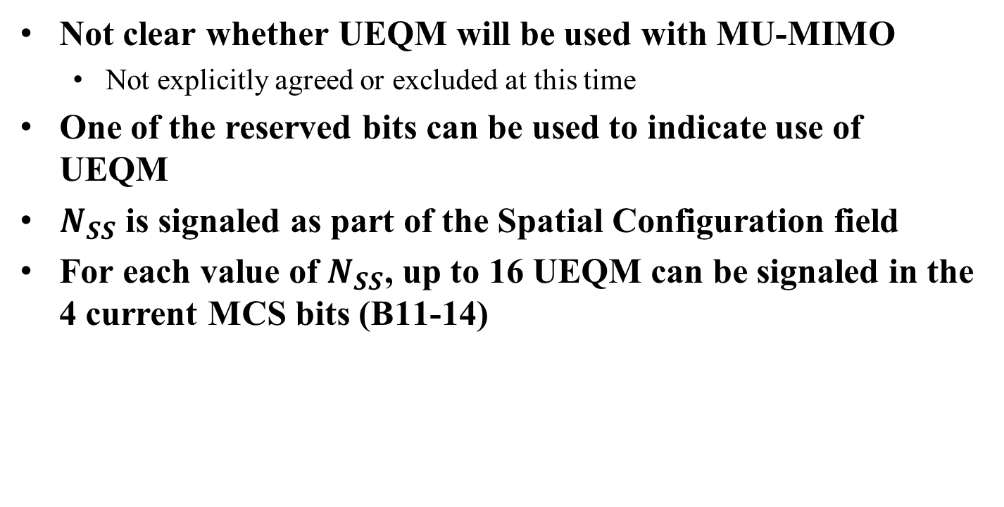
Signaling UEQM for MU MIMO
Not clear whether UEQM will be used with MU-MIMO
  Not explicitly agreed or excluded at this time
One of the reserved bits can be used to indicate use of UEQM
$N_{SS}$ is signaled as part of the Spatial Configuration field
For each value of $N_{SS}$, up to 16 UEQM can be signaled in the 4 current MCS bits (B11-14)

Slide 13
Summary
We have discussed the following topics:
  Why 2xLDPC doesn’t need to be signaled in the preamble
  Available bits in current User Field to extend 11be signaling
    Both non-MU MIMO and MU MIMO have two “de facto” reserved bits
  Possible ways to signal UEQM for these two cases
  TBD: decide on the use of UEQM in MU-MIMO
The proposed approach keeps User Fields compatible with 11be definition
  Easier reuse
The proposed approach does not reduce any capabilities relative to 11be
  Range of NSS, MCS, … support

Slide 14
References
[1] Investigation of LDPC Improvements, IEEE 802.11-24/1159r1
[2] LDPC and Framing Settings for Ultra High Reliability, IEEE 802.11-24/1487

Slide 15
Straw Poll 1
Do you agree to include the following into the 11bn SFD?
  The use of 2xLDPC is an optional capability, indicated by the STA
Y/N/A:

Slide 16
Straw Poll 2
Do you agree to include the following into the 11bn SFD?
  Support for 2xLDPC can be indicated as a separate capability for 2.4 GHz and 5/6 GHz.
Y/N/A:

Slide 17
Straw Poll 3
Do you agree to include the following into the 11bn SFD?
  When both Tx and Rx support 2xLDPC, the use of 2xLDPC shall be mandatory (subject to the rules in the (extended) Table 19-16)
Y/N/A:

Slide 18
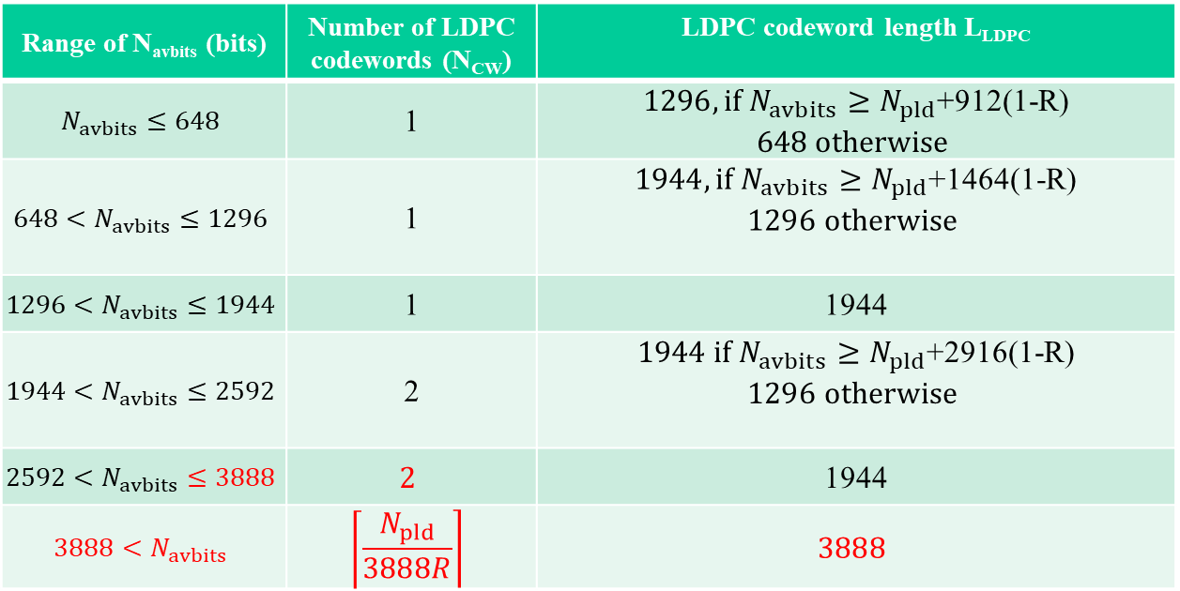
Straw Poll 4
Do you agree to include the following into the 11bn SFD?
  The selection of LDPC CW size shall be based on the following rules:
Y/N/A:

Slide 19
Straw Poll 5
Do you agree to include the following into the 11bn SFD?
  The length of a User field in UHR-SIG shall be the same as the User field in EHT- SIG (22 bits).
Y/N/A:

Slide 20
Straw Poll 6
Do you agree to include the following into the 11bn SFD?
  UHR shall be able to signal at least the same ranges for NSS, MCS, … as EHT
Y/N/A:

Slide 21
Straw Poll 7
Do you agree to include the following into the 11bn SFD?
  In a non-MU-MIMO User field, UEQM shall be signaled by using one of the currently reserved bits
Y/N/A:

Slide 22
Straw Poll 8
Do you agree to include the following into the 11bn SFD?
  In a non-MU-MIMO User field, UEQM shall be signaled as an entry in a list of defined UEQMs (i.e., not using separate signaling for NSS and Modulation)
  Note: this is similar to the way UEQM was defined in 802.11n
Y/N/A:

Slide 23
Straw Poll 9
Should UEQM be defined for MU-MIMO?
Note: this is for information gathering, not an SFD proposal
Y/N/A:

Slide 24
Straw Poll 10
Do you agree to include the following into the 11bn SFD?
  In a UHR MU-MIMO User field, the Spatial Configuration field shall be restructured to a 4-bit field and up to two reserved bits.
Y/N/A:

