Slide 1
Discussion on TB ELR PPDU
Date: 2024-09-10
Authors:
Name | Affiliations | Address | Phone | email
Mengshi Hu | Huawei |  |  | humengshi@huawei.com
Ross Jian Yu
Ming Gan
Stephen McCann

Slide 2
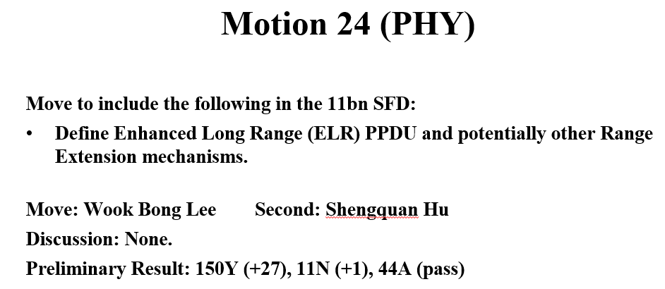
Enhanced Long Range (ELR)
Enhanced Long Range (ELR) has been discussed in UHR for a long time [1]. It can improve the range of uplink to overcome the link budget imbalance between the downlink and uplink [2].
In many regulatory domains, APs are allowed to transmit with higher power or higher power spectrum density than those of non-AP STAs, which may lead to the range imbalance.
In the 802.11 July meeting [3], a motion related to ELR (Motion 24) passed:

Slide 3
TB and Non-TB ELR
Enhanced Long Range (ELR) suggests the following design: 20 MHz BW, single stream only, and low MCS, to achieve a high reliability of transmission.
The following figure shows an example of the discussed ELR PPDU:
According to the discussions, the ELR PPDU may have the following two variants [4]:
Non-TB ELR PPDU: This variant could be used for the uplink contention based transmission. Besides the enhancement of the Data field, the SIG field is needed to be enhanced to provide an extended range.
TB ELR PPDU: This variant could be used in the trigger-based transmission. Since the AP already knows the related SIG information that the STA transmits, the main updates may be within the Data field.
20 MHz
Fig. An Example of ELR PPDU

Slide 4
Considerations on Efficiency
Non-TB ELR PPDU should be supported because the PPDU supporting contention based transmission is needed. However, as discussed previously, the BW of the non-TB ELR PPDU is 20 MHz, indicating a low spectrum efficiency.
To fully utilize the spectrum, the transmission of multiple TB PPDUs containing at least one TB ELR PPDU should also be supported.
Each TB ELR PPDU may still correspond to 20 MHz.
OFDMA could be used to support the transmission of multiple TB PPDUs.
Fig. transmission containing at least one TB ELR PPDUs
In the subsequent slides, two variants of the transmission containing the TB ELR PPDU are discussed.

Slide 5
Transmission of Pure TB ELR PPDUs
The first transmission variant correspond to pure TB ELR PPDUs, indicating that the TB PPDUs solicited by a Trigger frame are all TB ELR PPDUs.
The following figure shows an example of the discussed ELR PPDU:
Note: Larger BW are also allowed.
Compared to the transmission of a single TB ELR PPDU, there is no big change because all of the TB PPDUs are ELR TB PPDUs.

Slide 6
Transmission of Hybrid TB PPDUs
Different from the previous one, hybrid TB PPDUs indicates that the TB PPDUs solicited by a Trigger frame contain both TB ELR PPDUs and conventional UHR TB PPDUs.
The following figure shows an example of the discussed ELR PPDU:
Note: Larger BW are also allowed.
Compared to the pure TB ELR transmission, this hybrid transmission is more reasonable because most devices do not need to use the ELR format.

Slide 7
Symbol Alignment
Note that in the case of hybrid TB PPDU transmissions, if those hybrid TB PPDUs are simply put together:
The symbols may not be aligned because of different PPDU formats.
This will lead to the adjacent channel interference.
To avoid the above symbol misalignment, some methods could be considered, such as using a unified preamble.

Slide 8
Conclusion
To fully utilize the spectrum, Enhanced Long Range (ELR) supporting multiple TB PPDUs should be supported in the TB case. Two modes were further discussed:
Transmission of pure TB ELR PPDUs
Transmission of hybrid TB PPDUs
Symbol alignment should be considered for the transmission of hybrid TB PPDUs.

Slide 9
References
[1] Jianhan Liu, et al, Enhanced Long Range-Usage Scenarios, Design Target and Feasibility, 802.11 DCN 22/1928r1
[2] Jianhan Liu, et al, Design Targets and Considerations for Enhanced Long Range, 802.11 DCN 24/0873r2
[3] Alfred Asterjadhi, TGbn Motions List - Part 1, 802.11 DCN 2024/0171r13
[4] Dongguk Lim, et al, Considerations on ELR transmission, 802.11 DCN 2024/1184r0

Slide 10
Straw Poll #1
Do you agree to include the following into the 11bn SFD?
  The transmission of multiple ELR TB PPDUs is allowed when solicited by a Trigger frame.
    Y
    N
    A

Slide 11
Straw Poll #2
Do you agree to include the following into the 11bn SFD?
  The transmission of hybrid TB PPDUs is allowed when solicited by a Trigger frame.
    Hybrid TB PPDUs indicates that the TB PPDUs solicited by a Trigger frame containing both TB ELR PPDUs and conventional TB non-ELR PPDUs .
    Y
    N
    A

Slide 12
Straw Poll #3
Do you agree to include the following into the 11bn SFD?
  The Symbol alignment should be considered for the transmission of hybrid TB PPDUs solicited by a Trigger frame.
    Hybrid TB PPDUs indicates that the TB PPDUs solicited by a Trigger frame containing both TB ELR PPDUs and conventional TB non-ELR PPDUs .
    Y
    N
    A

