Slide 1
Concurrent Messaging
Date: 2024-08-28
Authors:
Name | Affiliations | Address | Phone | Email
Yue Xu | Huawei | Huawei Nanjing R&D Institute, Nanjing, Jiangsu, China, 210012 |  | xuyue57@Huawei.com
Chenhe Ji
Shuaishuai Zhang
Chun Pan

Slide 2
Introduction
Reliability and Low Latency is one of the most important and practical requirement in TGbn.
In the real industrial, enterprise, agricultural scenarios, with the increasing demand for intelligent control and precise adjustment, the number of various distributed sensors is increasing. When the sensors report abnormal information simultaneously, it raises the issue of concurrent messaging within a dense network.
In this contribution, we discuss the issue of concurrent messages and provide some considerations regarding reliability and latency.

Slide 3
Recap: Reliability and Low Latency in TGbn
Task
The approved TGbn PAR intends to consider, compared to EHT MAC/PHY operation, at least one mode of operation that is capable of [1] :
- Reducing latency
- Increased reliability of WLAN connectivity

Slide 4
Recap: Scenarios in TGbn
Implementation
The approved TGbn PAR intends to the scenarios and the demands:
- Increased manageability and mobility support
- Increased performance in congested environments

Slide 5
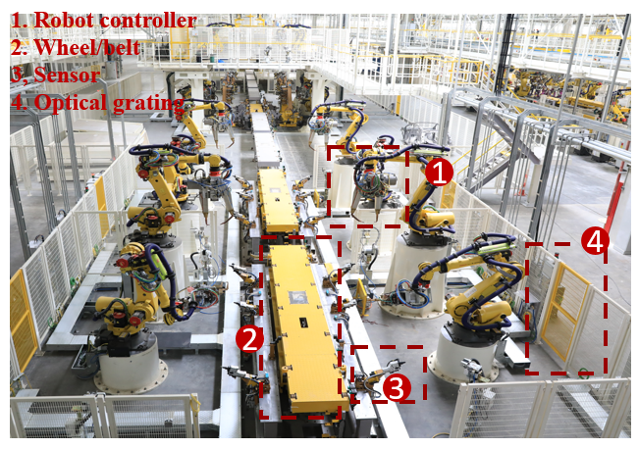
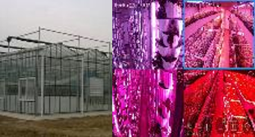
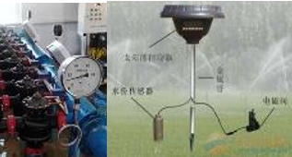
Demands in real
The use cases of industrial scenarios [2] [3]
Sensors | Periodical-based & Event-based report of information to the control system. High-density deployment environment.
Robot/drone motion control | Remotely operating group devices
Assembly line | Combination of AGV/AMR, sensors, robot/drone motion control, and video transfer.
The use cases of agricultural scenarios: Anomaly Detection and Precise Control
In these scenarios, a common feature is that sufficient sensors are required to monitor specific environment features and report specific information periodically or in event-triggered mode.
In addition, to ensure the accuracy of reported information, the feedback mechanism of multiple sensors is reasonable.
Smart greenhouse
Temperatures
Humidity
CO2 concentration
Soil PH
…
Smart irrigation
Temperatures
Lighting
Soil ph
insect pest
…
Smart farming
Temperatures
Ventilation
Foodstuffs
Density
…
Concurrency issue

Slide 6
Concurrent messages issue (1/3)
BA
BA
BA
BA
#1
#3
8
Sensor
Sensor
Sensor
#1
Exception
Exception
backoff
Exception
8
#2
#2
#4
backoff
Exception
#3
Sensor
Sensor
Sensor
backoff
Exception
Example: Smart greenhouse for CO2 concentration
(Event-Triggered)
#4
The AP obtains ‘abnormal’ information through 4 sensors, which is at least 4 times of EDCA process (The four sensors need to report data in sequence.)
Difficulty
In existing WLANs, to obtain more accurate exception information, sensors (STAs) need to perform EDCA for multiple rounds to report sufficient data of an exception.
Performance of Latency and reliability may not be guaranteed.

Slide 7
Concurrent messages issue (2/3)
Both exception detection and periodic detection have several features in common:
- A specific quantity of sensors (or STAs)
- Report data of the same feature.
- The data size may be limited
- In a (short) time period.
Group1
STA
STA
Reduced multiple rounds of EDCA process
Grouped by certain characteristics within the WLAN
Grouping interaction
Event-triggered and/or periodically
Group2
AP
STA
STA
Grouping?
Group3
STA
STA

Slide 8
Concurrent messages issue (3/3)
BA
Trigger
BA
8
Notice
UL-OFDMA
PPDU
All devices are equal.
- No ‘leader’, No ‘sub’
‘Notice’ information needs to be carried.
- AP should know the timing
The AP performs scheduling
Both Event-triggered and periodically.
Grouping in AP sides, and STA does not need to know other members.
Group1
PPDU
PPDU
Group2
PPDU
backoff
backoff
Group3

Slide 9
Summary
With the increasing demand for intelligent control and precise regulation, based on the analysis of real industrial, enterprise, and agricultural scenarios, the issue of concurrent messages is presented together with considerations (high level) that may be helpful.

Slide 10
SP
Do you agree that the ‘grouping’ in scenarios with concurrent messages (as described in the submission) is an issue that needs further research and discussion.
-Yes
-No
-Abstain

