Slide 1
UEQM Transmission Over Spatial Streams
Date: 2024-09-09
Authors:

Slide 2
Introduction
Unequal modulation (UEQM) is accepted as a feature for 11bn
  TGbn SFD: “TGbn defines unequal modulation over different spatial streams.” [1]
A stream parser that considers UEQM should be defined
  UEQM stream parser was introduced in 802.11n, but was not included in later amendments
  The stream parser formulas used for 802.11n could be reused with some small changes

Slide 3
Brief Recap on the 802.11n Stream Parser (1)

Slide 4
Brief Recap on the 802.11n Stream Parser (2)

Slide 5
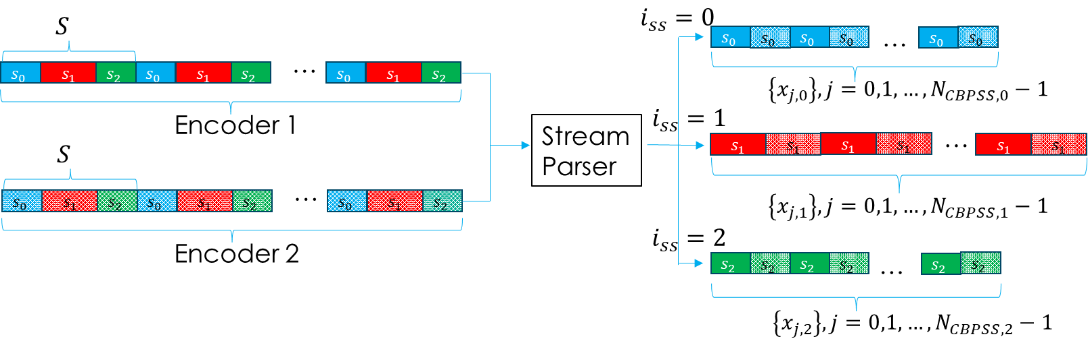
Brief Recap on the 802.11n Stream Parser (3)

Slide 6
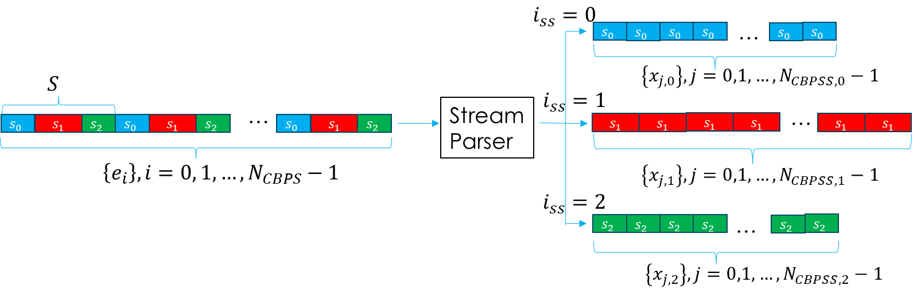
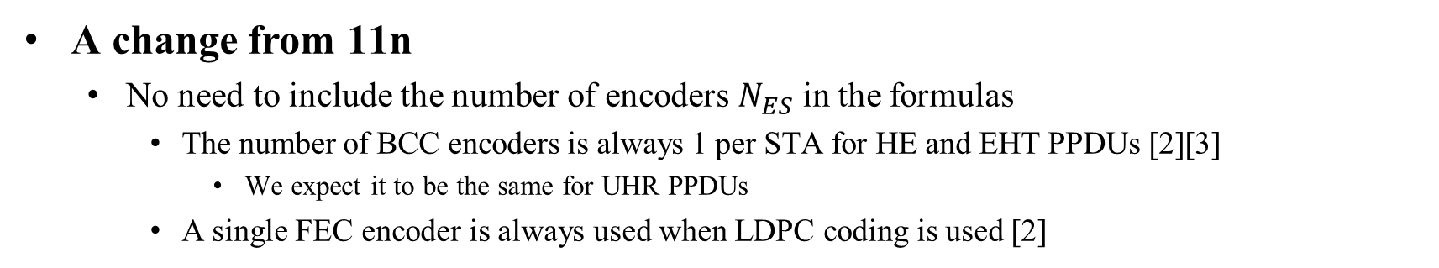
What is Different for 11bn
A change from 11n
  No need to include the number of encoders $N_{ES}$ in the formulas
    The number of BCC encoders is always 1 per STA for HE and EHT PPDUs [2][3]
      We expect it to be the same for UHR PPDUs
    A single FEC encoder is always used when LDPC coding is used [2]

Slide 7
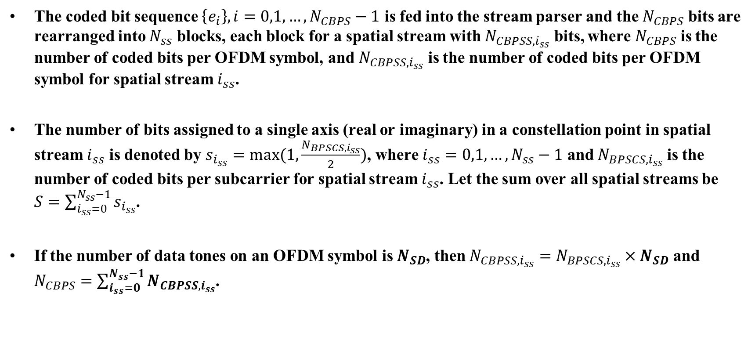
UEQM Stream Parser for 11bn (1)
The coded bit sequence $\left\{e_{i}\right\}, i=0,1,…, N_{CBPS}−1$ is fed into the stream parser and the $N_{CBPS}$ bits are rearranged into $N_{ss}$ blocks, each block for a spatial stream with $N_{CBPSS,i_{ss}}$ bits, where $N_{CBPS}$ is the number of coded bits per OFDM symbol, and $N_{CBPSS,i_{ss}}$ is the number of coded bits per OFDM symbol for spatial stream $i_{ss}$.
The number of bits assigned to a single axis (real or imaginary) in a constellation point in spatial stream $i_{ss}$ is denoted by $s_{i_{ss}}=max⁡(1,\frac{N_{BPSCS,i_{ss}}}{2})$, where $i_{ss}=0,1,…,N_{ss}−1$ and $N_{BPSCS,i_{ss}}$ is the number of coded bits per subcarrier for spatial stream $i_{ss}$. Let the sum over all spatial streams be $S=\sum_{i_{ss}=0}^{N_{ss}−1}{s_{i_{ss}}}$.
If the number of data tones on an OFDM symbol is $N_{SD}$, then $N_{CBPSS,i_{ss}}=$ $N_{BPSCS,i_{ss}}×N_{SD}$ and $N_{CBPS}=\sum_{i_{ss}=0}^{N_{ss}−1}{N_{CBPSS,i_{ss}}}$.

Slide 8
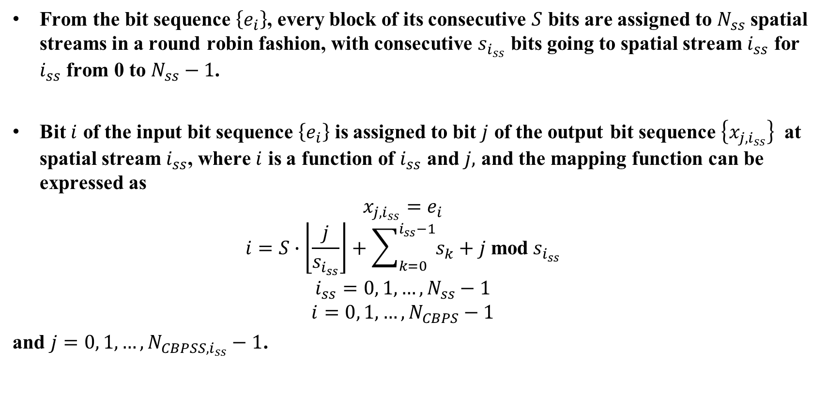
UEQM Stream Parser for 11bn (2)
From the bit sequence $\left\{e_{i}\right\}$, every block of its consecutive $S$ bits are assigned to $N_{ss}$ spatial streams in a round robin fashion, with consecutive $s_{i_{ss}}$ bits going to spatial stream $i_{ss}$ for $i_{ss}$ from 0 to $N_{ss}−1$.
Bit $i$ of the input bit sequence $\left\{e_{i}\right\}$ is assigned to bit $j$ of the output bit sequence $\left\{x_{j,i_{ss}}\right\}$ at spatial stream $i_{ss}$, where $i$ is a function of $i_{ss}$ and $j,$ and the mapping function can be expressed as
$$x_{j,i_{ss}}=e_{i}$$
$$\begin{aligned}i=S∙\left\lfloor \frac{j}{s_{i_{ss}}}\right\rfloor +\sum_{k=0}^{i_{ss}−1}{s_{k}}+j \text{mod}{ s}_{i_{ss}}\end{aligned}$$
$$i_{ss}=0, 1,…, N_{ss}−1$$
$$i=0, 1,…,N_{CBPS}−1$$
and $j=0, 1,…,N_{CBPSS,i_{ss}}−1$.

Slide 9

Summary
We revisited the UEQM stream parser used in 11n
Since the number of encoders is always 1 for 11bn, i.e., $N_{ES}=1,$ the stream parser formulas of 11n can be simplified with $N_{ES}=1$and applied to the UEQM stream parser of 11bn

Slide 10
References
IEEE 802.11-24/0209r4, “Specification Framework for TGbn,” July 2024.
IEEE P802.11-REVme™/D6.0: Wireless LAN Medium Access Control (MAC) and Physical Layer (PHY) Specifications, June 2024.
IEEE P802.11-be™/D6.0: Wireless LAN Medium Access Control (MAC) and Physical Layer (PHY) Specifications, May 2024.

Slide 11
SP #1
Do you agree that the stream parser process for unequal modulation (UEQM) over spatial streams in 802.11bn should be as described in Pages 7-8 of 11-24/1451r0?

