Slide 1
In-Device Coexistence Indication
Date: 2024-09-08
Authors:

Slide 2
Abstract
  There are proposals for an non-AP STA to indicate/report unavailability, for example due to P2P transmissions, power save, and in-device coexistence activities [1-13]
    There are proposals for a non-AP STA to report aperiodic unavailability [1-6] and periodic unavailability [7-9]
    Motion approved to include in the 11bn SFD: “define a mechanism for a non-AP STA to report unavailability at TxOP level and define or reuse/update existing mechanism for a non-AP STA to report long term (periodic) unavailability” [13]
  This submission presents a mechanism for a non-AP STA to report coarse-grained and fine-grained unavailability information
    It helps AP and other STAs infer whether the non-AP STA has in-device coexistence activities at TXOP level, especially when the non-AP STA is the TXOP responder.

Slide 3
Introduction
  802.11be D7.0 defines one bit to indicate that there may be in-device coexistence activities for EML operation [13]
    EML Operating Mode Notification frame => EML Control field => In-Device Coexistence Activities subfield
    There are requests to extend the in-device coexistence indication for NSTR or generic operations [14]
  There are proposals in TGbn to indicate unavailability for a non-AP STA by defining new mechanism or reusing exiting mechanism
    Control frame: Multi-STA BlockAck [1, 3, 4, 10], RTS [10], BAR [10]
    Trigger frame: MU-RTS [3, 10], MU-BAR [10], BSRP [3, 10]
    A-Control [3]
    Information Element: TWT [7, 8, 9]
    New frame/field/subfield/type/subtype/element

Slide 4
Proposal: Two Levels of In-Device Coexistence Indication
Coarse-grained unavailability information
  Mostly long-term for future TXOP(s)
  Basic info: to indicate that a non-AP STA may have or does not have in-device coexistence activities
  Low overhead: one bit, and optionally more bits for coarse timing information, cross-link indication, IDC types, certainty of existence/non-existence of IDC activities
  To define new mechanism or reuse existing mechanism such as OMN, TWT, TTLM, BA
Fine-grained unavailability information
  Mostly short-term for the current TXOP, and also for future TXOP(s)
  More details and more accurate info: to indicate that a non-AP STA has or does not have in-device coexistence activities, mostly at the beginning of the TXOP in ICF/ICR
  One bit, and optionally more info, e.g., fine timing information, for the current and future TXOPs
  To define new mechanism or reuse existing mechanism such as MU-RTS, MU-BAR, BSRP
The coarse and fine unavailability information can be used separately and independently.

Slide 5
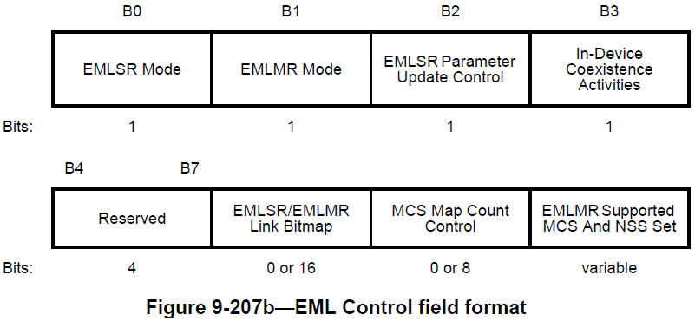
Motivation of the Proposal
The proposal is built on top of 802.11be D7.0: an AP MLD may infer a non-AP MLD has in-device coexistence events by EML Operating Mode Notification frame and initial Control frame
  “If an AP MLD has received EML Operating Mode Notification frame with the In-Device Coexistence Activities subfield of the EML Control field set to 1 from a non-AP MLD,
  and the AP MLD does not receive a response to an initial Control frame that it transmits to the non-AP MLD,
  then the AP can consider the nonresponse as a result of the in-device coexistence events at the non-AP MLD on the link where the frame was transmitted.”
  “The AP is recommended to consider the in-device coexistence indication and select appropriate transmission parameters and methods for the non-AP MLD.”
and extend it to report two levels of unavailability information
  Long-term, coarse IDC information in OMN/TWT or other frames
  Short-term, fine IDC information in ICF/ICR or other frames

Slide 6
Potential Issues and Resolutions
Potential issues when IDC indication is sent too early or too late
If sent too early:
  IDC information may change, e.g., due to TSF, schedule, or priority changes
  Information may not be used, e.g., no overlapping between IDC activities and TXOP
  Aperiodic/unpredictable IDC activities: hard to announce accurate information in advance
  May provide inaccurate information and introduce extra overhead
If sent too late:
  Unpredictable for when TXOP is granted for transmission between the non-AP STA and AP
  IDC info may not be usable, e.g., switch delay or IDC activities happening when ICF/ICR is sent, especially when the non-AP STA is the TXOP responder
The combination of coarse and fine unavailability information helps avoid the potential issues and helps the AP determine if transmission failure is due to link quality or coexistence activities.

Slide 7
Procedures
When the AP obtains TXOP
  (Optional) The AP checks if it got history IDC indication from the non-AP STA(s)
  (Optional) The AP requests the non-AP STA(s) to report IDC indication for the current TXOP, and optionally for future TXOP(s)
    The AP sends ICF to the non-AP STA(s) to request for IDC information
    The AP waits for ICR from the non-AP STA(s)
    The AP receives short-term IDC indication from the non-AP STA(s) for this TXOP and long-term IDC indication for future TXOP(s), or the AP does not receive ICR from certain non-AP STA(s)
  Depending on what IDC indication the AP receives, the AP selects transmission methods and parameters to initiate or terminate transmissions with the non-AP STA(s)
In addition to ICF/ICR, the AP/non-AP STA may request/report IDC information in other frames and/or on other link(s).

Slide 8
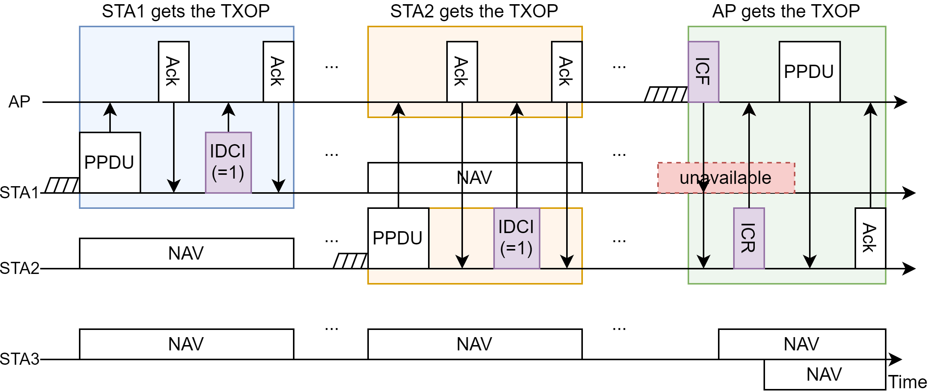
Example 1: MU Use Case
STA1/STA2 gets TXOP and sends IDCI to AP to indicate that STA1/STA2 may have IDC activities during future TXOP(s), respectively
AP gets TXOP and sends ICF to STA1 and STA2
AP does not receive ICR from STA1
AP receives ICR from STA2 indicating that STA2 does not have IDC activities during this TXOP
AP initiates transmissions with STA2
IDCI: sent from non-AP STA to AP for coarse IDC information
ICF: sent from AP to non-AP STA to request for fine IDC information
ICR: sent from non-AP STA to AP to report fine IDC information

Slide 9
Examples for Coarse/Fine IDC Indication with 1 Bit
** May have other actions based on additional information, e.g., PM bit.
* May have capability and timeout settings to determine if received successfully.
Long-term, coarse IDC indication |  | Short-term, fine IDC indication |  | Actions for the AP as TXOP holder **
IDC indication received by AP * | Coarse IDC indication value | ICF sent and ICR received by AP * | Fine IDC indication value | Infer that the non-AP STA is available or not | Transmit/retransmit with the non-AP STA
no | N/A | no | N/A | available (baseline) | yes
no | N/A | yes | N/A | available (baseline) | yes
no | N/A | yes | 0 | available | yes
no | N/A | yes | 1 | unavailable | no
yes | 0 | no | N/A | available | yes
yes | 0 | yes | N/A | available | yes
yes | 0 | yes | 0 | available | yes
yes | 0 | yes | 1 | unavailable | no
yes | 1 | no | N/A | unavailable | no
yes | 1 | yes | N/A | available/unavailable | yes/no
yes | 1 | yes | 0 | available | yes
yes | 1 | yes | 1 | unavailable | no

Slide 10
Options for Signaling
Coarse unavailability information:
  One bit to indicate that there may be in-device coexistence activities
  Optionally additional bit to indicate that the non-AP STA has no in-device coexistence activities
  Optionally additional bits to indicate coarse timing information (start time, periodicity, timeout), IDC types, cross-link indication, certainty of existence/non-existence of IDC activities, etc.
Fine unavailability information:
  One bit to indicate that the non-AP STA has or does not have in-device coexistence activity in the current TXOP
  Optionally additional bits to include more info such as fine timing information and for future TXOP(s)
If the AP cannot infer if the non-AP STA is available from coarse/fine unavailability indication:
  The AP may adjust the queue/user priority to transmit/receive with other non-AP STA(s), or retransmit with the non-AP STA until certain condition is met
  The non-AP STA may recommend parameters, e.g., certain number of retries, to the AP

Slide 11
Conclusion
This submission presents discussions on in-device coexistence indication
  A non-AP STA may report coarse-grained and fine-grained unavailability information.
  The coarse-grained and fine-grained unavailability information may have
    one bit to indicate the existence/non-existence of in-device coexistence activities,
    and optionally more subfields for coarse/fine timing information, cross-link indication, in-device coexistence types, certainty of existence/non-existence of in-device coexistence activities, etc.
  It helps other STAs infer whether the non-AP STA has in-device coexistence activities at TXOP level, especially when the non-AP STA is the TXOP responder.

Slide 12
References
[1] 802.11-24/0543r1, Coexistence Protocols for UHR - follow up, Sherief Helwa
[2] 802.11-24/0675r1, In-device Co-ex and P2P--Follow up, Rubayet Shafin
[3] 802.11-24/0834r0, Some Details on In-Device Coexistence, Insun Jang
[4] 802.11-24/0857r0, ICR consideration, Liwen Chu
[5] 802.11-24/0856r0, Further Discussions on In-Device Coexistence, Jeongki Kim
[6] 802.11-24/0806r0, Multi-link In-device Coexistence Management, Juseong Moon
[7] 802.11-24/0831r0, Periodic IDC use cases and considerations for signaling, Hongwon Lee
[8] 802.11-24/1108r0, Periodic IDC signaling for Mobile AP, Hongwon Lee
[9] 802.11-24/1109r0, More consideration for in-device-coexistence, Hongwon Lee
[10] 802.11-24/1126r1, ICF-ICR Discussion for DPS, GeonHwan Kim
[11] 802.11-24/0504r0, Considerations of A Unified Initial Control Frame Design, Hanqing Lou
[12] 802.11-24/0505r0, Considerations of Transmissions of Initial Control Response frames, Hanqing Lou
[13] 802.11-24/0171r13, tgbn-motions-list-part-1, Alfred Asterjadhi
[14] IEEE P802.11be/D7.0
[15] 802.11-24/0366r0, Proposed resolution to 11be initial SA ballot CID on EMLSR co-ex indication, Qi Wang

Slide 13
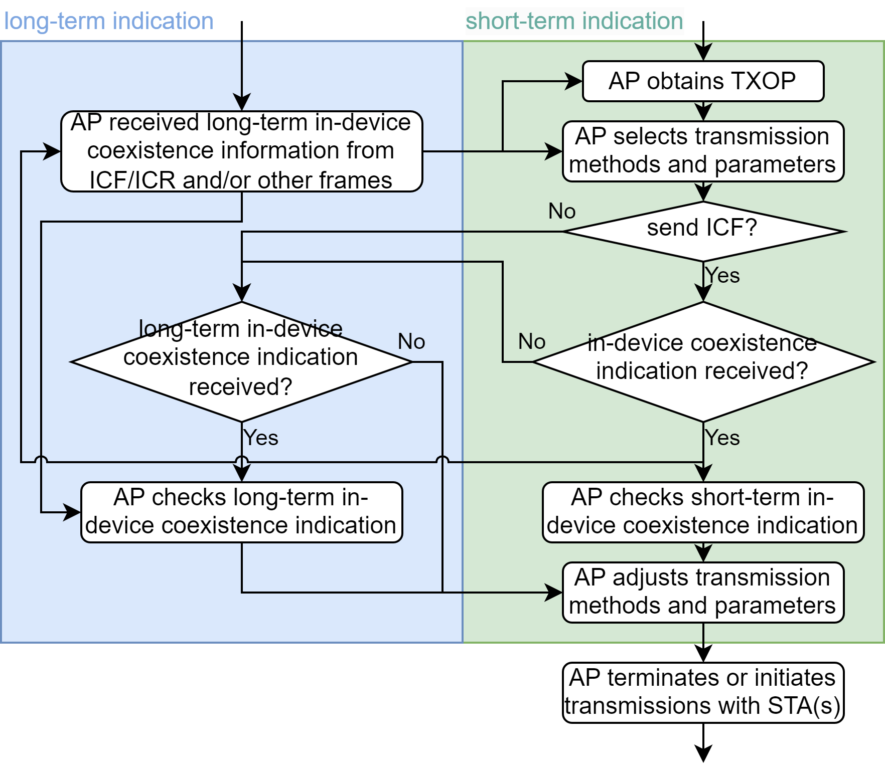
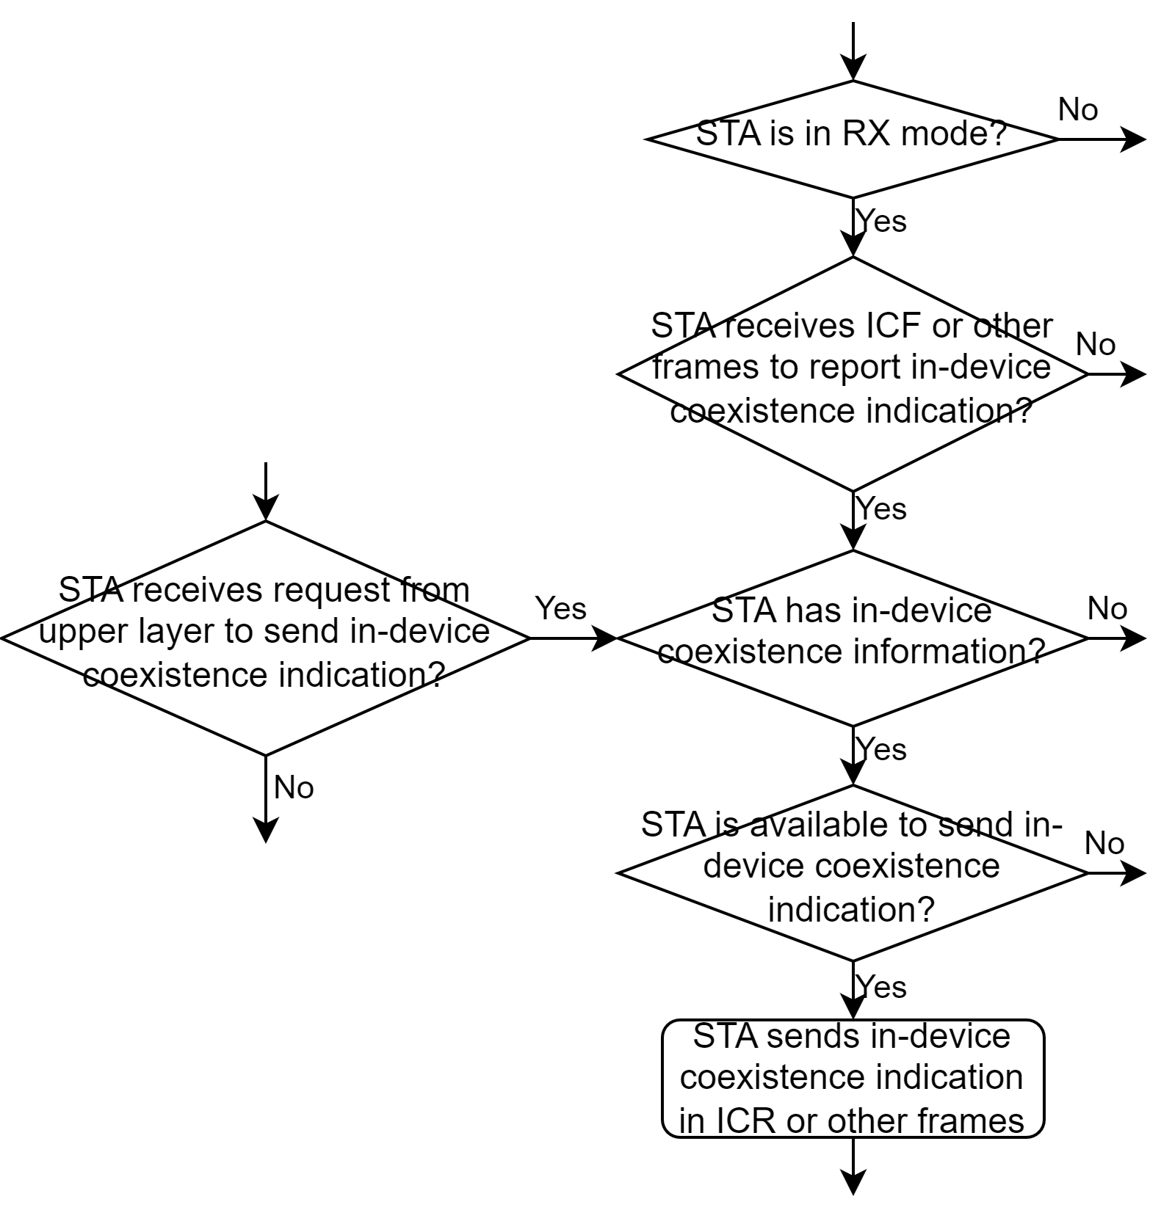
Backup
Flow chart for AP
Flow chart for non-AP STA

