Slide 1
DPWiFi revA
Date: 2024-10-26
Authors:

Slide 2
Abstract
November 2024
First, answer a fundamental question: “Why DPWiFi?”
Next, DPWiFi originally proposed as a TGbn PHY in Nov ‘23, an improved RF polarization processing model incorporated in June ‘24 unearthed a serious, latent flaw in the original Dynamic Polarization Propagation Medium formulation. Since remedied, an updated “DPWiFi revA” Tx-Rx mathematical model plus a corresponding “DPWiFiTRXv4” MATLAB computational model functional validation and performance characterization data, analyses and conclusions are presented herein.

Slide 3
November 2024
Q: Why DPWiFi? A: PAR Compliance!
Excerpted from the P802.11bn PAR:
…
5.2.b Scope of the project: This amendment defines modifications to both the IEEE Std 802.11 physical layer (PHY) and the IEEE Std 802.11 Medium Access Control (MAC). The amendment adds an Ultra High Reliability capability to a Wireless Local Area Network (WLAN). The Ultra High Reliability capability is defined for both an isolated Basic Service Set (BSS) and overlapping BSSs as:
• at least one mode of operation capable of increasing throughput by 25%, as measured at the MAC data service Access Point, in at least one Signal to Interference and Noise Ratio (SINR) level (Rate vs Range), compared to the Extremely High Throughput MAC/PHY operation, and
• at least one mode of operation capable of reducing latency by 25% for the 95th percentile of the latency distribution compared to the Extremely High Throughput MAC/PHY operation, and
…

Slide 4

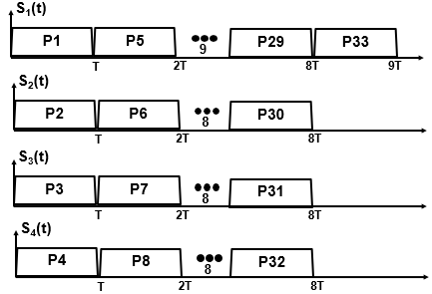
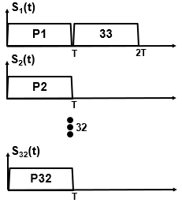
November 2024
DPWiFi vs EHT Throughput/ Latency
STA1
STA2
EHT
SMX-4 MCS13 320MHz
4 Spatial Streams
T = 13.6uS
R = 2.88 Gbps
Throughput = 4R
Latency (to P33) = 8T
DPWiFi
PMX-32 MCS13 320MHz
32 Spatial Streams
T = 13.6uS
R = 2.88 Gbps
Throughput = 32R = 800% EHT
Latency (to P33) = T = 12.5% EHT
    DPWiFi Increases Throughput 800% and Decreases Latency by 87.5% over EHT

Slide 5
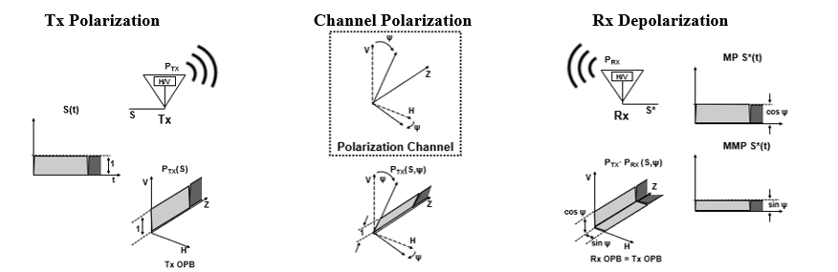
Legacy WiFi (Static) Polarization Processing
Propagation Medium Polarization
A WiFi Tx antenna “polarizes” by launching RF waveforms S in a precise spatial orientation IAW an “Orthogonal Polarization Baseline (OPB)”
Linearly Polarized P_{TX} radiates along a fixed angle between 0º (H) or 90º (V)
P_{TX}(S) = H or V, per the OPB
Normal terrestrial propagation may further polarize S, rotating P_{TX} by a “polarization angle” ψ
  LP waveforms propagate fixed-rotated by ψº from P_{TX}(S)
  P_{TX} (S, ψ) = ψ or ψ + 90º
A WiFi Rx antenna “depolarizes” a detected ψ-polarized waveform into
its OPB-aligned V-H component
P_{RX} (S, ψ) = P_{TX}(S) = H or V
P_{TRX} (S,ψ) = cosψ S(t)
WiFi Stream Static Polarization upon traversing a Propagation Medium ψ:
P_{TRX} (S,ψ) = cosψ S(t)

Slide 6
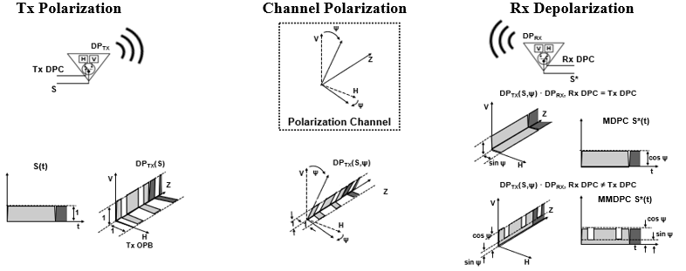
November 2024
Proposed DPWiFi Dynamic Polarization Operation
Propagation Medium Polarization
A DPWiFi Tx Antenna modulates RF Stream Polarization by switching its orthogonal elements H, V in accordance with a binary sequence DPC
DP_{TX}(S) = TxDPC
A DPWiFi Rx Antenna depolarizes DP_{TX} into its OPB-aligned component
DP_{RX}(S) = RxDPC
DP_{TRX}(S, ψ) = TxDPC(ψ) · RxDPC S(t)
= cosψ if TxDPC=RxDPC, else
= f(cosψ, cosψ)
The Propagation Medium further rotates DP_{TX}(S) by ψ
DP_{TX} (S, ψ) = TxDPC(ψ)
DPWiFi Stream Dynamic Polarization upon traversing a Propagation Medium ψ:
DP_{TRX} (S,ψ) = cosψ if TxDPC = RxDPC, else f(cosψ, cosψ)

Slide 7
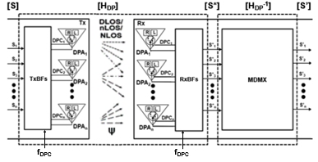
DPWiFi revA
  Given n WiFi-7 RF stream n-vectors [S], [S*] and [S’], and
  The ψ-polarized Propagation Medium nxn matrix [H_{DP}], and
  Walsh n-vectors [TxDPC] and [RxDPC] such that
[TxDPC] = [DPC₁ DPC₂ … DPC_{n}] = [RxDPC], where
DPC_{i} · DPC_{j} = cosψ if i = j
DPC_{i} · DPC_{j} = (cosψ + sinψ)/2 if i ≠ j
    If [H_{DP}] is Non-Singular there exists an [H_{DP}⁻¹]such that [S’] = [S] x [H_{DP}] x [H_{DP}⁻¹] = [S]

Slide 8
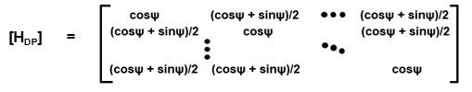
DPWiFi revA Propagation Medium [H_{DP}]
  Walsh-modulated DPWiFi Polarization establishes that
  S*(t) = cosψ S(t) if Tx DPC = Rx DPC, or
  S*(t) = (cosψ + sinψ)/2 S(t) if Tx DPC ≠ Rx DPC
  Extending to the case of n S_{i} and corresponding DPC_{i} we obtain
  [S*] = [S] x [H_{DP}], where
  Noting that for 0º < ψ < 45º
  0.50 ≤ (cosψ + sinψ)/2 ≤ 0.71 and 0.70 ≤ cosψ ≤ 1.00,
  we can therefore conclude
    The DPWiFi revA Propagation Medium/ MIMO Multiplexer [H_{DP}] is Indeed Non-Singular

Slide 9
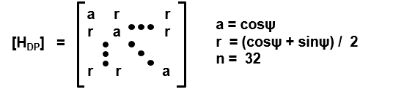
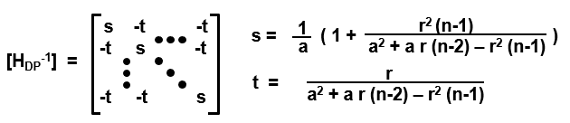
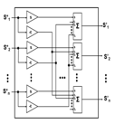
DPWiFi revA Rx MIMO Demultiplexer [H_{DP}⁻¹]
Given:
Then:
Then:
Equivalently:
Equivalently:
    The DPWiFi revA MIMO Demultiplexer [H_{DP}⁻¹] is a Trivial Construct

Slide 10
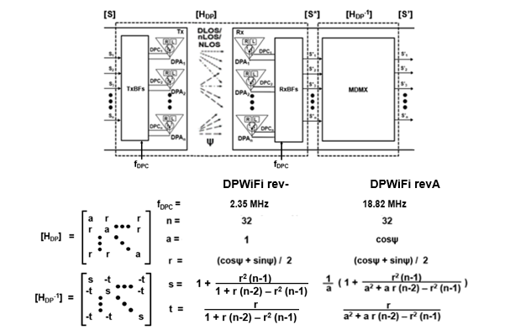
DPWiFi rev- vs DPWiFi revA
    Note: DPWiFi rev- and DPWiFi revA are equivalent for ψ < 7.5º
    DPWiFi rev- is just a Degenerate Manifestation of DPWiFi revA

Slide 11
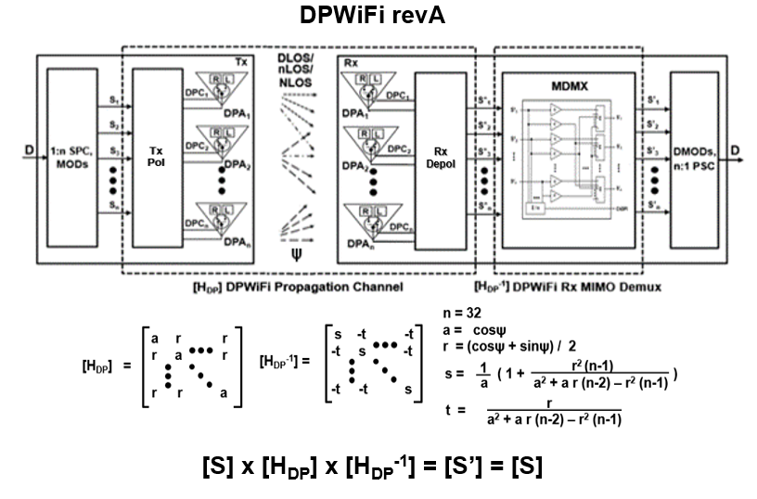
DPWiFi Mathematical Model

Slide 12

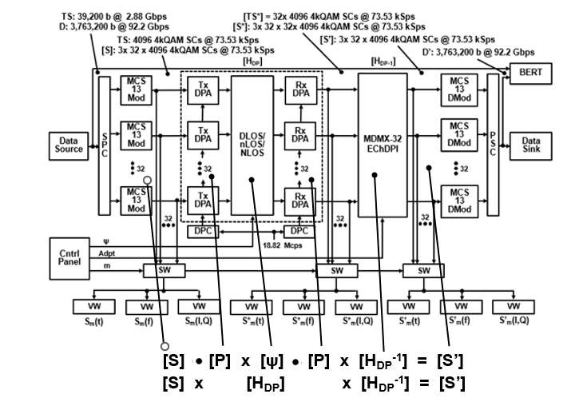
DPWiFi Computational Model

Slide 13
DPWiFi MATLAB Validation Plan
DPWiFiTRXv4 32x 4kQAM5/6-320MHz DPWiFi Streams BER vs Propagation Polarization, Rx Adaptation
Case | Polarization Angle ψ (º) | Rx Adaptation
VP-1 | 0.0 | N
- |  | Y
VP-2 | 1.0 | N
- |  | Y
VP-3 | 1.1 | N
VP-4 |  | Y
VP-5 | 5.0 | N
VP-6 |  | Y
VP-7 | 10.0 | N
VP-8 |  | Y
VP-9 | 25.0 | N
VP-10 |  | Y
VP-11 | 40.0 | N
VP-12 |  | Y

Slide 14
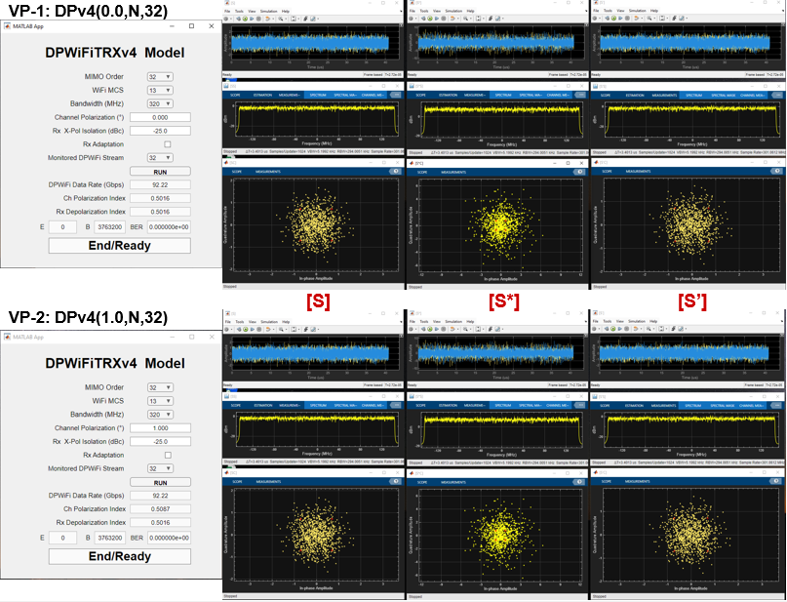
DPWiFi revA MATLAB Validation Exercise

Slide 15
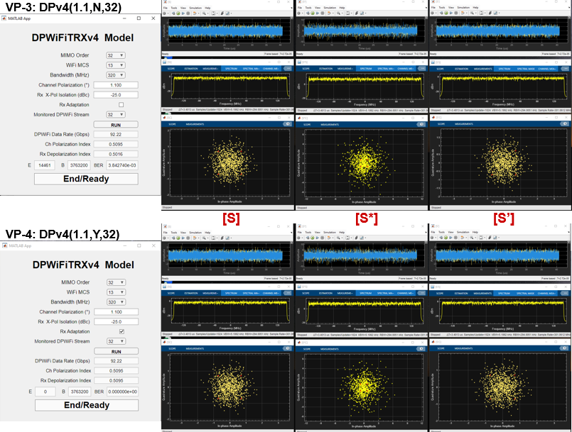
DPWiFi revA MATLAB Validation Exercise

Slide 16
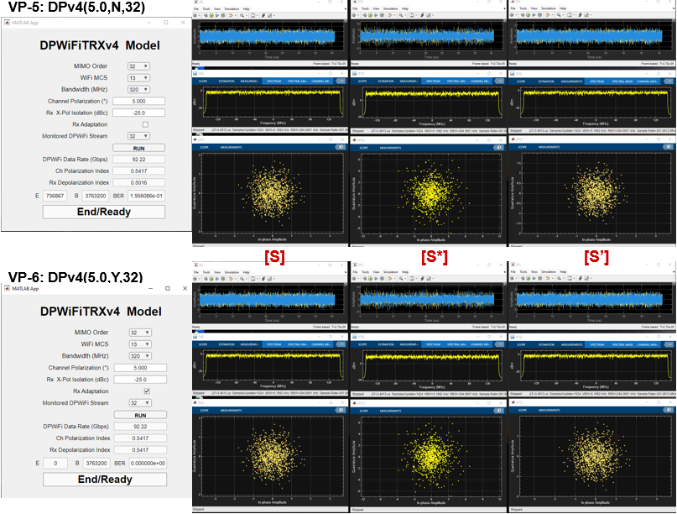
DPWiFi revA MATLAB Validation Exercise

Slide 17

DPWiFi revA MATLAB Validation Exercise

Slide 18
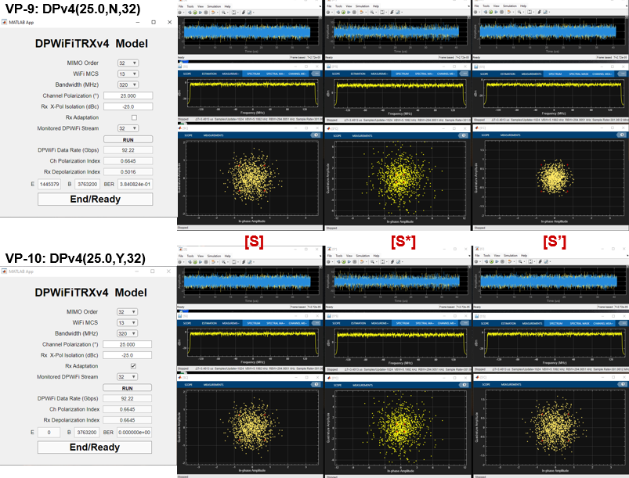
DPWiFi revA MATLAB Validation Exercise

Slide 19
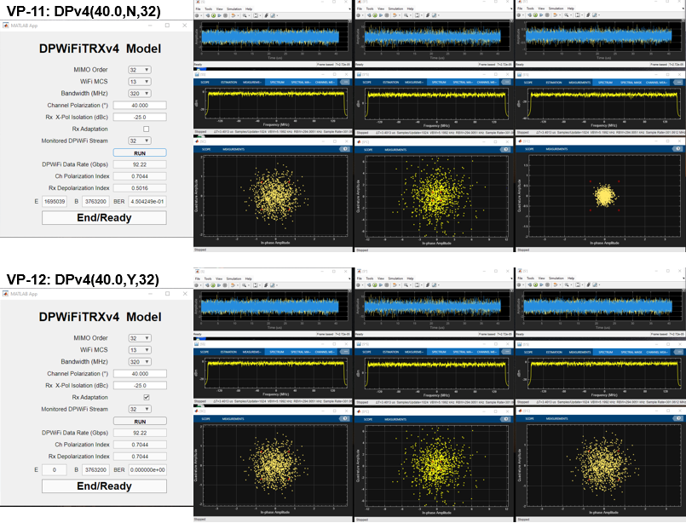
DPWiFi revA MATLAB Validation Exercise

Slide 20
DPWiFi revA MATLAB Validation Results
Observations
Assessments
  DPWiFi indeed transports 92 Gbps within a 320 MHz channel
  DPWiFi is extraordinarily sensitive to propagation medium impairments
  Absent receiver adaptation, even a slight morning mist would irremediably crash a DPWiFi link
  Rx Adaptation, however, comprehensively mitigates any amount of Propagation Polarization
Conclusions
DPWiFi revA (henceforth simply “DPWiFi”) will be the fastest (Rate), farthest (Range) and toughest (Impairment-impervious) WLAN PHY ever devised
DPWiFi revA BER Performance, Impaired Propagation DPWiFi-32 MCS13 320 MHz vs Propagation Polarization, Rx Adaptation
Propagation Impairment Polarization Angle | None 0.2º | Mist 1.0º | Fog 1.1º | Rain 5.0º | Foliage 10.0º | Grzng Reflection 25.0º | Nr Orthgnl Reflection 40.0º
Polarization Index | 0.5016 | 0.5087 | 0.5095 | 0.5417 | 0.5792 | 0.6645 | 0.7044
BER, No Adaptation | 0.000 | 0.000 | 0.003 | 0.196 | 0.275 | 0.384 | 0.450
BER, Adaptation | 0.000 | 0.000 | 0.000 | 0.000 | 0.000 | 0.000 | 0.000

Slide 21
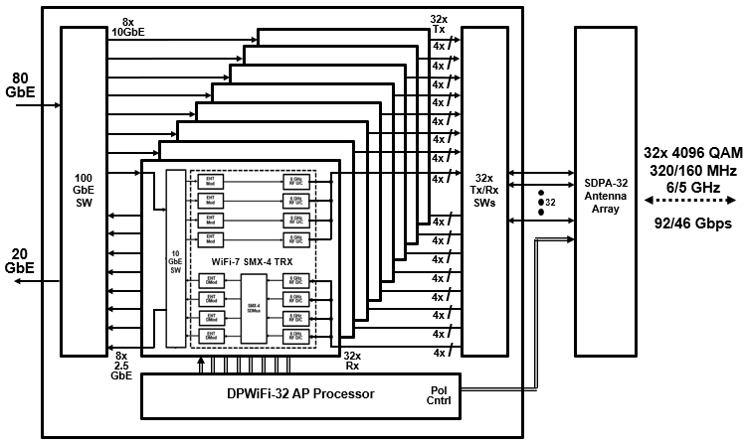

So, What Next? Hardware Validation!
Quick-turn DPWiFi Prototype
8x 11.5 Gbps SMX-4 WiFi-7s 1x 92.2 Gbps PMX-32 DPWiFi

Slide 22
Summary and Conclusions
TGbn PHY candidate DPWiFi comprises breakthrough MIMO Polarization Multiplexing delivering 92 Gbps P2P data transport within 320 MHz at 6 GHz, regardless of propagation medium impairments.
A MATLAB model has fully simulation-validated the above-claimed DPWiFi functionality and performance.
A WiFi-7 based prototype will attempt to correspondingly hardware-validate DPWiFi by this year’s end.
DPWiFi remains without peer as a candidate TGbn PHY and, incidentally, fully and uniquely complies with the P802.11 PAR

Slide 23
References
1. 23/1606r1-UHRSG
Dynamic Polarization Multiplexing and Beamforming WLANs
Carlos A Rios (Terabit Wireless Internet), 13-Sep-2023
23/1756r3-TGbn
MIMO Dynamic Polarization and Beamforming: Proposed IEEE802.11bn PHY
Carlos A Rios (Terabit Wireless Internet), 16-Nov-2023
24/0041r12-TGbn
DPWiFi MATLAB Validation
Carlos A Rios (Terabit Wireless Internet), 02-Feb-2024
24/0440r6-TGbn
DPWiFi for IEEE802.11bn WMANs
Carlos A Rios (Terabit Wireless Internet), 22-Apr-2024

