Slide 1
DPWiFi revA
Date: 2024-10-17
Authors:

Slide 2
Abstract
TGbn PHY candidate DPWiFi originally proposed in Nov ‘23, an improved radiowave polarization processing model incorporated June ‘24 unearthed a serious, latent flaw in the original Dynamic Polarization Propagation Channel formulation. Since remedied, an updated “DPWiFi revA” Tx-Rx model plus corresponding “DPWiFiTRXv4” MATLAB representation functional validation and performance characterization data, analyses and conclusions are presented herein.

Slide 3
Legacy WiFi (Static) Polarization Operation
A WiFi Tx antenna “polarizes” by launching RF waveforms S in a precise spatial orientation per an “Orthogonal Polarization Baseline (OPB)”
Linearly Polarized P_{TX} radiates along a fixed angle between 0º (H) or 90º (V)
P_{TX}(S) = H or V, per the OPB
Normal terrestrial propagation may further polarize S by rotating P_{TX} by a “polarization angle” ψ
LP waveforms propagate fixed-rotated by ψº from P_{TX}(S)
P_{TX} (S, ψ) = ψ or ψ + 90º
A WiFi Rx antenna “depolarizes” detected waveforms into “Matched-Polarization (MP)” or “Mismatched-Polarization (MMP)” components
P_{RX} (S, ψ) = H or V
MP (P_{TX} (S,ψ)) = cosψ S(t)
MMP (P_{TX} (S, ψ)) = sinψ S(t)
As Legacy WiFi Polarization assumes OPB-aligned Tx and Rx antennas
Legacy WiFi Polarization = P_{TRX}(S) = MP (P_{TX} (S,ψ)) = cosψ S(t)

Slide 4
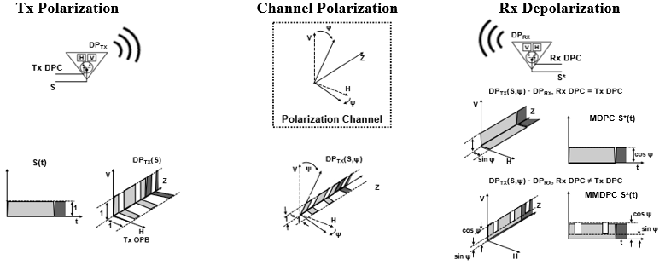
Proposed DPWiFi Dynamic Polarization Operation
A DPWiFi Tx Antenna modulates its Polarization by switching orthogonal antenna elements H and V per a binary sequence DPC
DP_{TX}(S) = Tx DPC
A DPWiFi Rx Antenna depolarizes DP_{TX} into either “Matched-DPC (MDPC)” or “Mismatched-DPC (MMDPC)” elements
DP_{RX}(S) = Rx DPC
MDPC (S, ψ) = (Tx DPC · Rx DPC) S(t)
MMDPC (S, ψ) = f(S(t), cosψ, sinψ)
Channel Polarization further rotates DP_{TX}(S) by ψ
DP_{TX} (S, ψ) = Tx DPC(ψ)
As DPWiFi Polarization also assumes OPB-aligned Tx and Rx antennas
DPWiFi Polarization = DP_{TRX}(S) = MDPC (S, ψ) = (Tx DPC · Rx DPC) S(t)

Slide 5
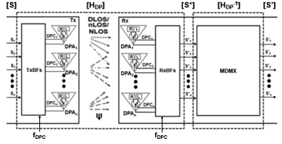
DPWiFi revA TRX Model
Given n WiFi-7 RF stream n-vectors [S], [S*] and [S’], and
The ψ-polarized Propagation Channel nxn matrix [H_{DP}], and
Walsh n-vectors [TxDPC] and [RxDPC] such that
[TxDPC] = [DPC₁ DPC₂ … DPC_{n}] = [RxDPC], where
DPC_{i} · DPC_{j} = cosψ if i = j
DPC_{i} · DPC_{j} = (cosψ + sinψ)/2 if i ≠ j
If [H_{DP}] is Non-Singular there exists an [H_{DP}⁻¹]such that [S’] = [S] x [H_{DP}] x [H_{DP}⁻¹]= [S]

Slide 6
DPWiFi revA Propagation Channel [H_{DP}]
Walsh-modulated DPWiFi Polarization establishes that
S*(t) = cosψ S(t) if Tx DPC = Rx DPC, or S*(t) = (cosψ + sinψ)/2 S(t) if Tx DPC ≠ Rx DPC
Extending to the case of n S_{i} and corresponding DPC_{i} we obtain [S*] = [S] x [H_{DP}], where
Noting that for 0º < ψ < 45º
0.50 ≤ (cosψ + sinψ)/2 ≤ 0.71 and 0.70 ≤ cosψ ≤ 1.00, we can therefore conclude
The DPWiFi revA Propagation Channel [H_{DP}] is Indeed Non-Singular

Slide 7
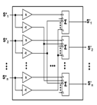
DPWiFi revA Rx MIMO Demultiplexer [H_{DP}⁻¹]
Given:
Then:
Then:
Equivalently:
Equivalently:
The DPWiFi revA MIMO Demultiplexer [H_{DP}⁻¹] is a Trivial Construct

Slide 8
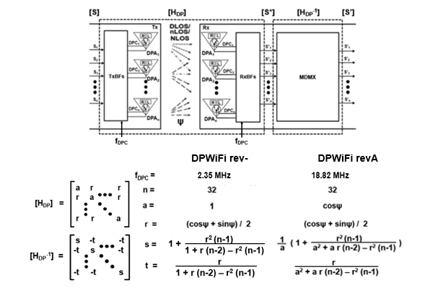
DPWiFi rev- vs DPWiFi revA
Note: DPWiFi rev- and DPWiFi revA are equivalent for ψ < 7.5º
DPWiFi rev- was just a Degenerate Manifestation of DPWiFi revA

Slide 9
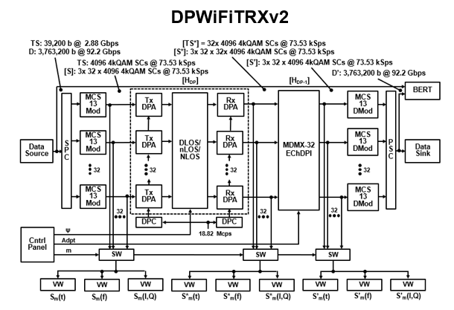
DPWiFi revA MATLAB Representation: DPWiFiTRXv4
[S] [P] x [ψ] [P] x [H_{DP}⁻¹] = [S’]
[S] x [H_{DP}] x [H_{DP}⁻¹] = [S’]

Slide 10
DPWiFi revA MATLAB Validation Plan
DPWiFiTRXv4 32x 4kQAM5/6-320MHz DPWiFi Streams BER vs Channel Polarization, Rx Adaptation
Case | Channel ψ (º) | Rx Adaptation
VP-1 | 0.0 | N
- |  | Y
VP-2 | 1.0 | N
- |  | Y
VP-3 | 1.1 | N
VP-4 |  | Y
VP-5 | 5.0 | N
VP-6 |  | Y
VP-7 | 10.0 | N
VP-8 |  | Y
VP-9 | 25.0 | N
VP-10 |  | Y
VP-11 | 40.0 | N
VP-12 |  | Y

Slide 11
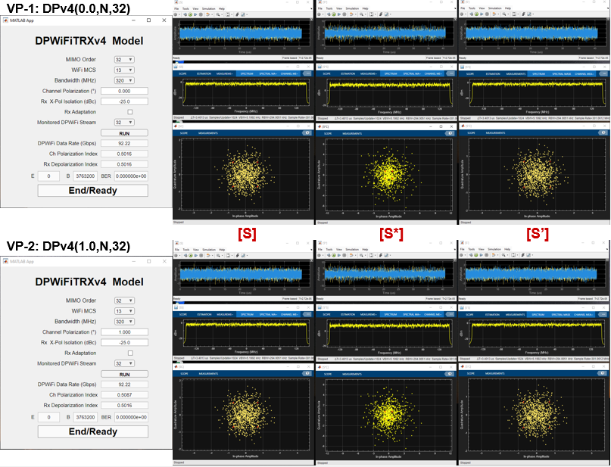
DPWiFi revA MATLAB Validation Exercise

Slide 12
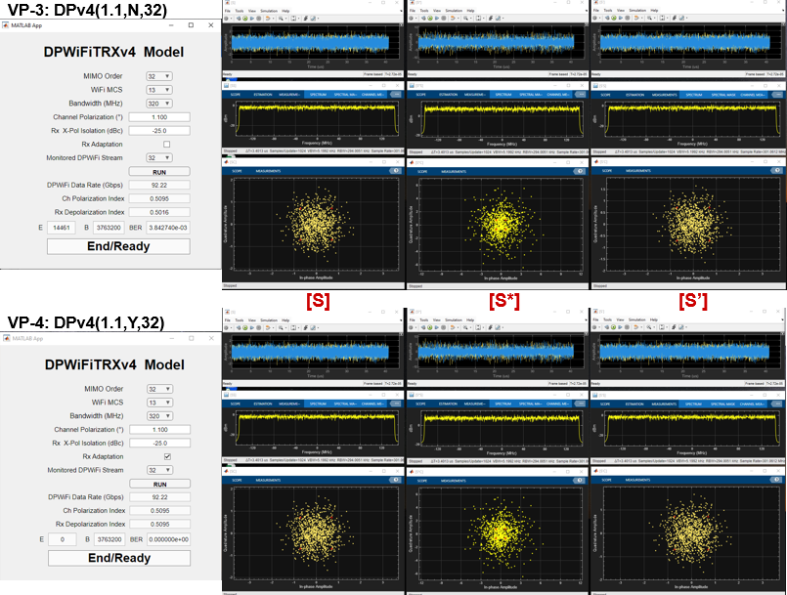
DPWiFi revA MATLAB Validation Exercise

Slide 13
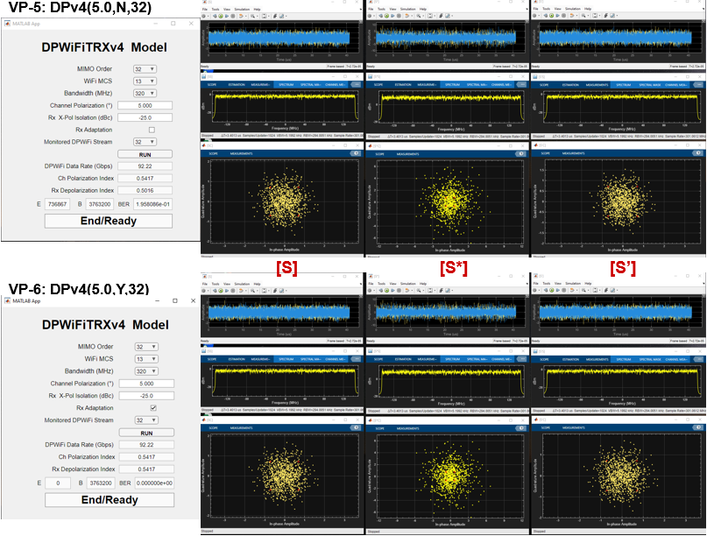
DPWiFi revA MATLAB Validation Exercise

Slide 14
DPWiFi revA MATLAB Validation Exercise

Slide 15
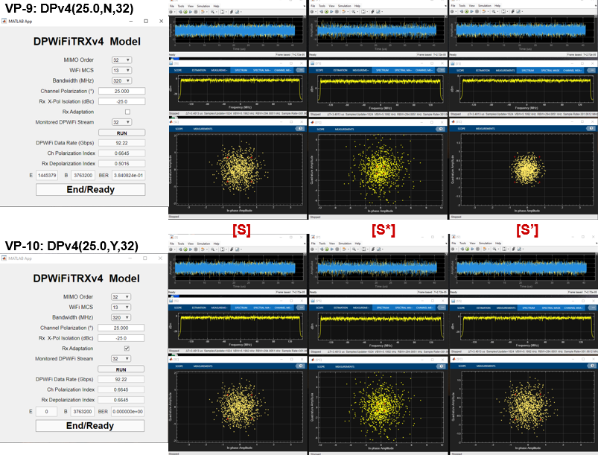
DPWiFi revA MATLAB Validation Exercise

Slide 16
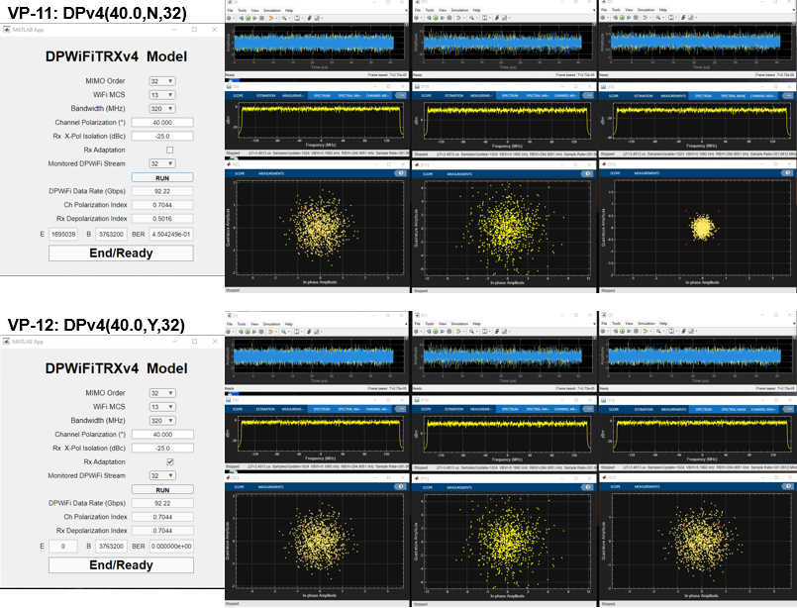
DPWiFi revA MATLAB Validation Exercise

Slide 17
DPWiFi revA MATLAB Validation Results
Observations
Assessments
DPWiFi indeed transports 92 Gbps within a 320 MHz channel
DPWiFi is extraordinarily sensitive to propagation impairments Absent receiver adaptation, even a slight morning mist would irremediably crash a DPWiFi link
Rx Adaptation, however, comprehensively mitigates any amount of Channel Polarization
Conclusions DPWiFi revA (henceforth simply “DPWiFi”) will be the fastest (Rate), farthest (Range) and toughest (Impairment-impervious) WLAN PHY ever devised
DPWiFi revA BER Performance in Impaired Propagation Channels DPWiFi-32 MCS13 320 MHz vs Channel Polarization, Rx Adaptation
Channel Impairment Polarization Angle | None 0.2º | Mist 1.0º | Fog 1.1º | Rain 5.0º | Foliage 10.0º | Grzng Reflection 25.0º | Nr Orthgnl Reflection 40.0º
Ch Polarization Index | 0.5016 | 0.5087 | 0.5095 | 0.5417 | 0.5792 | 0.6645 | 0.7044
BER, No Adaptation | 0.000 | 0.000 | 0.003 | 0.196 | 0.275 | 0.384 | 0.450
BER, Adaptation | 0.000 | 0.000 | 0.000 | 0.000 | 0.000 | 0.000 | 0.000

Slide 18
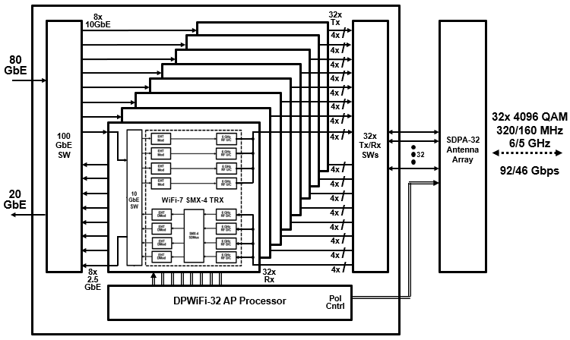
So, What Next? Hardware Validation!
Quick-turn DPWiFi Prototype
8x 11.5 Gbps SMX-4 WiFi-7s 1x 92.2 Gbps PMX-32 DPWiFi

Slide 19
Summary and Conclusions
TGbn PHY candidate DPWiFi comprises breakthrough MIMO Polarization Multiplexing providing 92 Gbps P2P data transport within 320 MHz at 6 GHz, regardless of propagation impairments.
A MATLAB model has fully simulation-validated the above-claimed DPWiFi functionality and performance.
A WiFi-7 based prototype will attempt to correspondingly hardware-validate DPWiFi by this year’s end.
DPWiFi remains without peer as a candidate TGbn PHY

Slide 20
References
1. 23/1606r1-UHRSG Dynamic Polarization Multiplexing and Beamforming WLANs Carlos A Rios (Terabit Wireless Internet), 13-Sep-2023
23/1756r3-TGbn MIMO Dynamic Polarization and Beamforming: Proposed IEEE802.11bn PHY Carlos A Rios (Terabit Wireless Internet), 16-Nov-2023
24/0041r12-TGbn DPWiFi MATLAB Validation Carlos A Rios (Terabit Wireless Internet), 02-Feb-2024
24/0440r6-TGbn DPWiFi for IEEE802.11bn WMANs Carlos A Rios (Terabit Wireless Internet), 22-Apr-2024

