Slide 1
DPWiFi revA
Date: 2024-09-23
Authors:

Slide 2
Abstract
TGbn PHY candidate DPWiFi originally proposed in Nov ‘23, an improved radiowave polarization processing model incorporated June ‘24 unearthed a serious, latent flaw in the original Dynamic Polarization Propagation Channel formulation. Remedied, the updated “DPWiFi revA” TRX model plus corresponding MATLAB functional validation and performance characterization data, analyses and conclusions are presented herein.

Slide 3
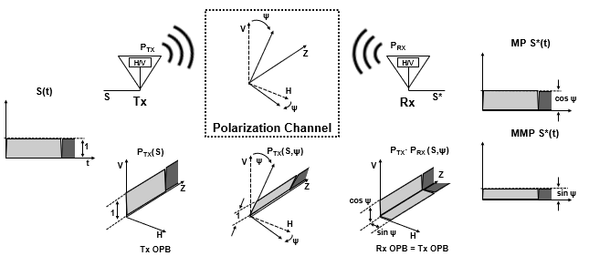
WiFi Static Polarization Operation
A WiFi Tx antenna “polarizes” by launching RF waveforms S in a precise spatial orientation per an “Orthogonal Polarization Baseline (OPB)”
Linearly Polarized P_{TX} radiates along a fixed angle between 0º (H) or 90º (V)
P_{TX}(S) = H or V, per the OPB
Typical terrestrial propagation “depolarizes” S by rotating P_{TX} by a “depolarization angle” ψ
  LP waveforms propagate fixed-rotated by ψº from true OPB H-V
  P_{TX} (S, ψ) = ψ or ψ + 90º
A WiFi Rx antenna “polarization-filters” detected waveforms into “Matched-Polarization (MP)” or “Mismatched-Polarization (MMP)” components
P_{RX} (S, ψ) = H or V
MP (P_{TX} (S,ψ)) = cosψ S(t)
MMP (P_{TX} (S, ψ)) = sinψ S(t)

Slide 4
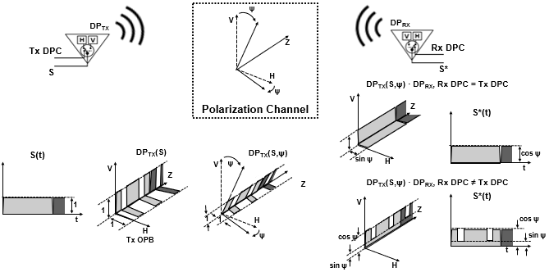
DPWiFi Dynamic Polarization Operation
MDPC S*(t)
MMDPC S*(t)
A DPWiFi Tx Antenna modulates waveform polarization by switching orthogonal antenna elements H and V per a binary sequence DPC
DP_{TX}(S) = Tx DPC
Propagation depolarization rotates DP_{TX} orthogonality baseline by ψ
DP_{TX} (S, ψ) = Tx DPC(ψ)
A DPWiFi Rx Antenna polarization-filters DP_{TX} into “Matched-DPC (MDPC)” or “Mismatched-DPC (MMDPC)” elements
DP_{RX}(S) = Rx DPC
MDPC (S, ψ) = cosψ S(t)
MMDPC (S, ψ) = f(S(t), cosψ, sinψ)

Slide 5
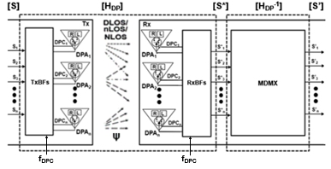
DPWiFi revA TRX Model
  Given n WiFi-7 RF stream n-vectors [S], [S*] and [S’], and
  The ψ-depolarized Propagation Channel nxn matrix [H_{DP}], and
  Walsh n-vectors [TxDPC] and [RxDPC] such that
[TxDPC] = [DPC₁ DPC₂ … DPC_{n}] = [RxDPC], where
DPC_{i} · DPC_{j} = cosψ if i = j
DPC_{i} · DPC_{j} = (cosψ + sinψ)/2 if i ≠ j
    If [H_{DP}] is Non-Singular there exists an [H_{DP}⁻¹]such that [S’] = [S] x [H_{DP}] x [H_{DP}⁻¹]= [S]

Slide 6
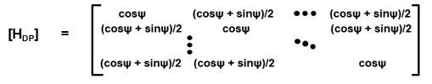
DPWiFi revA [H_{DP}] Propagation Channel
  Walsh-modulated DPWiFi Polarization establishes that
  S*(t) = cosψ S(t) if Tx DPC = Rx DPC, or
  S*(t) = (cosψ + sinψ)/2 S(t) if Tx DPC ≠ Rx DPC
  Extending to the case of n S_{i} and corresponding DPC_{i} we obtain
  [S*] = [S] x [H_{DP}], where
  Noting that for 0º < ψ < 45º
  0.50 ≤ (cosψ + sinψ)/2 ≤ 0.71 and 0.70 ≤ cosψ ≤ 1.00,
  we can therefore conclude
    The DPWiFi revA Propagation Channel [H_{DP}] is Indeed Non-Singular

Slide 7
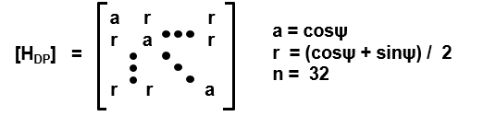
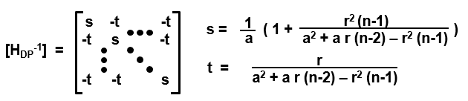
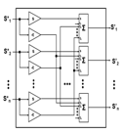
DPWiFi revA [H_{DP}⁻¹] Rx MIMO Demultiplexer
Given:
Given:
Then:
Then:
Equivalently:
Equivalently:
    The DPWiFi revA MIMO Demultiplexer [H_{DP}⁻¹] is a Trivial Construct

Slide 8
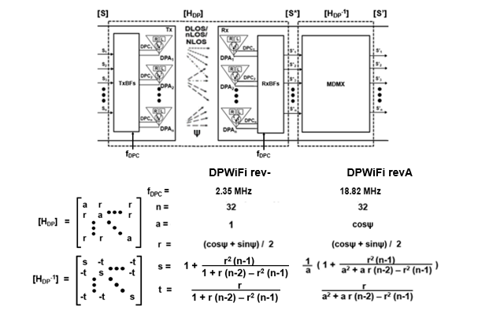
DPWiFi (rev-) vs DPWiFi (revA)
    Note: DPWiFi rev- and DPWiFi revA are equivalent for ψ < 7.5º
    DPWiFi rev- is just a Degenerate Manifestation of DPWiFi revA

Slide 9
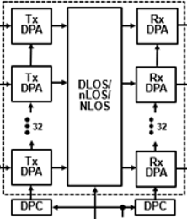
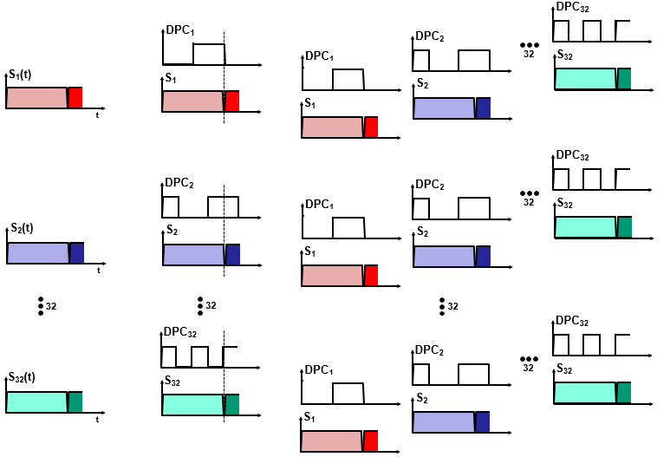
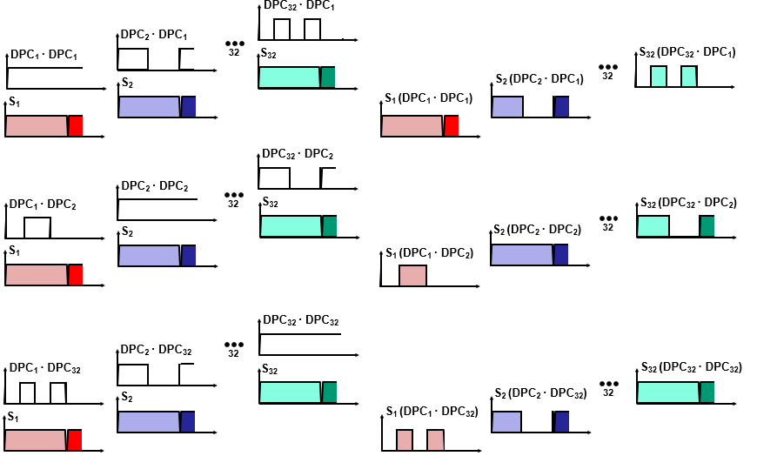
DPWiFi revA [H_{DP}] MATLAB Operation
S₁
S*₁
S₂
S*₂
[S]
S₃₂
S*₃₂
[S*]

Slide 10
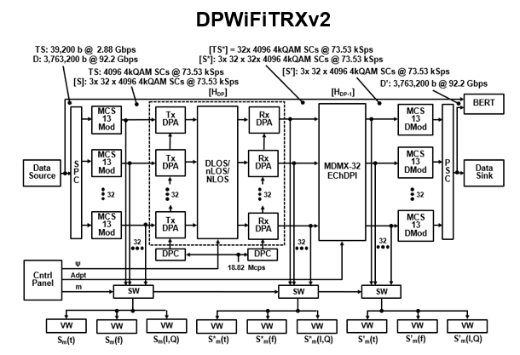
DPWiFi revA MATLAB Representation: DPWiFiTRXv2
[S] [P] x [ψ] [P] x [H_{DP}⁻¹] = [S’]

Slide 11
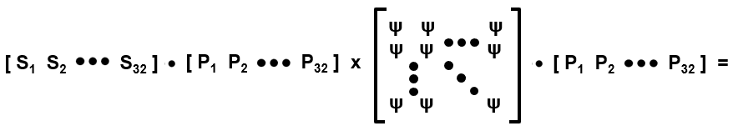
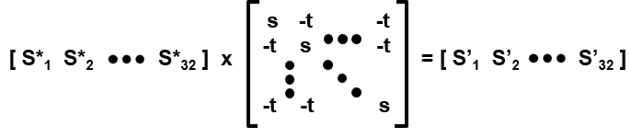
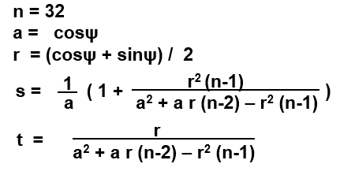
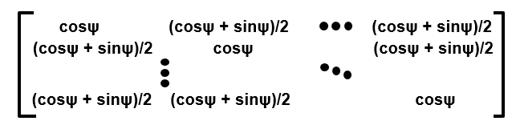

DPWiFiTRXv2 Processing
[S] [P] x [ψ] [P] x [H_{DP}⁻¹] = [S’]
[S] [H_{DP}] x [H_{DP}⁻¹] = [S’] = [S]

Slide 12
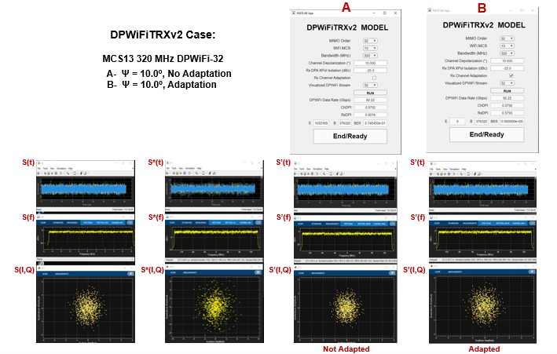
Representative DPWiFi revA MATLAB Simulation Results

Slide 13
DPWiFi revA MATLAB Validation
(See Appendix A for full DPWiFiTRXv2 Control Panel/Visualization Window Screen Shots)
DPWiFiTRXv2 BER vs Channel Depolarization, Rx Adaptation
Case | Signal | MIMO Order | Channel ψ (º) | Rx Adaptation | BER
1 | MCS13 320 MHz | 32 | 0.0 | N | 0.00e0
2 | MCS13 320 MHz | 32 | 1.0 | N | 0.00e0
3 | MCS13 320 MHz | 32 | 1.1 | N | 3.84e-3
4 | MCS13 320 MHz | 32 | 1.1 | Y | 0.00e0
5 | MCS13 320 MHz | 32 | 5.0 | N | 1.96e-1
6 | MCS13 320 MHz | 32 | 5.0 | Y | 0.00e0
7 | MCS13 320 MHz | 32 | 10.0 | N | 2.75e-1
8 | MCS13 320 MHz | 32 | 10.0 | Y | 0.00e0
9 | MCS13 320 MHz | 32 | 25.0 | N | 3.84e-1
10 | MCS13 320 MHz | 32 | 25.0 | Y | 0.00e0
11 | MCS13 320 MHz | 32 | 40.0 | N | 4.50e-1
12 | MCS13 320 MHz | 32 | 40.0 | Y | 0.00e0

Slide 14
DPWiFi revA MATLAB Validation Analysis
Salient Observations
Key Assessments
  DPWiFi is extraordinarily sensitive to propagation channel depolarization
  Absent receiver adaptation, even a slight morning mist would irremediably crash a DPWiFi link
  Rx Adaptation, however, comprehensively mitigates any amount of such depolarization
Fundamental Conclusions
DPWiFi revA (henceforth simply “DPWiFi”) stands to become the fastest (Rate), farthest (Range) and toughest (Impairment-impervious) Wireless PHY ever devised
DPWiFi revA BER Performance in Impaired FWA Propagation Channels DPWiFi-32 MCS13 320 MHz vs Channel Depolarization, Rx Adaptation
Channel Impairment Depolarization Angle | None 0.2º | Mist 1.0º | Slight Fog 1.1º | Heavy Rain 5.0º | Foliage 10.0º | Grz Reflection 25.0º | Orth Reflection 40.0º
Ch Depolarization Index | 0.5016 | 0.5087 | 0.5095 | 0.5417 | 0.5792 | 0.6645 | 0.7044
BER, No Adaptation | 0.000 | 0.000 | 0.003 | 0.196 | 0.275 | 0.384 | 0.450
BER, Adaptation | 0.000 | 0.000 | 0.000 | 0.000 | 0.000 | 0.000 | 0.000

Slide 15
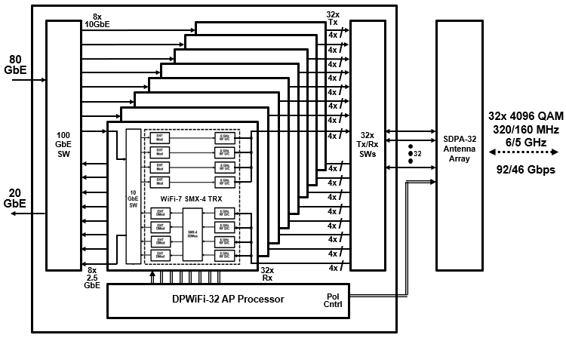

So, What Next? Hardware Validation!
Quick-turn DPWiFi Prototype
8x 11.5 Gbps SMX-4 WiFi-7s 1x 92. 2 Gbps PMX-32 DPWiFi

Slide 16
Summary and Conclusions
TGbn PHY candidate DPWiFi proposes breakthrough Polarization MIMO Multiplexing providing 92 Gbps P2P data transport within 320 MHz at 6 GHz, regardless of propagation channel impairments.
A MATLAB model has fully simulation-validated the above-claimed DPWiFi functionality and performance.
A WiFi-7 based prototype will attempt to correspondingly hardware-validate DPWiFi by this year’s end.
DPWiFi remains without peer as a candidate TGbn PHY

Slide 17
Appendix
DPWiFi RevA MATLAB Simulation Results

Slide 18
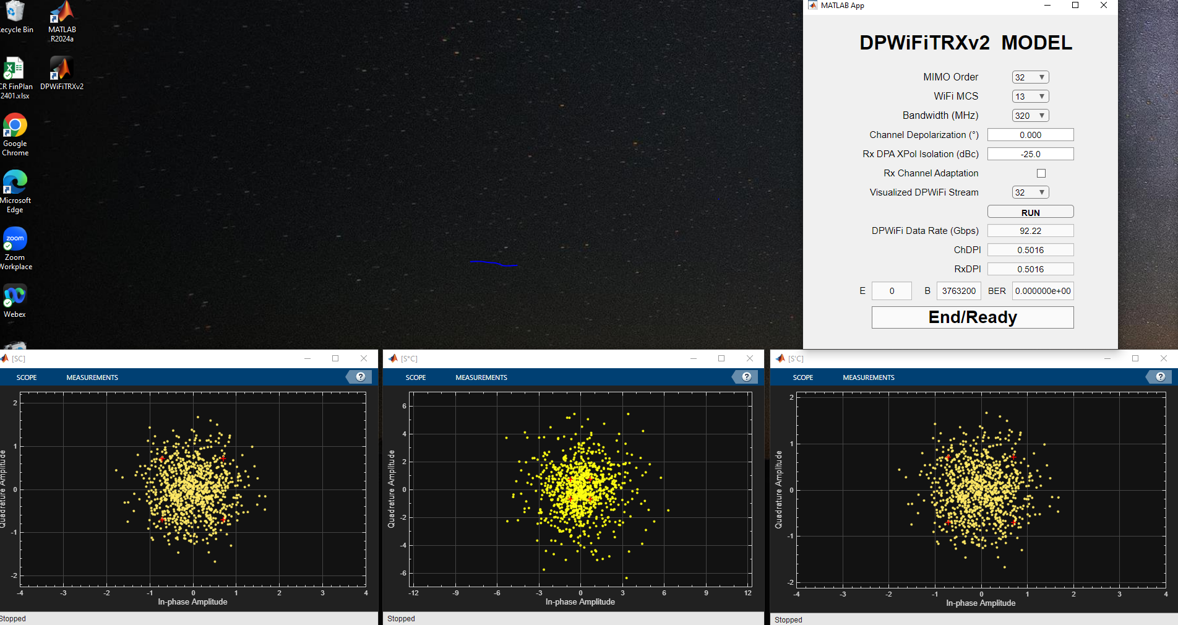
Case 1: DPWiFi-32 MCS13 320MHz / ψ = 0.0º / No Adaptation

Slide 19
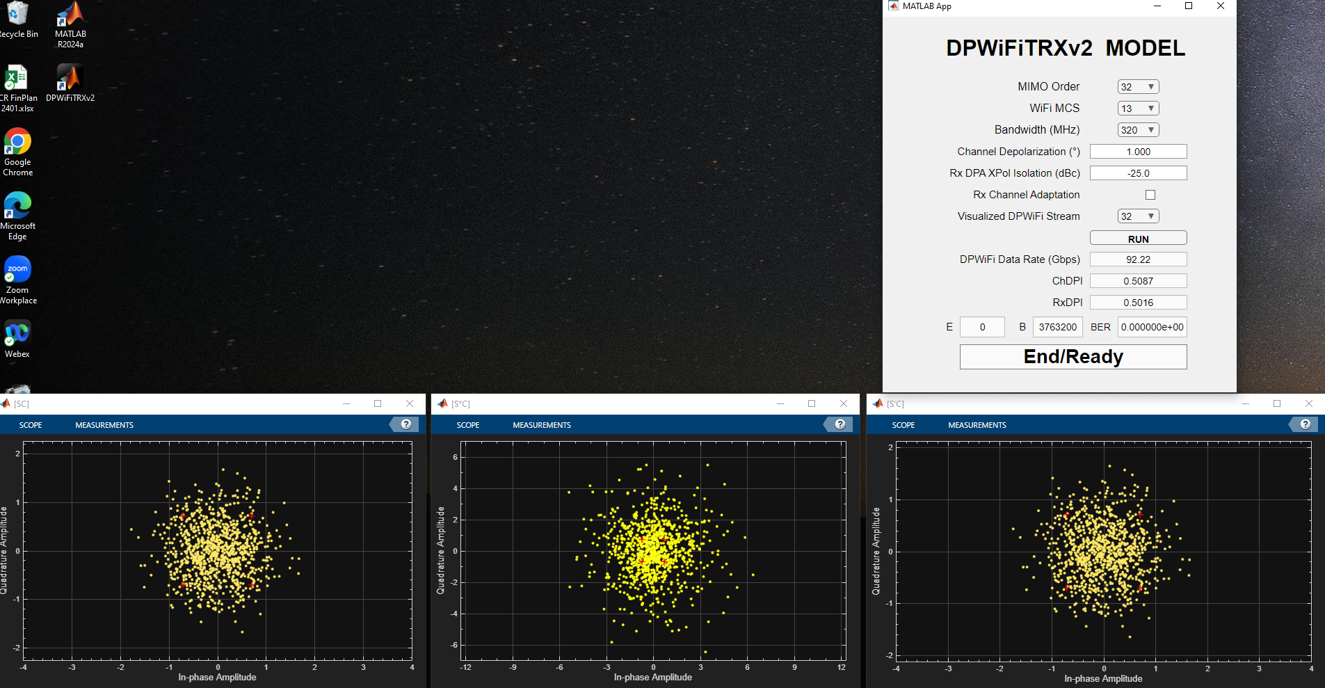
Case 2: DPWiFi-32 MCS13 320MHz / ψ = 1.0º / No Adaptation

Slide 20
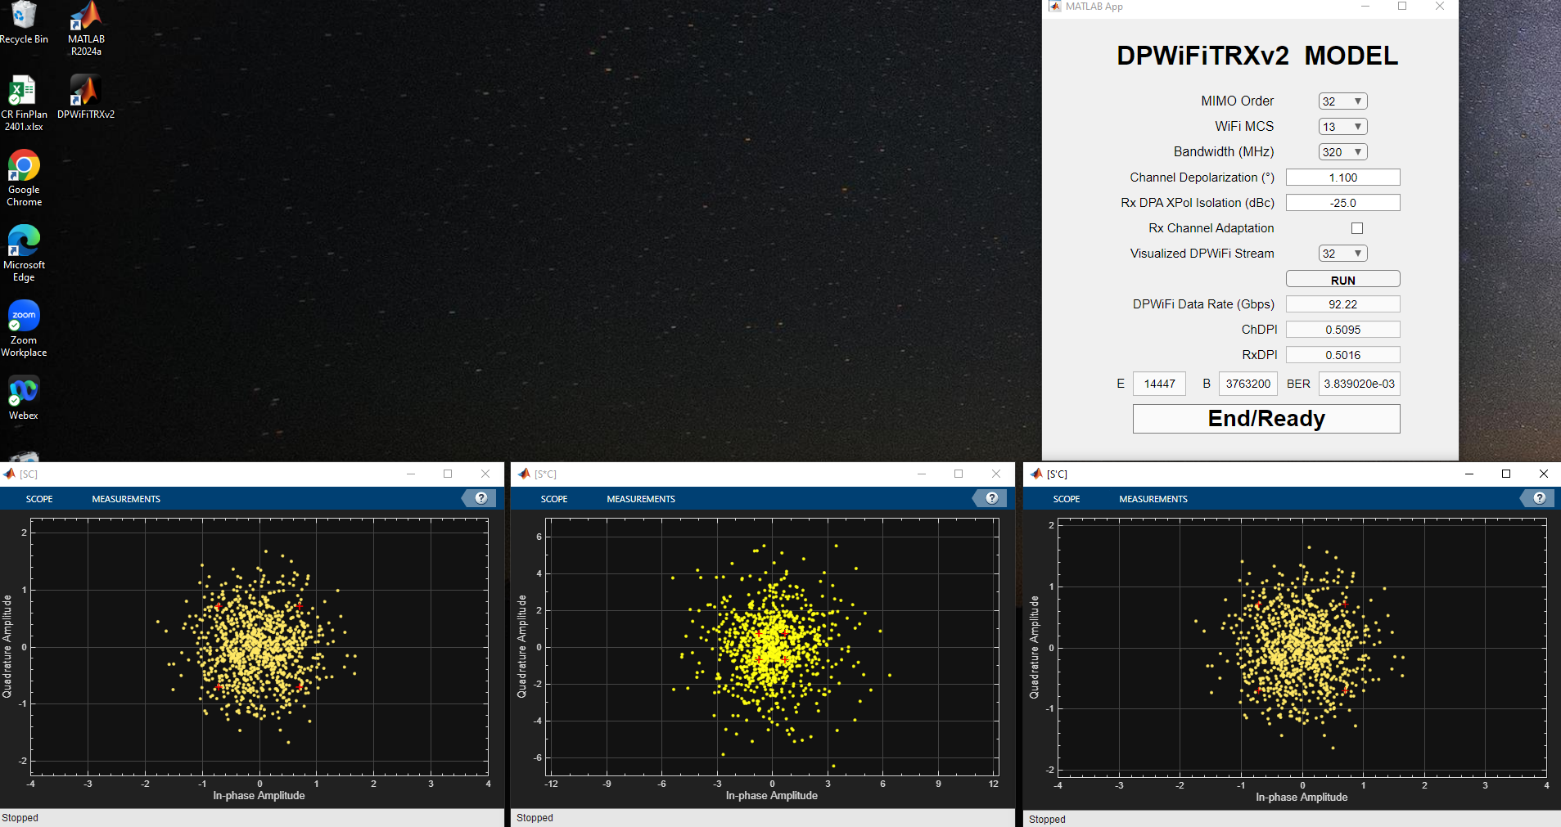
Case 3: DPWiFi-32 MCS13 320MHz / ψ = 1.1º / No Adaptation

Slide 21
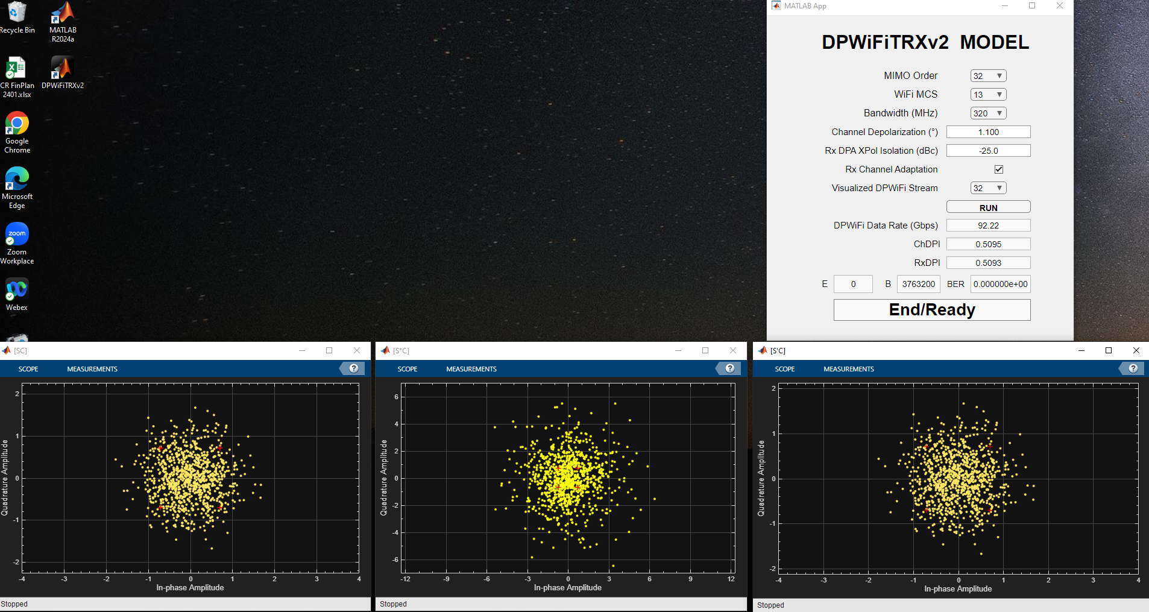
Case 4: DPWiFi-32 MCS13 320MHz / ψ = 1.1º / Adaptation

Slide 22
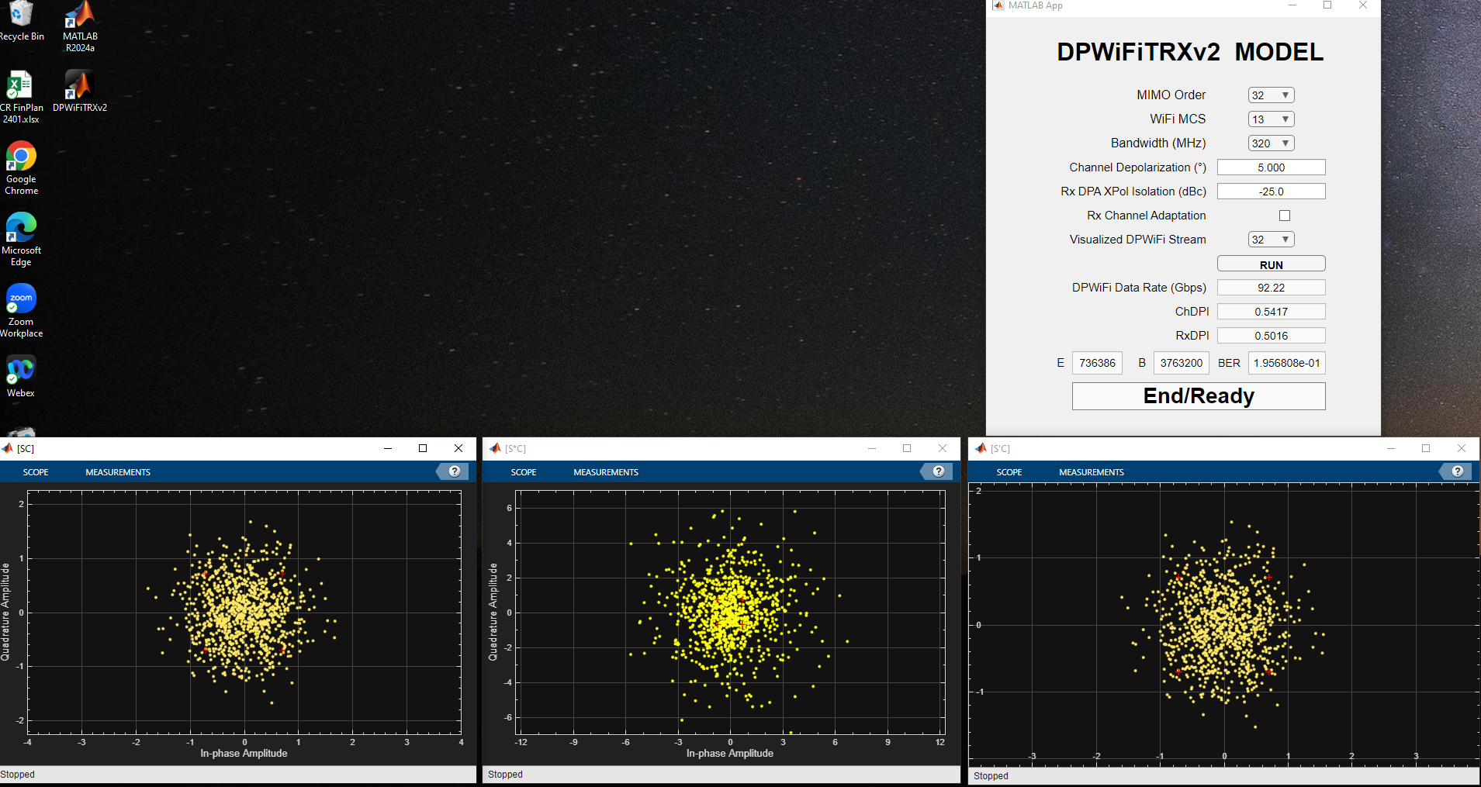
Case 5: DPWiFi-32 MCS13 320MHz / ψ = 5.0º / No Adaptation

Slide 23
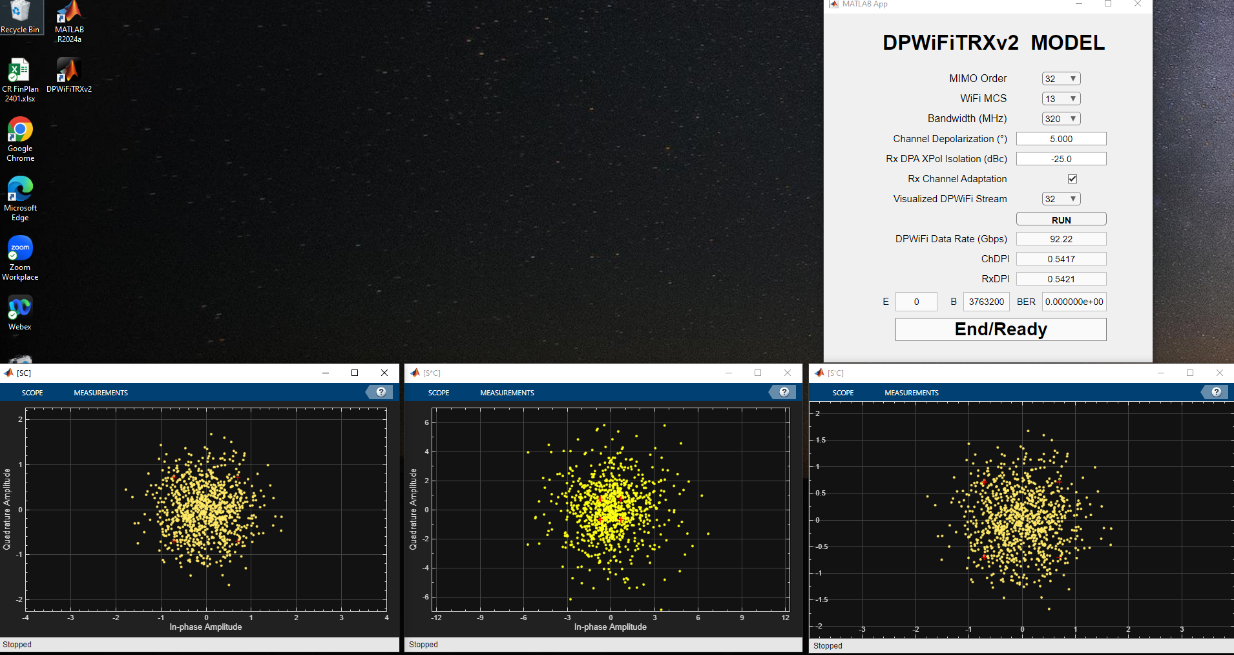
Case 6: DPWiFi-32 MCS13 320MHz / ψ = 5.0º / Adaptation

Slide 24
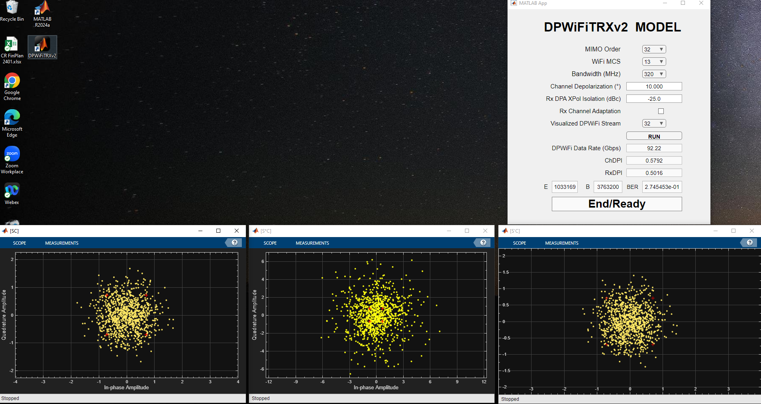
Case 7: DPWiFi-32 MCS13 320MHz / ψ = 10.0º / No Adaptation

Slide 25

Case 8: DPWiFi-32 MCS13 320MHz / ψ = 10.0º / Adaptation

Slide 26
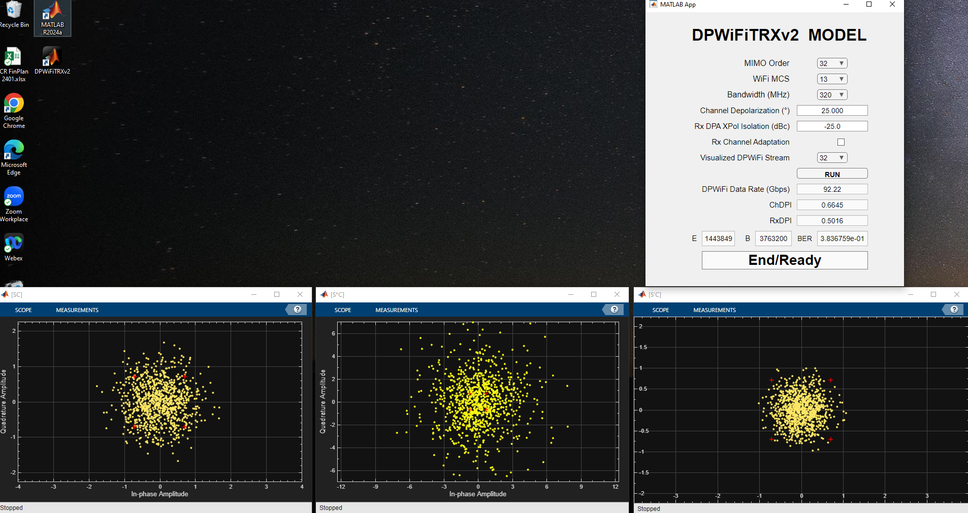
Case 9: DPWiFi-32 MCS13 320MHz / ψ = 25.0º / No Adaptation

Slide 27
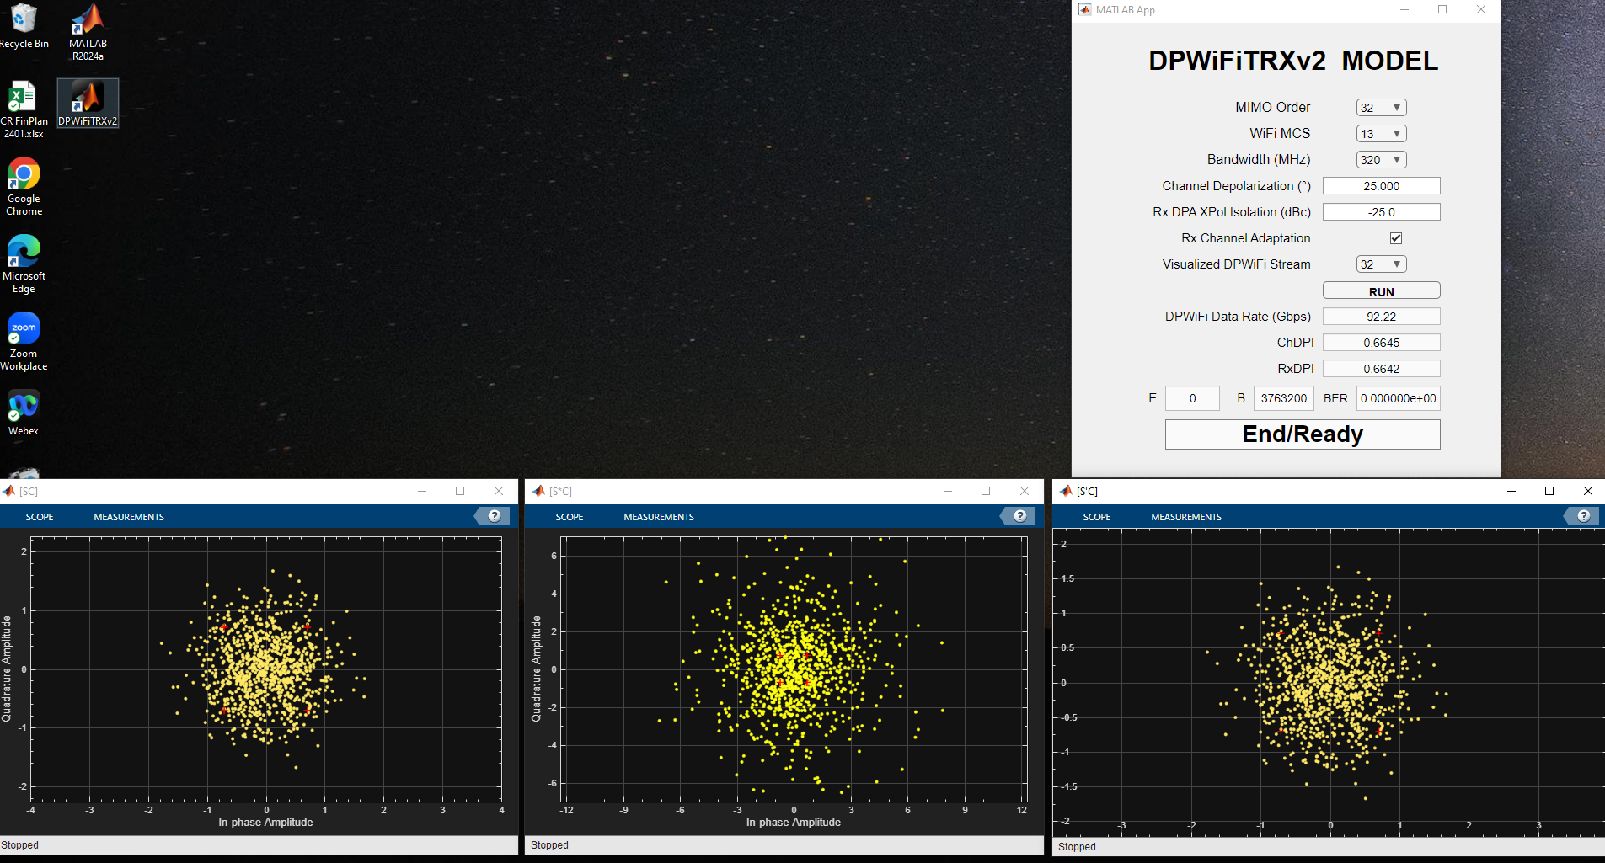
Case 10: DPWiFi-32 MCS13 320MHz / ψ = 25.0º / Adaptation

Slide 28
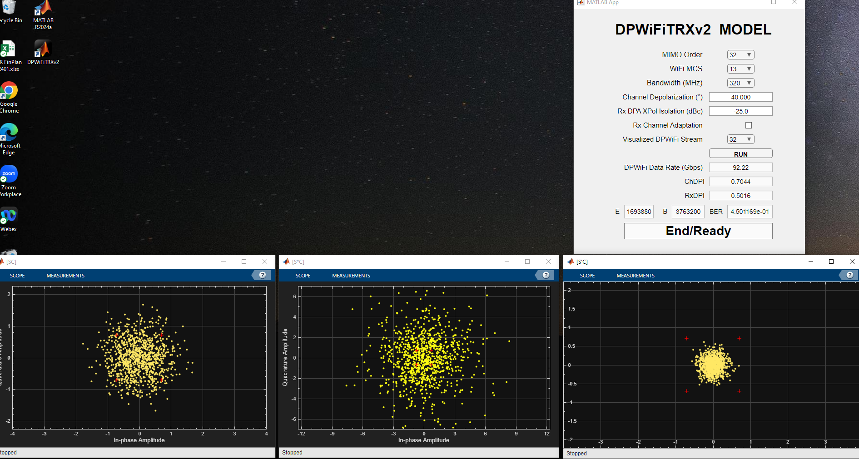
Case 11: DPWiFi-32 MCS13 320MHz / ψ = 40.0º / No Adaptation

Slide 29
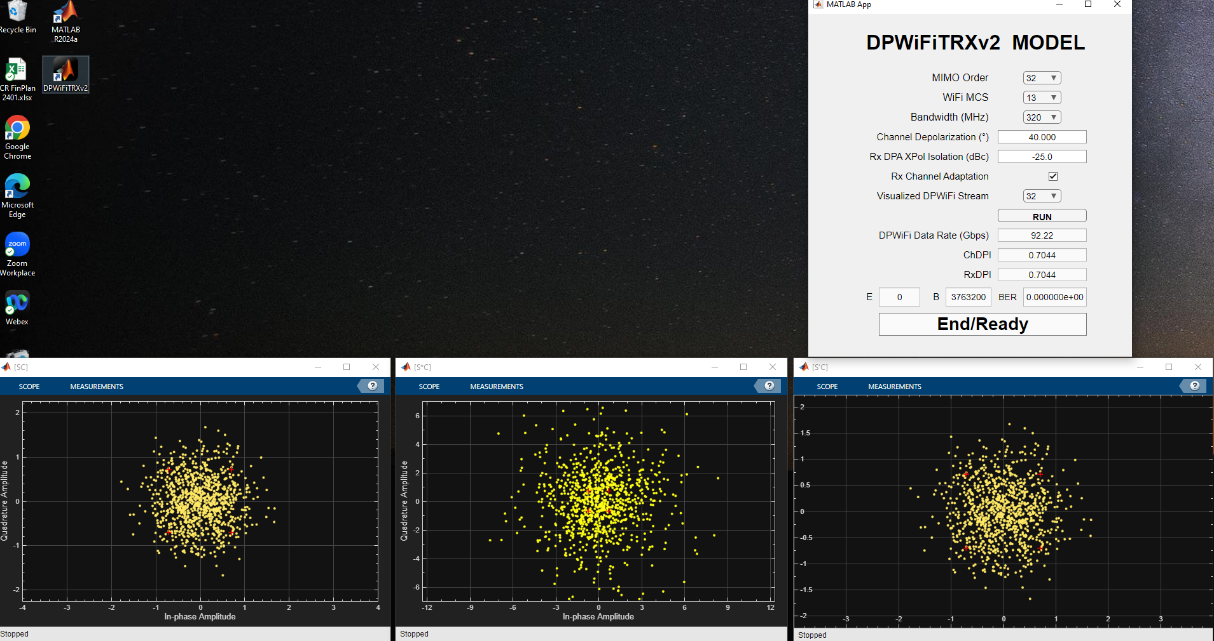
Case 12: DPWiFi-32 MCS13 320MHz / ψ = 40.0º / Adaptation

Slide 30
References
1. 23/1606r1-UHRSG
Dynamic Polarization Multiplexing and Beamforming WLANs
Carlos A Rios (Terabit Wireless Internet), 13-Sep-2023
23/1756r3-TGbn
MIMO Dynamic Polarization and Beamforming: Proposed IEEE802.11bn PHY
Carlos A Rios (Terabit Wireless Internet), 16-Nov-2023
24/0041r12-TGbn
DPWiFi MATLAB Validation
Carlos A Rios (Terabit Wireless Internet), 02-Feb-2024
24/0440r6-TGbn
DPWiFi for IEEE802.11bn WMANs
Carlos A Rios (Terabit Wireless Internet), 22-Apr-2024

