Slide 1
DPWiFi revA
Date: 2024-9-12
Authors:

Slide 2
Abstract
TGbn PHY candidate DPWiFi originally proposed Nov ‘23, an improved radiowave polarization processing model incorporated June ‘24 unearthed a serious, latent flaw in the original Dynamic Polarization Propagation Channel formulation. Since remedied, the updated “DPWiFi revA” TRX model as well as its corresponding MATLAB functional validation and performance characterization data, analyses and conclusions are presented herein.

Slide 3
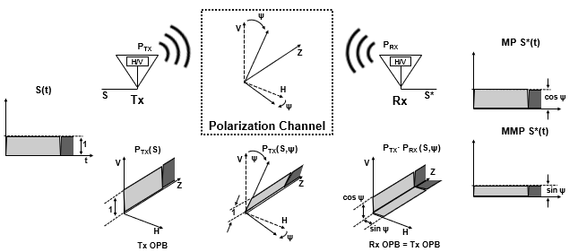
WiFi Static Polarization Operation
A WiFi Tx antenna “polarizes” by launching RF waveforms S in a precise spatial orientation per an “Orthogonal Polarization Baseline (OPB)”
Linearly Polarized P_{TX} radiates along a fixed 0º or 90º H/V angle
P_{TX}(S) = H or V
Typical terrestrial propagation “depolarizes” S by rotating P_{TX} by a “depolarization angle” ψ
  LP waveforms propagate fixed-rotated by ψº from true OPB H-V
  P_{TX} (S, ψ) = ψ or ψ + 90º
A WiFi Rx antenna “polarization-filters” detected waveforms into “Matched-Polarization (MP)” or “Mismatched-Polarization (MMP)” components
P_{RX} (S, ψ) = H or V
MP (P_{TX} (S,ψ)) = cosψ S(t)
MMP (P_{TX} (S, ψ)) = sinψ S(t)

Slide 4
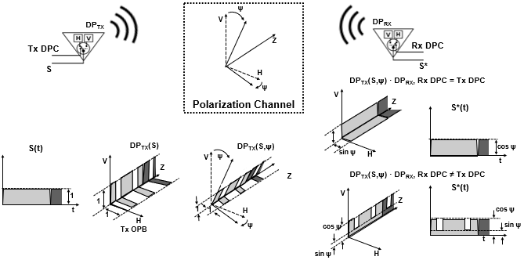
DPWiFi Dynamic Polarization Operation
MDPC S*(t)
MMDPC S*(t)
A DPWiFi Rx Antenna polarization-filters DP_{TX} into “Matched-DPC (MDPC)” or “Mismatched-DPC (MMDPC)” elements
DP_{RX}(S) = Rx DPC
MDPC (S, ψ) = cosψ S(t)
MMDPC (S, ψ) = f(S(t), cosψ, sinψ)
A DPWiFi Tx Antenna modulates polarization by switching between two orthogonal antenna elements per a binary sequence DPC
DP_{TX}(S) = Tx DPC
Propagation depolarization rotates DP_{TX} orthogonality baseline by ψ
DP_{TX} (S, ψ) = Tx DPC(ψ)

Slide 5
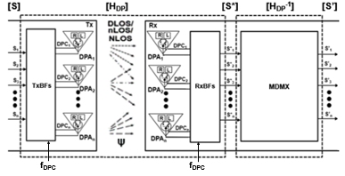
DPWiFi revA TRX Model
  Given n WiFi-7 RF stream n-vectors [S], [S*] and [S’], and
  The ψ-depolarized Propagation Channel nxn matrix [H_{DP}], and
  Walsh n-vectors [TxDPC] and [RxDPC] such that
[TxDPC] = [DPC₁ DPC₂ … DPC_{n}] = [RxDPC], where
DPC_{i} · DPC_{j} = cosψ if i = j
DPC_{i} · DPC_{j} = (cosψ + sinψ)/2 if i ≠ j
    If [H_{DP}] is Non-Singular there exists an [H_{DP}⁻¹]such that [S’] = [S] x [H_{DP}] x [H_{DP}⁻¹]= [S]

Slide 6
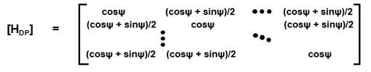
DPWiFi revA [H_{DP}] Propagation Channel
  Walsh-modulated DPWiFi Polarization establishes that
  S*(t) = cosψ S(t) if Tx DPC = Rx DPC, or
  S*(t) = (cosψ + sinψ)/2 S(t) if Tx DPC ≠ Rx DPC
  Extending to the case of n S_{i} and corresponding DPC_{i} we obtain
  [S*] = [S] x [H_{DP}], where
  Noting that for 0º < ψ < 45º
  0.50 ≤ (cosψ + sinψ)/2 ≤ 0.71 and 0.70 ≤ cosψ ≤ 1.00,
  we can therefore conclude
    The DPWiFi revA Propagation Channel [H_{DP}] is Indeed Non-Singular

Slide 7
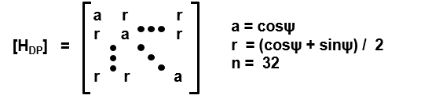
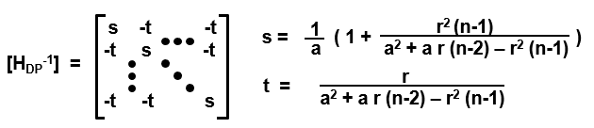
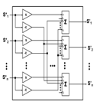
DPWiFi revA [H_{DP}⁻¹] Rx MIMO Demultiplexer
Given:
Given:
Then:
Then:
Equivalently:
Equivalently:
    The DPWiFi revA MIMO Demultiplexer [H_{DP}⁻¹] is a Trivial Construct

Slide 8
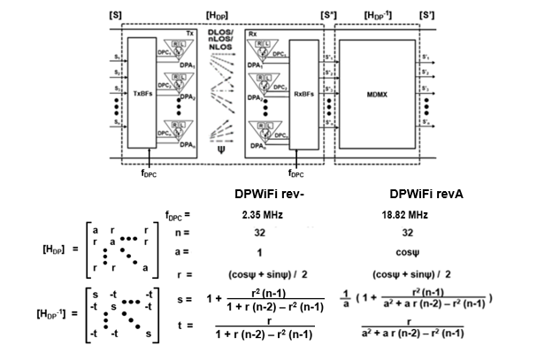
DPWiFi (rev-) vs DPWiFi (revA)
    Note: DPWiFi rev- and DPWiFi revA are equivalent for ψ < 7.5º
    DPWiFi rev- is just a Degenerate Manifestation of DPWiFi revA

Slide 9
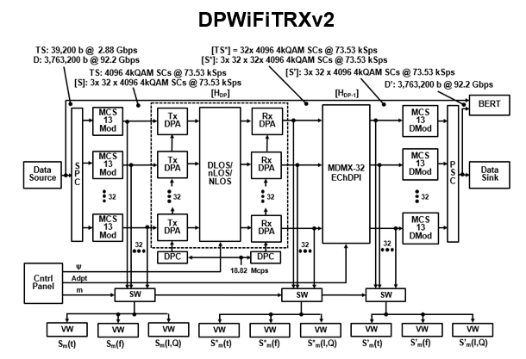
DPWiFi revA MATLAB Representation

Slide 10
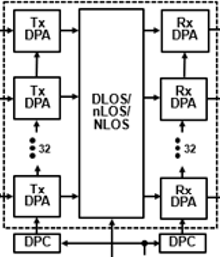
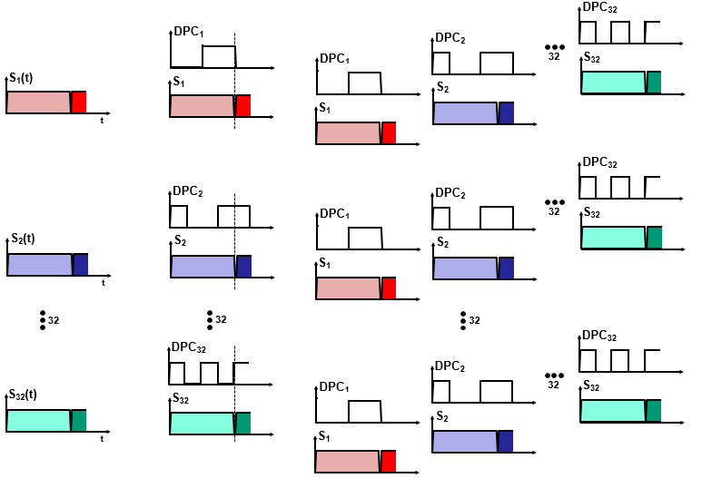
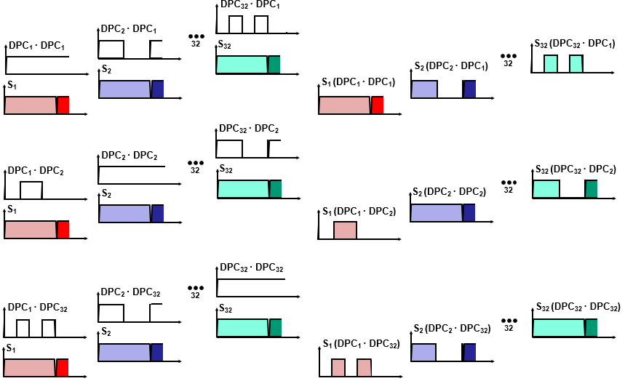
DPWiFi revA [H_{DP}] MATLAB Operation
S₁
S*₁
S₂
S*₂
[S]
S₃₂
S*₃₂
[S*]

Slide 11
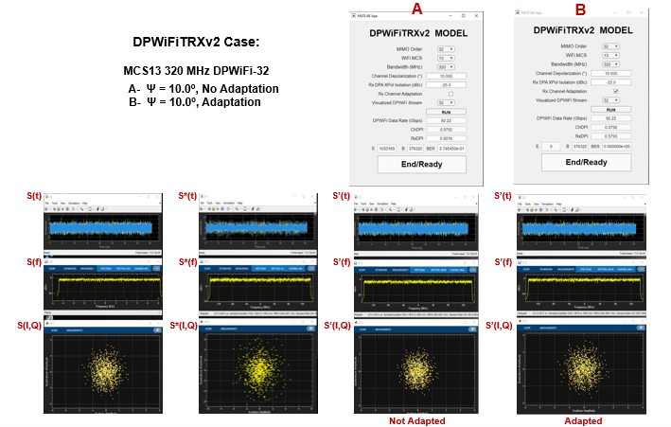
Representative DPWiFi revA MATLAB Simulation Results

Slide 12
DPWiFi revA MATLAB Validation
(See Appendix A for full DPWiFiTRXv2 Control Panel/Visualization Window Screen Shots)
DPWiFiTRXv2 BER vs Channel Depolarization, Rx Adaptation
Case | Signal | MIMO Order | Channel ψ (º) | Rx Adaptation | BER
1 | MCS13 320 MHz | 32 | 0.0 | N | 0.00e0
2 | MCS13 320 MHz | 32 | 1.0 | N | 0.00e0
3 | MCS13 320 MHz | 32 | 1.1 | N | 3.84e-3
4 | MCS13 320 MHz | 32 | 1.1 | Y | 0.00e0
5 | MCS13 320 MHz | 32 | 5.0 | N | 1.96e-1
6 | MCS13 320 MHz | 32 | 5.0 | Y | 0.00e0
7 | MCS13 320 MHz | 32 | 10.0 | N | 2.75e-1
8 | MCS13 320 MHz | 32 | 10.0 | Y | 0.00e0
9 | MCS13 320 MHz | 32 | 25.0 | N | 3.84e-1
10 | MCS13 320 MHz | 32 | 25.0 | Y | 0.00e0
11 | MCS13 320 MHz | 32 | 40.0 | N | 4.50e-1
12 | MCS13 320 MHz | 32 | 40.0 | Y | 0.00e0

Slide 13
DPWiFi revA MATLAB Validation Analysis
DPWiFi RevA Salient Observations
DPWiFi revA Evaluation
  DPWiFi revA is extraordinarily sensitive to propagation channel depolarization
  Absent receiver adaptation, even a slight morning mist would crash a DPWiFi link
  Rx Adaptation, however, comprehensively mitigates any amount of such depolarization
DPWiFi revA Concluding Remarks
DPWiFi revA (henceforth simply “DPWiFi”) stands to become the highest performance (i.e., Rate-Range) and most robust (i.e., impairment-resilient) Wireless PHY ever devised
DPWiFi revA BER Performance in Impaired FWA Propagation Channels DPWiFi-32 MCS13 320 MHz vs Channel Depolarization, Rx Adaptation
Channel Impairment Depolarization Angle | None 0.0º | Mist 1.0º | Slight Fog 1.1º | Heavy Rain 5.0º | Foliage 10.0º | Med Reflection 25.0º | Lg Reflection 40.0º
Ch Depolarization Index | 0.5016 | 0.5087 | 0.5095 | 0.5417 | 0.5792 | 0.6645 | 0.7044
BER, No Adaptation | 0.000 | 0.000 | 0.003 | 0.196 | 0.275 | 0.384 | 0.450
BER, Adaptation | 0.000 | 0.000 | 0.000 | 0.000 | 0.000 | 0.000 | 0.000

Slide 14
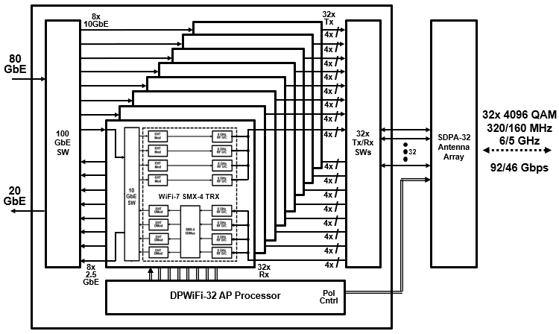
So, What’s Next Up? Hardware Validation!
Quick-turn Build a 92.2 Gbps PMX-32 DPWiFi Prototype
From 8x 11.5 Gbps SMX-4 WiFi-7 SoCs (QPC9274/ BCM67263/ MT7990)

Slide 15
Summary and Conclusions
DPWiFi has proposed breakthrough MIMO Multiplexing multi-signal processing delivering 92 Gbps P2P data transport in a 320 MHz channel at 6 GHz, regardless of propagation impairments.
A 92 Gbps DPWiFi physical MATLAB model has fully simulation-validated the functionality and performance claimed above.
A contemplated WiFi-7 based 92 Gbps DPWiFi prototype will similarly hardware-validate DPWiFi by this year’s end.
DPWiFi remains without peer as a candidate TGbn PHY

Slide 16
Appendix
DPWiFi RevA MATLAB Simulation Results

Slide 17
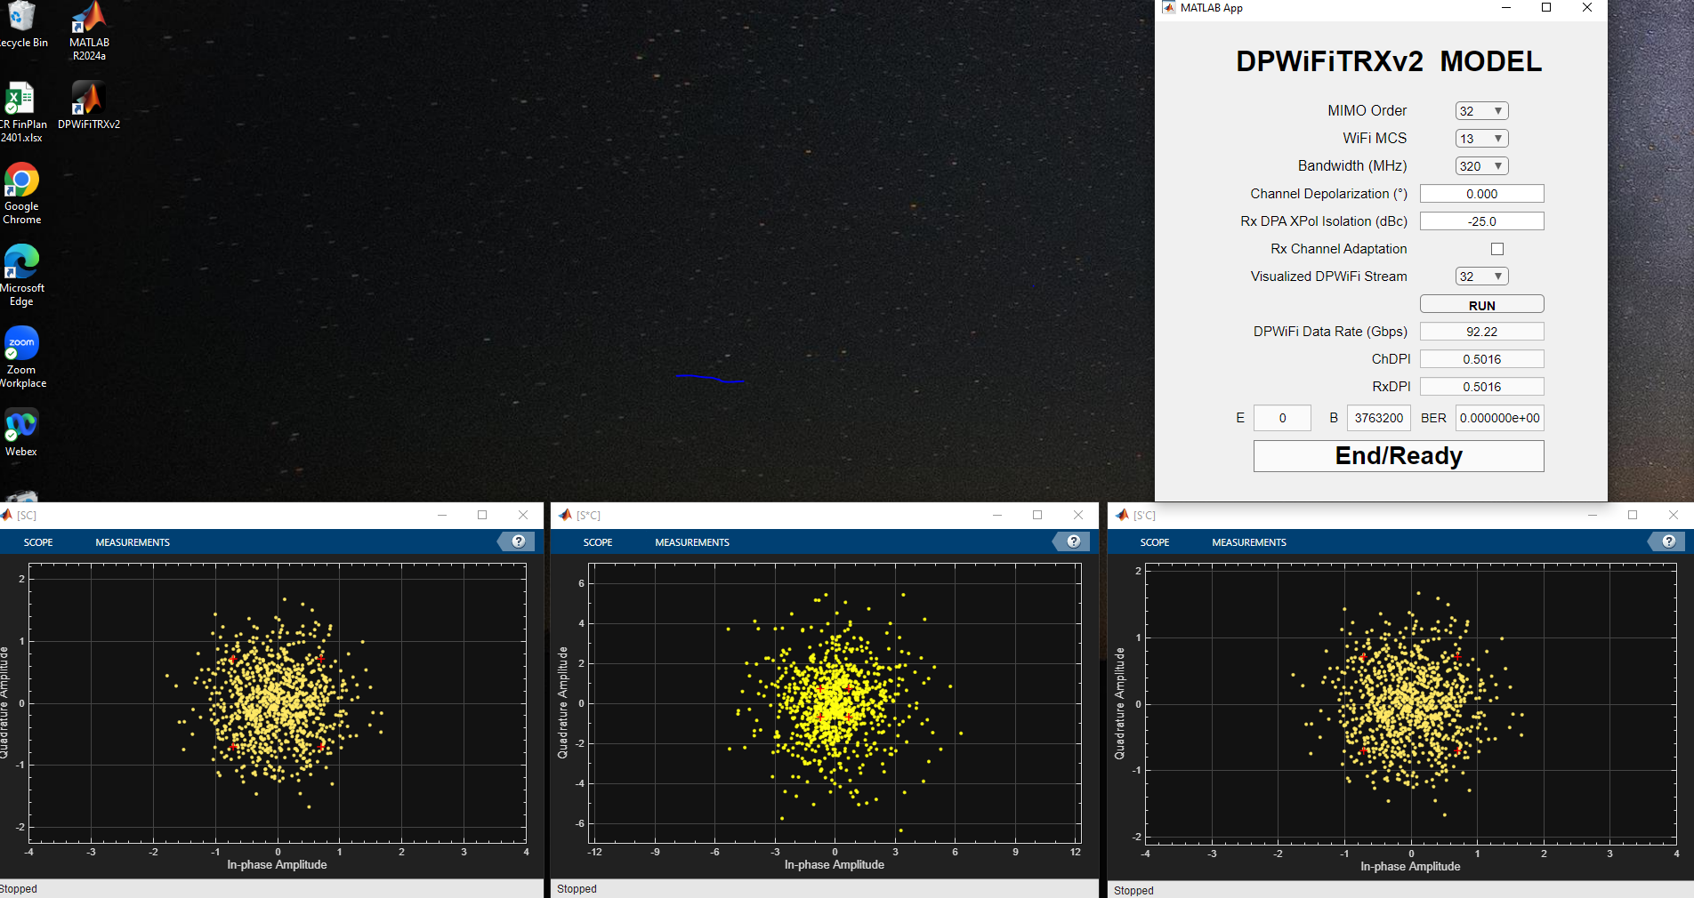
Case 1: DPWiFi-32 MCS13 320MHz / ψ = 0.0º / No Adaptation

Slide 18
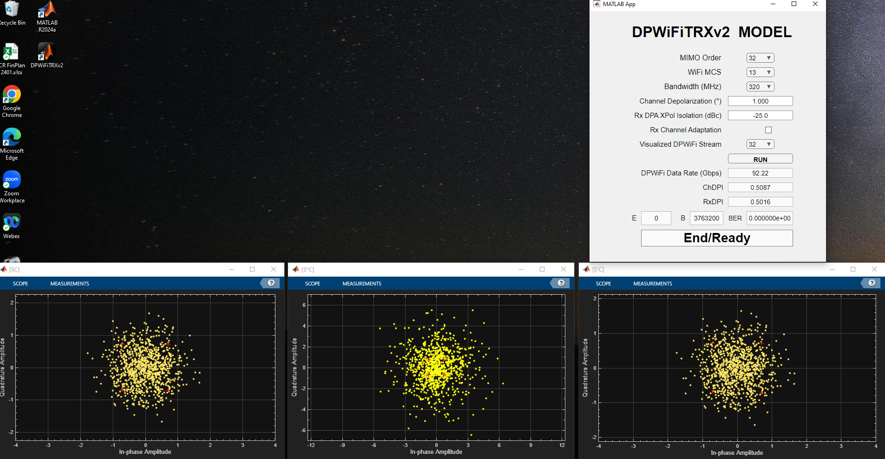
Case 2: DPWiFi-32 MCS13 320MHz / ψ = 1.0º / No Adaptation

Slide 19
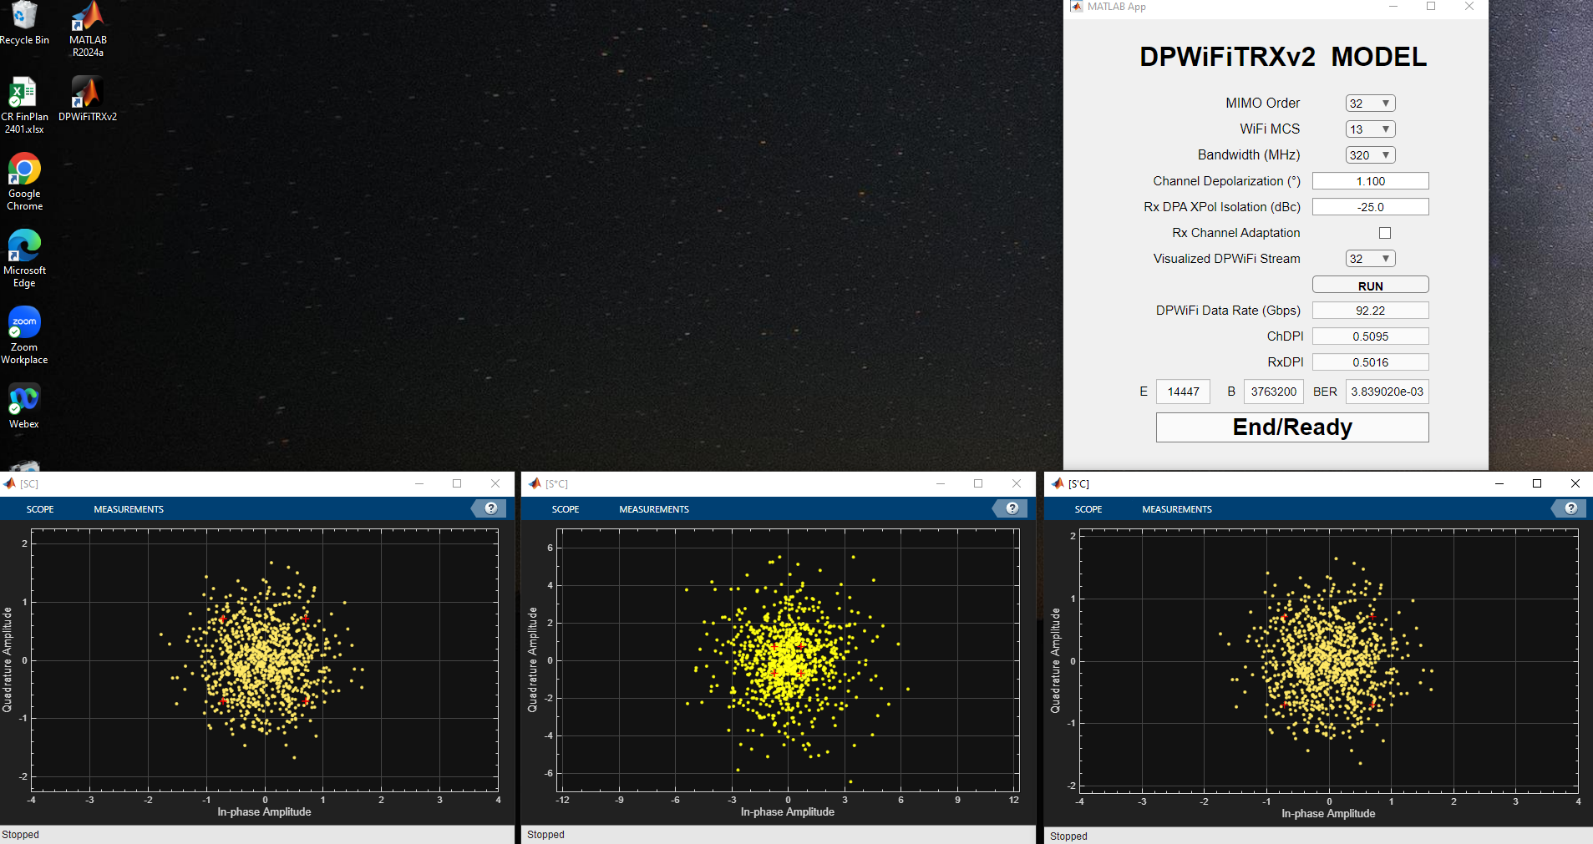
Case 3: DPWiFi-32 MCS13 320MHz / ψ = 1.1º / No Adaptation

Slide 20
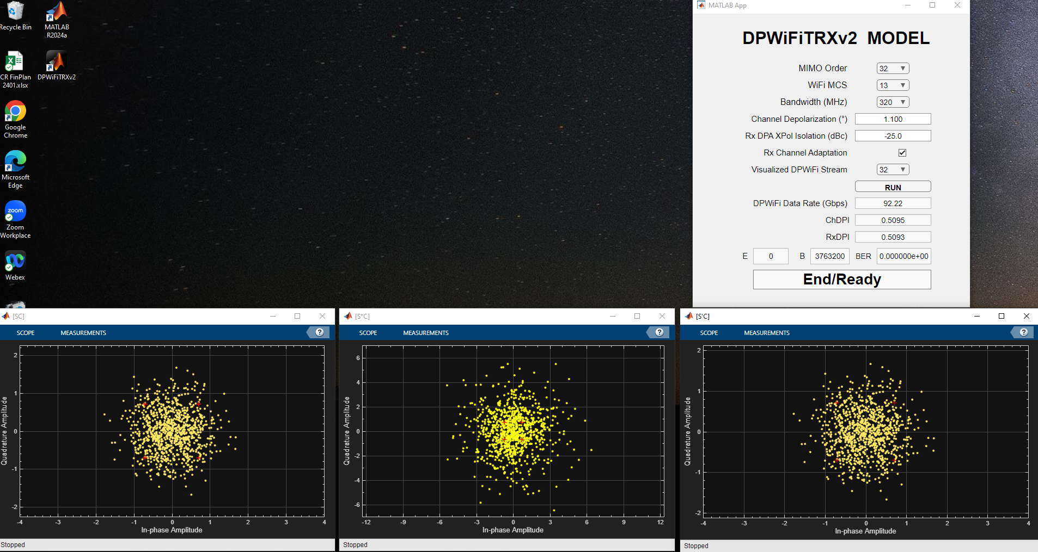
Case 4: DPWiFi-32 MCS13 320MHz / ψ = 1.1º / Adaptation

Slide 21
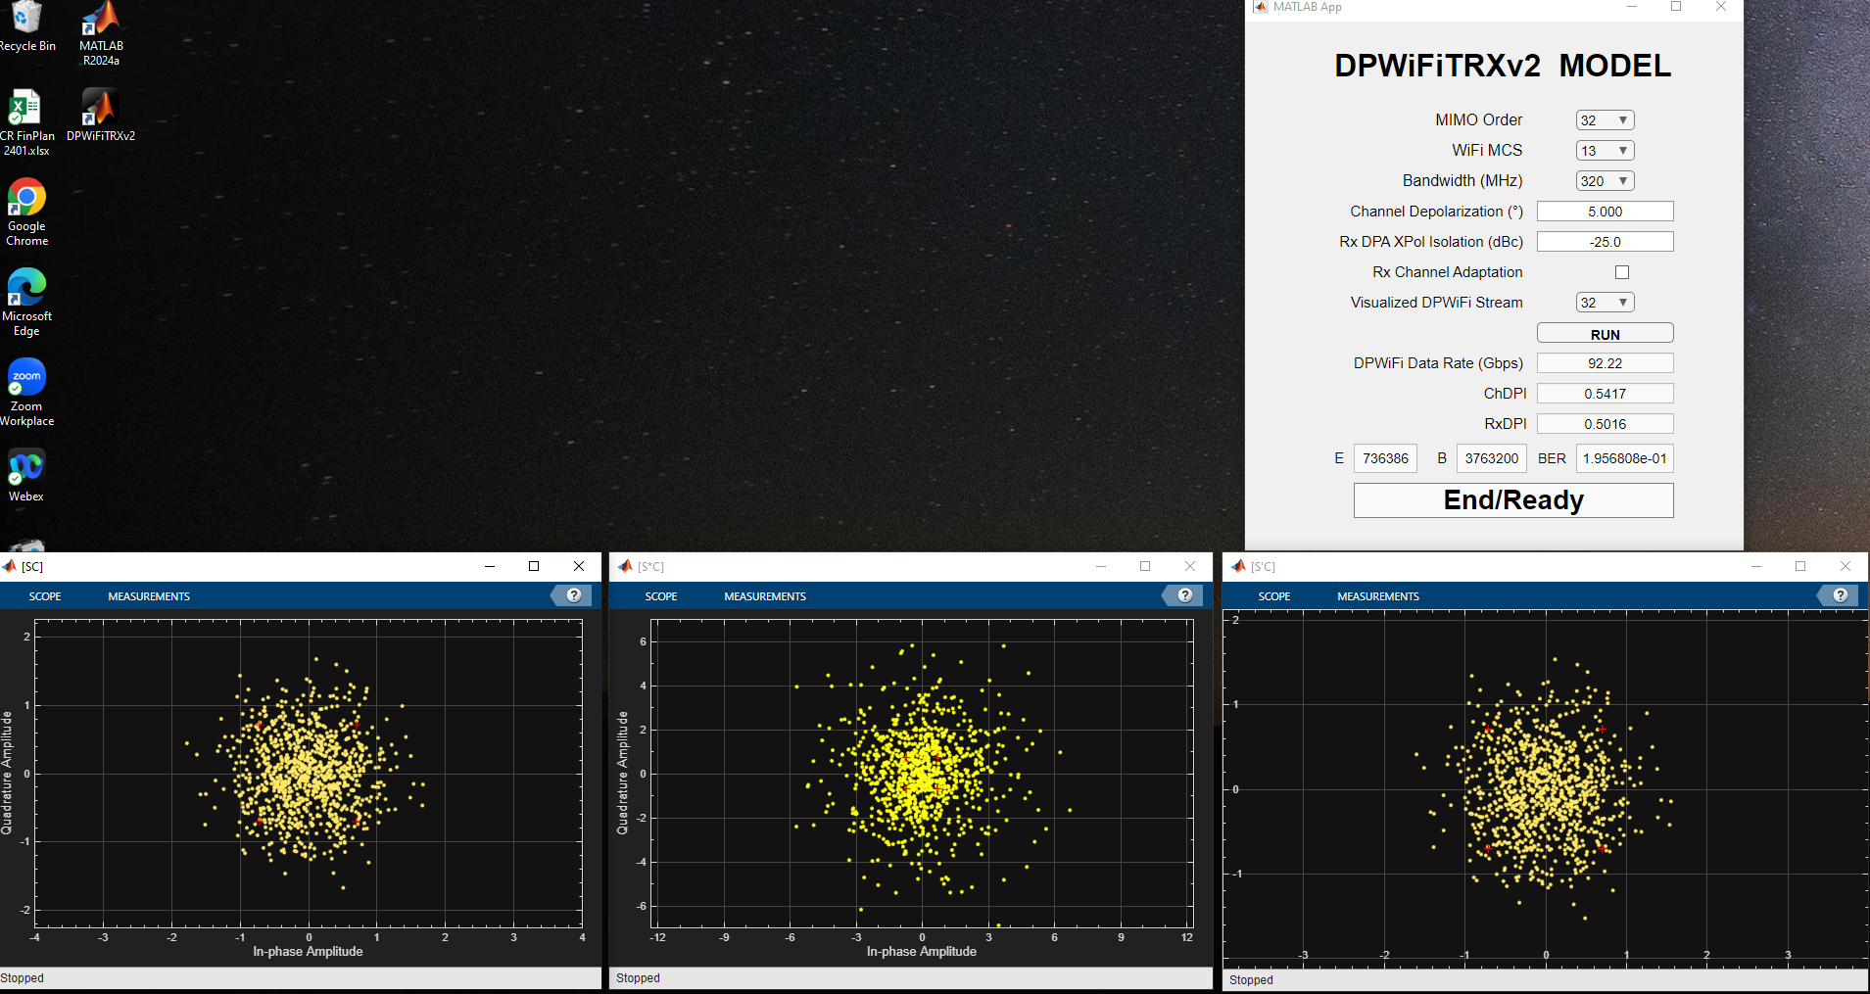
Case 5: DPWiFi-32 MCS13 320MHz / ψ = 5.0º / No Adaptation

Slide 22
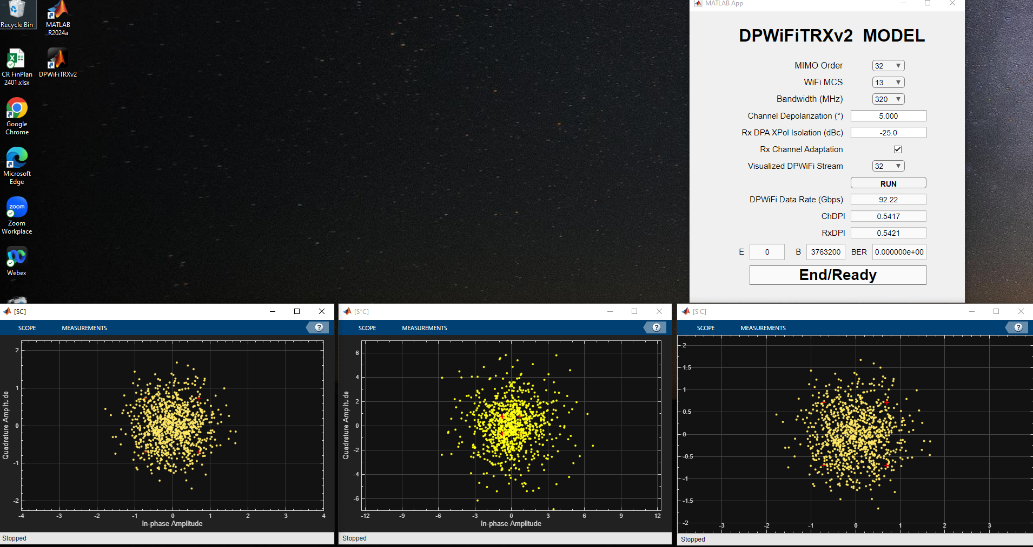
Case 6: DPWiFi-32 MCS13 320MHz / ψ = 5.0º / Adaptation

Slide 23
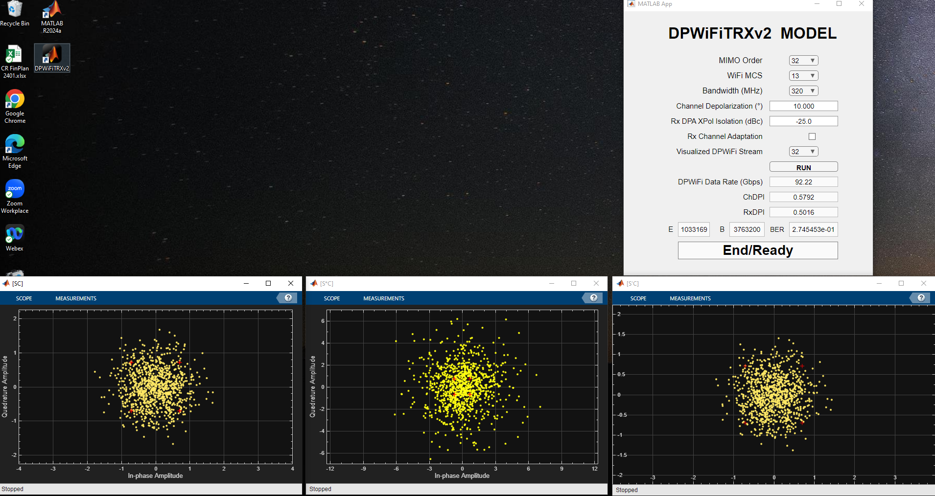
Case 7: DPWiFi-32 MCS13 320MHz / ψ = 10.0º / No Adaptation

Slide 24

Case 8: DPWiFi-32 MCS13 320MHz / ψ = 10.0º / Adaptation

Slide 25
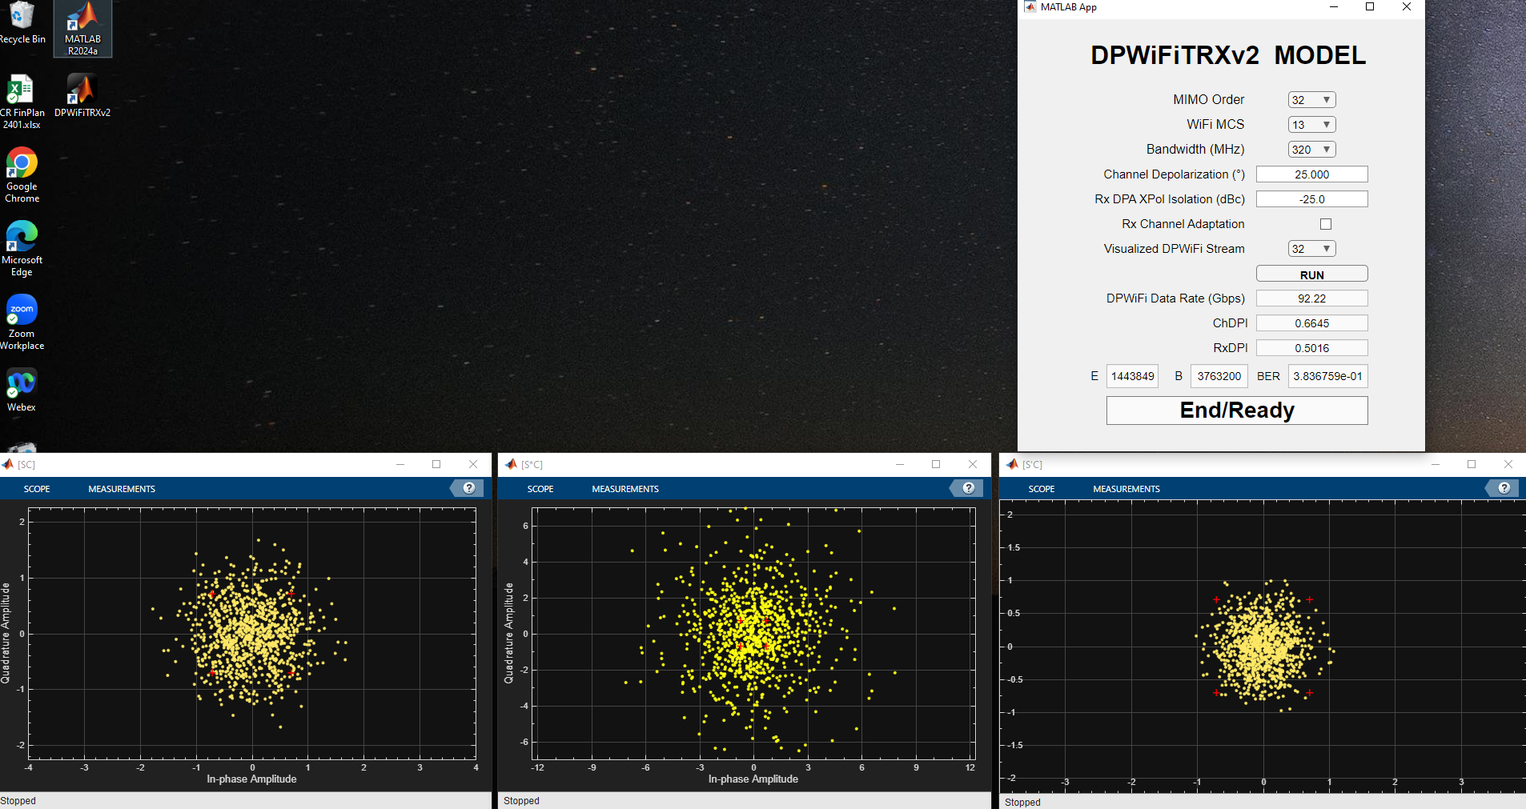
Case 9: DPWiFi-32 MCS13 320MHz / ψ = 25.0º / No Adaptation

Slide 26
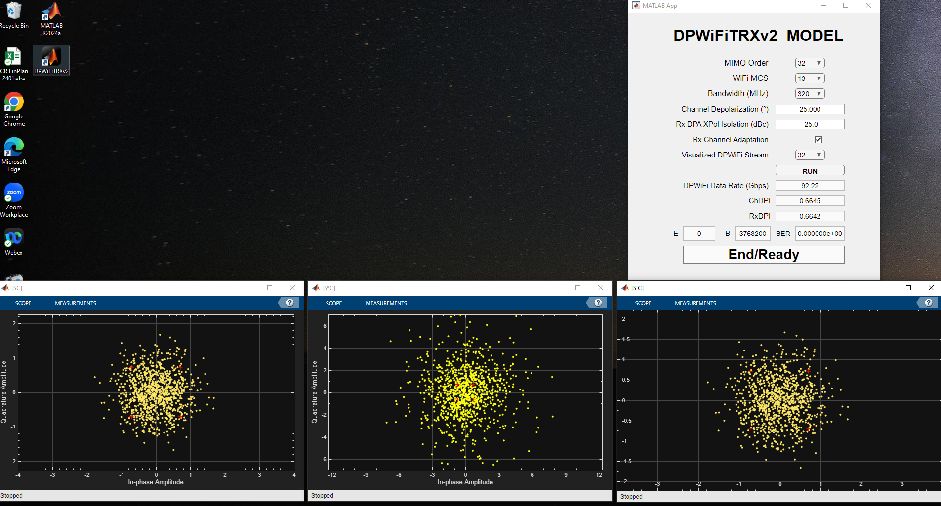
Case 10: DPWiFi-32 MCS13 320MHz / ψ = 25.0º / Adaptation

Slide 27
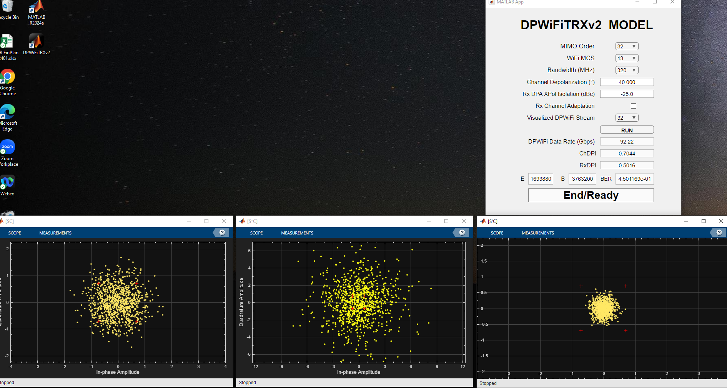
Case 11: DPWiFi-32 MCS13 320MHz / ψ = 40.0º / No Adaptation

Slide 28
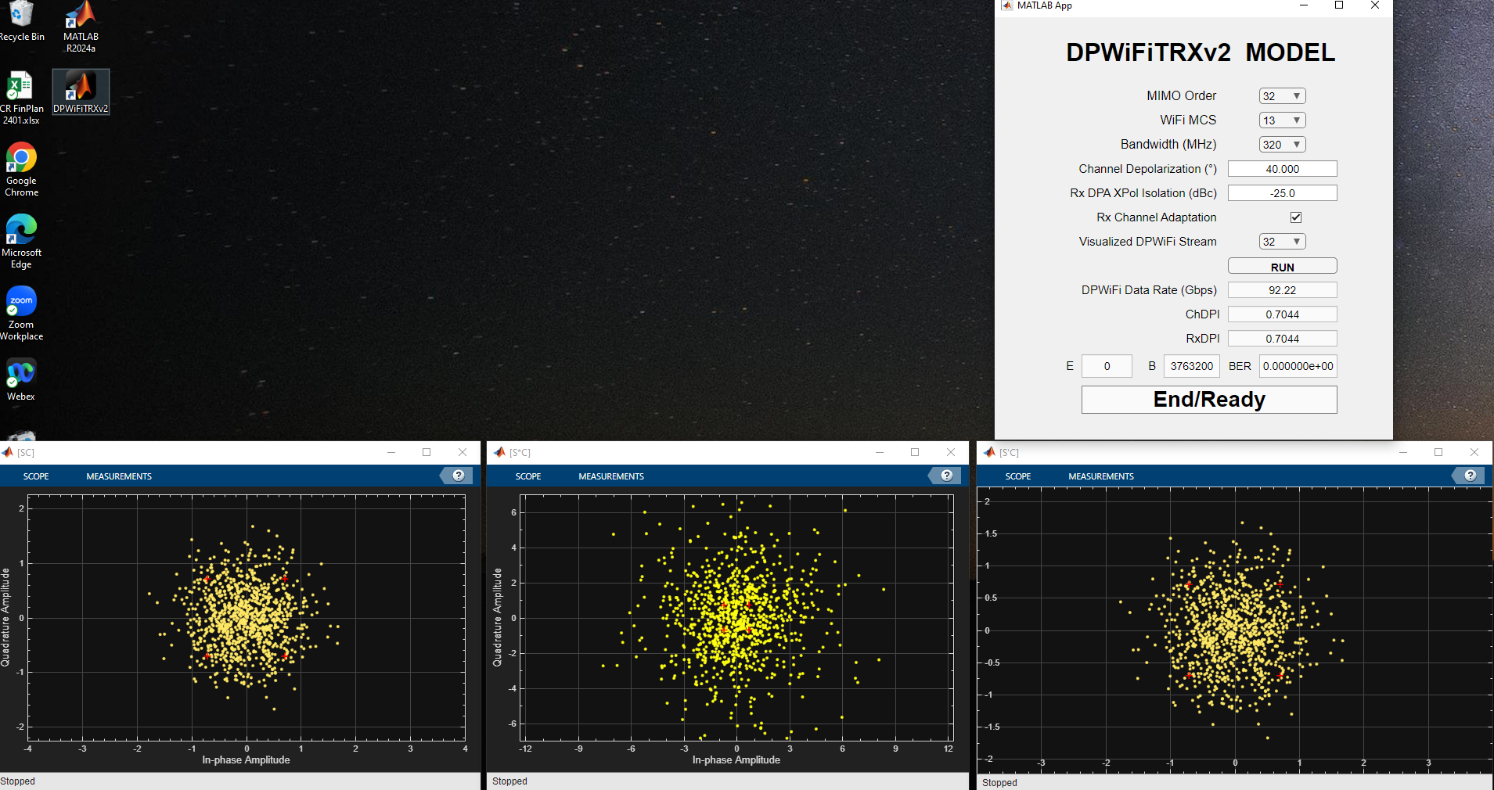
Case 12: DPWiFi-32 MCS13 320MHz / ψ = 40.0º / Adaptation

Slide 29
References
1. 23/1606r1-UHRSG
Dynamic Polarization Multiplexing and Beamforming WLANs
Carlos A Rios (Terabit Wireless Internet), 13-Sep-2023
23/1756r3-TGbn
MIMO Dynamic Polarization and Beamforming: Proposed IEEE802.11bn PHY
Carlos A Rios (Terabit Wireless Internet), 16-Nov-2023
24/0041r12-TGbn
DPWiFi MATLAB Validation
Carlos A Rios (Terabit Wireless Internet), 02-Feb-2024
24/0440r6-TGbn
DPWiFi for IEEE802.11bn WMANs
Carlos A Rios (Terabit Wireless Internet), 22-Apr-2024

