Slide 1
Enabling QoS Monitoring at AP side
July 2024
Date: 2024-07-23
Authors:
Notes:
September 2012

Slide 2
Introduction
In 11be and 11bn, some contributions [1-4] propose to define a new buffer report with timing information (e.g. enqueue timestamp or expiration timestamp).
The AP can use this timing information to improve scheduling performance, especially for the low-latency traffic.
In this contribution, the timing info is proposed to include within the MPDU header.
  Which can enable the QoS measurement of both DL and UL transmissions at the AP’s side

Slide 3
Recap SCS mechanism
The SCS mechanism has been improved in 11be, which can help the STA to report a latency-sensitive traffic flow with the expected QoS requirements.
For a latency-sensitive traffic flow, there are two important QoS metrics, i.e. delay bound and MSDU delivery ratio.
However, currently the AP as the controller of the BSS has no way to monitor these two important QoS metrics in a real time manner.
  Note the attempt to modernize the Transmit Stream/Category Measurement report is failed in 11be. And this non-real-time QoS measurement for the uplink traffic relies on the STA’s measurement and feedback, which may introduce much computation burden to the STA side.

Slide 4
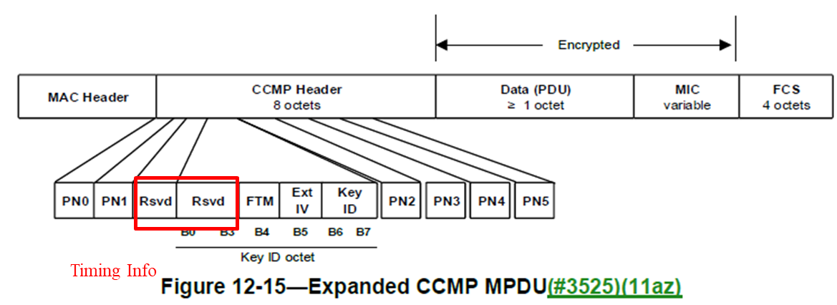
New MPDU Format with Timing Information
We propose to define a new MPDU format with the timing information in 11bn.
  The timing information can be carried within the CCMP Header or a new field.
  There are 12 reserved bits within the CCMP Header.
In the following, we will give an examples.

Slide 5
Example
Example. The Timing Information field includes the following signaling:
  SCSID subfield
    The SCSID allows the receiver to know which traffic flow this MPDU belongs to.
    In order to reduce the overhead, one way is to restrict the SCSID value to 0000XXXX.
    Only need to indicate the lower four bits. Then we can use the TID plus SCSID to uniquely identify a traffic flow of a STA.
  Timing subfield
    Indicate the corresponding enqueue timestamp of the current MPDU/MSDU.
Thus the AP can calculate the actual MSDU delay and the MSDU delivery ratio based on the delay bound required by the SCS stream which is identified by the SCSID.

Slide 6
Enable Timing Operation
The non-AP MLD and AP MLD respectively signal whether to support or enable this operation.
  E.g., add one bit within the QoS Characteristics element
When both of them support this operation, they can negotiate the following configurations during the association or the SCS session establishment:
  Starting bit of the TSF or Partial TSF
    Which allows to collect the delay performance with different precisions according to the application.
  Link ID corresponding to the reference TSF for the timing info
    Which can reuse the same signaling on the Service Start Time Link ID in the QoS Characteristics element.

Slide 7
QoS Monitoring at AP side
The non-AP MLD and the associated AP MLD can negotiate to include the timing info for the uplink or downlink MPDU.
  E.g. reuse the Direction subfield of the QoS Characteristics element
The AP MLD may only enable to include the timing info within the uplink MPDU for a specific SCS stream, then the AP MLD can monitor the QoS of this SCS stream without the non-AP MLD’s feedback. Specifically,
  For the downlink QoS statistics (e.g. average MSDU delay and MSDU delivery ratio), the AP MLD can use the time when the ACK/BA frame is received to instead the time when the corresponding MSDU has been successfully received.
  For the uplink QoS statistics, the AP MLD can calculate the MSDU delay based on the timing info included within the MPDU and the successful reception of the MPDU containing the MSDU.

Slide 8
Summary
In this contribution, a new MPDU format with the timing info is proposed
  Which can help the AP monitor the QoS in real time and at different levels, e.g.
    The QoS of a specific TID of a STA
    The QoS of a specific traffic flow of a STA if the SCSID info is included
  Which shifts the most of the measurement burden to the AP side.

Slide 9
References
[1] 11-20-1006-03-00be-new-methods-to-meet-low-latency-requirements
[2] 11-22-1454-02-00be-lb266-cr-for-cid-10674
[3] 11-24-0264-01-00bn-timing-information-sharing-for-next-generation-wlans
[4] 11-24-0863-00-00bn-feedback-based-tua-optimization-with-scs

Slide 10
SP
Do you support to include the timing information within each MPDU?
  Note. How to include the timing information (e.g. enqueue time) is TBD.

