Slide 1
Enhancing BF Feedback Mechanism in 11bn
Date: 2024-08-14
Authors:
Name | Affiliation | Address | Phone | Email
Aiguo Yan | Samsung | 3655 N First St, San Jose, CA 95134 |  | aiguo.yan@samsung.com
Zigui Yang
Srini Kandala
Ravi Gidvani
Eunsung Jeon

Slide 2
Introduction
Channel smoothing at receivers is a common technique for improving channel estimation accuracy.
The channel smoothing in general can’t be applied to a vanilla BFed channel.
The Optimal BF was proposed to enable the optimal channel smoothing at BFee side.
Multiple contributions proposed to modify BF feedback mechanism to better support the optimal BF, but encountered a lot of resistances.
This contribution is trying to propose differrnt ways to enable optimal channel smoothing, with minimum changes in 11bn standard.

Slide 3
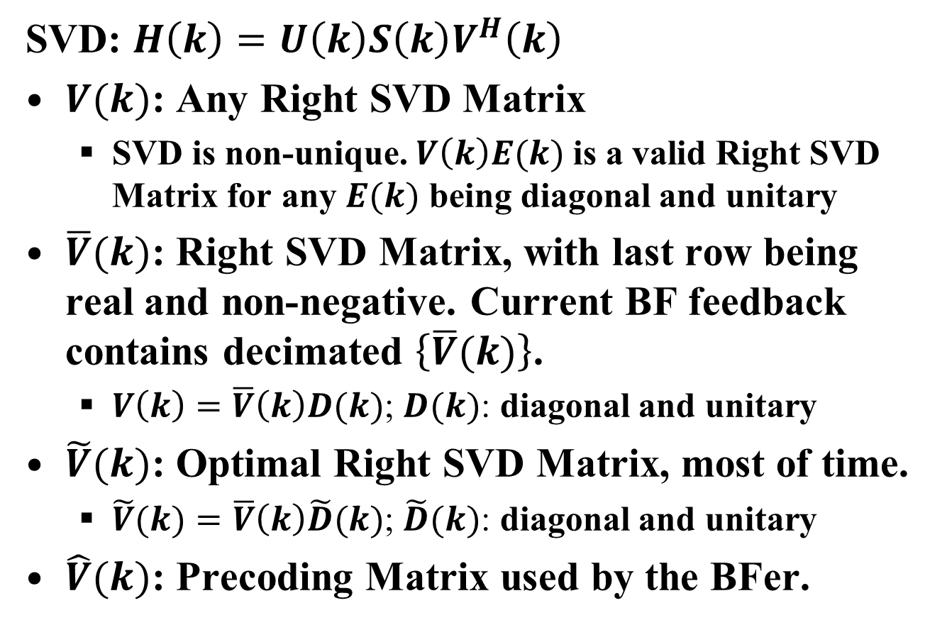
Summary of Notations
SVD: $H\left(k\right)=U\left(k\right)S\left(k\right)V^{H}\left(k\right)$
$V(k)$: Any Right SVD Matrix
  SVD is non-unique. $V\left(k\right)E(k)$ is a valid Right SVD Matrix for any $E(k)$ being diagonal and unitary
$\overline{V}(k)$: Right SVD Matrix, with last row being real and non-negative. Current BF feedback contains decimated $\left\{\overline{V}(k)\right\}$.
  $V\left(k\right)=\overline{V}\left(k\right)D(k)$; $D(k)$: diagonal and unitary
$\tilde{V}(k)$: Optimal Right SVD Matrix, most of time.
  $\tilde{V}(k)=\overline{V}\left(k\right)\tilde{D}(k)$; $\tilde{D}(k)$: diagonal and unitary
$\hat{V}(k)$: Precoding Matrix used by the BFer.

Slide 4
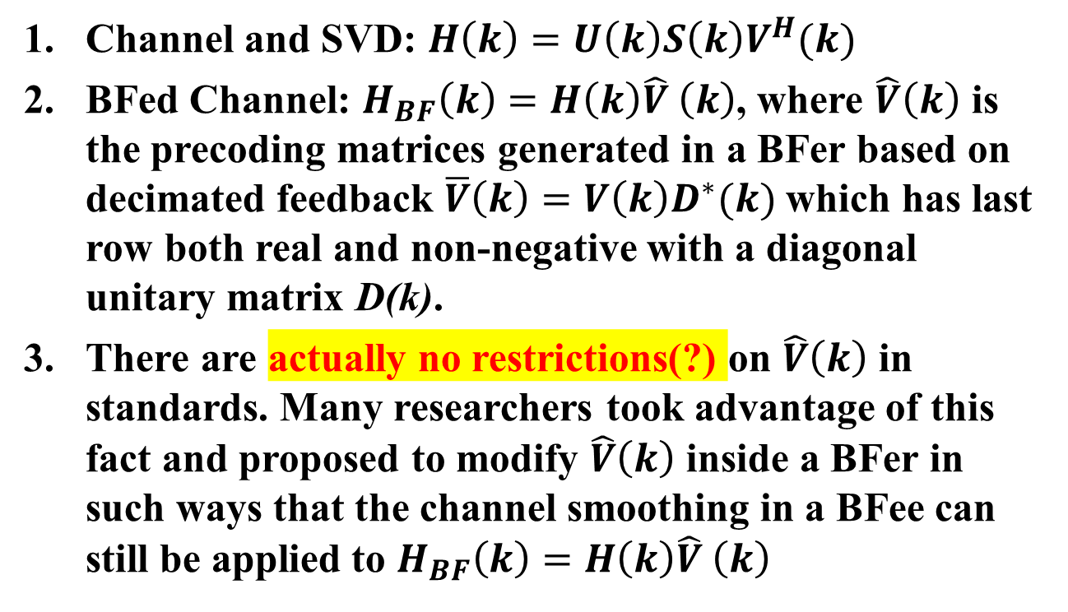
Wi-Fi BF Recap
Channel and SVD: $H\left(k\right)=U\left(k\right)S\left(k\right)V^{H}(k)$
BFed Channel: $H_{BF}\left(k\right)=H\left(k\right)\hat{V} \left(k\right)$, where $\hat{V}\left(k\right)$ is the precoding matrices generated in a BFer based on decimated feedback $\overline{V}\left(k\right)=V\left(k\right)D^{∗}(k)$ which has last row both real and non-negative with a diagonal unitary matrix D(k).
There are actually no restrictions(?) on $\hat{V}\left(k\right)$ in standards. Many researchers took advantage of this fact and proposed to modify $\hat{V}\left(k\right)$ inside a BFer in such ways that the channel smoothing in a BFee can still be applied to $H_{BF}\left(k\right)=H\left(k\right)\hat{V} \left(k\right)$

Slide 5
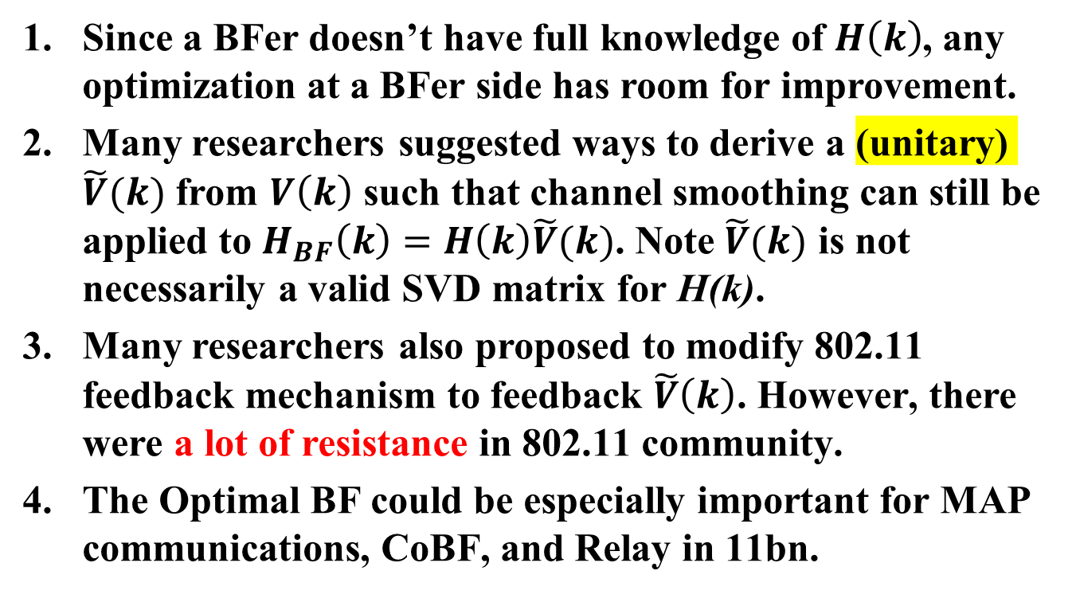
Wi-Fi Optimal BF Recap; [2-5]
Since a BFer doesn’t have full knowledge of $H\left(k\right)$, any optimization at a BFer side has room for improvement.
Many researchers suggested ways to derive a (unitary) $\tilde{V}(k)$ from $V\left(k\right)$ such that channel smoothing can still be applied to $H_{BF}\left(k\right)=H\left(k\right)\tilde{V}(k)$. Note $\tilde{V}(k)$ is not necessarily a valid SVD matrix for H(k).
Many researchers also proposed to modify 802.11 feedback mechanism to feedback $\tilde{V}\left(k\right)$. However, there were a lot of resistance in 802.11 community.
The Optimal BF could be especially important for MAP communications, CoBF, and Relay in 11bn.

Slide 6
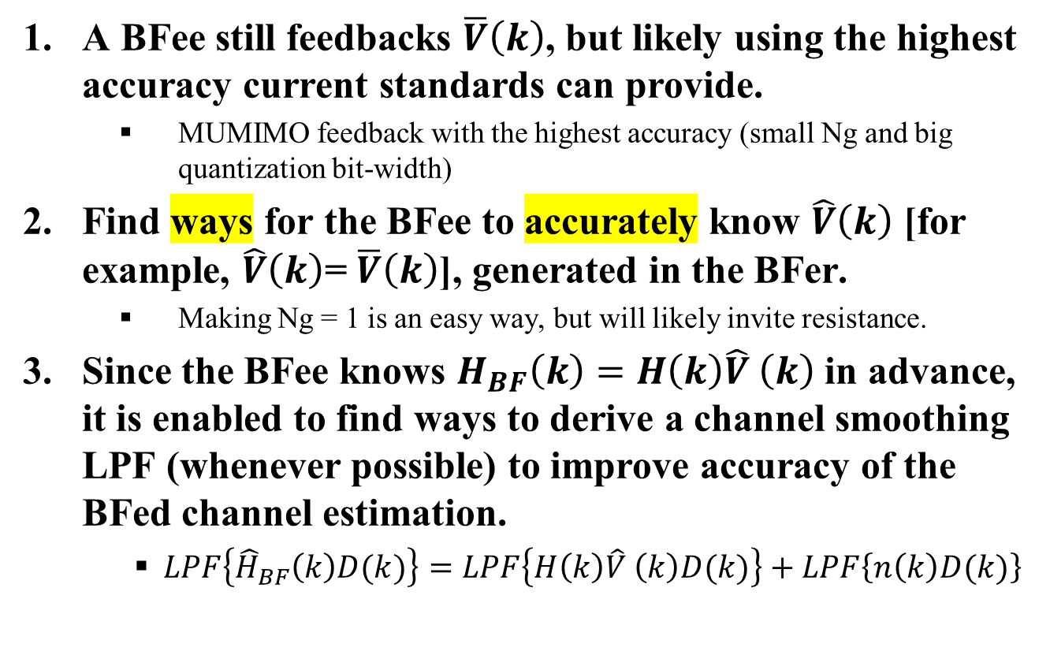
A New Proposal
A BFee still feedbacks $\overline{V}\left(k\right)$, but likely using the highest accuracy current standards can provide.
    MUMIMO feedback with the highest accuracy (small Ng and big quantization bit-width)
Find ways for the BFee to accurately know $\hat{V}\left(k\right)$ [for example, $\hat{V}\left(k\right)$= $\overline{V}\left(k\right)$], generated in the BFer.
    Making Ng = 1 is an easy way, but will likely invite resistance.
Since the BFee knows $H_{BF}\left(k\right)=H\left(k\right)\hat{V} \left(k\right)$ in advance, it is enabled to find ways to derive a channel smoothing LPF (whenever possible) to improve accuracy of the BFed channel estimation.
    $LPF\left\{{\hat{H}}_{BF}\left(k\right)D(k)\right\}=LPF\left\{H\left(k\right)\hat{V} \left(k\right)D(k)\right\}+LPF\left\{n\left(k\right)D(k)\right\}$
Minimum Distortion

Slide 7
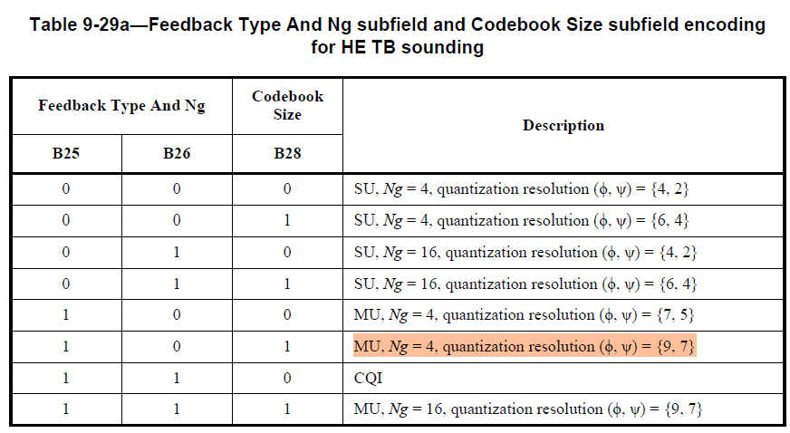
Existing MUMIMO Feedback (11be)
The highlighted option has the highest accuracy

Slide 8
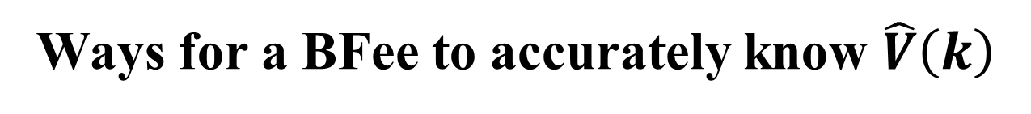
Ways for a BFee to accurately know $\hat{V}\left(k\right)$
We are open for all kinds of suggestions
In addition, this feature is likely non-mandatory
Some quick ideas
  Mutually agreed regeneration algorithm, such as a simple linear interpolation based on feedback (note: we already asked for highest possible accuracy feedback)
[8]-[9] proposed “Vendor Specific PHY Signaling”
  Can we take advantage of his feature?

Slide 9
Summary
Optimal BF (i.e., Optimal Channel Smoothing) significantly improves Tput/PER performance.
Let’s find ways to enable this feature, with minimum changes in 11bn standard.

Slide 10
References
[1] 22/1820: BF Feedback with the Optimal SVD
[2] 22/1869: TXBF based on the Optimal SVD
[3] 21/1413: Thoughts-on-High-Reliability-Communications
[4] 23/1906: Channel Information Feedback for Smooth Beamforming - Follow Up
[5] 22/1842: Channel Information Feedback for Smooth Beamforming
[6] 24/1158: Uplink MU MIMO Precoding Precoder Message Format
[7] 24/0395: MU CSI FB Type for Non-TB Sounding
[8] 24/1122: Vendor Specific PHY Options Follow Up
[9] 24/0100: Vendor Specific PHY Signaling

Slide 11
Straw Poll #1
Do you agree to include the following text to the 11bn SFD:
“11bn will extend 11be’s high accuracy MU-MIMO sounding and BF feedback mechanism to all 11bn BF modes (such as UL/DL-SU/MU; MAP; CoBF; Relay; CSR, and etc), as an optional feature”
Y/N/A

Slide 12
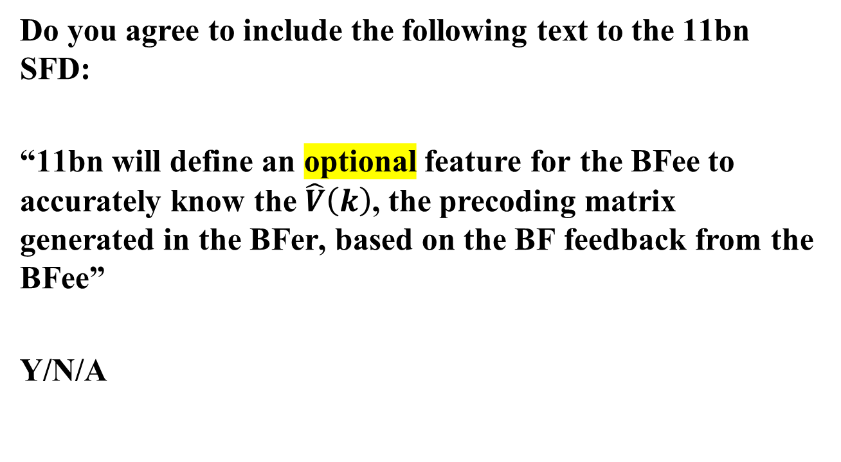
Straw Poll #2
Do you agree to include the following text to the 11bn SFD:
“11bn will define an optional feature for the BFee to accurately know the $\hat{V}\left(k\right)$, the precoding matrix generated in the BFer, based on the BF feedback from the BFee”
Y/N/A

