Slide 1
Unified CoBF/MUMIMO Schemes with Zero-MUI
Date: 2024-08-21
Authors:
Name | Affiliation | Address | Phone | Email
Aiguo Yan | Samsung | 3655 N First St, San Jose, CA 95134 |  | aiguo.yan@samsung.com
Zigui Yang
Eunsung Jeon
Srini Kandala
Ravi Gidvani

Slide 2
Introduction and Outlines
The contribution [1] “23/1998: Zero-MUI Coordinated Beamforming” discussed CoBF/MUMIMO schemes, especially with cases of more RX antennas than TX antennas.
[1] also stated the schemes needs advanced MVDR-like receivers to achieve zero-MUI.
This contribution is proposing unified CoBF/MU-MIMO schemes achieving Zero-MUI with precoding alone.
Providing the equivalence between ZF and BD (Block-Diagonalization)
Sharing Linearly Constrained Linear Optimal Receivers
Analyzing Impacts to Optimal Filtering; UEQMCS; as well as Sounding and Feedback Mechanism.
Note: A motion is already passed to have CoBF in 11bn

Slide 3

MUMIMO Precoding - (1/3)
ZF-1: Good for EQMCS
# of RX Ants ≤ # of TX Ants; $H_{EQ1}$ is from Feedbacks

Slide 4

MUMIMO Precoding (2/3)
ZF-2: Good for UEQMCS/UEQM
# of RX Ants ≤ # of TX Ants; $H_{EQ2}$ is from Feedbacks

Slide 5

MUMIMO Precoding (3/3)
BD
BFer may not know H 100%
BFee may not know $H_{BF,User_1}$ 100%
# of RX Ants ≤ # of TX Ants

Slide 6
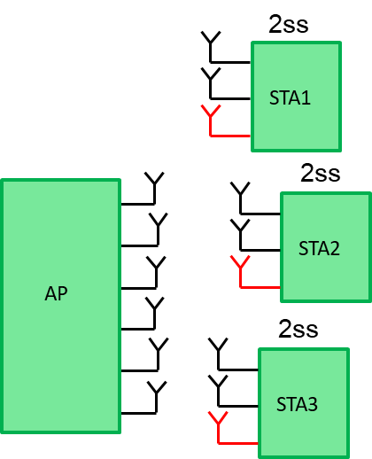
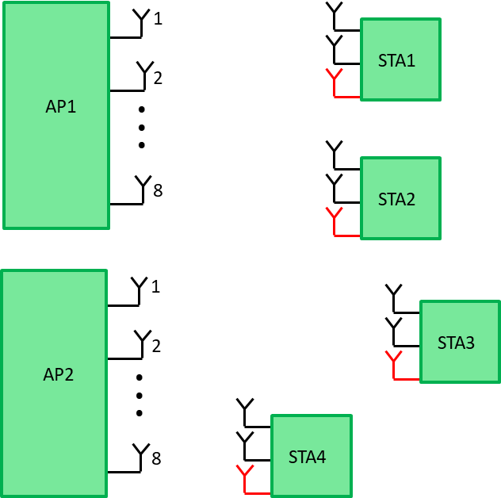
Cases of # of RX Ants > # of TX Ants
[1] and others stated that MUI can’t be completely eliminated with the traditional pre-coding scheme alone, and hence “advanced” receivers can be used to suppress MUI at the BFee side.
CoBF
MUMIMO

Slide 7
The Unified Scheme (1/2)
Each STA has 3 physical, but only 2 virtual, antennas
H₁₁
# of Virtual RX Ants
=
# of TX Ants
Similarly for MU cases
H₂₁
H₂₃
H₂₄

Slide 8
The Unified Scheme (2/2)
Zero-MUI !!!

Slide 9
Equivalence of ZF and BD
BFers have info of S and V, but not U

Slide 10
MUI-Mitigation at Receivers – Many Ways
[1] mentioned MVDR-like receivers.
LMMSE-IRC [10] is another well-known option.
We propose Linearly Constrained Linear (WMF/ZF/MMSE) Optimal Receivers
This optimization problem can be easily solved.
We can provide detailed algorithms
Notes:
WMF: Weighted Matched Filter (MF with noise whitening)

Slide 11
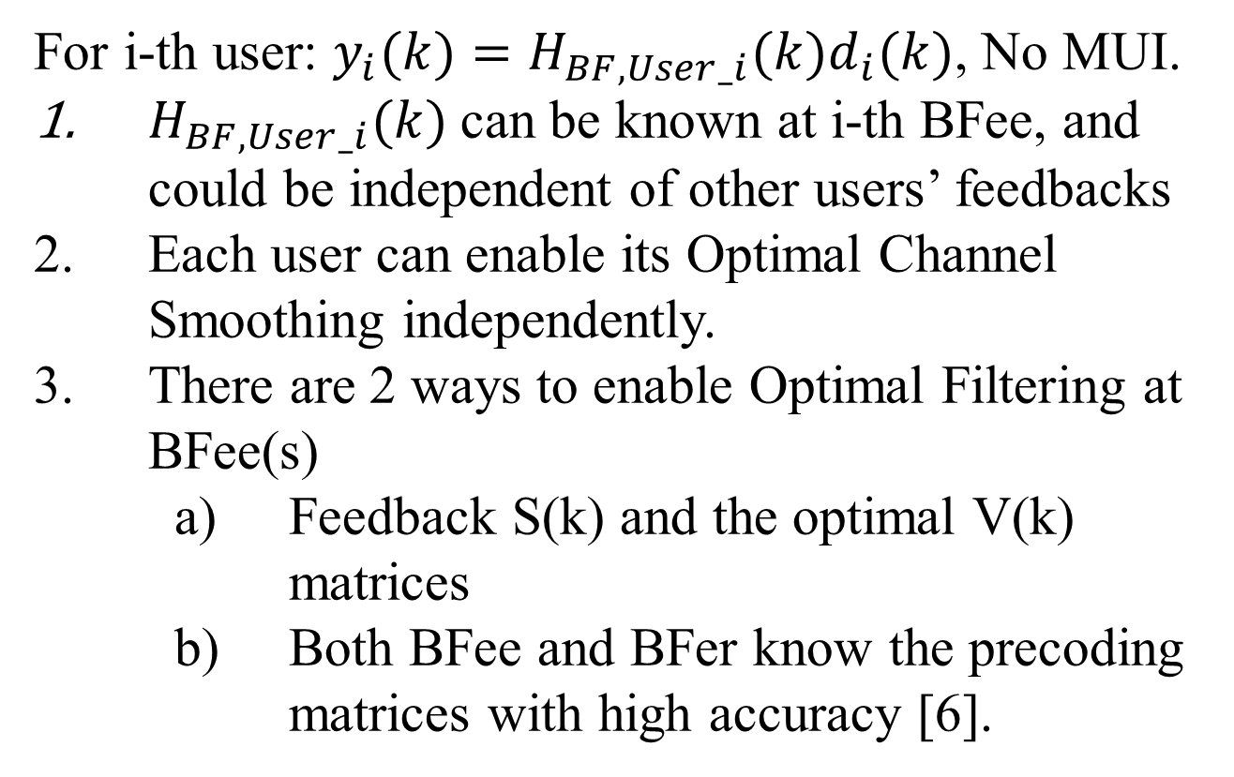
Impacts (1/3) – Optimal Channel Smoothing
For i-th user: $y_{i}(k)=H_{BF,User_i}(k)d_{i}(k)$, No MUI.
$H_{BF,User_i}(k)$can be known at i-th BFee, and could be independent of other users’ feedbacks
Each user can enable its Optimal Channel Smoothing independently.
There are 2 ways to enable Optimal Filtering at BFee(s)
    Feedback S(k) and the optimal V(k) matrices
    Both BFee and BFer know the precoding matrices with high accuracy [6].

Slide 12
Impacts (2/3) – EQMCS and UEQMCS
We have many choices for MUMIMO/CoBF pre-coding matrices
    Make all singular value =1 (traditional DL-MU-MIMO)
    Keep original singular values (likely different per user and stream)
    Have desired new singular values.
We can therefore choose to use EQ- or UEQ- MCS/MOD per stream per user.

Slide 13
Impacts (3/3) – Sounding and Feedback

Slide 14
11be Sounding Sequence Recap

Slide 15
11bn Sounding Sequence Proposal
Key point or difference from earlier generations:
BFees have to have channel estimations with ALL related BFers for calculation of feedbacks.
Exact Details are TBD.

Slide 16
Summary
Unified CoBF/MU-MIMO schemes can achieve Zero-MUI with precoding alone, with any kind of RX/TX antenna configurations
Linearly Constrained Linear Optimal Receivers are also proposed to mitigate MUI at BFee side.
Schemes can enable Optimal Channel Smoothing and UEQMCS/UEQMOD.
Proposed to enhance 11bn Sounding and Feedback Mechanism to take better advantage of the Unified CoBF/MU-MIMO schemes

Slide 17
References
[1] 23/1998: Zero-MUI Coordinated Beamforming (Huawei)
[2] 24/0011: Coordinated Spatial Nulling (C-SN) Concept (MaxLinear)
[3] 24/0012: Coordinated Spatial Nulling (C-SN) Simulations (MaxLinear)
[4] 24/1204: Coordinated Beamforming for 11bn (LGE)
[5] 23/0776: Performance of C-BF and C-SR (BRCM)
[6] 24/1431: Enhancing BF Feedback Mechanism in 11bn (Samsung)
[7] 22/1820: BF Feedback with the Optimal SVD (Zeku)
[8] 22/1869: TXBF based on the Optimal SVD (Zeku)
[9] 22/1413: Thoughts-on-High-Reliability-Communications (Zeku)
[10] Book: “Next Generation Wireless LANs 80211n and 80211ac”

Slide 18
SP #1/3
Do you agree to include the following text to the 11bn SFD:
“11bn will extend 11be’s high accuracy MU-MIMO (TB) Sounding and BF Feedback mechanism to all 11bn BF scenarios (such as UL/DL-SU; UL/DL-MU; CoBF; and etc) , as an optional feature”.
Y/N/A

Slide 19
SP #2/3
Do you agree to include the following text to the 11bn SFD:
“11bn will extend UEQM to all BF modes (such as CoBF and MUMIMO) as an optional feature”.
Y/N/A

Slide 20
SP #3/3
Do you agree to include the following text to the 11bn SFD:
“11bn will enhance the Sounding and Feedback Mechanism for CoBF, as an optional feature”
Note: Exact Details are TBD
Y/N/A

