Slide 1
Unified CoBF/MUMIMO Schemes with Zero-MUI
Date: 2024-08-21
Authors:
Name | Affiliation | Address | Phone | Email
Aiguo Yan | Samsung | 3655 N First St, San Jose, CA 95134 |  | aiguo.yan@samsung.com
Zigui Yang
Eunsung Jeon
Srini Kandala
Ravi Gidvani

Slide 2
Introduction and Outlines
The contribution [1] “23/1998: Zero-MUI Coordinated Beamforming” discussed CoBF/MUMIMO schemes, especially with cases of more RX antennas than TX antennas.
[1] also stated the schemes needs advanced MVDR-like receivers to achieve zero-MUI.
This contribution is proposing unified CoBF/MU-MIMO schemes achieving Zero-MUI with precoding alone.
Providing the equivalence between ZF and BD (Block-Diagonalization)
Sharing Linearly Constrained Linear Optimal Receivers
Analyzing Impacts to Optimal Filtering; UEQMCS; as well as Sounding and Feedback Mechanism.
Note: A motion is already passed to have CoBF in 11bn

Slide 3

MUMIMO Precoding - (1/3)
ZF-1: Good for EQMCS
# of RX Ants ≤ # of TX Ants; $H_{EQ1}$ is from Feedbacks

Slide 4

MUMIMO Precoding (2/3)
ZF-2: Good for UEQMCS/UEQM
# of RX Ants ≤ # of TX Ants; $H_{EQ2}$ is from Feedbacks

Slide 5

MUMIMO Precoding (3/3)
BD
BFer may not know H 100%
BFee may not know $H_{BF,User_1}$ 100%
# of RX Ants ≤ # of TX Ants

Slide 6
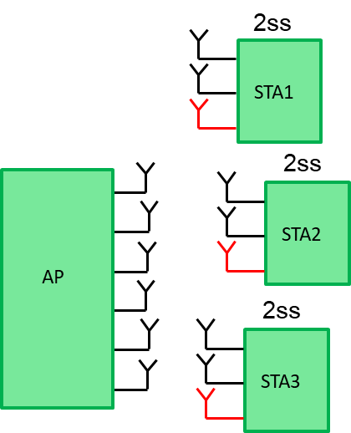
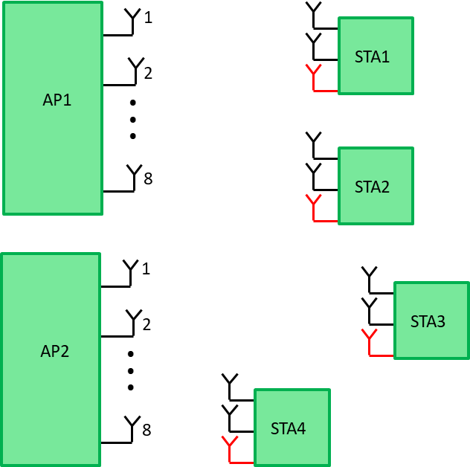
Cases of # of RX Ants > # of TX Ants
[1] and others stated that MUI can’t be completely eliminated with traditional pre-coding scheme alone, and hence “advanced” receivers have to be used to suppress MUI at the BFee side.
CoBF
MUMIMO

Slide 7
The Unified Scheme (1/2)
Each STA has 3 physical, but only 2 virtual, antennas
H₁₁
# of Virtual RX Ants
=
# of TX Ants
Similarly for MU cases
H₂₁

Slide 8
The Unified Scheme (2/2)
Zero-MUI !!!

Slide 9
Equivalence of ZF and BD

Slide 10
MUI-Mitigation at Receivers
[1] mentioned MVDR-like receivers.
LMMSE-IRC [10] is another well-known option.
We propose Linearly Constrained Linear Optimal Receivers, with WMF, ZF, or LMMSE criteria.
This optimization problem can be easily solved.
We can provide detailed algorithms

Slide 11
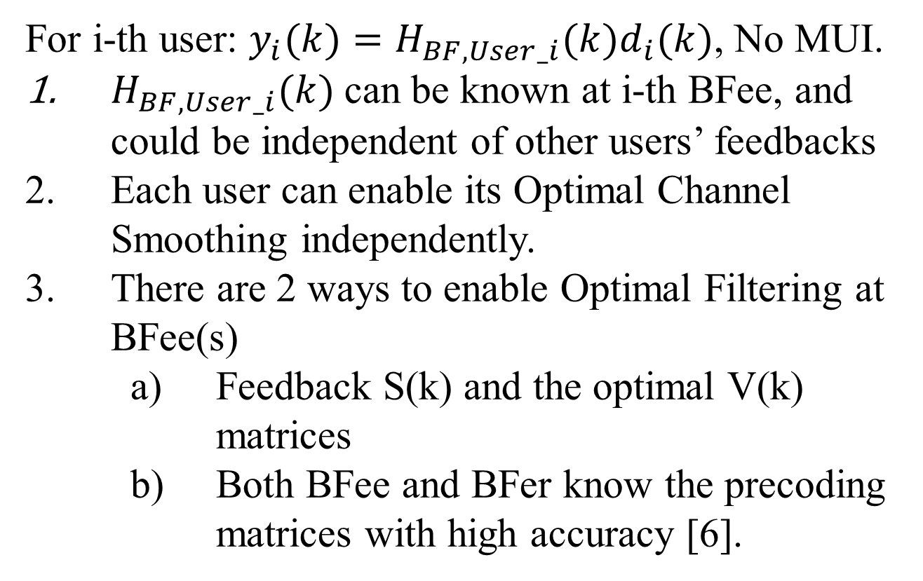
Impacts (1/3) – Optimal Channel Smoothing
For i-th user: $y_{i}(k)=H_{BF,User_i}(k)d_{i}(k)$, No MUI.
$H_{BF,User_i}(k)$can be known at i-th BFee, and could be independent of other users’ feedbacks
Each user can enable its Optimal Channel Smoothing independently.
There are 2 ways to enable Optimal Filtering at BFee(s)
    Feedback S(k) and the optimal V(k) matrices
    Both BFee and BFer know the precoding matrices with high accuracy [6].

Slide 12
Impacts (2/3) – EQMCS and UEQMCS
We have many choices for MUMIMO/CoBF pre-coding matrices
    Make all singular value =1 (traditional DL-MU-MIMO)
    Keep original singular values (likely different per user and stream)
    Have desired new singular values.
We can therefore choose to use EQ- or UEQ- MCS/MOD per stream per user.

Slide 13
Impacts (3/3) – Sounding and Feedback

Slide 14
11be Sounding Sequence Recap

Slide 15
11bn Sounding Sequence Proposal
Key point or difference from earlier generations:
BFees have to have channel estimations with ALL related BFers for calculation of feedbacks.
Exact Details are TBD.

Slide 16
Summary
Unified CoBF/MU-MIMO schemes can achieve Zero-MUI with precoding alone, with any kind of RX/TX antenna configurations
Linearly Constrained Linear Optimal Receivers are also proposed to mitigate MUI at BFee side.
Schemes can enable Optimal Channel Smoothing and UEQMCS/UEQMOD.
Proposed to enhance 11bn Sounding and Feedback Mechanism to take better advantage of the Unified CoBF/MU-MIMO schemes

Slide 17
References
[1] 23/1998: Zero-MUI Coordinated Beamforming (Huawei)
[2] 24/0011: Coordinated Spatial Nulling (C-SN) Concept (MaxLinear)
[3] 24/0012: Coordinated Spatial Nulling (C-SN) Simulations (MaxLinear)
[4] 24/1204: Coordinated Beamforming for 11bn (LGE)
[5] 23/0776: Performance of C-BF and C-SR (BRCM)
[6] 24/1431: Enhancing BF Feedback Mechanism in 11bn (Samsung)
[7] 22/1820: BF Feedback with the Optimal SVD (Zeku)
[8] 22/1869: TXBF based on the Optimal SVD (Zeku)
[9] 22/1413: Thoughts-on-High-Reliability-Communications (Zeku)
[10] Book: “Next Generation Wireless LANs 80211n and 80211ac”

Slide 18
SP #1/3
Do you agree to include the following text to the 11bn SFD:
“11bn will extend 11be’s high accuracy MU-MIMO (TB) Sounding and BF Feedback mechanism to all 11bn BF scenarios (such as UL/DL-SU; UL/DL-MU; CoBF; and etc) , as an optional feature”.
Y/N/A

Slide 19
SP #2/3
Do you agree to include the following text to the 11bn SFD:
“11bn will extend UEQM to all BF modes (such as CoBF and MUMIMO) as an optional feature”.
Y/N/A

Slide 20
SP #3/3
Do you agree to include the following text to the 11bn SFD:
“11bn will enhance the Sounding and Feedback Mechanism for CoBF, as an optional feature”
Note: Exact Details are TBD
Y/N/A

