Slide 1
A Unified Signaling Scheme for EQM/UEQM
Date: 2024-08-21
Authors:
Name | Affiliation | Address | Phone | Email
Aiguo Yan | Samsung | 3655 N First St, San Jose, CA 95134 |  | aiguo.yan@samsung.com
Zigui Yang
Srini Kandala
Ravi Gidvani
Eunsung Jeon

Slide 2
Introduction
The UEQMOD will be a key feature in 11bn to enhance BF ThroughPut.
A Motion on UEQMOD was already passed in July/2024 meeting.
There is a wide consensus on major combinations of UEQMOD. [4]-]7]
Many contributions proposed signaling details for UEQMOD (UEQM for short). [1],[3]
This contribution is proposing a unified signaling mechanism for both EQM and UEQM.

Slide 3
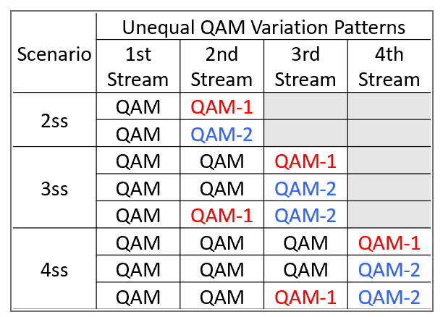
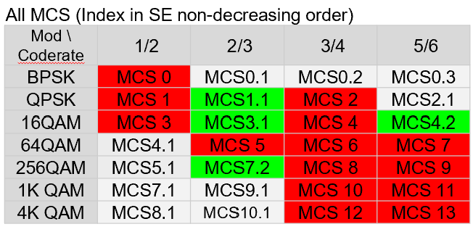
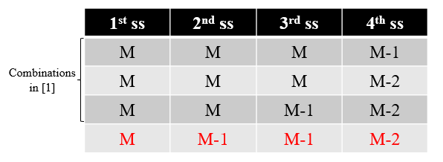
Proposed UEQM Combinations Recap
Following 2 tables are cut and pasted from [5]. Similar info can also be found in [1]-[7], and many other contributions.
[2] also proposed to add one more combination for 4SS case.
No “BaseMCS-2” twice

Slide 4
4 Options for a Unified Indicator
 | Combine? | Combine? | Combine? | Combine?
 | EQM/UEQM | Patterns | Nss | BaseMCS
Option 0 | N | N | N | N
Option 1a | Y | Y | N | N
Option 1b | Y | Y | N | N
Option 3 | Y | Y | Y | N
Option 4 | Y | Y | Y | Y
Reason for no details on Option 4 in this submission
No consensus yet on total # of bits for the BaseMCS
Details can be worked easily once having consensus.
Don’t want to make the table too complex. Any of Option 1a/1b/3 could be a good compromise.

Slide 5
A Unified Indicator – Option 1a (1/2)
We use an example to explain the key ideas
4SS (all): QAM; QAM; QAM-1; QAM-2.
3SS (top 3): QAM; QAM; QAM-1.
2SS (top 2): QAM; QAM.
Objective:
Enable more combinations with same # of bits
UEQM Pattern
0
0
1
2

Slide 6
A Unified Indicator - Option 1a (2/2)
2SS
3SS
4SS
Samsung Proposal
(3 bits)
0 0
0 0 0
0 0 0 0
EQMCS
0 0 0 1
ID-0
Existing
Proposals
0 0 0 2
Note:
No EQMCS for 4 SS
Without counting EQMCS
1: 2SS case has 2 choices
2: 3SS case has 4 choices
3: 4SS case has 5 choices
Total # of combinations: 13 (with 2 EQ-MCS)
ID-1
0 0 1
0 0 1 1
Pick
ID-2
0 0 1 2
ID-3
0 0 2
Either
ID-4
0 1
0 1 1
0 1 1 1
No Pick
ID-X
0 1 1 2
ID-5
0 1 2
ID-6
Enable [2]’s preference
0 2
ID-7

Slide 7
Option 1b
2 SS
3 SS
4 SS
Indicator ID | Pattern
0 | 00
1 | 01
2 | 02
3 | RSVD
4 | RSVD
5 | RSVD
6 | RSVD
7 | RSVD
Indicator ID | Pattern
0 | 000
1 | 001
2 | 002
3 | 011
4 | 012
5 | RSVD
6 | RSVD
7 | RSVD
Indicator ID | Pattern
0 | 0000
1 | 0001
2 | 0002
3 | 0011
4 | 0012
5 | 0111
6 | 0112
7 | RSVD

Slide 8
Option 3 (Combine Nss)
(all combinations without double-2 Patterns)
2 SS
3 SS
4 SS
Indicator ID | Pattern
0 | 00
1 | 01
2 | 02
Indicator ID | Pattern
3 | 000
4 | 001
5 | 002
6 | 011
7 | 012
Indicator ID | Pattern
8 | 0000
9 | 0001
10 | 0002
11 | 0011
12 | 0012
13 | 0111
14 | 0112
15 | RSVD
Not in option 1a
Not in option 1a
UEQM Covered by
Option 1a Already
[2]’s Preference

Slide 9
Summary
UEQM is one of key features for 11bn.
3 options of a unified signaling scheme for EQM/UEQM are presented

Slide 10
References
[1] 24/1411: Signaling for UHR PPDU (Huawei/Ross Yu)
[2] 24/1409: Unequal Pattern Discussion Follow up (Huawei/Ross Yu)
[3] 24/1427: Signaling for MCS and UEQM in 11bn (LGE/Dongguk Lim)
[4] 24/0474: UHR Unequal Modulation Pattern and New MCS (NXP/Rui Cao)
[5] 24/0498: Unequal Modulation in MIMO TXBF and New MCS for 11bn (QCOM/Alice Chen )
[6] 24/0734: On UEQM and UEQ-MCS (BRCM/Ron Porat)
[7] 24/0507: UEQM Further Details (BRCM/Ron Porat)

Slide 11
SP #1
Do you agree to include the following into the 11bn SFD?
  11bn will use an unified scheme to indicate different (EQM and UEQM) combinations (exact detail to be further harmonized)
  Note: Option 1a and 1b
  Y; N; A

Slide 12
SP #2
Do you agree to include the following into the 11bn SFD?
  11bn will use an unified scheme to indicate different (EQM, UEQM, and Nss) combinations (exact detail to be further harmonized)
  Note: Option 3
  Y; N; A

