Slide 1
A Unified Signaling Scheme for EQM/UEQM
Date: 2024-08-21
Authors:
Name | Affiliation | Address | Phone | Email
Aiguo Yan | Samsung | 3655 N First St, San Jose, CA 95134 |  | aiguo.yan@samsung.com
Zigui Yang
Srini Kandala
Ravi Gidvani
Eunsung Jeon

Slide 2
Introduction
The UEQMOD will be a key feature in 11bn to enhance BF ThroughPut.
A Motion on UEQMOD was already passed in July/2024 meeting.
There is a wide consensus on major combinations of UEQMOD. [4]-]7]
Many contributions proposed signaling details for UEQMOD (UEQM for short). [1],[3]
This contribution is proposing a unified signaling mechanism for both EQM and UEQM.

Slide 3
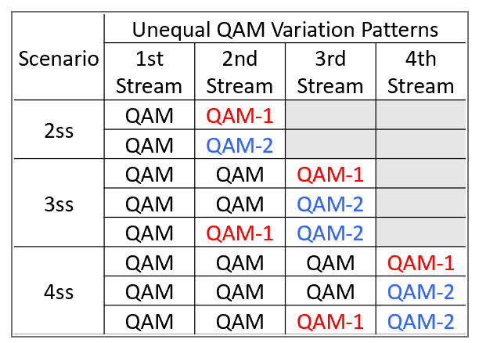
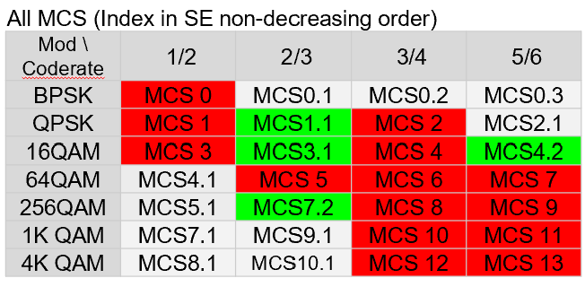
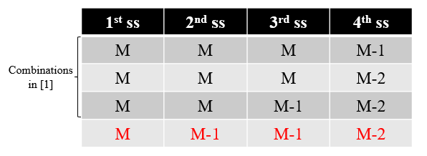
Proposed UEQM Combinations Recap
Following 2 tables are cut and pasted from [5]. Similar info can also be partially found in [1]-[7], and many other contributions.
[2] also proposed to add one more combination for 4SS case.

Slide 4
4 Options for a Unified Indicator
 | Combine? | Combine? | Combine? | Combine?
 | EQM/UEQM | Patterns | Nss | BaseMCs
Option 0 | N | N | N | N
Option 1 | Y | Y | N | N
Option 2 | Y | Y | N | N
Option 3 | Y | Y | Y | N
Option 4 | Y | Y | Y | Y
Reason for no details on Option 4
No consensus yet on total # of bits for the BaseMCS
Details can be worked easily once having consensus.
Don’t want to make the table too complex. Any of Option 1/2/3 could be a good compromise.

Slide 5
A Unified Indicator - Option1 (1/2)
We use an example to explain the key ideas
4SS: QAM; QAM; QAM-1; QAM-2.
3SS: QAM; QAM; QAM-1.
2SS: QAM; QAM.
Objective:
Enable more combinations with same # of bits
0
0
1
2

Slide 6
A Unified Indicator - Option 1 (2/2)
2SS
3SS
4SS
Samsung Proposal
(3 bits)
0 0
0 0 0
0 0 0 0
EQMCS
0 0 0 1
ID-0
Existing
Proposals
0 0 0 2
Note:
No EQMCS for 4 SS
Without counting EQMCS
1: 2SS case has 2 choices
2: 3SS case has 4 choices
3: 4SS case has 5 choices
No indication of EQM/UEQM is needed
Total # of combinations: 13
ID-1
0 0 1
0 0 1 1
Pick
ID-2
0 0 1 2
ID-3
0 0 2
Either
ID-4
0 1
0 1 1
0 1 1 1
No Pick
ID-X
0 1 1 2
ID-5
0 1 2
ID-6
Enable Huawei’s preference
0 2
ID-7

Slide 7
Option 2 (Keep Nss)
2 SS
3 SS
4 SS
Indicator ID | Pattern
0 | 00
1 | 01
2 | 02
3 | RSVD
4 | RSVD
5 | RSVD
6 | RSVD
7 | RSVD
Indicator ID | Pattern
0 | 000
1 | 001
2 | 002
3 | 011
4 | 012
5 | RSVD
6 | RSVD
7 | RSVD
Indicator ID | Pattern
0 | 0000
1 | 0001
2 | 0002
3 | 0011
4 | 0012
5 | 0111
6 | 0112
7 | RSVD

Slide 8
Option 3 (Combine Nss)
(no double 2 Patterns)
2 SS
3 SS
4 SS
Indicator ID | Pattern
0 | 00
1 | 01
2 | 02
Indicator ID | Pattern
3 | 000
4 | 001
5 | 002
6 | 011
7 | 012
Indicator ID | Pattern
8 | 0000
9 | 0001
10 | 0002
11 | 0011
12 | 0012
13 | 0111
14 | 0112
15 | RSVD
UEQM Covered by
Option 1 Already
Huawei’s Preference

Slide 9
Summary
UEQM is one of key features for 11bn.
3 options of a unified signaling scheme for UEQM are presented

Slide 10
References
[1] 24/1411: Signaling for UHR PPDU (Huawei/Ross Yu)
[2] 24/1409: Unequal Pattern Discussion Follow up (Huawei/Ross Yu)
[3] 24/xxxx: Signaling for MCS and UEQM in 11bn (LGE/Dongguk Lim)
[4] 24/0474: UHR Unequal Modulation Pattern and New MCS (NXP/Rui Cao)
[5] 24/0498: Unequal Modulation in MIMO TXBF and New MCS for 11bn (QCOM/Alice Chen )
[6] 24/0734: On UEQM and UEQ-MCS (BRCM/Ron Porat)
[7] 24/0507: UEQM Further Details (BRCM/Ron Porat )

Slide 11
SP #1
Do you agree to include the following into the 11bn SFD?
  11bn will use an unified scheme to indicate different EQM and UEQM combinations (exact detailed to be further harmonized)
  Note: Option 1 and option 2
  Y
  N
  A

Slide 12
SP #2
Do you agree to include the following into the 11bn SFD?
  11bn will use an unified scheme to indicate different Nss, EQM, and UEQM combinations (exact detailed to be further harmonized)
  Note: Option 3
  Y
  N
  A

