Slide 1
Considerations for Context Transfer in 11bn
Date: 2024-08-06
Authors:

Slide 2
Abstract
Context transfer is one of the key roaming enhancements under consideration in 11bn.
However, target AP can reject some of the contexts that the STA has setup with the current AP. This can result in some performance issues for the STA.
It is important for the STA to understand prior to roam which APs are likely to accept its important contexts so it can chose a target AP accordingly.
In this contribution,
  We propose a pre-roam context transfer feasibility check procedure to enable the STA’s AP selection.
  We discuss the high level call flow and show examples to explain the benefits to the STA side.

Slide 3
Context Transfer
Context transfer has been considered as one of the enhancements for enabling seamless roaming in 11bn.
So far, a high level division has been considered as follows:
  Near static contexts: which do not change on a short time scale.
  Dynamic contexts: which can keep changing on a short time scale.
To enable a seamless roaming experience, it is necessary that as many contexts as possible can be transferred to the target AP prior to roam so that the STA does not need to set them up post roaming.
Example features that can benefit from context transfer
Context | Type
Seq Number (SN) | Dynamic
Packet Number (PN) | Dynamic
BA setup | Near Static
SCS/MSCS | Near Static
EPCS | Near Static
TWT and variants (rTWT, etc.) | Near Static
P2P TWT/CoEx session | Near Static

Slide 4
High Level Problem Statement
Some context setup procedures can be request/response or negotiation based. E.g., SCS, TWT and variants, etc.
These features can be critical for maintaining application performance.
When a STA roams, the target AP may reject some of these setups in their present form with the current AP.
This may either require:
  The STA to renegotiate with the target AP upon roam: which may deprive the application of the necessary support until a renegotiation is not completed.
  Search for a new AP: which may not be desired as the STA may already be at roam point.
  Stay with the current AP: which may not be desired if roam point was triggered due to link degradation with current AP.

Slide 5
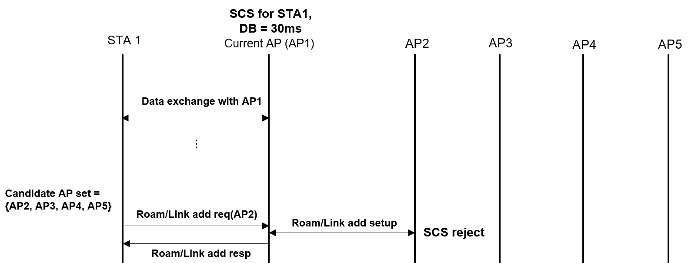
Example
STA is running a low latency application which needs a 30ms delay bound. STA has setup an SCS with the current AP and current AP has agreed to support a delay bound of 30ms.
STA triggers a roam and provides roam notification to the current AP.
However, SCS transfer fails as the target AP rejects it.
STA’s possible options:
  Negotiate a new SCS with the target AP: operating with a higher delay bound.
  Searching for a new target AP and attempting a transfer with that AP: this could go on forever.
Both the options can result in a period of time where the application does not have SCS support and may have a degraded performance.
A procedure that can enable the STA to understand which contexts can be accepted by which candidate AP can help the STA to make informed decisions and not suffer a performance degradation.

Slide 6
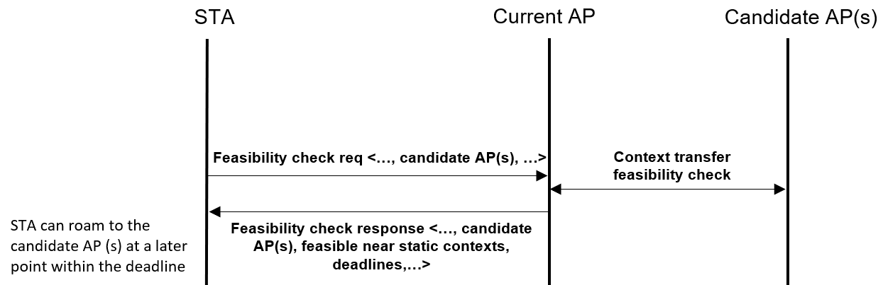
Pre-roam Context Transfer Feasibility Check
STA can perform a context transfer feasibility check prior to roam
  Either check for all the features at once
  Or STA can specify which ones it wants to run the feasibility check on.
STA can determine its candidate AP set based on the outcome
STA can chose a target AP out of this candidate set during roam

Slide 7
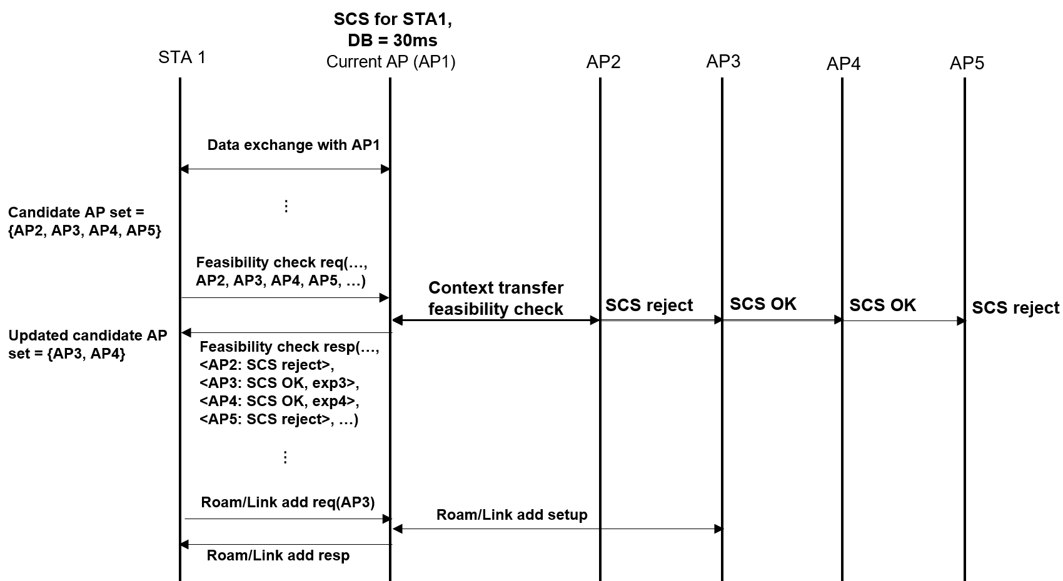
Example

Slide 8
Conclusion
A pre-roam context transfer feasibility check procedure is proposed.
Such a procedure can enable the STA to understand which AP can take its contexts prior to roaming.
The information obtained by the STA from the procedure can enable the STA to make an informed decision on AP selection.

