Slide 1
Unequal Pattern Discussion Follow up
Date: 2024-08-12
Authors:

Slide 2
Introduction
In [1-6], there exists detailed discussions on UEQM gains and UEQM pattern selection.
In this contribution, we show our further findings on UEQM pattern selections.

Slide 3
Criteria for Modulation Combinations
Number of modulation combinations cannot be too large as we want to limit the complexity (signaling, link/rate-adaptation choices)
  Due to Tx EVM/backoff constraints we also limit the maximum gap between modulation orders
On the other hand, we want to select proper combinations such that performance is not degraded
So what are the criteria for potential modulation combinations?
  Performance – e.g. gap to ‘all combinations’ option
  Balance – limit gap between highest and lowest modulation
  Suitable for practical link adaptation
    Monotonic
    Increase/decrease within a single stream
    Increase/decrease in a single modulation step

Slide 4
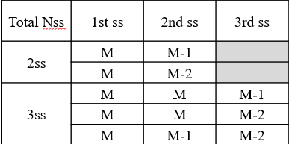
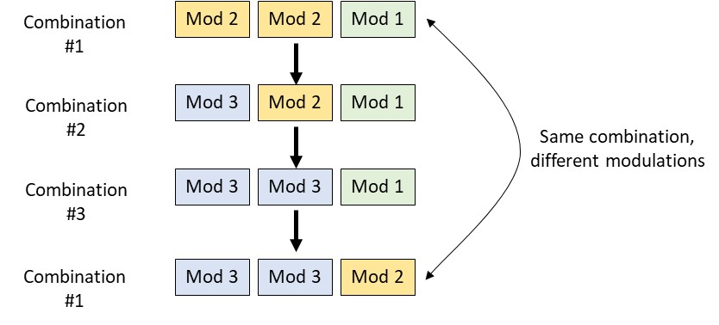
Criteria for Modulation Combinations – 2 & 3 streams
Considering the suggested combinations in [1]:
The performance of these combinations is near the ‘all combination’ case, they are balanced (maximum modulation gap is 2) and aligned with all requirements for practical link/rate adaptation showed in previous slide
Taking the 3-stream case as an
example, increasing a single
stream by 1 modulation order
in each step requires 3 steps
to reach the same combination
(with a higher modulation)

Slide 5
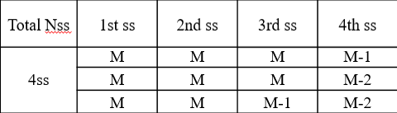
Criteria for Modulation Combinations – 4 streams
However, the suggested combinations for 4 streams in [1] do not meet the requirements defined earlier
As shown before, the performance of these combinations is ~1.5dB from the ‘all combination’ case [6]
Furthermore, from a rate/link-adaptation point-of-view, the difference between steps is not always limited to a single stream
  Would be beneficial to support combinations that are suitable for practical rate/link-adaptation as well as reduce the gap from the ‘all combinations’ curve

Slide 6
Alternative 4-Stream Modulation Combinations
Let us consider the following, alternative set of modulation combinations:
This set of combinations is fully aligned with the requirements for supporting a practical rate/link-adaptation mechanism
In the next slides, we show its impact on the performance and compare with the suggested combinations in [1]
1st ss | 2nd ss | 3rd ss | 4th ss
M | M | M | M-1
M | M | M | M-2
M | M | M-1 | M-2
M | M-1 | M-1 | M-2
Combinations
in [1]

Slide 7
Alternative 4-Stream Modulation Combinations
The following figures depict the 4x4 B-LOS case (figure on the right shows zooming in on high SNR)
The alternative combinations yield more than 0.5dB improvement

Slide 8
Alternative 4-Stream Modulation Combinations
The following figures depict the 4x4 D-NLOS case (figure on the right shows zooming in on high SNR)
Similar to the B-LOS case, the alternative combinations yield more than 0.5dB improvement

Slide 9
Summary
In the 4-stream case, the suggested modulation combinations in [1] yield not only a performance degradation compared to the ‘all combinations’ case, but are also not fully suitable for practical rate/link-adaptation
We suggested here a solution – using 4 different combinations – that addresses both issues
Other alternatives, using fewer (e.g. 3) combinations but with superior performance, are also possible

Slide 10
Straw Poll 1
Do you agree to include the following into the 11bn SFD?
  For 4 SS, the UEQM pattern variations include:
  Y
  N
  A
1st ss | 2nd ss | 3rd ss | 4th ss
M | M | M | M-1
M | M | M | M-2
M | M | M-1 | M-2
M | M-1 | M-1 | M-2

Slide 11
Reference
11-24-0474-02-00bn-uhr-unequal-modulation-pattern-and-new-mcs, Rui Cao (NXP)
11-24-0498-01-00bn-unequal-modulation-in-mimo-txbf-and-new-mcs-for-11bn, Alice Chen (Qualcomm)
11-24-0176-01-00bn-unequal-modulation-over-spatial-streams, Hao Song (Intel Corporation)
11-24-0734-01-00bn-on-ueqm-and-ueq-mcs, Ron Porat (Broadcom)
11-24-0507-02-00bn-ueqm-further-details, Ron Porat (Broadcom)
11-24-0890-01-00bn-unequal-pattern-discussion, Ross Jian Yu (Huawei)

