Slide 1
August 2024
Some thoughts on NPCA Operation
Date: 2024-08-13
Authors:
Name | Affiliations | Address | Phone | email
Si-Chan Noh | Newracom |  |  | sc.noh@newracom.com
Joonsoo Lee |  |  |  | js.lee@newracom.com

Slide 2
Introduction
Non-Primary Channel Access(NPCA) STAs may switch to the NPCA primary channel when an OBSS traffic is detected on the BSS primary channel
The OBSS traffic that allow the NPCA STAs to switch to the NPCA primary channel are discussed in some contributions [1-2]
In this presentation, we share our thoughts on switching conditions according to the NPCA STA’s network topology when allowing NPCA STAs to perform NPCA operation based on OBSS PPDU

Slide 3
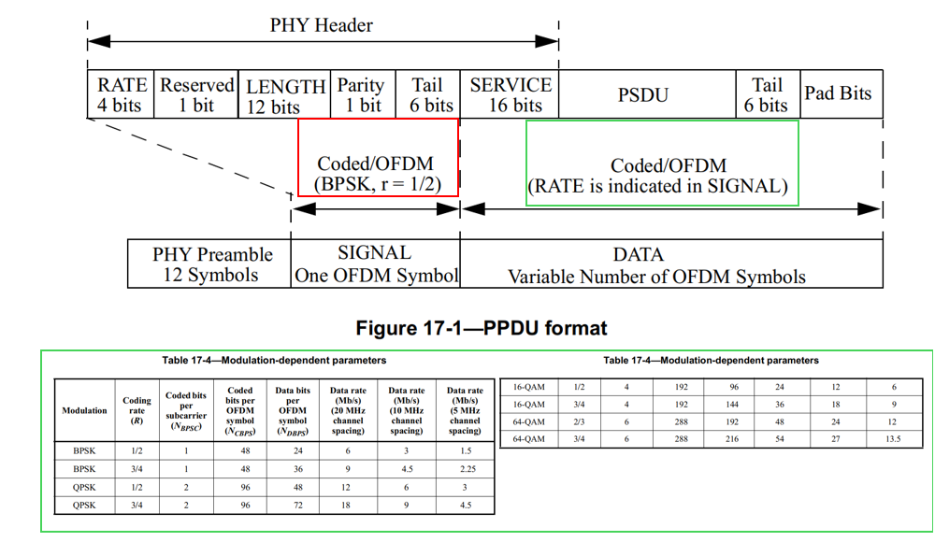
Recap : Legacy PPDU encoding
For example, in non-HT PPDU format,
the SIGNAL field shall be encoded with
BPSK modulation [4]
  The encoding of the SIGNAL single
  OFDM symbol shall be performed with
  BPSK modulation of the subcarriers and using
  convolution coding at R = ½
Moreover, the OFDM subcarriers
shall be modulated by using
(BPSK, QPSK, 16/64-QAM),
depending on the RATE requested [4]

Slide 4
Coverage imbalance in NPCA
The NPCA STAs may switch to the NPCA primary channel based on the detected OBSS PPDU and each STAs may detect the OBSS PPDU in a distributed manner
This means that coverage imbalance between the preamble and data payload of the OBSS PPDU can occur when the NPCA STAs overhear the OBSS PPDU, depending on their location within the network topology
  This can happen when each part(i.e., preamble/data payload) of the OBSS PPDU is modulated with a different order
  For example, the preamble part is modulated with BPSK, and data payload is modulated with a higher order than the preamble part
Coverage imbalance of signal can bring meaningless channel switching to the NPCA STAs
The next slide shows an example

Slide 5
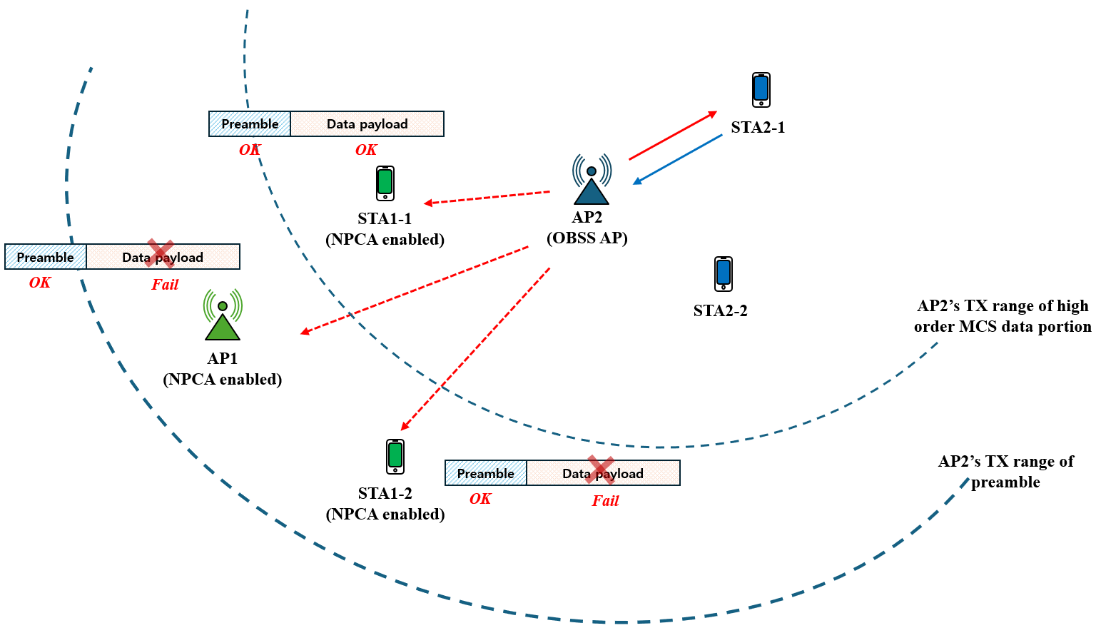
Coverage imbalance in NPCA
Network configuration :
  MyBSS: AP1, STA1-1, STA1-2
  OBSS: AP2, STA2-1, STA2-2
Scenario :
  AP2 transmits a pre-HE legacy PPDU(e.g., HT) to STA2-1
  with different modulate order between the preamble
  and the data payload
  MyBSS STAs share predefined OBSS listings(i.e., AP2) to perform reliable NPCA operation
Description :
  STAs of MyBSS may perform NPCA after overhearing the OBSS PPDU
  AP1/STA1-2 : Only decodable preamble part
  STA1-1 : Decodable both preamble and data payload

Slide 6
Coverage imbalance in NPCA
Problem statement :
  Although the preamble part has LENGTH field in the L-SIG,
  it does not include the necessary information(i.e., TXOP information, identification of OBSS PPDU) to perform NPCA
  Decoding the MAC header in the data payload may be a way
  to get the necessary information; however, AP1 may not get
  that information due to the coverage imbalance problem
    Therefore, it cannot perform NPCA operation
    after receiving the MAC header due to it cannot decode MAC header itself
  From the perspective of STA1-1, it can perform NPCA after decoding MAC header; however, it may not identify AP1’s circumstances
    Therefore, if STA1-1 switch to the NPCA primary channel,
    it can lead to ineffective channel switching

Slide 7
Switching conditions for NPCA
In the previous slide, the NPCA STA’s decodable part(i.e., preamble and/or data payload)
can be determined according to network topology
  Some NPCA STAs can both decode preamble and data part of OBSS PPDU
  However, some other NPCA STAs may only decode preamble part of OBSS PPDU
It means that the NPCA STAs can make switching decisions based on the OBSS PPDU whose decodable part may vary depending on network topology
To avoid ineffective channel switching caused by unaligned switching decisions, we consider some switching conditions

Slide 8
Switching conditions for NPCA
Opt1)
  In case of when the preamble part of OBSS PPDU can include the necessary information required for NPCA operation
  The NPCA STAs within the same BSS can decode the preamble part of OBSS PPDU in common
  This involves allowing NPCA based on (HE/EHT/UHR) PPDUs format
Opt2)
  In case of when the preamble part of OBSS PPDU may not include the necessary information required for NPCA operation
  The necessary information can be included in MAC header
  However, due to the coverage imbalance issues, we cannot ensure that all NPCA STAs can equally acquire the necessary information in MAC header for NPCA operation
  Performing NPCA operations based on control frames (e.g., ICF/ICR) with reliable modulation that contain the necessary information to carry out NPCA operation could be one of the candidate conditions

Slide 9
Summary
In this presentation, we share some thoughts on NPCA operation by considering coverage imbalance between preamble and data payload based on OBSS PPDU

Slide 10
Reference
[1] 24/0495r0, Non-Primary Channel Access (NPCA) - Follow up
[2] 24/0803r0, The Switching Time In NPCA
[3] IEEE802.11 REVme D7.0

Slide 11
SP1
Do you support the following in the NPCA operation?
In 802.11bn, the NPCA STAs switching to the NPCA primary channel can be
  ICF/ICR (e.g., (MU)-RTS/CTS) from OBSS or
  HE/EHT/UHR PPDU from OBSS

