Slide 1
Thoughts on interface between AP MLDs for seamless roaming
Date: 2024-10-8
Authors:
Name | Affiliations | Address | email
Haorui Yang | China Mobile | Hangzhou, Zhejiang, China | yanghaorui0217@163.com
Hangbin Zhao | China Mobile | Hangzhou, Zhejiang, China

Slide 2
Introduction
In [1], it has been agreed that
the non-AP MLD context is transferred from the source AP MLD to the target AP MLD;
the buffered DL data can be forwarded from the source AP MLD to the target AP MLD.
Therefore, the interface protocol between AP MLDs is the base of the seamless roaming procedure.
There is the submission that proposes the below options for the interface between AP MLDs:
over the air; or
over the DS.
This submission provides some thoughts on these 2 types of interface in the infrastructure network.

Slide 3
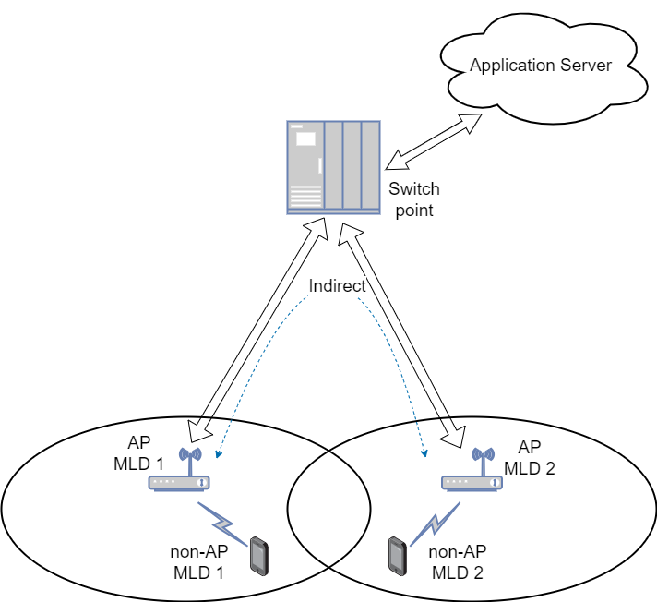
Over the DS
The over-the-DS interface requests that there is a physical line connecting via the DS between the AP MLDs
Indirect line over the network
Most feasible deployment option;
Impossible transmission if the AP MLDs connect to the different operator networks.
This cannot assume that both AP MLDs connect
to the same ESS/operator network.

Slide 4
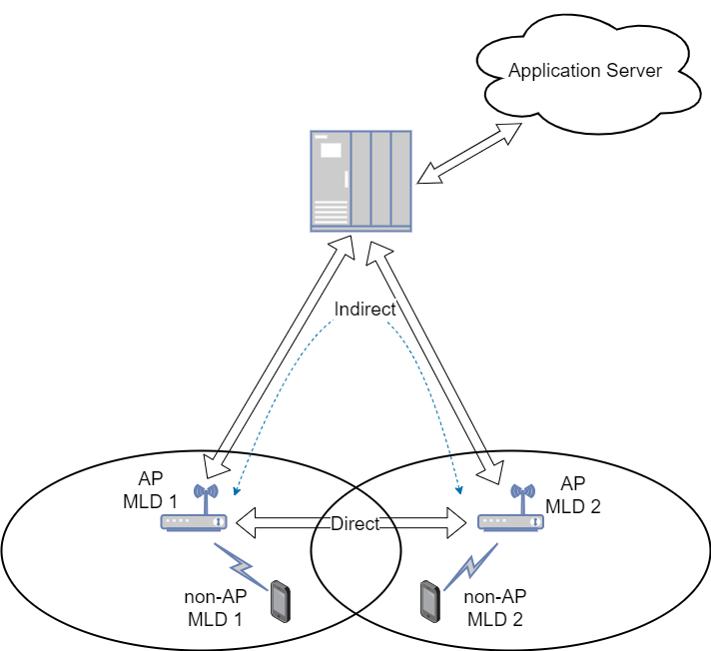
Over the DS
Connecting to the different operator network results in the failed seamless roaming and bad performance.
There may be the idea that the existing mobility domain concept can be reused to guarantee the AP MLDs belong to the same network, however, it has the below issues:
Out of control of the operator since it is not specified that who controls.
Operator, AP vendor, user are all possible.
Limiting the performance of seamless roaming
Mobility domain is a part of ESS which covers a limited area.
This makes that the seamless roaming is not an attractive and advanced feature.

Slide 5
Over the DS
Proposal:
The seamless roaming is applied to the AP MLDs connecting to the same operator infrastructure network.
The solution to guarantee this is TBD.

Slide 6
Over the air
The over-the-air interface requests that one AP MLD is inside the service area of another AP MLD, which cannot be always guaranteed.
The scenario depends on how to deploy the AP MLDs.
Over-the-air interface can be independent from the operator network.
Considering the radio capability of AP MLD, it is possible that the AP MLD cannot communicate with each other at the same time with their STAs.
NOTE: There can be direct physical line between AP MLDs, but these AP MLDs may connect to the same or different operator networks and the deployment is uncertain and does not depend on the operator.

Slide 7
Over the air
Proposal:
The over-the-DS interface should be the default option.
The over-the-air interface between AP MLDs should use the dedicated channel to communicate with each other and the transmit power should be controlled to avoid interference.

Slide 8
Further thinking
It is better to utilize the current infrastructure network as much as possible.
The protocol between AP MLDs should be specified in 802.11 to make the deployment more feasible.
The protocol can be designed as the payload of data frame in order to minimize the impact to the network behind AP MLD.
The network behind AP MLD is out of scope of 802.11, so more dependent less possibility of deployment.

Slide 9
Summary
This submission provides some thoughts on the 2 options for the interface between AP MLDs: over the DS or over the air.
Proposal:
The seamless roaming is applied to the AP MLDs under the same operator infrastructure network.
The over-the-DS interface between AP MLDs is the default option, considering the over-the-air interface may be impossible.
The over-the-air interface between AP MLDs should use the dedicated channel to communicate with each other and the transmit power should be controlled to avoid interference.

Slide 10
References
[1]: 24/0209r4, Specification Framework for TGbn

