Slide 1
September 2024 802.11 Session
WG Chair’s Supplementary Material
Date: 2024-09-11
Authors:

Slide 2
Introduction
This report provides the WG chair’s supplementary material for the September 2024 802.11 WG session.
Topics in this report are referenced in the agenda: 11-24/1361

Slide 3
Wednesday

Slide 4
W2.1 Participant behavior in IEEE-SA activities is guided by the IEEE Codes of Ethics & Conduct
All participants in IEEE-SA activities are expected to adhere to the core principles underlying the:
  IEEE Code of Ethics
  IEEE Code of Conduct
The core principles of the IEEE Codes of Ethics & Conduct are to:
  Uphold the highest standards of integrity, responsible behavior, and ethical and professional conduct
  Treat people fairly and with respect, to not engage in harassment, discrimination, or retaliation, and to protect people's privacy.
  Avoid injuring others, their property, reputation, or employment by false or malicious action
The most recent versions of these Codes are available at
  http://www.ieee.org/about/corporate/governance

Slide 5
W2.1 Participants in the IEEE-SA “individual process” shall act independently of others, including employers
The IEEE-SA Standards Board Bylaws require that “participants in the IEEE standards development individual process shall act based on their qualifications and experience”
This means participants:
  Shall act & vote based on their personal & independent opinions derived from their expertise, knowledge, and qualifications
  Shall not act or vote based on any obligation to or any direction from any other person or organization, including an employer or client, regardless of any external commitments, agreements, contracts, or orders
  Shall not direct the actions or votes of other participants or retaliate against other participants for fulfilling their responsibility to act & vote based on their personal & independently developed opinions
By participating in standards activities using the “individual process”, you are deemed to accept these requirements; if you are unable to satisfy these requirements then you shall immediately cease any participation

Slide 6
W2.1 IEEE-SA standards activities shall allow the fair & equitable consideration of all viewpoints
The IEEE-SA Standards Board Bylaws (clause 5.2.1.3) specifies that “the standards development process shall not be dominated by any single interest category, individual, or organization”
  This means no participant may exercise “authority, leadership, or influence by reason of superior leverage, strength, or representation to the exclusion of fair and equitable consideration of other viewpoints” or “to hinder the progress of the standards development activity”
This rule applies equally to those participating in a standards development project and to that project’s leadership group
Any person who reasonably suspects that dominance is occurring in a standards development project is encouraged to bring the issue to the attention of the Standards Committee or the project’s IEEE-SA Program Manager

Slide 7
W2.1 IEEE Event Conduct and Safety Statement
IEEE believes that science, technology, and engineering are fundamental human activities, for which openness, international collaboration, and the free flow of talent and ideas are essential. Its meetings, conferences, and other events seek to enable engaging, thought-provoking conversations that support IEEE’s core mission of advancing technology for humanity. Accordingly, IEEE is committed to providing a safe, productive, and welcoming environment to all participants, including staff and vendors, at IEEE-related events.

Slide 8
W2.1 IEEE Event Conduct and Safety Statement
IEEE has no tolerance for discrimination, harassment, or bullying in any form at IEEE-related events. All participants have the right to pursue shared interests without harassment or discrimination in an environment that supports diversity and inclusion. Participants are expected to adhere to these principles and respect the rights of others.
IEEE seeks to provide a secure environment at its events. Participants should report any behavior inconsistent with the principles outlined here, to onsite staff, security or venue personnel, or to eventconduct@ieee.org.

Slide 9
W2.2 – Call for potentially essential patents
If anyone in this meeting is personally aware of the holder of any patent claims that are potentially essential to implementation of the proposed standard(s) under consideration by this group and that are not already the subject of an Accepted Letter of Assurance, please respond at this time by providing relevant information to the WG Chair.

Slide 10



W2.3 Meeting Decorum
Please observe proper decorum in meetings
No photography or recording
Press (i.e., anyone reporting publicly on this meeting) must announce their presence
In-person attendees:
  Laptop / tablet speakers and cell phone ringers off
  Join Webex using “no audio” option
  Wear your badge in the meeting areas (helps hotel staff improve the general security)
Remote attendees must mute when not speaking
All attendees use Webex chat to enter the queue

Slide 11
W2.4 2024 September Designation of Individual experts
Individual experts who attend electronically for a specific purpose/presentation can be designated as such by the WG Chair and receive a registration fee waiver and limited attendance rights.
See section 5 in https://mentor.ieee.org/802-ec/dcn/17/ec-17-0090-25-0PNP-ieee-802-lmsc-operations-manual.pdf ,
  The Working Group Chair may designate specific individual experts who are allowed to participate in Working Group discussions via electronic means during an in-person meeting for the benefit of the group. These individuals are not considered to be attending the meeting and so they are not required to pay meeting fees and they do not get participation credit. The participation of these individuals should be limited to specific technical topics. Such participation shall be documented in the minutes of the Working Group meeting.
The individuals listed below are hereby designated as specific individual experts on their respective topics and subject to the restrictions and benefits described in the 802 OM.
  <Name>, <Affiliation>, <Slot>
For WNG, attendance for each is limited to the WNG timeslot in which the respective presentation is scheduled.

Slide 12
W4.4 IETF questions on OWE transfer
The IETF would like to receive answers to the two following questions/proposals:
Q1: Does the IEEE want an expedite processing, i.e., getting the RFC number in 1 month or even sooner? This means that the RFC won’t have a forward pointer to the IEEE Std
  WG11 answer: No
Q2: Would IEEE agree that the RFC publication is postponed until the IEEE Std is published to allow the RFC to contain a reference to the IEEE Std?
  WG11 answer: Yes. “Publication” would be SASB approval of P802.11REVme as “IEEE Std 802.11-2024” expected September 26, 2024. The WG chair will inform the IETF on the outcome of the SASB consideration.

Slide 13
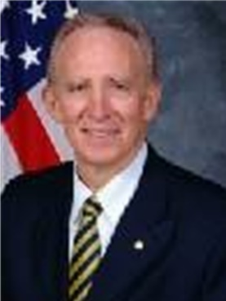
Remembering Frank Suraci
Mr. Frank Suraci was born December 21, 1940 in Washington, D.C, USA, to Joseph Suraci and Betty Driscoll Suraci. He is survived by his wife Rachel and his loving children Christine Rhoa (Joseph), Thomas Suraci and John Suraci (Amanda). Frank cherished his five grandchildren. He is also survived by his sister Betty Ann House (Richard) and two brothers,
Frank Suraci served as Senior Advisor for National Security and Emergency Preparedness (NS/EP) Communications within the Emergency Communications Division (ECD) in the Cybersecurity and Infrastructure Security Agency, Department of Homeland Security (DHS), USA. In this role, Mr. Suraci directly supported the Executive Assistant Director in managing a myriad of critical emergency communications tasks and represented ECD on senior committees across Departments and Agencies in order to further advance interoperable NS/EP communications.
Prior to the above assignment, Mr. Suraci served for over thirty years as the Government Emergency Telecommunications Service (GETS) and Wireless Priority Service (WPS) Program Director. He was responsible for taking GETS and WPS from concepts to the operational services. During this time, Mr. Suraci was appointed to serve on the Federal Communications Commission (FCC) Communications Security, Reliability and Interoperability Council (CSRIC) Working Groups. Most notably, planning for NS/EP Next Generation Network Priority Services during Pandemic Events tasked with developing recommendations for actions the FCC can take to enhance the nation’s communications infrastructure to respond to pandemics while also considering the associated impacts to new and advanced technologies including broadband and IP-based technologies.
Mr. Suraci started participating in IEEE 802.11 from 2019 and his last face-to-face meeting was in Panama, January, 2024, His goal was to take the IEEE 802.11be Emergency Preparedness Communications Service (EPCS) features and help accelerate the deployment of the next generation NS/EP services over Wi-Fi networks. Unfortunately, he was unable to witness it.

Slide 14
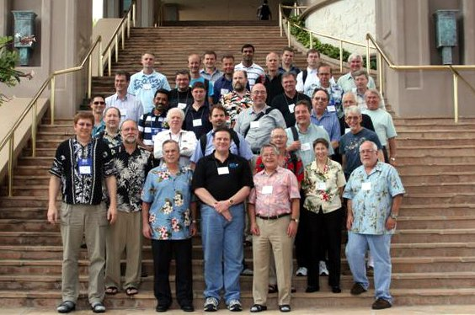
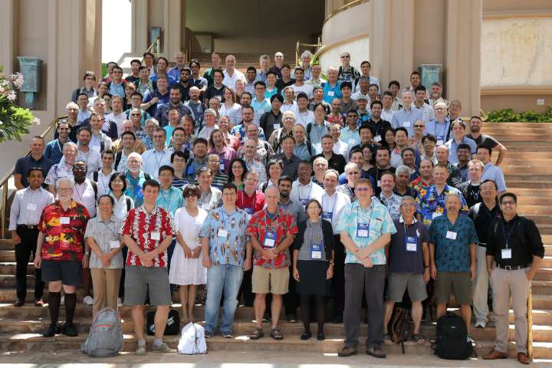
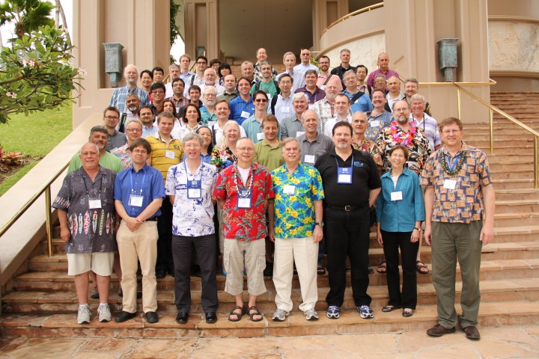
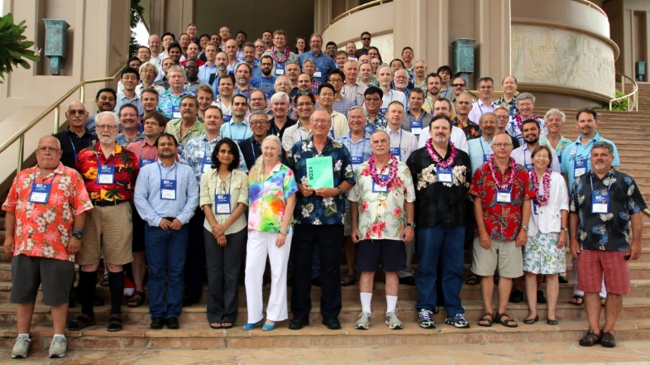
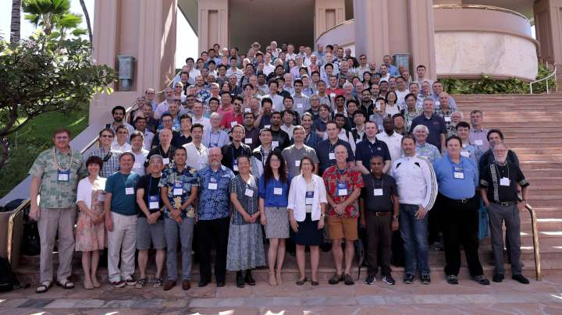
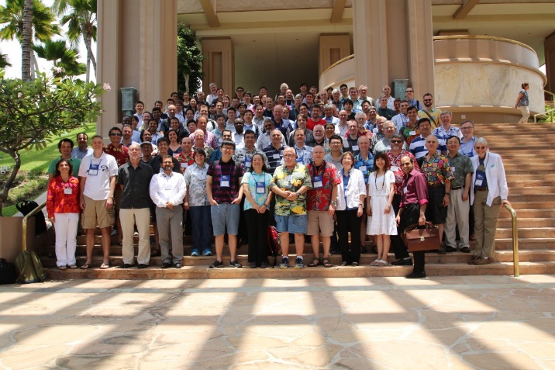
Group Photo
Please join us on the Grand Staircase immediately after the Mid-Week plenary
2010
2018
2014
2015
2019
2016

Slide 15
Friday

Slide 16
F2.1 Participant behavior in IEEE-SA activities is guided by the IEEE Codes of Ethics & Conduct
All participants in IEEE-SA activities are expected to adhere to the core principles underlying the:
  IEEE Code of Ethics
  IEEE Code of Conduct
The core principles of the IEEE Codes of Ethics & Conduct are to:
  Uphold the highest standards of integrity, responsible behavior, and ethical and professional conduct
  Treat people fairly and with respect, to not engage in harassment, discrimination, or retaliation, and to protect people's privacy.
  Avoid injuring others, their property, reputation, or employment by false or malicious action
The most recent versions of these Codes are available at
  http://www.ieee.org/about/corporate/governance

Slide 17
F2.1 IEEE-SA standards activities shall allow the fair & equitable consideration of all viewpoints
The IEEE-SA Standards Board Bylaws (clause 5.2.1.3) specifies that “the standards development process shall not be dominated by any single interest category, individual, or organization”
  This means no participant may exercise “authority, leadership, or influence by reason of superior leverage, strength, or representation to the exclusion of fair and equitable consideration of other viewpoints” or “to hinder the progress of the standards development activity”
This rule applies equally to those participating in a standards development project and to that project’s leadership group
Any person who reasonably suspects that dominance is occurring in a standards development project is encouraged to bring the issue to the attention of the Standards Committee or the project’s IEEE-SA Program Manager

Slide 18
F2.1 Participants in the IEEE-SA “individual process” shall act independently of others, including employers
The IEEE-SA Standards Board Bylaws require that “participants in the IEEE standards development individual process shall act based on their qualifications and experience”
This means participants:
  Shall act & vote based on their personal & independent opinions derived from their expertise, knowledge, and qualifications
  Shall not act or vote based on any obligation to or any direction from any other person or organization, including an employer or client, regardless of any external commitments, agreements, contracts, or orders
  Shall not direct the actions or votes of other participants or retaliate against other participants for fulfilling their responsibility to act & vote based on their personal & independently developed opinions
By participating in standards activities using the “individual process”, you are deemed to accept these requirements; if you are unable to satisfy these requirements then you shall immediately cease any participation

Slide 19
F2.2 – Call for potentially essential patents
If anyone in this meeting is personally aware of the holder of any patent claims that are potentially essential to implementation of the proposed standard(s) under consideration by this group and that are not already the subject of an Accepted Letter of Assurance, please respond at this time by providing relevant information to the WG Chair.

Slide 20
F2.3 Meeting Decorum
Please observe proper decorum in meetings
No photography or recording
Press (i.e., anyone reporting publicly on this meeting) must announce their presence
In-person attendees:
  Laptop / tablet speakers and cell phone ringers off
  Join Webex using “no audio” option
  Wear your badge in the meeting areas (helps hotel staff improve the general security)
Remote attendees must mute when not speaking
All attendees use Webex chat to enter the queue

Slide 21
F2.4 Next session and CAC meetings announcements
Planned next full WG11 Session: Mixed-mode November 10-15, 2024
Upcoming Chair Advisory Committee (CAC) meetings
  CAC teleconference: Monday 2024-09-30 at 09:00 ET
  Initial objectives/agendas should be uploaded as mentor documents (.ppt format) or send to chair (.xls tab format) before this call to meet 30-day agenda submission deadline.
  CAC teleconference: Monday 2024-11-04 at 09:00 ET
  CAC teleconference: Sunday 2024-11-10 at 18:00 ET
  Send snapshots before this meeting.
The purpose of the CAC is to prepare session agendas, room requests/meeting times, and advise and support the chair re: responsibilities as an EC member.
Leaders of 802.11 subgroups (or their nominee) should attend CAC meetings

Slide 22
F2.5 Announcements: 2024 September Designation of Individual experts
Individual experts who attend electronically for a specific purpose/presentation can be designated as such by the WG Chair and receive a registration fee waiver and limited attendance rights.
See section 5 in https://mentor.ieee.org/802-ec/dcn/17/ec-17-0090-25-0PNP-ieee-802-lmsc-operations-manual.pdf ,
  The Working Group Chair may designate specific individual experts who are allowed to participate in Working Group discussions via electronic means during an in-person meeting for the benefit of the group. These individuals are not considered to be attending the meeting and so they are not required to pay meeting fees and they do not get participation credit. The participation of these individuals should be limited to specific technical topics. Such participation shall be documented in the minutes of the Working Group meeting.
The individuals listed below are hereby designated as specific individual experts on their respective topics and subject to the restrictions and benefits described in the 802 OM.
  <Name>, <Affiliation>, <Slot>
For WNG, attendance for each is limited to the WNG timeslot in which the respective presentation is scheduled.

Slide 23
F2.7 Requests for Letters of Assurance
IEEE PatCom LOA Listing for 802.11 is here: https://standards.ieee.org/about/sasb/patcom/patents.html
Open LoA requests (i.e., those that the WG chair is pursuing) :
Communication Systems LLC (x3)
Mitsubishi Electric Corporation (2023)
Detailed status is here (updated 2024-08-22):
https://mentor.ieee.org/802.11/dcn/15/11-15-1489-23-0000-register-of-loa-requests.docx
Recent changes: Request and response from Hedwig Wireless Technologies affiliates

Slide 24
F2.8 Drafts for Sale by IEEE– as of 2024-03-14
Publication | Published in TechStreet | Draft in Members Area | Published in Get 802? | Published by ISO?
IEEE Std 802.11-2020 | $844 printed |  | Yes | Yes
IEEE Std 802.11ax-2021 | $368 pdf |  | Yes | No
IEEE Std 802.11ay-2021 | $368 pdf |  | Yes | No
IEEE Std 802.11az-2022 | $227 pdf |  | Yes | No
IEEE Std 802.11ba-2021 | $208 pdf |  | Yes | No
IEEE Std 802.11bb-2023 | $77 pdf |  | No
IEEE Std 802.11bc-2023 | $120 pdf $150 print
IEEE Std 802.11bd-2022 | $198 pdf |  | Yes
IEEE P802.11be D7.0 | $365 pdf | D7.0
IEEE P802.11bf D4.0 | $168 pdf | D4.0
IEEE P802.11bh D6.0 | $86 pdf | D6.0
IEEE P802.11REVme D7.0 | $676 pdf | D7.0

Slide 25
F2.9 ISO/IEC JTC1/SC6
Published 2022 July: IEEE Std 802.11-2020 as ISO/IEC/IEEE 8802-11:2022
Since 2021, 14 drafts have been submitted, but all are currently stalled due to IPR concerns
Drafts are sent to JTC1/SC6 during SA ballot to solicit comments. Approved drafts may also be sent during working group ballot. Any comments received from ISO are processed by the comment resolution committee. All drafts are liaised subject to EC approval

Slide 26
F2.10 Social media, blog posts and similar
Subgroup | Event | Status | Target/Published document, completed info
802.11ah | IEEE Livestream | Completed | April 2024

Slide 27
F2.11 IEEE 802 Public Visibility Standing Committee
Scope
  To raise industry awareness in timely fashion of IEEE 802 WG / TAG activities
  Develop social media content based on IEEE 802 WG / TAG activities
    Twitter - https://twitter.com/ieee802
    LinkedIn – https://www.linkedin.com/company/ieee802
    IEEE-SA 802 - https://standards.ieee.org/featured/802/index.html
Content examples –
  Meeting announcements
  PARs to be considered
  Tutorials
  [802.3] Call-for-Interests
  New Task Force formations
  Study Group formations
Other 802 related material
  Press Releases
  White Paper publications
  Standards Approval
  Standards Publication
  IEEE Educational Activities Tech Talks
  Other 802 approved news
Contact Tuncer Baykas tbaykas@ieee.org (Chair, PVSC) if interested in helping develop content)

Slide 28
F2.11 IEEE 802 Public Visibility Standing Committee
IEEE 802 has a linkedin page
LinkedIn – https://www.linkedin.com/company/ieee802
We have 4698 followers; help us to reach 5000
Some of the latest IEEE 802.11 related activities:
IEEE Computer Society webinar about IEEE 802.11be (Wi-Fi 7) July 30, 2024
to register:
https://lnkd.in/eR6Z2TiN
IEEE SA IEEE 802.11ah HaLow webinar: 20 June 2024
to watch:
https://lnkd.in/ddpSWaQa
Recording of the latest IEEE 802 – ITU Workshop:
https://lnkd.in/d3zK8mcQ

Slide 29
F6.1 802 Wireless Chairs meeting
The wireless chairs meeting makes decisions related to the operation of the wireless interim meetings, such as location and cost.
The meeting is open to all. If you are interested in these topics, please attend.
The wireless chairs meeting
  At 4:00pm local time on the Sunday of 802 Plenary and Wireless Interim in-person sessions
  As scheduled via teleconference for electronic sessions;
  Next meetings: Wednesday 2024-10-09 15:00 ET, Sunday 2024-11-10 16:00 ET call details will be posted here: http://ieee802.org/802tele_calendar.html.

Slide 30
F6.2 Upcoming Sessions
Nov 10-15, 2024, Hyatt Regency Vancouver, Vancouver, Canada
Jan 12-17, 2025, Kobe, Japan
These sessions will count towards voting rights.
Paid registration is required.
For meeting information and registration links, see http://www.ieee802.org/11/Meetings/Meeting_Plan.html

Slide 31
6.3 Announcements
We will have an ePoll on start times for the July plenary session in Madrid, Spain

Slide 32
References and additional material

Slide 33
Comment Resolution Resources
Comment resolution resources
  See https://mentor.ieee.org/802.11/dcn/13/11-13-0230-05-0000-comment-resolution-tutorial.ppt
  See https://mentor.ieee.org/802.11/dcn/11/11-11-1625-02-0000-comment-resolution-guide.doc
There are many examples of good practice for documentation of comment analysis and resolution; ensures there is a record of comment consideration and agreed resolution
  https://mentor.ieee.org/802.11/dcn/18/11-18-0669-04-000m-revmd-mac-comments-assigned-to-hamilton.docx
  https://mentor.ieee.org/802.11/dcn/18/11-18-1410-00-00ax-lb233-cr-spatial-reuse.docx
Motion templates (updated 2018):
  https://mentor.ieee.org/802.11/dcn/08/11-08-0762-12-0000-motion-templates.doc

Slide 34
Amendment Development Resources
MIB development
  See ARC MIB usage patterns: https://mentor.ieee.org/802.11/dcn/15/11-15-0355
  See ARC recommendations on MIB types and usage: https://mentor.ieee.org/802.11/dcn/09/11-09-0533
Style Guide
  See Editorial Style Guide: https://mentor.ieee.org/802.11/dcn/09/11-09-1034
ANA Database
  See https://mentor.ieee.org/802.11/dcn/11/11-11-0270

Slide 35
Completed 802.11 Public Visibility Events
Tech Talks: https://innovationatwork.ieee.org/events/techtalk-panel-802/
  2020-11-04 Tech talk on 802.11bf and WLAN Sensing , Tony Han, Claudio Da Silva
  2021-05-26 Tech talk on 802.11, D. Stanley, P. Nikolich
  2022 June Tech talk on Coexistence, see 11-22-0921, A. Myles
2021-01-20 January Computer Society Standards Activities Board Webinar Series 802 Wireless Standards: D. Stanley, P. Kinney, P. Nikolich
2023-04-04 Computer Society hosted 2023 webinar on 802.11bb and 802.11bc
2023-05-22 Wi-Fi Now tutorial on 802.11az technology: J. Segev, R. Want
2023-11-07 IEEE Computer Society webinar on 802.11az: J. Segev, C. Berger
2023-11-09 IEEE SA Webinar on 802.11az: R. Want, A, Raissinia
2023-11-16 IEEE SA Livestream on 802.11bb: N. Serafimovski, T. Baykas
2024-01-24 IEEE GEPS Webinar on 802.11: D. Stanley, H. Yaghoobi, R. DeVegt, E. Au

Slide 36
Completed Social media, blog posts and similar
Subgroup | Event | Status | Target/Published document
AIML TIG | TIG formation | Completed | September 2022 SMEs identified, working with IEEE staff. Initial social media post completed. Standards evolution blog published 16 May 2023.
AMP TIG | TIG formation | Completed | September 2022 SMEs identified, working with IEEE staff. Initial social media post completed. Standards evolution blog published 16 May 2023.
UHR SG | SG formation | Completed | September 2022 SMEs identified, working with IEEE staff. Initial social media post . Standards evolution blog published 16 May 2023.
11az, 11bd | Publication | Completed | June 2023 Blog completed
11az | Publication | Completed | Nov 23: IEEE SA Webinar, IEEE Computer Society Webinar
11bb | Publication | Completed | Livestream 2023-11-16

Slide 37
Published IEEE Press Releases, Blogs
Subgroup | Event | Published document
TGaj | Amendment publication | http://standards.ieee.org/news/2018/standard_increased_high_bandwidth_wlan_china.html
BCS SG | SG Formation | http://standards.ieee.org/news/2018/ieee_802-11_study_groups.html
NGV SG | SG Formation | http://standards.ieee.org/news/2018/ieee_802-11_study_groups.html
TGak | Amendment publication | http://standards.ieee.org/news/2018/ieee_802_11ak-2018.html
TGbb | TGbb formation | https://beyondstandards.ieee.org/general-news/ieee-802-11-launches-standards-amendment-project-for-light-communications-lifi/
TGaq | Amendment publication | https://standards.ieee.org/news/2018/ieee-802_11aq-standard-amendment-wlan.html
EHT | Study Group Formation | https://standards.ieee.org/news/2018/ieee-802_11-extremely-high-throughput-study-group.html
RTA | Topic Interest Group Formation | https://standards.ieee.org/news/2018/ieee-802_11-extremely-high-throughput-study-group.html

Slide 38
Published IEEE Press Releases, Blogs
Subgroup | Event | Status | Target/Published document
TGbe | TG formation | Completed | September 2019 https://beyondstandards.ieee.org/networking/ieee-p802-11be-to-enable-extremely-high-throughput-eht-and-low-latency-for-wi-fi/
AANI | IMT-2020 Self Evaluation of 802.11ax | Completed | December 2019 http://standards.ieee.org/news/2019/5g-indoor-hotspot-and-dense-urban-deployments.html
TGbf | TG formation | Completed | December 2020 https://beyondstandards.ieee.org/networking/ieee-802-11bf-aims-to-enable-a-new-application-of-wlan-technology-wlan-sensing/

Slide 39
Published IEEE Press Releases, Blogs
Subgroup | Event | Status | Target/Published document
TGbf | TG formation | Completed | December 2020 https://beyondstandards.ieee.org/networking/ieee-802-11bf-aims-to-enable-a-new-application-of-wlan-technology-wlan-sensing/
TGbh | TG formation | Completed | May 2021, https://beyondstandards.ieee.org/data-privacy-and-ease-of-use-in-wireless-networks/
TGbi | TG formation | Completed | May 2021, https://beyondstandards.ieee.org/data-privacy-and-ease-of-use-in-wireless-networks/

