Slide 1
L4S Support Implementation Options
Date: Sept 2024
Authors:
Name | Affiliation | Address | Phone | Email
Lili Hervieu | CableLabs |  |  | l.hervieu@cablelabs.com
Greg White |  |  |  | g.white@cablelabs.com
Luther Smith |  |  |  | l.smith@cablelabs.com
Darshak Thakore |  |  |  | d.Thakore@cablelabs.com
Carol Ansley | Cox |  |  | carol.ansley@cox.com

Slide 2
Introduction
UHR PAR scope includes the reduction of tail latency
Achieving Low Latency Wi-Fi requires to reduce both
  Buffer delays that occur when packet arrivals exceed departures and lead to high buffer occupancy.
  Media access delays in scenarios with moderate/high airtime contention
L4S technology defined by IETF RFCs [1-3] supports end-to-end low latency, including tail latency, with low packet loss
  Address buffer delays
Overview of L4S presented in [4][13] and proposals to support L4S in 802.11bn presented in [5-9]
This presentation covers:
  A recap on L4S architecture
  L4S test results showing how L4S reduces buffer delays
  Recap on proposed L4S implementations in 802.11bn in the AP
  AP MAC enhancement proposal for efficiently supporting L4S above the MAC

Slide 3
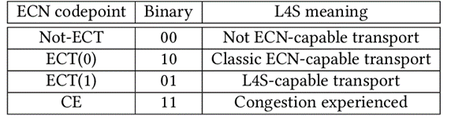
Recap on L4S architecture: Key Components
L4S introduces new rules for internet congestion control:
  L4S uses the explicit congestion notification (ECN) in the IP header to explicitly signal congestion early and frequently.
  ECN indicates congestion before the network gets to the point of dropping packets
  When the receiver gets packets that are marked with congestion experienced, the receiver relays these congestion marks back to the sender so that the sender can adjust its sending rate and react more subtly to congestion. The sender can fine-tune transmission rates more accurately and quickly.

Slide 4
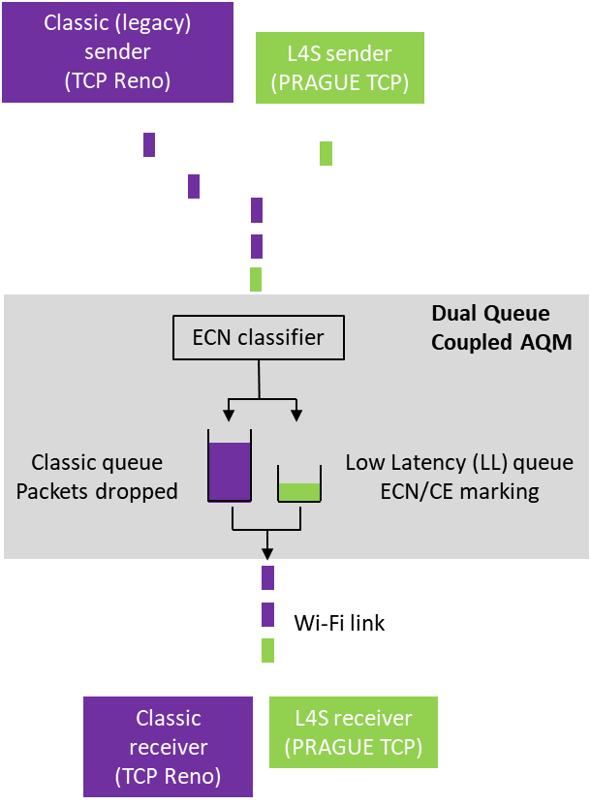
Recap on L4S architecture: Key Components
L4S active queue management (AQM) applies CE-marks to packets at a very shallow buffer threshold
To coexist with classic congestion-control traffic, Dual-Queue Coupled AQM uses 2 queues, one for L4S traffic and 1 for classic traffic.
  It isolates L4S flows from the queuing of classic flows and sends congestion signals appropriately scaled for each type of traffic.
  The classic AQM applies a drop level to classic traffic that is coupled to the CE marking level being applied to low latency (LL) traffic in such a way that packet rates of the two types of flow turn out roughly the same.
Propose to support L4S for best effort (AC_BE) and video (AC_VI). AC_VO is tbd.

Slide 5
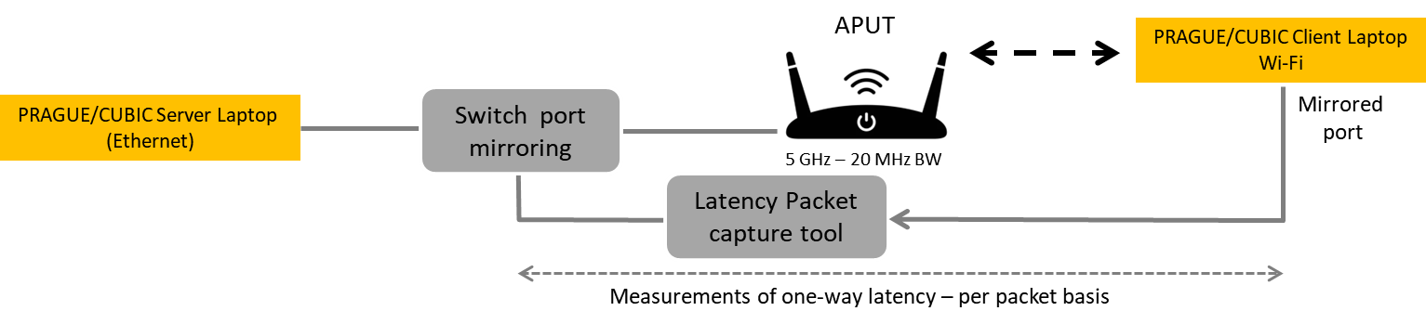
Nokia Beacon 6 L4S Test Setup
Test conducted on a clean 5 GHz channel – 20 MHz bandwidth with 1 AP and 1 STA
Tests compares classic flows (TCP CUBIC) versus L4S flows (TCP Prague) when ‘L4S’ is enabled and disabled on the APUT.
Unlimited iperf3 flows
Report average downlink throughput and downlink one way latency (P50, P90, P95, P99)
2 scenarios reported: one with a stationary client and one with a moving client
  L4S (A)) ON/OFF refers to enabling/disabling dual-queue coupled AQM and CE marking on the AP

Slide 6
L4S Test Results – 1 Stationary Client
AP ‘L4S’ | Classic FLOWS | DN Throughput Mbps | DN Latency P50 ms | DN Latency P90 ms | DN Latency P95 ms | DN Latency P99 ms | L4S FLOWS | DN Throughput Mbps | DN Latency P50 ms | DN Latency P90 ms | DN Latency P95 ms | DN Latency P99 ms
OFF | 1 | 218 | 90 | 111 | 116 | 128
OFF | 2 | 210 | 104 | 118 | 121 | 127
OFF | 4 | 205 | 217 | 244 | 252 | 266
OFF |  |  |  |  |  |  | 1 | 204 | 105 | 126 | 131 | 141
OFF |  |  |  |  |  |  | 2 | 198 | 122 | 214 | 224 | 242
OFF |  |  |  |  |  |  | 4 | 202 | 131 | 179 | 198 | 222
ON | 1 | 193 | 8 | 12 | 13 | 16
ON | 2 | 192 | 9 | 14 | 15 | 19
ON | 4 | 203 | 12 | 17 | 19 | 22
ON |  |  |  |  |  |  | 1 | 183 | 5 | 8 | 9 | 11
ON |  |  |  |  |  |  | 2 | 186 | 5 | 8 | 9 | 11
ON |  |  |  |  |  |  | 4 | 188 | 6 | 9 | 10 | 13
ON | 1 | 92 | 7 | 14 | 16 | 21 | 1 | 105 | 6 | 8 | 9 | 11
ON | 2 | 106 | 10 | 18 | 21 | 26 | 2 | 90 | 6 | 8 | 9 | 11
1 row is 1 test result
Test result shows the benefit of L4S, reducing latency from ~200 ms when L4S is disabled down to ~20 ms (CUBIC) and ~11 ms (Prague) when L4S is enabled.
More than 10X reduction in latency, less than 16% reduction in throughput
Latency reduction more significant with multiple concurrent flows

Slide 7
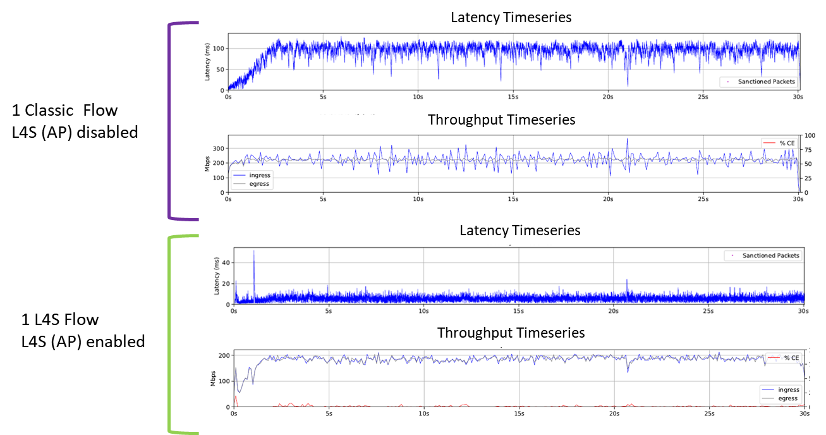
L4S Tests Results – 1 Stationary client

Slide 8
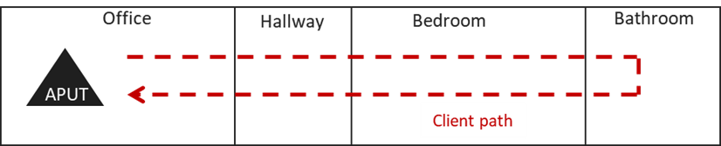
L4S Test Results – 1 Moving Client
Wi-Fi 6 AP located in the office
  Client (laptop) moves quickly from the office through hallway, bedroom and bathroom.
  Client stays for a couple of seconds in bathroom
  Client moves back quickly to the office.
--- Client position throughout the test (clients stays a couple of seconds in bathroom)

Slide 9
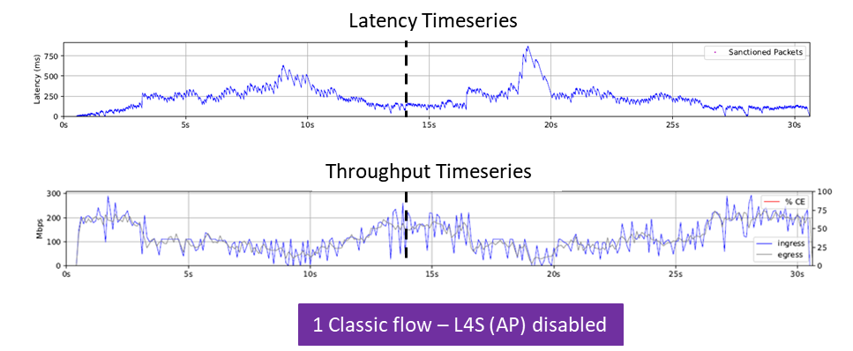
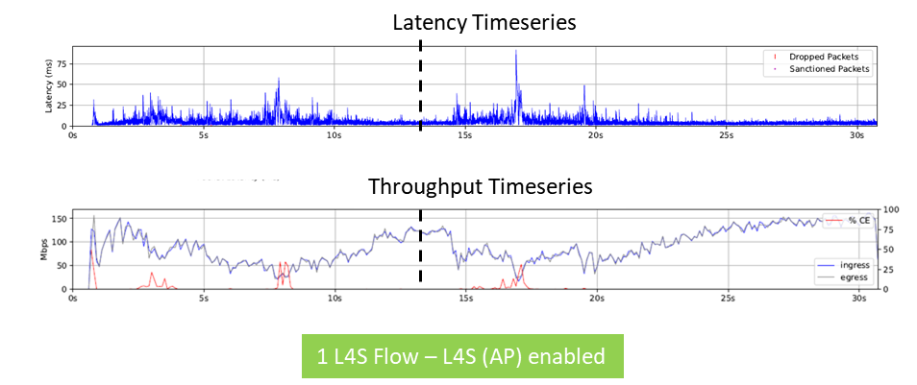
L4S Test Results – 1 Moving Client
AP ‘L4S’ | Classic FLOWS | DN Throughput | DN Latency P50 | DN Latency P90 | DN Latency P95 | DN Latency P99 | L4S FLOWS | DN Throughput | DN Latency P50 | DN Latency P90 | DN Latency P95 | DN Latency P99
OFF | 1 | 121 | 145 | 315 | 358 | 568
OFF | 1 | 117 | 157 | 306 | 389 | 527
OFF | 1 | 124 | 141 | 313 | 360 | 520
ON | 1 |  |  |  |  |  | 1 | 93 | 4 | 12 | 16 | 27
ON | 1 |  |  |  |  |  | 1 | 93 | 3 | 9 | 12 | 23
ON | 1 |  |  |  |  |  | 1 | 91 | 4 | 11 | 15 | 25
L4S reduces P99 latency by 500 msec with less than 20% throughput reduction
Throughput in Mbps, latency in msec

Slide 10
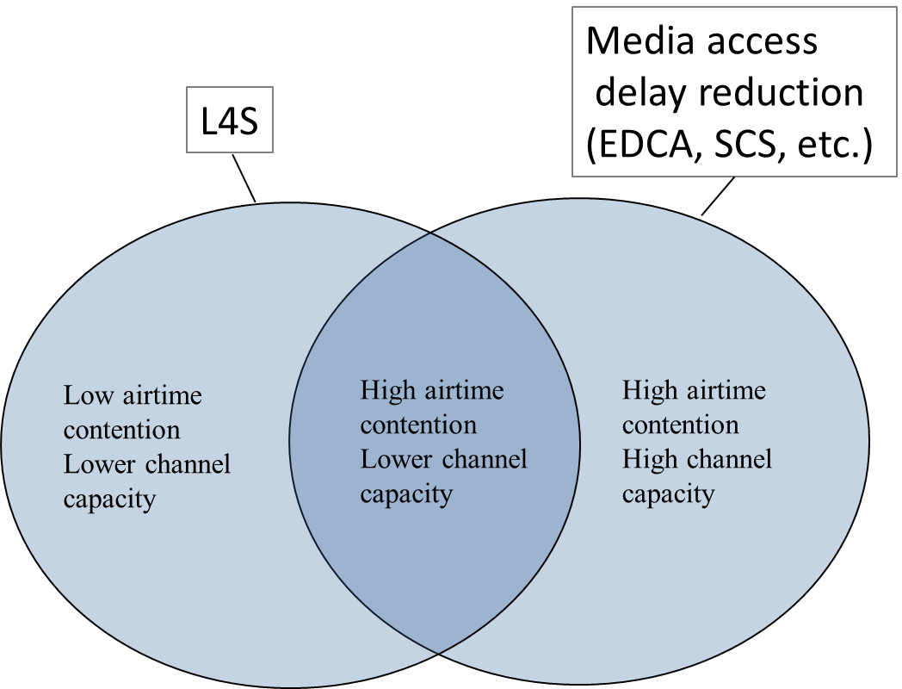
Summary of Tests
L4S significantly reduces the latency while moderately reducing the throughput when latency is due to buffer delays
Dual-queue coupled AQM benefits L4S flows and also classic flows
L4S further reduces latency for L4S flows and leads to no packet drop
  Lower packet drop may have a significant impact on applications that are sensitive to packet loss.
L4S leads to ‘smoother’ throughput due to new congestion control mechanism
  May lead to better trigger access scheduling

Slide 11
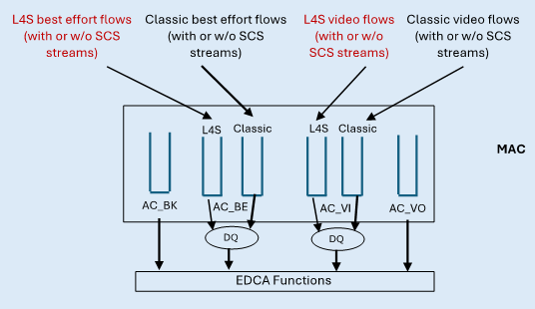
L4S Integration in 802.11bn MAC – Proposals Recap [6][7][8][9]
L4S traffic classification support by:
  Adding an L4S field in the TCLAS element (if supporting SCS)
  Adding an L4S parameter in the MA-UNITDATA.request primitive (if not supporting SCS)
DUAL-queue coupled AQM in the 802.11 MAC for BE and VI category to isolate L4S flows and classic flows and calculate congestion signals appropriately scaled for each type of traffic.
Schemes to notify congestion to the non-AP STA assuming no CE marking at MAC layer
  When congestion is experienced at the MAC, it is signaled to the upper layer/L3 with a new L4S-CE.indication primitive and the upper layer CE-mark subsequent packets.
  When an MSDU experiences congestion at the MAC, the MSDU is sent to the upper layer for CE marking, and after marking the MSDU is inserted back in the MAC queue at the same place. This is based on a new L4S-CE-MARKING.request/response primitive.
  Transmit the congestion notification between AP and the STA with L2 CE signaling in A-control field. When STA receives a data frame with L4S CE in A-Control, it requests upper layer to add L3 CE marking with new L4S-CE-MARKING.request/response primitive
Drawing from 802.11-2024/399

Slide 12
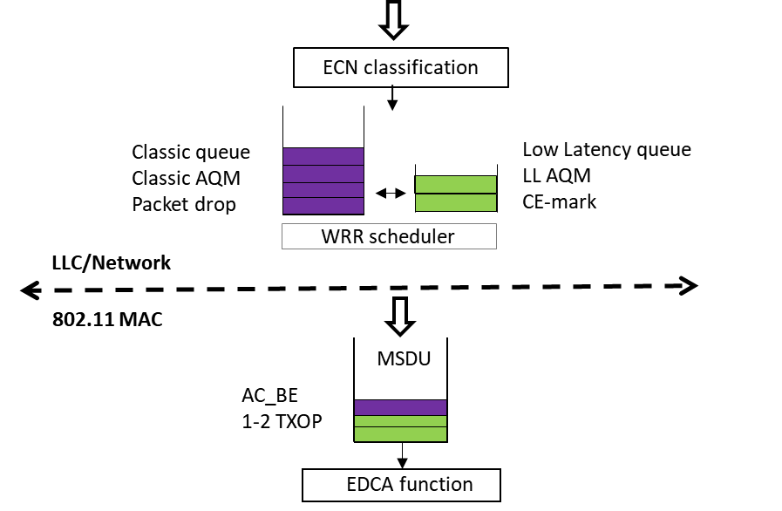
MAC Enhancement for Efficiently Supporting L4S Above the MAC - Principal
Dual-queue coupled AQM is implemented above the MAC (BE and VI) and handles traffic classification and congestion signals, including CE-marks in the IP headers.
Need to maintain a shallow queue in the MAC queue to try to ensure that the AC queue is populated to a degree that it can efficiently use the link capacity (i.e. fill each TXOP) and no bigger, while all of the rest of the queued packets are maintained in the L4S queuing structure above the MAC.
AC buffer is typically 1 to 2 TXOP worth of data => buffer size not constant (depends on PHY rate, TXOP etc.)
Diagram applies to AC_VI as well
AC_VO is tbd

Slide 13
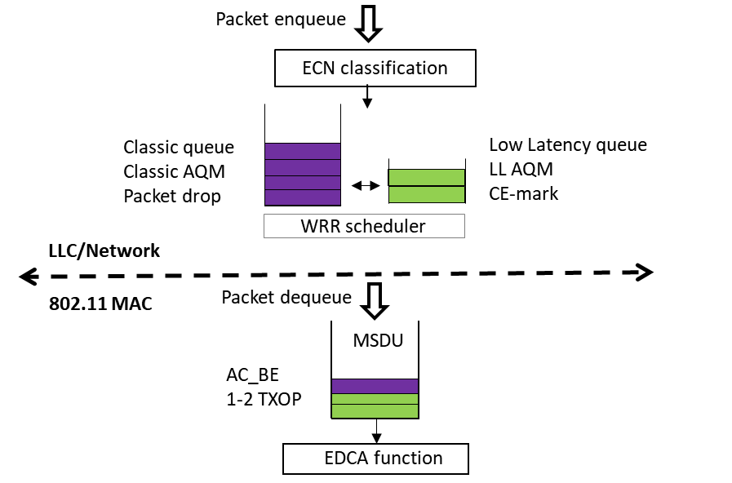
MAC Enhancement for Efficiently Supporting L4S Above the MAC - Principal
Unsaturated operation (by reference to AC-BE)
AC_BE buffer not full, AQM is just a no operation pass through
Saturated operation:
At enqueue: C-queue packet drops and LL-queue packet marks (based on coupled probability).
At dequeue, when a BlockAck creates space in AC_BE
  M packets from C-queue and K packets from LL queue are dequeued. Some number of packets may be left in the LL-queue (N)
  CE-mark an additional N packets in the dequeued packets
[13] provides architecture details and NS3 simulation results based on this architecture (NS3 model to be available soon)
Diagram applies to AC_VI as well
AC_VO is tbd

Slide 14
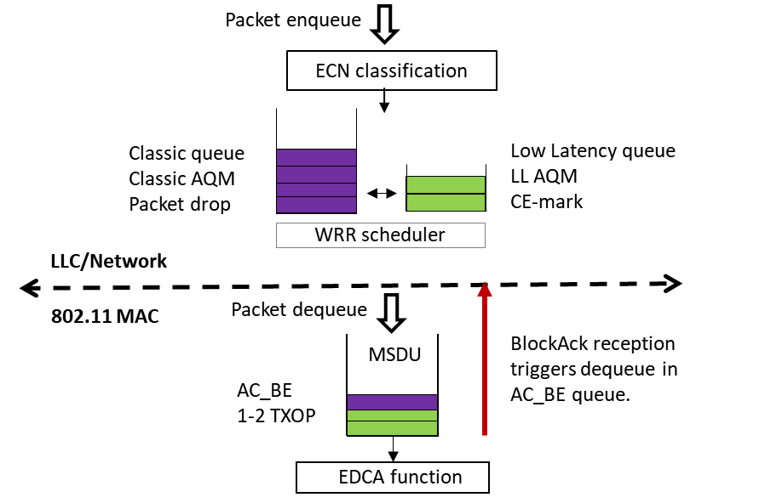
MAC Enhancement for Efficiently Supporting L4S Above the MAC - Principal
Flow control is needed between the MAC and the upper layer
Upon reception of a BlockAck, MAC notifies the upper layer the number of bytes available in the AC buffer
Propose a new L4S-MAC-buffer-availability.indication (MAC-SAP or MLME) primitive
L4S-MAC-buffer-availability.indication(
source address,
destination address,
priority,
Bytes_to_buffer_full
)
Diagram applies to AC_VI as well
AC_VO is tbd

Slide 15
L4S Capability Signaling
https://slideplayer.com/slide/2525044/
  APs and STAs need to signal L4S capabilities
    Non-AP STAs use this information in their AP selection process
    APs to provision for L4S support for the client supporting L4S
  L4S related capabilities can be signaled in Capabilities element

Slide 16
Summary
L4S significantly reduces the latency caused by ingress/egress rate mismatch
Achieving very low latency relies on reducing media access delay in combination with L4S
  802.11 features to reduce media access delay (e.g., SCS, EDCA).
  As these features may not be available (e.g., residential deployments where all traffic is sent to AC_BE), it is important to consider new techniques to reduce media access delays such as proposed in [10][11][12]
We propose to support L4S Dual-Queue Coupled AQM above the 802.11 MAC layer for AC_BE and AC_VI. This requires:
  Shallow AC buffer - 1 to 2 TXOP worth of data – Buffer size will change over time
  Propose L4S-MAC-buffer-availability.indication primitive (MAC-Sap or MLME) to notify the upper layer the number of bytes available in the AC buffer upon reception of a BlockAck
L4S related capabilities to be signaled in Capabilities element

Slide 17
References
[1] IETF RFC 9330 “Low Latency, Low Loss, and Scalable Throughput (L4S) Internet Service: Architecture”
[2] IETF RFC 9331 “The Explicit Congestion Notification (ECN) Protocol for Low Latency, Low Loss, and Scalable Throughput (L4S)”
[3] IETF RFC 9332 “Dual-Queue Coupled Active Queue Management (AQM) for Low Latency, Low Loss, and Scalable Throughput (L4S)”
[4] 11-23/2065, WNG, “End-to-End Congestion Control, L4S and Implications for Wi-Fi”
[5] 11-24-0080-01-0arc-l4s-over-wi-fi-links
[6] 11-23-0679-00-0uhr-low-latency-qos-based-on-l4s
[7] 11-24-0384-01-00bn-low-latency-based-on-l4s
[8] 11-24-0399-01-00bn-thoughts-on-l4s-in-wi-fi
[9] 11-23-0650-01-0uhr-qos-re-visited
[10]11-24-0031-00bn-Deterministic-Backoff
[11] 11-23-2126-03-00bn-low-latency-channel-access-follow-up
[12] 11-24-0773-01-00bn-csma-with-enhanced-collision-avoidance
[13] https://www.ieee802.org/11/private/liaisons/WBA_2024_E2EQOS_L4S_v1.0.0%20-%20for%20IEEE%20802.11.pdf

Slide 18
SP
SP1: Do you agree to define L4S capability element to communicate support for L4S
  Capabilities element is tbd
SP2: Do you agree to define primitive(s) in 802.11bn to support L4S above the 802.11 MAC
  Primitive(s) is/are tbd

