Slide 1
High-Level Requirements for Downlink PHY in 2.4 GHz
Date: 2024-09-11
Authors:
Name | Affiliations | email
Steve Shellhammer | Qualcomm | shellhammer@ieee.org
Pooria Pakrooh |  | ppakrooh@qti.qualcomm.com
Bin Tian |  | btian@qti.qualcomm.com

Slide 2
Introduction
There are several deployment scenarios that are of interest to the Task Group
Here we consider the location of the downlink transmitter and the Energizer and its impact on the downlink requirements
There are two possible deployments of interest to the Task Group
The downlink transmitter is not in the same physical devices as the RF Energizer, or there is different energy source (non-Integrated Energizer deployment)
The downlink transmitter and the Energizer are in the same physical device (Integrated Energizer deployment)

Slide 3
Difference in Link Budgets
In [1] we showed that there is a significant difference in the link budget between the non-Integrated Energizer deployment and the Integrated Energizer deployment
It is expected that 802.11ba can support the non-Integrated Energizer deployment, so here we focus on the Integrated Energizer deployment needs
As shown in [1] it is possible to support higher data rate and a shorter Sync field in the Integrated Energizer deployment

Slide 4
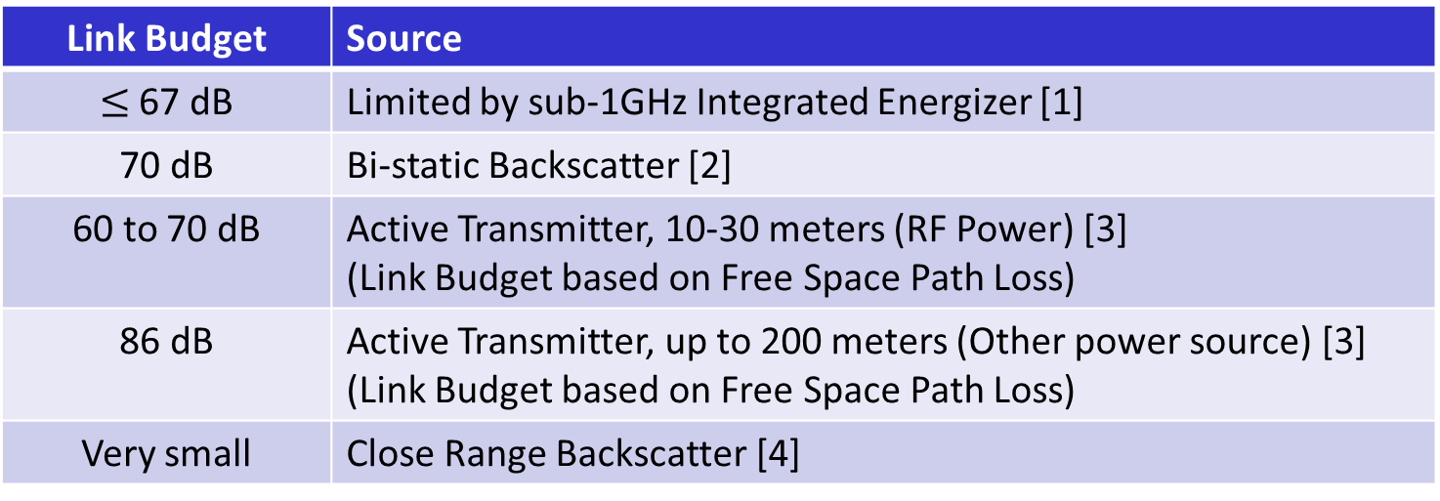
Example Link Budgets
Here are some example Link Budgets that have been provided in 11bp contributions
Link Budget | Source
$≤$ 67 dB | Limited by sub-1GHz Integrated Energizer [1]
70 dB | Bi-static Backscatter [2]
60 to 70 dB | Active Transmitter, 10-30 meters (RF Power) [3] (Link Budget based on Free Space Path Loss)
86 dB | Active Transmitter, up to 200 meters (Other power source) [3] (Link Budget based on Free Space Path Loss)
Very small | Close Range Backscatter [4]
We see that except for the 200-meter case, all the link budgets are less than 70 dB

Slide 5
Proposal
Here we propose that the 11bp specifies an AMP Downlink PPDU to address the case with link budget around 70 dB
We propose that the AMP Downlink PPDU include a Legacy Preamble field, a Sync field and a Data field. Inclusion of a SIG field is TBD.
The Sync field will be a shorter duration than the 802.11ba HDR Sync field
We provide several straw polls

Slide 6
Simulation Channel Models
For the AMP Downlink evaluation simulations, we need to agree on which channel models to use
It makes sense to include an AWGN channel model
Since the link budget is less than a conventional 802.11 link budget, for a multipath model we could consider Channel Model B
Alternatively, we can stick with Channel Model D, as was done in 802.11ba
Recommend that the Task Group decided on whether to use Channel Model B or D in the evaluation simulations

Slide 7
Straw Poll #1
Do you agree to add following content to sub-clause 4 of SFD:
IEEE 802.11bp will specify, in 2.4 GHz, an AMP Downlink PPDU containing at least an 802.11 preamble field, an AMP-Sync field and an AMP-Data field. Inclusion of an AMP-SIG field is TBD.
The details of the 802.11 preamble field are TBD.
Additionally, for transmission to backscatter STAs there will be one or more Excitation fields
Additionally, for transmission to backscatter STAs there may be more than one AMP-Data field
Additionally, AMP-Sync and AMP-SIG field may precede each AMP-Data field
Name of this Downlink PPDU is TBD.
Yes
No
Abstain

Slide 8
Straw Poll #2
Do you agree to add following content to sub-clause 4 of SFD:
IEEE 802.11bp will specify an AMP Downlink PPDU with an AMP-Sync field with duration less than 64 µs
The AMP-Sync field design is TBD.
Note: the duration of the 802.11ba HDR Sync field is 64 µs
Yes
No
Abstain

Slide 9
Straw Poll #3
Do you agree to add following content to sub-clause 4 of SFD:
The AMP Downlink PPDU AMP-Sync field and the AMP-Data field will use On-Off Keying (OOK) modulation
Yes
No
Abstain

Slide 10
Straw Poll #4
Do you agree to add following content to sub-clause 4 of SFD:
The AMP Downlink PPDU AMP-Data field will use Manchester encoding for non-backscatter operation.
For the Backscatter case, the AMP-Data field encoding scheme is TBD.
Yes
No
Abstain

Slide 11
Straw Poll #5 – For Information Collection (Not for SFD)
For the AMP Downlink PPDU evaluation simulations which multipath channel model should be used?
Channel Model B
Channel Model D
Abstain

Slide 12
References
Steve Shellhammer, Bin Tian and Pooria Pakrooh, , “WUR for Integrated Energizer Case,” IEEE 802.11-24/1163r0, July 2024
Wei Lin, et., al., “Feasibility study on long range backscatter operation,” 802.11-24/1215r0, July 2024
Weijie Xu, Yinan Qi, and Chuanfeng He, “Design target and device capabilities for AMP IoT,” IEEE 802.11-24/853r0, May 2024
Rui Cao, et. al, “Close-Range Backscattering Waveform and Modulation,” IEEE 802.11-24/1236r0, July 2024

