Slide 1
High-Level Requirements for Downlink PHY in 2.4 GHz
Date: 2024-08-01
Authors:
Name | Affiliations | email
Steve Shellhammer | Qualcomm | shellhammer@ieee.org
Pooria Pakrooh |  | ppakrooh@qti.qualcomm.com
Bin Tian |  | btian@qti.qualcomm.com

Slide 2
Introduction
There are several deployment scenarios that are of interest to the Task Group
Here we consider the location of the downlink transmitter and the Energizer and its impact on the downlink requirements
There are two possible deployments of interest to the Task Group
  The downlink transmitter is not in the same physical devices as the RF Energizer, or there is different energy source (non-Integrated Energizer deployment)
  The downlink transmitter and the Energizer are in the same physical device (Integrated Energizer deployment)

Slide 3
Difference in Link Budgets
In [1] we showed that there is a significant difference in the link budget between the non-Integrated Energizer deployment and the Integrated Energizer deployment
It is expected that 802.11ba can support the non-Integrated Energizer deployment, so here we focus on the Integrated Energizer deployment needs
As shown in [1] it is possible to support higher data rate and a shorter Sync field in the Integrated Energizer deployment

Slide 4
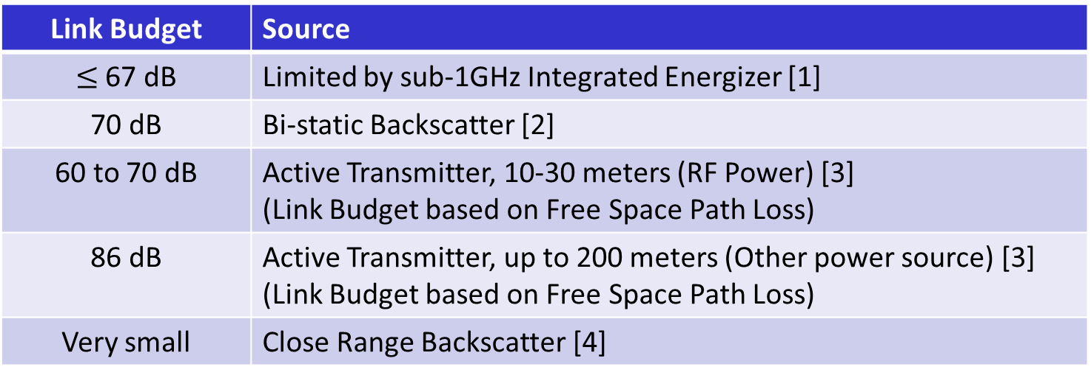
Example Link Budgets
Here are some example Link Budgets that have been provided in 11bp contributions
Link Budget | Source
$≤$ 67 dB | Limited by sub-1GHz Integrated Energizer [1]
70 dB | Bi-static Backscatter [2]
60 to 70 dB | Active Transmitter, 10-30 meters (RF Power) [3] (Link Budget based on Free Space Path Loss)
86 dB | Active Transmitter, up to 200 meters (Other power source) [3] (Link Budget based on Free Space Path Loss)
Very small | Close Range Backscatter [4]
We see that except for the 200-meter case, all the link budgets are less than 70 dB

Slide 5
Proposal
Here we propose that the 11bp draft specifies a Downlink PPDU to address the Integrated Energizer case
The portion of the PPDU to be decoded by the intended receiver will include a Sync field and a Data field. Inclusion of a SIG field is TBD.
  Here we do not discuss the legacy preamble, since there have been several presentation on that topic, and can be discussed further later.
The Sync field will be a shorter duration than the 802.11ba HDR Sync field
The data rate will be higher than the 802.11ba HDR data rate
We provide several straw polls to be discussed on conference calls
  Running the Straw Polls can be done during the IEEE session

Slide 6
Simulation Channel Models
For the AMP Downlink evaluation simulations, we need to agree on which channel models to use
  It makes sense to include an AWGN channel model
Since the link budget is less than a conventional 802.11 link budget, for a multipath model we could consider Channel Model B
Alternatively, we can stick with Channel Model D, as was done in 802.11ba
  Recommend that the Task Group decided on whether to use Channel Model B or D in the evaluation simulations

Slide 7
Straw Poll #1
Do you agree to add the following text to the SFD:
  The 802.11bp draft will specify in 2.4 GHz a new AMP Downlink PPDU structure containing a Sync Field and a Data Field. Inclusion of a SIG Field is TBD.
Yes
No
Abstain

Slide 8
Straw Poll #2
Do you agree to add the following text to the SFD:
  The AMP Downlink Sync field duration will be less than 64 µs (which is the duration of the 802.11ba HDR Sync field). Detailed design of the AMP Downlink Sync field is TBD.
Yes
No
Abstain

Slide 9
Straw Poll #3
Do you agree to add the following text to the SFD:
  Do you agree that the AMP Downlink data rate will be at least 1 Mb/s. The exact data rate of the AMP Downlink is TBD.
    Note, the 802.11ba HDR data rate is 250 kb/s.
Yes
No
Abstain

Slide 10
Straw Poll #4
Do you agree to add the following text to the SFD:
  The AMP downlink Data field will use Manchester encoding
Yes
No
Abstain

Slide 11
Straw Poll #5
For the Downlink evaluation simulations which multipath channel model should be used?
Channel Model B
Channel Model D

Slide 12
Straw Poll #6
Do you agree to add the following text to the FRD:
  For the Downlink evaluation simulations, the following two channel models will be used
    AWGN
    Channel Model TBD (Either B or D)

Slide 13
References
Steve Shellhammer, Bin Tian and Pooria Pakrooh, , “WUR for Integrated Energizer Case,” IEEE 802.11-24/1163r0, July 2024
Wei Lin, et., al., “Feasibility study on long range backscatter operation,” 802.11-24/1215r0, July 2024
Weijie Xu, Yinan Qi, and Chuanfeng He, “Design target and device capabilities for AMP IoT,” IEEE 802.11-24/853r0, May 2024
Rui Cao, et. al, “Close-Range Backscattering Waveform and Modulation,” IEEE 802.11-24/1236r0, July 2024

