Slide 1
802.15 Liaison Report – July 2024
Date: 2024-07-19
Authors:

Slide 2
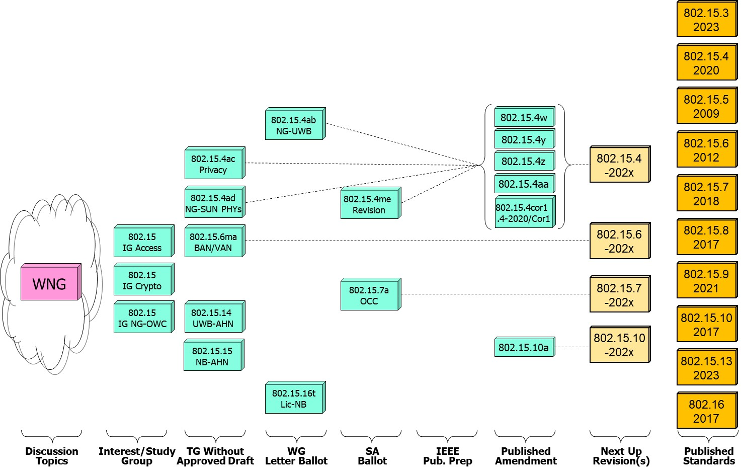
802.15 WG Standards Pipeline (July update)
802.15
IG Access
Moving to SA Ballot
New!

Slide 3
802.15.4 Rev E
What it is:
Revision to 802.15.4-2020 for the usual reasons
Major reorganization to make the standard easier to use and amend
Status:
Resolved comments from 3rd SA recirculation ballot
Applied resolutions to draft and initiated SA recirculation
Conditional approval to submit to RevCom (pending)
Closing report: https://mentor.ieee.org/802.15/dcn/24/15-24-0297-06-04me-july-2024-ieee-802-15-4me-opening-agenda-and-closing.pptx

Slide 4
TG 4ad
Amendment: Data rate and range extensions for the Smart Utility Network (SUN) Physical layer (PHY)
What is it?
  Extension to one or more SUN PHYs (commonly known as 802.15.4g)
  Expanding trade-offs for higher data rates and improved range.
  Enhancing existing SUN PHYs (3) - no new PHYs proposed
Status:
  Developing Technical Guidance Document
  Developing evaluation criteria and methodologies
    Informed by studies of spectrum usage in various scenarios and regions
  Considering technical proposals
    So far, extensions for SUN-FSK, SUN-OQPSK and SUN-OFDM presented
Closing report: https://mentor.ieee.org/802.15/dcn/24/15-24-0365-01-04ad-tg4ad-agenda-opening-and-closing-report-july-2024.pptx

Slide 5
802.15.4ab Next Generation UWB
What is it:
  Building on 802.15.4z
  Areas of enhancements:
    Ranging performance, resiliency and improved adaptability
    UWB PHY Optimizations and new features for sensing
    Enhancements and new features for data communication
    New UWB PHY features for extremely low energy consumption
    Additional means for interference mitigation and enhanced co-existence
    Narrow band assisted UWB operation
Status:
  First Working Group letter ballot completed
  1470 comments received on the draft: 854 technical, 611 editorial, 5 general
  47 comments received in the Coexistence Assessment Document

Slide 6
802.15.4ab Next Generation UWB
Near term activities (July – Sept):
  Letter ballot comment resolution
  Some more letter ballot comment resolution
  Update Coexistence Assessment Document
  Continued discussion of co-existence and related topics
Closing report: https://mentor.ieee.org/802.15/dcn/24/15-24-0424-00-04ab-july-closing-report.pptx

Slide 7
802.15.4ac Privacy
What is it:
  Improved user privacy to protect from user tracking and profiling attack.
  Mechanisms include MAC address randomization and rolling MAC address.
  Modifications to the IEEE Std 802.15.4 medium access control (MAC) wrt address usage
  Corresponding changes to MAC primitives
Status:
  Characterization of privacy issues (Issues List) completed
  Draft development, current timeline (next steps):
    Pre-ballot draft and comment collection: September 2024
    First WG LB November 2024
  Closing report: https://mentor.ieee.org/802.15/dcn/24/15-24-0372-01-04ac-july-opening-and-closing.pptx

Slide 8
802.15.16t Narrow Band Licensed Operation (NB-Lic)
What is it:
  Licensed Narrow Band (NB) Operation in channels bandwidth between 5 – 100KHz in the VHF/UHF bands such as 160MHz, 450MHz, 700MHz and 900MHz, taking advantage of the superior channel propagation properties. Targeted usages mission critical operation.
Status and main discussion topics:
  WG LB completed
  Advancing to initial SA ballot (pending)

Slide 9
802.15.6ma - Enhanced Dependability Body Area Network (ED-BAN)
What is it:
  Enhancements to the BAN (Body Area NW) Ultra Wideband (UWB) physical layer (PHY) and media access control (MAC) to support enhanced dependability to a human BAN (HBAN) and support for vehicle body area networks (VBAN).
Status:
  Resolving pre-ballot comments(D0.2.3)
  Preparing for initial WG LB
  Continuing refinement of technical content
  Reviewed analysis and contributions for the Coexistence Assessment Document
Closing report: https://mentor.ieee.org/802.15/dcn/24/15-24-0404-01-006a-tg15-6ma-closing-report-july-2024.pptx

Slide 10
Next Generation Optical Camera Communication (OCC)
What is it:
  Interest group to evaluate the value of a new OCC standard with focus on 190-10K nm
  Future applications include indoor/outdoor and submerged applications with data rates of 100Mbps and mobility of up to 350Km/h and 200m range.
Technology and techniques considered:
  Introduction of MIMO OFDM, relaying and heterogenous operation (RF based networks).
Status:
  Completed initial SA ballot
  Comment resolution underway
  PAR extension in progress
Closing report: https://mentor.ieee.org/802.15/dcn/24/15-24-0417-00-007a-15-7a-higher-rate-longer-range-occ-tg-closing-report-july-2024.pptx

Slide 11
IG-Crypt
Purpose: explore adoption of a light-weight cryptographic extension for 802.15.4
Recommendation: 2 projects needed, PARs generated in May
  Ascon cipher algorithms for 802.15.4 (Projet 15.4ae)
  EDHOC KMP for 802.15.9 (Project 15.9a)
Resolved comments received on the PARs
Closing report: https://mentor.ieee.org/802.15/dcn/24/15-24-0373-02-cryp-july-opening-and-closing.pptx

Slide 12
WNG and IG-Access
Wireless Next Generation (WNG)
Presentation: Diversified Range Communication for Disaster Response Operations [https://mentor.ieee.org/802.15/dcn/24/15-24-0402-00-wng0-diversified-range-communication-for-disaster-response-operations.pptx]
Report on ETSI TR 103 970: Feasibility study on the use of UWB in ITS [https://mentor.ieee.org/802.15/dcn/24/15-24-0375-00-wng0-etsi-tr-103-970-feasibility-study-on-the-use-of-uwb.pptx]
A good time was had by all – consider joining us in September!
IG-Access
Formed to explore the larger picture of improving effective shared access to the RF channel through coexistence of multiple 802 wireless technologies
Discussion on spectrum sharing concepts, traditional and future trends
Discussion on scope of IG and possible outputs
Will meet again in September

