Slide 1
11bn Roaming with Non-AP STA Availability Check
Date: 2024-07-15
Authors:

Slide 2
Abstract
Roaming is an important feature of 802.11bn in Multi-BSSs environment.
Since communication signal quality between non-AP STA and AP can be changed dynamically, it is difficult to estimate when non-AP STA is available in roaming target AP.
Therefore, non-AP STA’s availability check method with roaming target AP is necessary.
In this submission, availability check based roaming is proposed.

Slide 3
Roaming with Non-AP STA availability check
To address the issue, an availability check method for 11bn can be considered
  Between the original AP and the non-AP STA, the target AP’s link is enabled.
  After link enable and link switching, the target AP can perform availability check for the non-AP STA
    The availability check can be performed within specific timeout
  After the availability check, the non-AP STA can:
    communicate with the target AP if the availability check succeeds.
    return to and communicate with the original AP if the availability check fails.

Slide 4
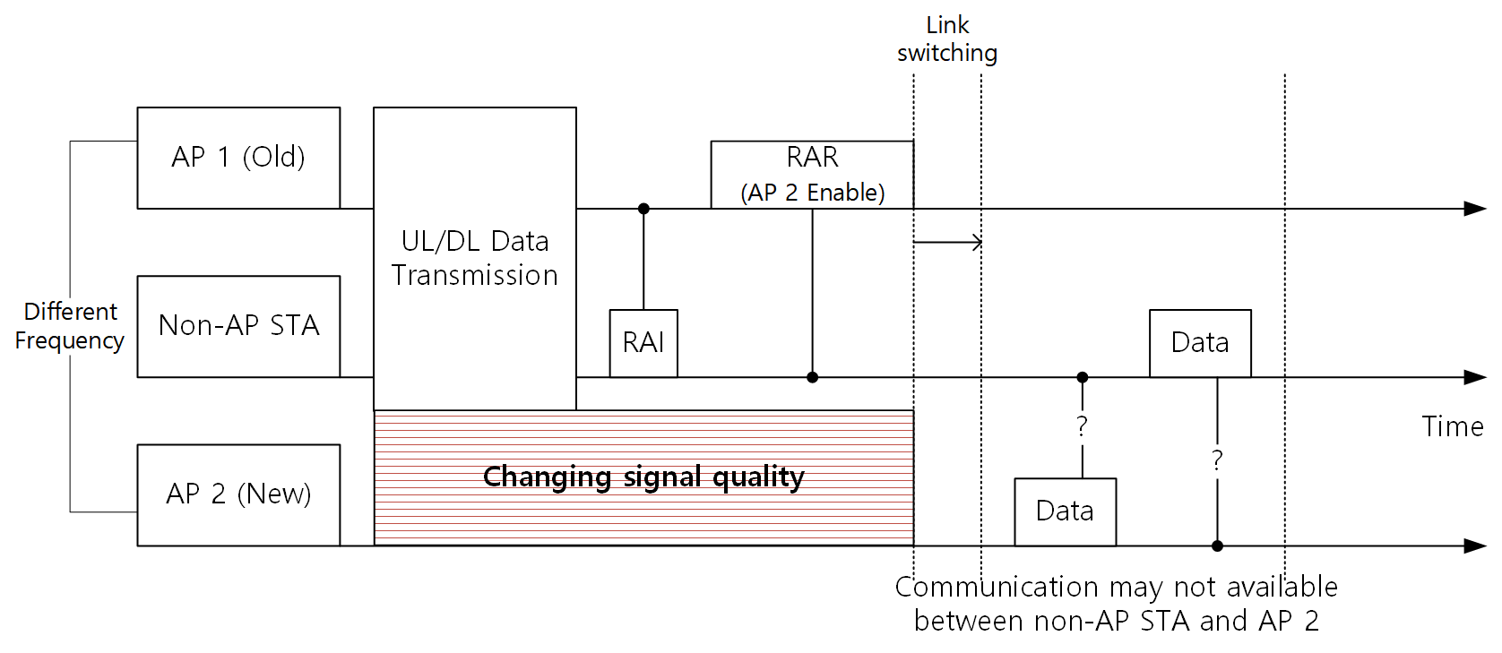
Recap: 11bn Roaming from past discussions
In some submissions [1] [2], variety of roaming methods for 11bn was proposed.
E.g., A non-AP STA roams from AP 1(Old AP) to AP 2(New, Target AP). AP 2’s link can be enabled by the non-AP STA from AP 1.
Because the non-AP STA enabled AP 2’s link from AP 1, communication may not be available between the non-AP STA and AP 2.

Slide 5
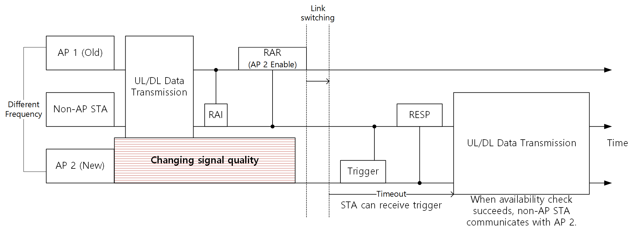
Non-AP STA availability check in target AP (Success)
Candidate target APs (e.g., AP 2) can solicit non-AP STA’s response at the roaming expected time.
  A frame soliciting non-AP STA’s response may be a Trigger frame, RTS frame, etc.,
Target AP which receives a response from the non-AP STA can commence communication with the non-AP STA.

Slide 6
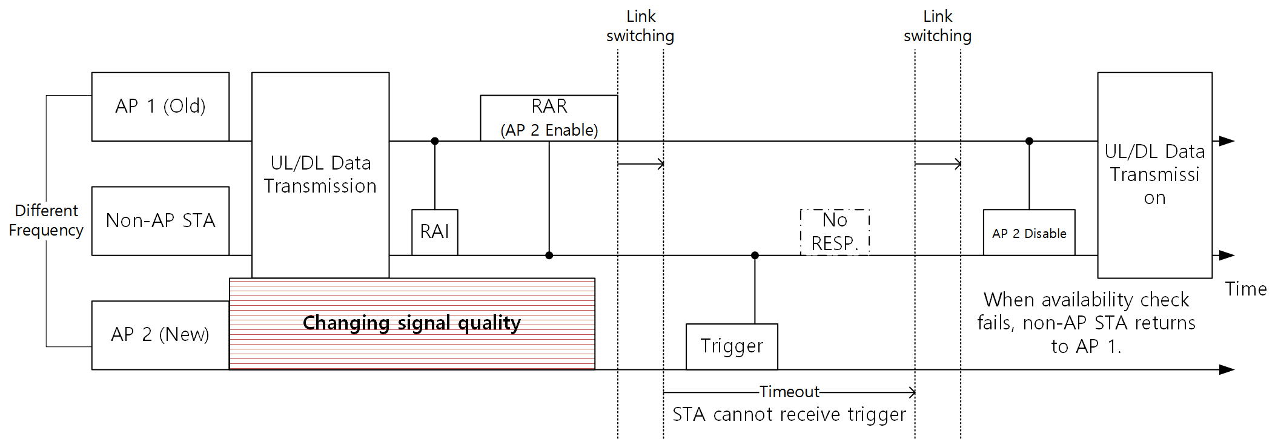
STA availability check in target AP (Failure)
Roaming procedure with the target AP can fail due to unexpected signal quality change.
  The non-AP STA cannot receive from the the target AP a frame which soliciting non-AP STA’s response.
STA can resume communication with the old AP(e.g., AP 1) by transmitting comeback frame.

Slide 7
Summary
In this submission, STA availability check based roaming is proposed.
Since communication signal quality between STA and AP can be changed unexpectedly, it is difficult to estimate when STA is available in roaming target AP.
In order to provide reliable roaming performance, STA’s availability based roaming method is necessary.

Slide 8
References
[1] 24/0052r0, “Seamless Roaming Details”, https://mentor.ieee.org/802.11/dcn/24/11-24-0052-00-00bn-seamless-roaming-details.pptx
[2] 24/0412r1, “Seamless Roaming Procedure Follow-Up”, https://mentor.ieee.org/802.11/dcn/24/11-24-0412-01-00bn-seamless-roaming-procedure-follow-up.pptx

