Slide 1
High Duty Cycle NB Transmission vs Wi-Fi
Date: 2024-07-17
Authors:

Slide 2
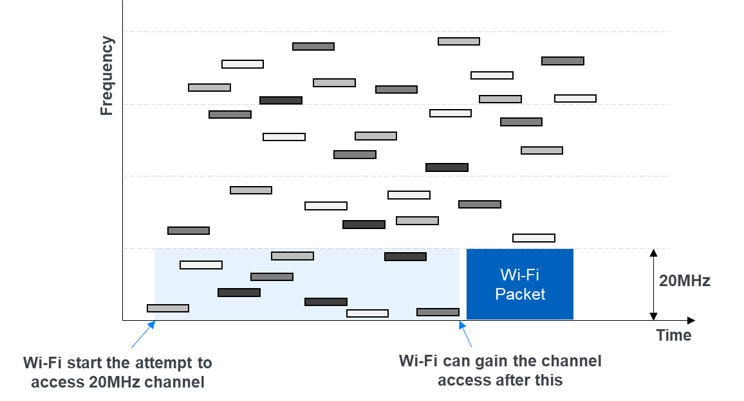
Problem Description
Multiple high duty cycle NB connection can result in very high channel access latency for Wi-Fi
The topic has been discussed in the IEEE Coex SC [1][2]

Slide 3
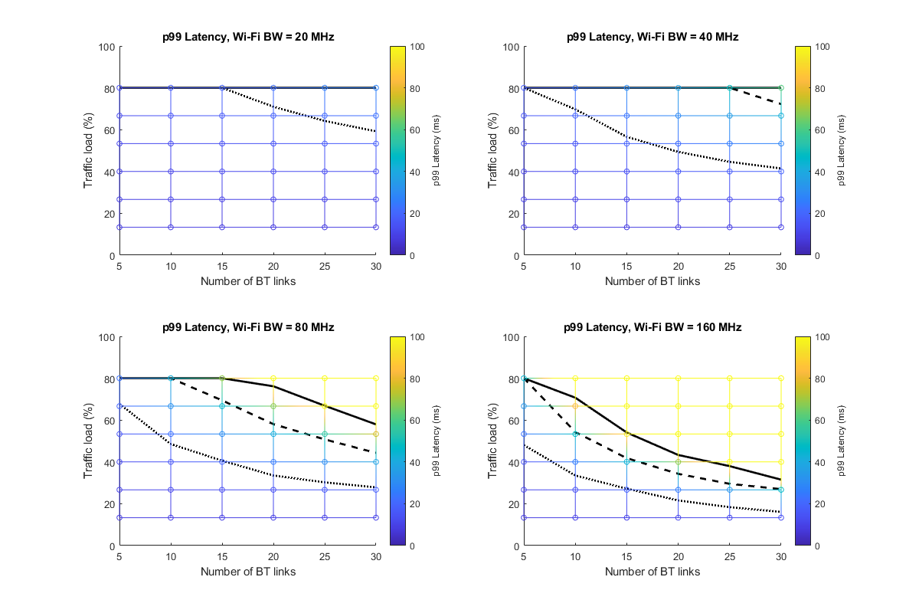
Channel Access Delay for Wi-Fi
240 channels
All links located in 20m×20m area
Bluetooth is the NB transmitter
Uses secondary channel deferral
Each link has a central & peripheral device
Connection interval = 7.5ms
Packet size = variable
Wi-Fi AP of different bandwidth tries to access the channel
Channel access delay: time from packet arrival to start of transmission
  99%ile shown in the plots
100ms
50ms
20ms

Slide 4
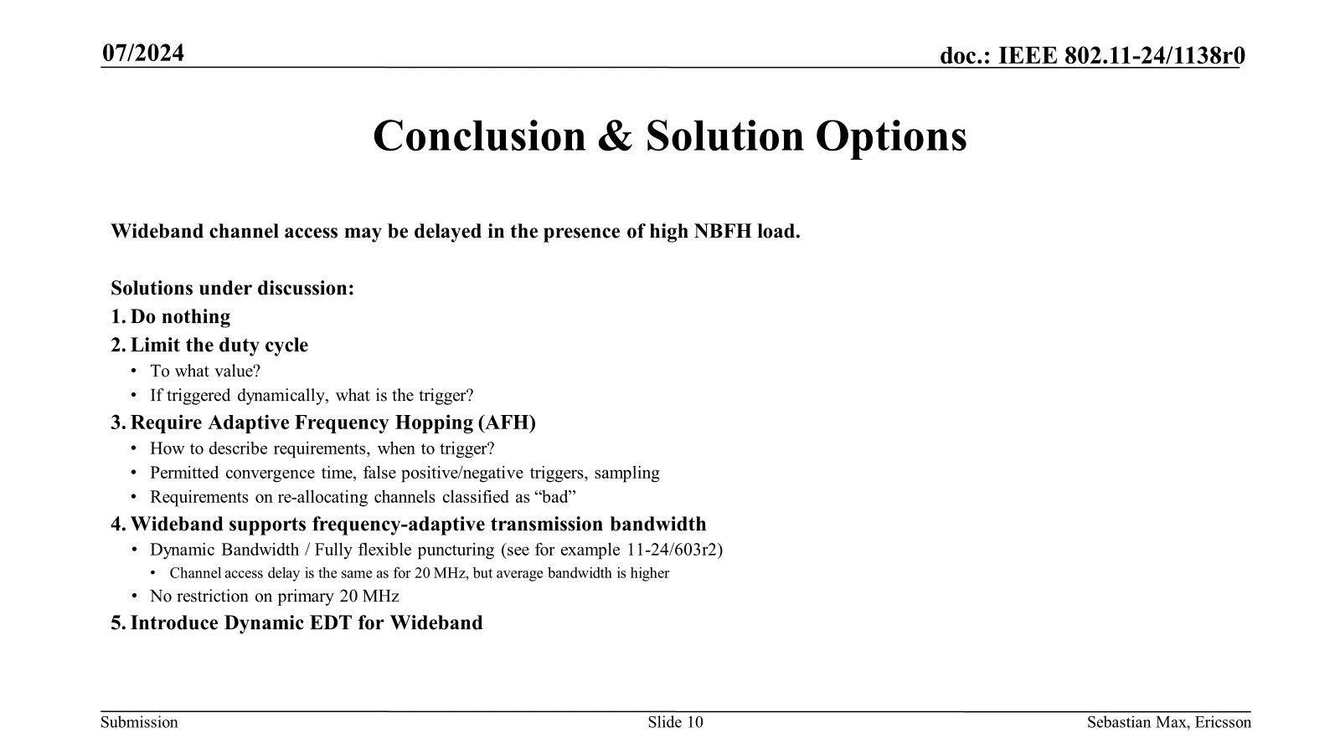
Potential Solutions
Prioritize certain part of the band that is not used by Wi-Fi for high duty cycle transmission
Stricter requirements for channel access for high duty cycle transmission
Efforts by NB
Efforts by Wi-Fi

Slide 5
Prioritized Channels
Certain portions of 5 and 6 GHz are either lightly used or not used by Wi-Fi
  Ch144, 5710-5730 MHz (UNII-2C/UNII-3)
  Ch169, 5835-5855 MHz (UNII-3/UNII-4)
  5925-5945 MHz (UNII-5)
Prioritize these channels when NB wants to use high duty cycle NB transmission

Slide 6
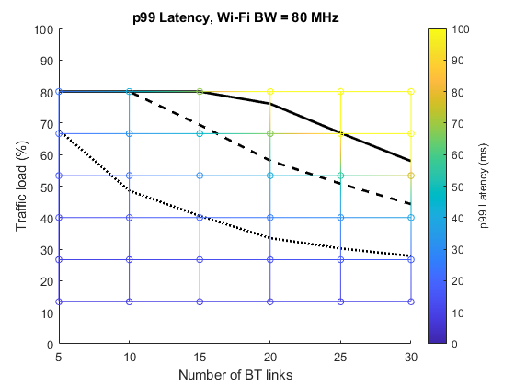
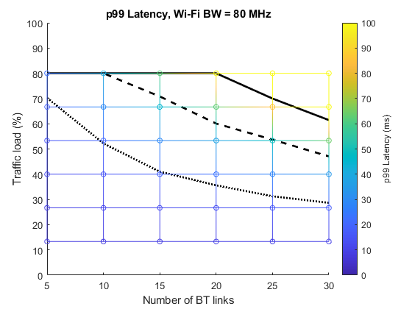
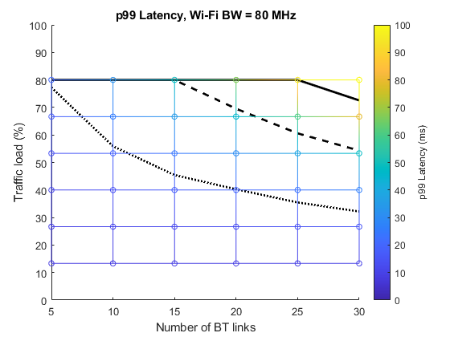
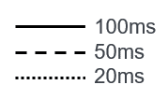
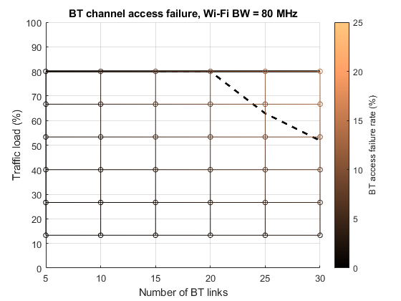
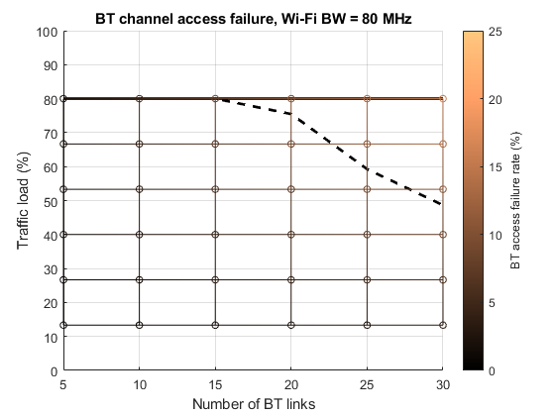
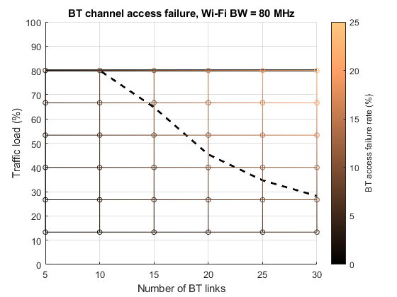
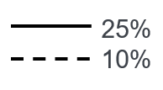
Example: 10 Prioritized channels
Uniform probability of all channels
Probability of selecting prioritized channels = 10%
Probability of selecting prioritized channels = 25%
Wi-Fi channel access latency improves
Higher failure rate of NB channel access

Slide 7
Stringent Requirements For Channel Access
The fundamental issue arises when a NB begins transmitting on a Wi-Fi channel that is already occupied by an ongoing NB transmission.
A potential solution could involve setting a higher threshold for channel access when NB wants to use high duty cycle NB transmission, thereby reducing the likelihood of concurrent transmissions within a single band.
CCA deferral
cca-2
20MHz
cca-k
NB TX
cca-1

Slide 8
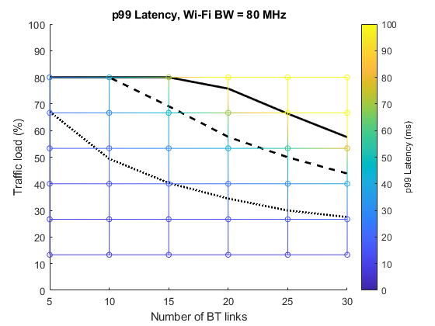

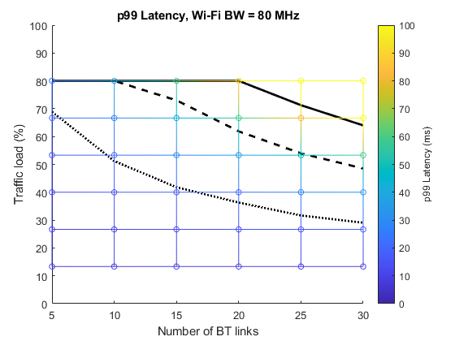
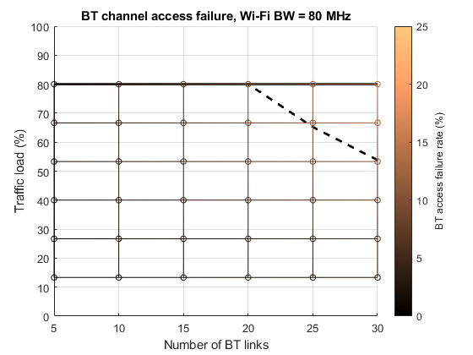
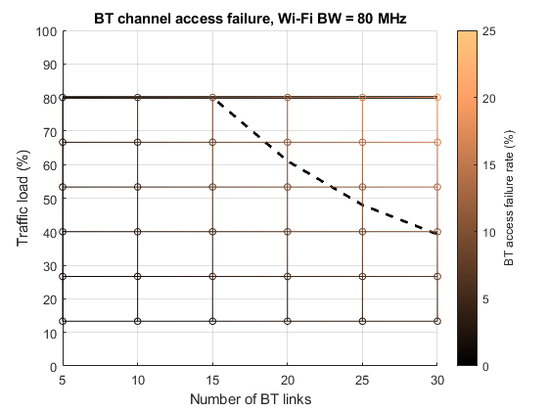
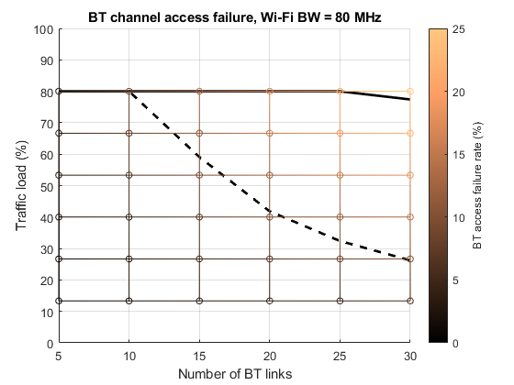
Example
Number of CCAs = 2
Number of CCAs = 3
Number of CCAs = 5
For a similar degradation in NB performance, the improvement in Wi-Fi latency is not as good as using prioritized channels

Slide 9
Summary
Giving preference to channels with lower Wi-Fi usage for high duty cycle NB transmissions might be advantageous
  A simpler solution that might be easier to implement
Setting a stringent channel access requirement is not as useful as using a set of prioritized channels

Slide 10
Reference
[1] IEEE 802.11-24/1138r0: Narrowband Frequency-Hopping blocking Wideband, Sebastian Max (Ericsson)
[2] IEEE 802.11-24/1150r1: NB hop density, Menzo Wentink (Qualcomm)

