Slide 1
TGbi – Discussion on initial group assignment
Date: 2024-07-15
Authors:
Name | Affiliations | Address | Phone | email
A. De la Oliva | InterDigital, UC3M | Avda. De la Universidad 30, Leganes, Madrid, Spain | +34 91 6248803 | aoliva@it.uc3m.es
J. Levy | Interdigital

Slide 2
Discussion
Current IEEE 802.11bi/D0.4 indicates in different places the process for initial assignment of the default group epoch.
Default group epoch is identified by Epoch Group Number 0 and its characteristics are not defined at the moment (may vary with each AP?)
The process defined in the spec varies in different clauses, but it seems to be the following:
STA includes in the encrypted Association Request frame optionally the Minimum Epoch Pacing element (9.4.2.338).
AP assigns the STA to the default EDP group epoch by including in the encrypted Association Response frame an EDP element (9.4.2.337, btw not included in the Association Response frames elements)

Slide 3
Discussion
Once the STA is assigned with the default group epoch parameters, it can get information on other groups
This is done by receiving an EGPA element (9.4.2.339) with the list of groups and their parameters (frame to do this is not yet defined)
After this the STA can ask to join a different group or it can ask for a new group to be created.

Slide 4
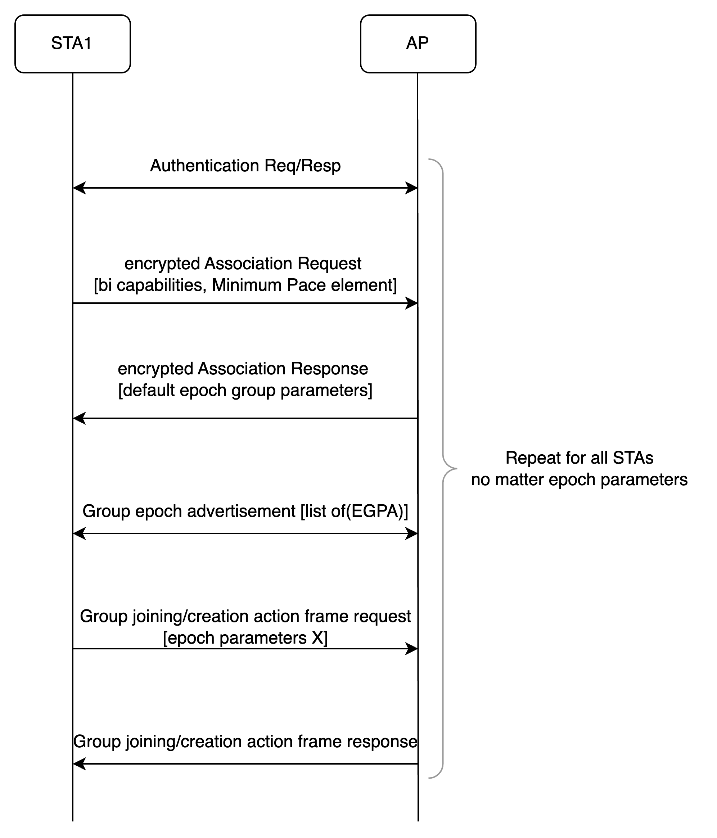

Slide 5
Analysis
Following the proposed approach, for each STA at least 2 (assoc) + 2 (group parameters learning + request) messages need to be exchange in order to join a group different from the default one
In addition, the EGPA can be potentially large (n x 17 octets) and it is sent (currently) in unicast to each STA

Slide 6
Proposed change
STAs send their desired group epoch parameters on association, using already defined elements in encrypted Association Request frame.
The STA can include, in addition to the Minimum Pace Element, information similar to the EDP element to indicate the parameters they would like to use for the group epoch
The AP can directly assign the group epoch of choice to the STA in association, avoiding overhead
This has no impact in the rest of messages or procedures already defined

Slide 7
