Slide 1
Transmission Enhancement for XR Use case
July 2024
Date: 2024-07-01
Authors:
Notes:
September 2012

Slide 2
Introduction
XR use-case
Encompassing the case where the two devices (i.e., remote device like XR headset, and device for computation offloading such as laptop) are connected through the same AP
Need to support low End-to-End (E2E) latency
A proxy SCS mechanism is proposed in [1-3]
Enhanced TXOP sharing mechanisms are proposed. [4-5]
AP
AP relay link
STA A
STA B
Direct link

Slide 3
Motivation
The transmission between STA_A and STA_B can be via either the AP relay link or the direct link.
Considering the mobility of STA_A, the delay performance of the direct link (i.e. one-hop delay) may be better than the one of the relay link (i.e. two-hop delay).
One potential enhancement is to allow the data transmission can be quickly switched between the AP relay link and the direct link without the packet loss.
Or aggregate the data transmission through the AP relay link and the direct link if both STA_A and STA_B are multi-radio MLDs.
In this contribution, we propose two candidate schemes, i.e. one is transparent for the associated AP, the other one is non-transparent for the associated AP.
AP
AP relay link
{SNS1,PTK1}
{SNS2,PTK2}
{SNS3,TPK3}
STA A
STA B
Direct link

Slide 4
Transparent Scheme
In order to maintain a common BA scoreboard and reorder buffer when the data transmission is switched from the direct link to the AP relay link, the transmitter (e.g. STA_A) shall send the packet to the destination STA (e.g. STA_B) with the following procedure and rules:
Step 1. Construct the MPDU (protected by TPK) as it will be sent through the direct link, e.g.
RA：STA_B MAC address
TA：STA_A MAC address
A3：BSSID
TID #a, SN#m
Step 2. Encapsulate the above MPDU into a Data frame with the following setting and transmitted to the recipient STA through the AP (See Appendix for details)
RA：BSSID
TA：STA_A MAC address
A3：STA_B MAC address
TID #b, SN#n

Slide 5
Transparent Scheme (Cont.)
In order to allow the TDLS transmitter to know the receive status of MSDUs and shift the BA scoreboard window through the AP relayed link, define TDLS BAR and BA Management frames which are encapsulated in Data frames and transmitted to the TDLS peer STA through the associated AP.
Table. TDLS BAR Management frame
Table. TDLS BA Management frame
Order | Information
1 | Category
2 | Action
3 | Dialog Token
4 | BAR Control
5 | BAR Information
Order | Information
1 | Category
2 | Action
3 | Dialog Token
4 | BA Control
5 | BA Information

Slide 6
Transparent Scheme (Cont.)
The TDLS transmitter may monitor the link qualities of the direct link and the relay link and decide when to switch the data transmission from one link to the other link.
Define TDLS Relay Link Measurement Request and Response Management frames
Which can be encapsulated in a Data frame and transmitted to the TDLS Peer STA through the AP
Which also can be transmitted through the TDLS direct link
When the TDLS peer STA receives a TDLS Relay Link Measurement Request, then it shall report the link quality with the associated AP
May include the link quality between STA_A and AP within the TDLS Relay Link Measurement Request
Include the link quality between STA_B and AP within the TDLS Relay Link Measurement Response

Slide 7
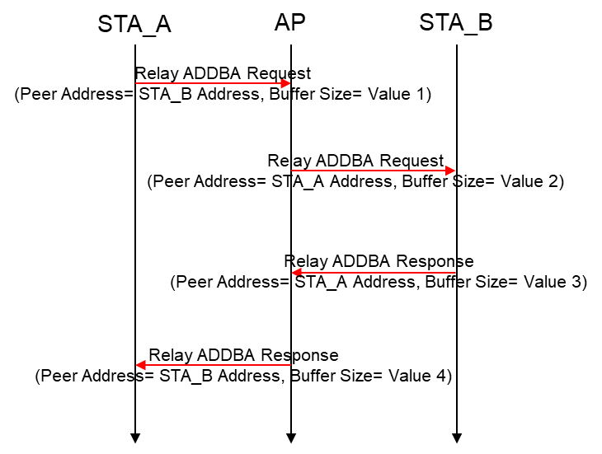
Non-transparent Scheme
Define Relay ADDBA Request and Response frames
Which are the same as the current ADDBA Request and Response frames except including a Peer Address or AID field
When the AP forwards the received Relay ADDBA Request and Response, it is only allowed to change the Buffer Size Value, as shown in the right figure.
The AP shall maintain a separate BA scoreboard and a reordering buffer for the relayed data
Keep the SN and the TID of the relayed MPDU unchanged
Hence, the AP shall recognize relayed data frame from the non-relayed data frame according to the TA and Address 3
The relayed data frame is the data frame between STA_A and STA_B
The other data frame is named as the non-relayed data frame

Slide 8
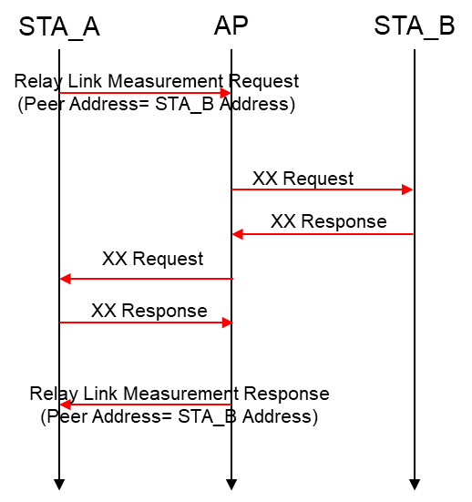
Non-transparent Scheme (Cont.)
The transmitter may monitor the link qualities of the direct link and the AP relay link. Then it decides when to use the direct link for transmission
Define a new Relay Link Measurement Request/Response frames. And the corresponding frame exchange procedure is shown as the right figure.
Peer Address
Link quality, e.g. RSSI
Similarly, STA_A may transmit a Relay BAR frame to the AP to acquire the status of MPDUs destination to STA_B. The AP shall respond with a Relay BA frame
Which are the same as the current BAR and BA frames except including a Peer Address field

Slide 9
Conclusions
In this presentation, we propose two candidate schemes in order to facilitate the data transmission can be quickly switched or aggregated between the AP relay link and the direct link.
The proposed transparent scheme can be easily incorporated into the current TDLS protocol.

Slide 10
References
[1] 11-23/1958r0 Proxy QoS management for XR use cases (Guoqing Li, Meta)
[2] 11-23/0073r0 Thoughts on Proxy SCS (Guogang Huang, Huawei)
[3] 01-24/1885r1 End-to-end QoS with SCS (Duncan Ho, Qualcomm)
[4] 11-23/1387r1 TXOP sharing extensions for XR use-cases (Dibakar Das, Intel)
[5] 11-24/0668r1 Data Forwarding within TXOP for XR Use Cases (Seongho Byeon, Samsung)

Slide 11
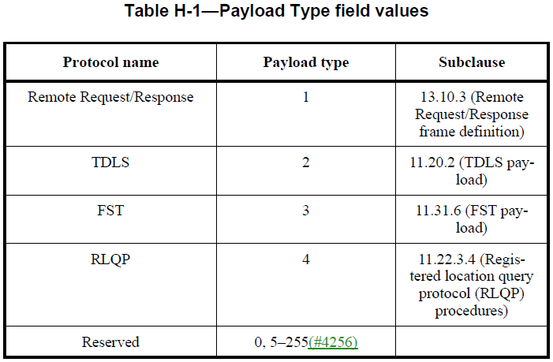
Appendix Usage of EtherType 89-0d

