Slide 1
802.11 WG July 2024 Session Report
Date: 2024-07-18
Authors:

Slide 2
Abstract
This document is a digest of the closing reports of all 802.11 sub-groups for presentation at the July 2024 closing plenary meeting. Liaison reports (including liaison reports from the opening plenary) are also included.

Slide 3
Robert Stacey, Intel

Slide 4
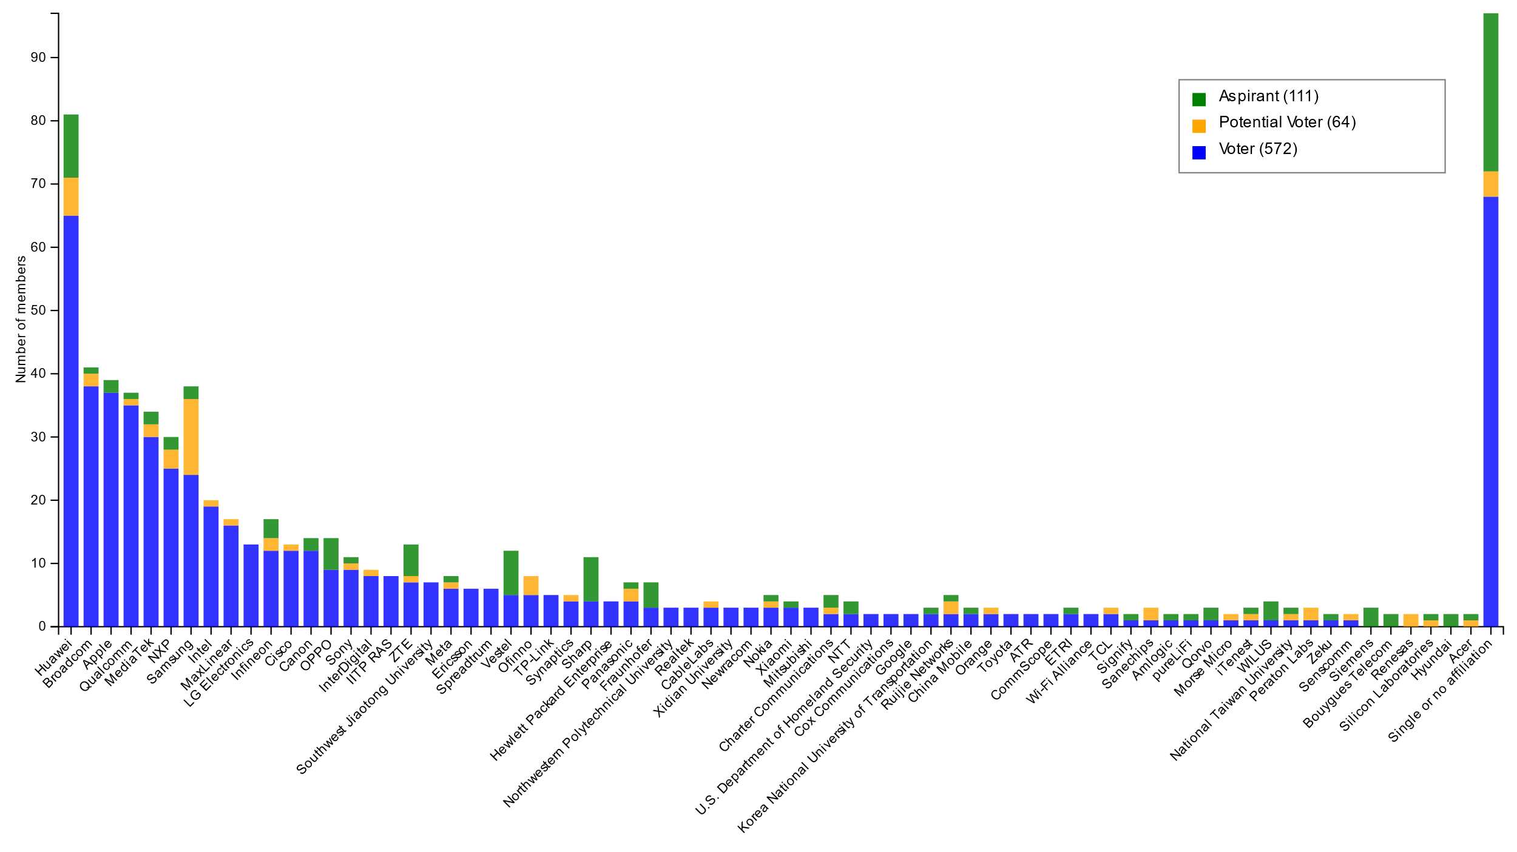
Members by affiliation
Robert Stacey, Intel

Slide 5
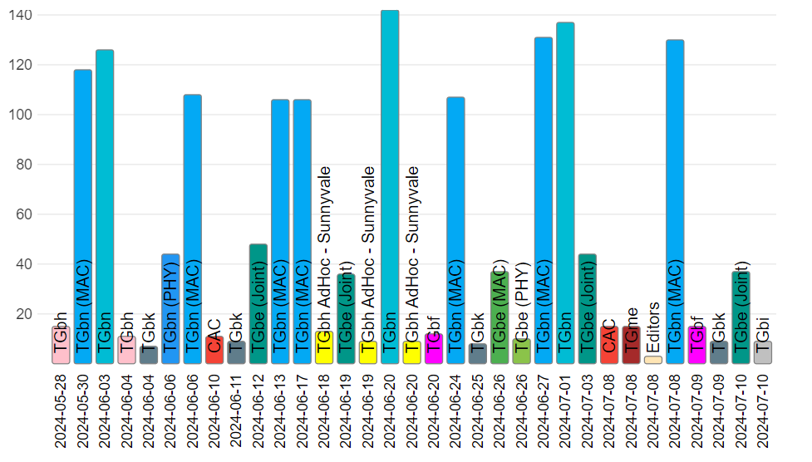
Attendance by subgroup (May to July)
Robert Stacey, Intel

Slide 6
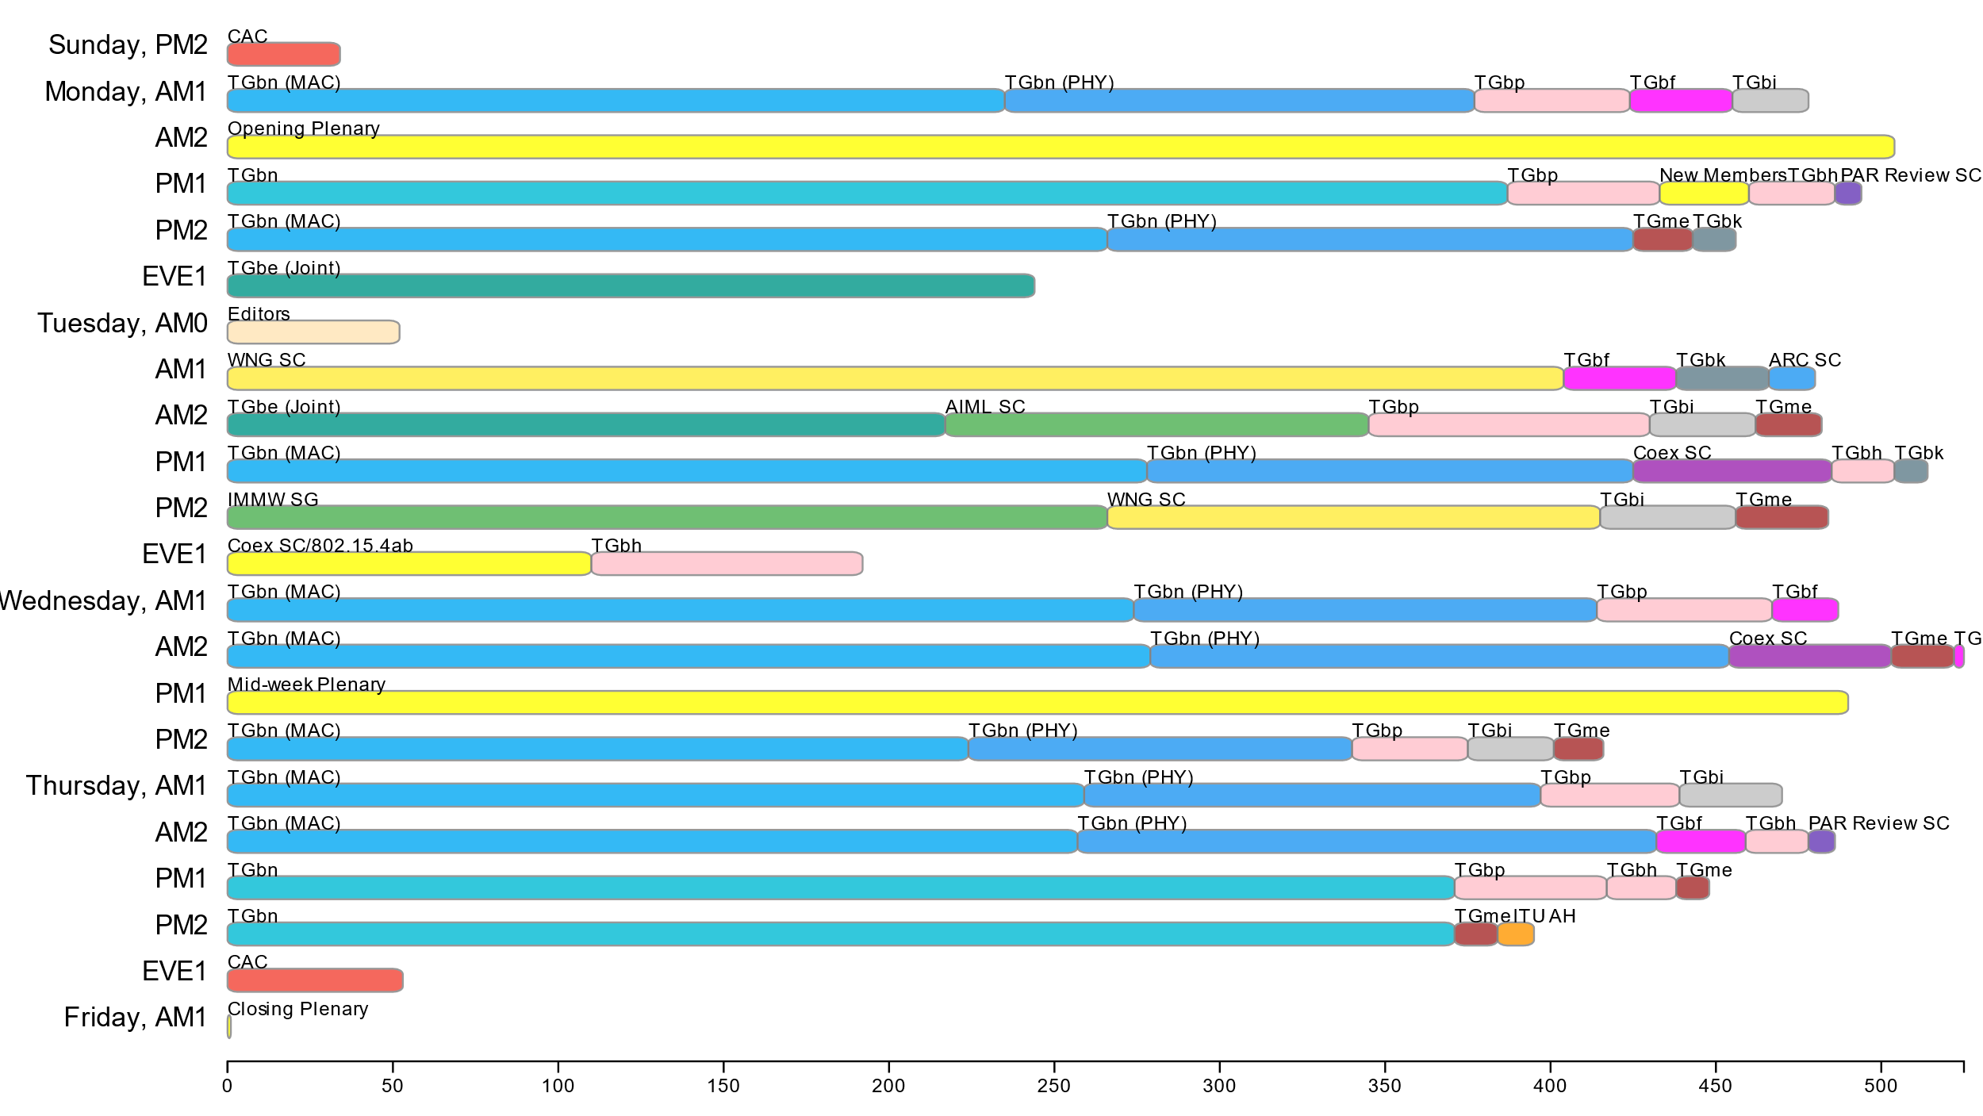
Attendance by breakout (July plenary session)
Robert Stacey, Intel

Slide 7
802.11 WG Editors’ Meeting (July 2024)
Date: 2024-07-16
Authors:

Slide 8
July 2024 Editors’ Meeting Report
Roll Call / Contacts / Reflector
Brief status report
Amendment alignments and draft development snapshot
Process of reviewing drafts when their baseline changes
11bk/D2.0 MDR/MEC Completed
Editorial Style Guide updates and issues for feedback
ANA number spaces

Slide 9
Volunteer Editor Contacts
  WG – Robert Stacey – robert.stacey@intel.com, Emily Qi – emily.h.qi@intel.com
  TGbe – Edward Au – edward.ks.au@gmail.com
  TGbh – Carol Ansley – carol@ansley.com
  TGbi – Po-kai Huang – po-kai.huang@intel.com
  TGbn- Ross Jian Yu – ross.yujian@huawei.com
TGbk – Roy Want – RoyWant@google.com
TGbf – Claudio da Silva – claudiodasilva@meta.com
  REVme – Emily Qi – emily.h.qi@intel.com, Edward Au – edward.ks.au@gmail.com

Slide 10
July meeting roundtable status report
11bh – D5.0. Received 115 comments and work on comment resolution and plan to recirc D6.0 out of the July meeting.
11be – D6.0. Received 160 comments and work on comment resolution and plan to recirc D7.0 out of the July meeting, which will be based on REVme D6.0 and 11bh 5.0.
11bk –D2.0. Completed MDR/MEC and expect to complete and go to WG recirc on D3.0 out of the July meeting.
11bf – D4.0. received 207 comments on the initial SA ballot and plan to recirc SA ballot out of Sept meeting.
11bi – D0.4 is available, received 507 comments on CC and plan to have D0.5 by the end of the week.
REVme – D6.0, 257 comments received on the second recirc SA Ballot on D6.0. Plan to go SA recirc D7.0 out of the July meeting.

Slide 11
Editor Amendment Ordering
See http://grouper.ieee.org/groups/802/11/Reports/802.11_Timelines.htm
Changes are usually based on MDR readiness.
As discussed in May 2024
Amendment Number | Task Group | Page Count | Projected RevCom Date (submission)
REVme | TGm | 6217 | Oct 2024
802.11-2024 Amendment 1 | TGbh | 34 | Oct 2024
802.11-2024 Amendment 2 | TGbe | 1031 | Oct 2024
802.11-2024 Amendment 3 | TGbk | 111 | Dec 2024 (?)
802.11-2024 Amendment 4 | TGbf | 220 | Mar 2025 (?)
802.11-2024 Amendment 5 | TGbi
802.11-2024 Amendment 6 | TGbn

Slide 12
Draft Development Snapshot
Changes from last report shown in red.
July 2024
TG | Published or Draft Baseline Document |  |  |  |  |  |  | Source | MDR | Editor | Snapshot Date
 | Published | me | bh | be | bk | bf | bi
me | Y | 6.0 |  |  |  |  |  | FrameMaker 2020 | Yes | Emily Qi, Edward Au | July 13, 2024
bh | Y | 6.0 | 5.0 |  |  |  |  | FrameMaker | Yes | Carol Ansley | July 16, 2024
be | Y | 5.0 | 4.0 | 6.0 |  |  |  | FrameMaker (old) | Yes | Edward Au | July 15, 2024
bk | Y | 5.0 | 4.0 | 5.01 | 2.0 |  |  | Word | No | Roy Want | July 16, 2024
bf | Y | 5.0 | 4.0 | 5.1 | 2.0 | 4.0 |  | FrameMaker 2020 | Yes | Claudio da Silva | July 15, 2024
bi | Y | 5.0 | 2.0 | 5.0 | 1.0 | 3.0 | 0.4 | FrameMaker 2020 |  | Po-kai Huang | July 15, 2024

Slide 13
Process of reviewing drafts when their baseline changes
When the baseline for a draft changes, the editor or a volunteer should review all tables and figures in the draft with change instructions against the baseline to ensure that there are no conflicts.
The editor or a dedicated volunteer should review the bit assignment in fields and tables (especially those that are not covered by ANA) immediately after the agreement.
If the order of the draft changes (e.g., two amendments were agreed to swap their publication orders or their baseline changes), each task group needs to identify a dedicated volunteers (or just the editor themselves, if the draft is small) whose job is to identify changes in baseline that are not present in the draft. Basically, responsible for identifying technical content changes and merging changes to quoted text, figures, etc. And, along the way, the numbering would be updated. Each review would end up with the draft’s title sheet accurately reflecting a new baseline.

Slide 14
11bk/D2.0 MDR/MEC Completed
11bk/D2.0 MDR started in May 2024 and completed in July 2024
  https://mentor.ieee.org/802.11/dcn/24/11-24-0879-04-0000-ieee-p802-11bk-d2-0-mandatory-draft-review-mdr-report.docx

Slide 15
802.11 Style Guide
See https://mentor.ieee.org/802.11/dcn/09/11-09-1034-21-0000-802-11-editorial-style-guide.docx
We update 802.11 Style Guide based on IEEE Standards Style Manual and consistency changes in final publication of the 802.11 standard
Editor’s responsibility includes checking the 2021 IEEE Standards Style Manual when creating or updating drafts. Policy (inclusive terms), key words and pronouns (e.g., he, she) were revised.
https://mentor.ieee.org/myproject/Public/mytools/draft/styleman.pdf
Submissions with draft text should conform to both the WG11 Style Guide and IEEE Standards Style Manual
Note that the 802.11 Style Guide evolves with our practice

Slide 16
Notes to Everyone
Whenever
a value is being added to a table or figure (whether bit position or enum value) or
a field is being added to a structure (whether itself a field or an element or a frame),
for everyone (including but not only the TG Editor) to ask themselves
is it possible someone else is also allocating in this field, and
if so how we find and coordinate with them

Slide 17
ANA managed number space
Protocol Version subfield: 9.2.4.1.2
Frame types and subtypes: 9.2.4.1.3, Tables 9-1 and 9-2
Element ID and Element ID extension: Table 9-128
Capability Information field: 9.4.1.4
Extended Capabilities: 9.4.2.25, Table 9-190
Reason codes: 9.4.1.7, Table 9-77
Status codes: 9.4.1.9, Table 9-78
Action frame categories: 9.4.1.11, Table 9-79
Authentication algorithm: 9.4.1.1
RSNE: 9.4.2.23
Cypher suites: Table 9-186
AKM suites: Table 9-188
RSN Capabilities: Figure 9-345
RSNXE Capabilities: 9.4.2.240, Table 9-365
ANQP-element (Info ID): 9.4.5.1, Table 9-412
Neighbor Report subelements: 9.4.2.35, Table 9-210
FTE subelements: 9.4.2.46, Table 9-219
Public Action frames: 9.6.7.1, Table 9-450
WMN-Notification Types: 9.6.13.29, Table 9-516
Mesh Configuration Active Path: 9.4.2.96.2, Table 9-277
TLV encodings: 9.4.4
KDE Selectors data type 12.7.6.1
Operating classes: Annex E
global, USA, Europe, Japan
MIB objects: Annex C
ieee802dot11, dot11smt, dot11phy, dot11mac, dot11StationConfigEntry, dot11OperationEntry, dot11Compliances, dot11Groups

Slide 18
Backup

Slide 19
MIB Style, Visio and Frame Practices
11-15/355r13 MIB TruthValue usage patterns
MIB Style: We use a single style with appropriately set tabs, and use leading Tabs to distinguish the syntax and description parts. (Adrian Stephens Feb 9, 2010)
Two ways to format a figure & its caption in frame:
  Insert a table. Insert anchored frame inside table cell to hold graphics. Use table caption as figure caption.
  Insert an anchored frame. Insert caption inside a text frame inside the anchored frame. Insert graphics inside the anchored frame.
Do not reference other clauses in Visio figures, it is very hard to maintain the references in figures
Comment resolvers on Visio figures will be asked to provide the revised figures
Keep embedded figures using Visio as long as possible (not in Word)
  Near the end of sponsor ballot, turn these all into .emf (windows meta file) format files (you can do this from visio using “save as”).
  Keep separate files for the .vsd source and the .emf file that is linked to from frame. There is high likelihood we should use .emf
  Use the figure number or a short version of the figure title (shown in your final draft) for the name of the Visio and emf file.
  One figure, one Visio file. Don’t store multiple figures in one Visio file.
Frame format figures are tables
The MathML editor for equations may be applicable

Slide 20
Publication process
Publication editor creates a marked up PDF with editorial changes highlighted
802.11 technical editor forms a review committee, usual the task group editor and one other person associated with 802.11 editing
Each member of the committee should review each change proposed by the publication editor
Pay particular attention to
  Reconstructed sentences
  Tables with number changes
  ANA assignments
The review process is complete when all publication changes have been reviewed

Slide 21
Clause 6 Re-Write
Changes have been included in REVme D2.0.
Discussion:
11az and 11bd have 802.11-2020 as their baseline and are not affected.
REVme will need to update these to conform to the new Clause 6 style when these are rolled in
Emily/Edward will setup a tiger team to do this.
11be has REVme as baseline and will need to conform when it bumps up to REVme/D2.0 as baseline.
Similarly, for 11bf, but should probably wait until 11be has done its update.
11bf/D1.0 will keep REVme/D1.3 as baseline and postpone updates until after initial WG ballot.

Slide 22
Searchable definitions ( to be discussed in Jan 2024)
Youhan Kim provided an update:
After discussion within the TGme group, the direction we are going with is
Add the full acronym AFTER the colon
Make incremental changes only. E.g. do not delete existing ‘partial’ acronyms within the ‘name’ of the term.
For example,
access point (AP) reachability: [AP reachability] An AP is reachable by a station (STA) if preauthentication messages can be exchanged between the STA and the target AP via the distribution system (DS)
Note that we are not deleting “(AP)” in the ‘name’ of the term (the point #2.a above) even though it seems it should be removed per some of the feedback from the publication editors. This is to avoid having too many changes lumped into this particular effort.
Already rolled into REVme.
===
A comment (from Robert Stacey) on the changes in D4.0 (#6035):
The style used here for providing an acronym for the term being defined (in square brackets after the colon) is inconsistent with the style used in other IEEE SA standards (for example 802.3-2022) and with the style used elsewhere in this standard (e.g. 258.35). It is also inconsistent with the IEEE SA style guide, which states: The abbreviation or acronym should be placed in parentheses when following the full term.
For example, access point (AP) : [AP] An entity that contains one station (STA) a ...
“(AP)” shall not be deleted.

Slide 23
Review updated style guide
See: https://mentor.ieee.org/802.11/dcn/09/11-09-1034-21-0000-802-11-editorial-style-guide.docx

Slide 24
Style guide update (to be discussed in Jan 2024)
(from Rubayet Shafin)
2.3 “Is set to”
The verb “set” should only be used when describing how a field obtains a value, e.g. “The Measurement Duration field is set to the preferred or mandatory duration of the requested measurement, expressed in units of TUs.”
Where the value of the field is read or referenced, (e.g., in the context of a condition), “is set to” shall not be used.
When used for explaining a causation/rationale for setting a value in a particular way, the usage of “set to” is appropriate. For example, “The <xyz> is set to 1 to indicate that…”.
Note that when a field value is tested in order to construct another field value, “equal to” is used for the test, and “set to” for the constructed field. When the sentence is followed by an alternative case (e.g., using “Otherwise”), “set to” is used for the value for the alternative case. “If the <xyz> field is equal to 0, the <abc> field shall be set to 1. Otherwise, the <abc> field shall be set to 0”

Slide 25
Issues for feedback
1) Based on the discussion in TGbe, I need an advice on whether the following terms are capitalized:
a) "HE sounding NDP" vs. "HE Sounding NDP"
b) "EHT sounding NDP" vs. "EHT Sounding NDP".
In P802.11be D5.01, I used "EHT sounding NDP" for the sake of consistency with "HE sounding NDP". A few members asked whether sounding should be capitalized or not 'cause they consider these are frame names.
2) Based on a comment assigned to me in REVme (and a discussion in the most recent Editors' teleconference call), for a term that has been defined in subclause 3.4 (Abbreviation), do we need to define the abbreviation again on the first use in each major clause?

Slide 26
July 2024 AIML SC Closing Report
Date: 2024-07-17
Authors:

Slide 27
Work Completed
  1 Meeting Slot
    Tuesday AM2
    Agenda: 11-24/955r1
    SP and Motion Booklet: 11-24/765r1
  Achievements
    One technical presentation
      ML-aided CSI Quantization for smooth beamforming
    Approved minutes of AIML SC for May 2024 Warsaw Interim: 11-24/961r0

Slide 28
Plans for September 2024
No teleconference planned
Technical presentations
  Additional results, exploration and feasibility for existing use cases
  Additional AIML use cases
  Technical report drafts

Slide 29
ARC Closing Report
Date: 2024-07-18
Authors:

Slide 30
Work Completed - 1
Agenda is here: 11-24/0988r2
IEEE Std 802 revision:
  Received a report on the P802REV activities
    Started to resolve SA ballot comments
    Resolutions that were completed were to the satisfaction of the 802.11 representatives
    SA recirc process continues...
  There is 1 item that impacts 802.11:
    Change of terminology and definition for EPD and LPD concepts

Slide 31
Work Completed - 2
WBA E2E QoS presentation
  Deferred to September – WBA is still having internal discussions.
Annex G:
  The author of an updated proposal progressing the Annex G replacement, was not available. This item is deferred to September.

Slide 32
Monitoring/future activities
    Other items being tracked (but not actively worked unless/until contributions):
    Related to IEEE Std 802 updates:
      EPD and LPD terms are going away – we need to update 802.11 to align
      802.1AC mapping from ISS to 802.11 MAC SAP interface
      Consider any changes to remove 802.2/LLC terms?
      802.11’s “Portal”, and mapping to/usage of IEEE Std 802 terminology
      Access Domains: “802 Access Domains”? In 802.11, an ESS? TGbe implications?
      Is the DS a bridge (small ‘b’)?
    MLME-RESET, versus MLME-JOIN, MLME-START, MLME-SCAN and MLME-END
      One aspect is how MAC address is set/controlled – related to IEEE 1609/TGbd activities

Slide 33
Plans
Ongoing work:
Monitor results of IEEE P802REVc recirculation ballot
  Start progress on EPD/LPD clean-up
Annex G replacement phase 2, continued
WBA E2E QoS coordination, continued
Monitoring/future activities, or other relevant topics, if any contributions
Teleconferences – None
Two meeting slots requested in September

Slide 34
Coex SC Closing Report
Date: 2024-07-18
Authors:

Slide 35
Coex SC’s week at a glance
Met three times
Two Coex SC (only) slots
One Joint session with 15.4.ab

Slide 36
ETSI BRAN Update to 802.11 (1/2)
EN 303 687 (Wireless Access System/Radio Local Area Network (WAS/RLAN) in the license-exempt 6 GHz band)
Version 1.1.1 published
EC criticizes normative reference to IEEE 802.11ax-2021 because EC does not recognize IEEE as SDO
TC BRAN asking EC to consider listing version 1.1.1 in OJEU – Even if this requires adding a note limiting how the standard may be used for providing presumption of conformity
Version 1.1.5 uses IEEE 802.11ax-2021 as informative reference
Inclusion of normative text describing requirements for operating Narrowband Frequency Hopping (NB FH) remains most important discussion item

Slide 37
ETST BRAN Update to 802.11 (2/2)
EN 301 893 (Wireless Access System/Radio Local Area Network (WAS/RLAN) in the license-exempt 5 GHz band)
Normative reference to IEEE 802.11-2020 replaced by ISO/IEC/IEEE 8802-11:2022
Additional normative reference updated to latest version of standard
Next: National Standards Bodies (NSBs) requested to review final version; To be published as version 2.2.1 if successful
TC BRAN asking EC to extend the Date of Withdrawal of version 2.1.1 to 36 months once 2.2.1 is in OJEU

Slide 38
ETSI BRAN Update on review of ITU-R WP5B.AR
ITU-R WP5B.AR contribution 556 by the World Meteorological Organization (WMO) and ITU-R R23-WP5B
  Discuss “Technical specifications of solid-state weather radar system – Draft liaison statement to WP 5A on efficiency of DFS regarding these radars in the 5 GHz frequency band”
  Announce that modern/future weather radars use/will use solid-state transmitters (SSTX)
  Will RLAN equipment be capable to detect the new radar pulses sequences that are transmitted a lower transmit powers?
Topic also discussed in 802.11 ITU AH

Slide 39
Update from Bluetooth SIG Work
Recent actions
Participating in and contributing to the ETSI BRAN
Reviewing draft text for EN 303 687
Plans for ETSI BRAN #125
Bluetooth SIG (and others) plan to present a full Narrow Band Equipment (NBE) Clause 4 changes for the EN 303 687 draft
The plan is to then begin the development of Clause 5 changes for the NBE test plans

Slide 40
Technical Submissions & Discussion Items (1/4)
NB Status Update (11-24/1143r0)
Discussion on interactions with 802.15.4ab / comment provided on the draft
Submissions presents Spectrum sensing based deferral (SSBD) as a suggested mandatory baseline mechanism
Narrowband Frequency-Hopping blocking Wideband (11-24/1138r0)
Analyse the probability of a wideband link being blocked from the channel access by multiple active narrowband frequency hopping (NBFH) links due to continuously received energy
Proposed mitigation dynamic Energy Detection Threshold (EDT)

Slide 41
Technical Submissions & Discussion Items (2/4)
NB Hop Density (11-24/1150r0)
Discussion of relation between hop density and Wi-Fi channel access latency
Increased hop density causes more partially overlapping NB transmissions, which impacts Wi-Fi transmissions
Discussed mitigation: (dynamically) control the NB duty cycle (DC)
High Duty Cycle NB Transmission vs Wi-Fi (11-24/1305r0)
Discussion how multiple high duty cycle NB connections can result in very high channel access latency for Wi-Fi
Proposed mitigation: Prioritize certain channels (not or not frequently used by Wi-Fi) for NB high duty cycle transmissions.

Slide 42
Technical Submissions & Discussion Items (3/4)
Co-Existence of Wi-Fi with Narrowband Technology (11-24/1059r0)
Revisit of WNG presentation
Discussion of results with group members
Is 802.11 Compatible with SLB? (11-24/1148r0)
Raised question: NearLink, in its Wi-Fi-like technology, Smart Link Basic (SLB), may or may not be compatible with IEEE 802.11
Learn more about SLB if members step forward to bring in corresponding contribution
Discussion / feedback: Impact out of control of 802 (i.e. Coex); other urgent issues on the table should be prioritized.

Slide 43
Technical Submissions & Discussion Items (4/4)
Joint Session Coex SC with 802.15.4ab
Discussion of: Energy Detect Proposal for NB Technologies (11-24/1182)
  Propose transmit power control (TPC)-based ED threshold
Review of comments received on the 802.15.4ab CAD

Slide 44
Plans for September
Coex slots:
One joint 802.11 Coex SC – 802.15.4ab – Tuesday EVE
Two dot11 Coex (only) slot (one before and one after the joint session with .15.4ab)
  Tuesday AM 1
  Thursday AM 1
Joint dot11 dot15.4ab slot:
Continue discussion on channel access schemes
Coex (only):
Update on ETSI BRAN
Update on Bluetooth SIG
Technical submissions (tba)
Note: coexistence-related topics are welcome. Please contact the Chair

Slide 45
Telcos
No telco scheduled.
May be announced with 10-day notice. Member feeling the need for telco and have submissions ready for discussion are asked to approach the Chair.

Slide 46
References for this week
Agenda for this week: 11-24/0970
Snapshot Slide: 11-24/0971
Meeting / Chair’s Slide Deck: 11-24/0972
Closing report: 11-24/0973
Meeting minutes: 11-24/1313

Slide 47
Coex Submissions
Bluetooth SG update | 11-24/1085
ETSI TC BRAN update | 11-24/1233
NB Status Update | 11-24/1143
Narrowband Frequency-Hopping blocking Wideband | 11-24/1138
NB Hop Density | 11-24/1150
Energy Detect Proposal for NB Technologies | 11-24/1182
Is 802.11 Compatible with SLB? | 11-24/1148
Co-Existence of Wi-Fi with Narrowband Technology | 11-24/1059
High Duty Cycle NB Transmission vs Wi-Fi | 11-24/1305

Slide 48
PAR Review SC Closing Report
After Reviewing the proposed PARs/CSDs that were available for the 2024 July IEEE 802 Mixed-mode Plenary, 802.11 made comments on 5 of the 8 PARs/CSDs.
The feedback on our Comments were generally positive and most of our changes were accepted or accepted with minor modification by the respective WG.
The exception was with the 802.16t comments which were ignored, and response was provided late.
Respectfully submitted
Jon Rosdahl
802.11 PAR Review SC Chair

Slide 49
WNG SC Closing Report
Date: 2024-07-19
Authors:

Slide 50
Summary
Final Agenda
  https://mentor.ieee.org/802.11/dcn/24/11-24-0983-01-0wng-agenda-for-wng-sc-2024-july.pptx
Presentations at July 2024 meeting
  > AM1 (0800-1000)
  “Enhancing Wi-Fi Privacy: A Focus on Frame Anonymization Techniques,” Rosario Giuseppe Garroppo (University of Pisa)
  "Post-Quantum 802.11,“ Dan Harkins (HP Enterprise)
  “Co-Existence of Wi-Fi with Narrowband Technology,” Stone Liu (Carleton University)
  > PM2 (1600-1800)
  “ns-3 Rel-42/43 Wi-Fi Model Updates and Network Simulations,” H. Yin, S. Roy and T. R. Henderson (University of Washington)
  “Proposal on data offload using WLAN in connected vehicle case,” Jing Ma (Toyota)
  “Automotive-TIG-Proposal,” Azin Neishaboori (General Motors)
Minutes
  https://mentor.ieee.org/802.11/dcn/24/11-24-1300-00-0wng-wng-meeting-minutes-2024-july-montreal-meeting.docx
Plans for September
  TBD: call for presentations will be sent out in August
No motions in the SG, one straw poll
  Support for creation of an Automotive WLAN TIG
    Y:85 / N:15 / A:17

Slide 51
IEEE 802 JTC1 Standing Committee
July 2024 (mixed-mode) closing report
Date: 2024-07-19
Author:

Slide 52
The IEEE 802 JTC1 SC reviewed the PSDO process status, including IPR issues holding up 802.11
Agenda - ec-24/0149r02; Minutes – ec-24/0177
WG | Completed | In-process
802.1 | 50 | 14
802.3 | 32 | 8
802.11 | 13 | 0
802.15 | 3 | 14
802.16 | 0 | 0
802.19 | 0 | 0
802.21 | 3 | 0
802.22 | 4 | 0
All | 105 | 36
802.11 IPR issue
Situation: IPR holding up PSDO process
  Going forward, 802.11 will not be shown as in-process
Next steps: keep waiting
  Resolution appears to be down to patent holders supplying LOAs under the ISO patent policy
  Observe how IEEE 802.3 fares in the parallel ITU-T SG15 process

Slide 53
The IEEE 802 JTC1 SC will undertake its usual work at its mixed-mode meeting in Waikoloa in September 2024
IEEE 802 JTC1 SC plans for September 2024 …
  Execute PSDO process, to the extent possible
    There are current ballots open for IEEE 802.1CS/Cor1 (DCOR: 7 August), IEEE 802.1AEdk (FDIS: 25 September), IEEE 802.1Qcz (FDIS: 25 September), IEEE 802.15.7-2018 (CIB: 23 July), IEEE 802.15.9 (FDIS: 8 November)
  Monitor ISO/IEC JTC 1/SC 6 activities

Slide 54
REVme Closing Report – July 2024
Date: 2024-07-18
Authors:

Slide 55
Work Completed
Completed comment resolution on SA Ballot recirculation comments received on D6.0
Initiated a 10-day recirculation ballot on D7.0
Approved a request to the 802 LMSC for conditional approval to submit REVme D7.0 to REVCOM.

Slide 56
Plans for September
Teleconferences scheduled
  Monday August 12 at 10am ET for 2hrs
No meetings in September session
Objectives:
  Wait for TGmf to begin

Slide 57
TGme Timeline (No changes)
Feb 2021 – PAR Approval
March 2021– Initial meeting, issue comment collection on IEEE Std 802.11-2020 (if published)
March 2021 – Draft 0.00 available
May 2021 – Process CC input, 11ax, 11ay, 11ba integration begins
Nov 2021 – Initial D1.0 WG Letter ballot
Sep 2022 – D2.0 Recirculation LB
Mar 2023 – D3.0 Recirculation LB
July 2023 – D4.0 Recirculation
Sep 2023 – D4.0 Initial SA Ballot
Feb 2024 – D5.0 Recirculation SA Ballot (roll-in of published amendment 11az, 11bd, 11bc, 11bb)
May 2024 – D6.0 Recirculation SA Ballot
Jul 2024 – D7.0 Recirculation SA Ballot (clean recirculation)
Sep 2024 – RevCom/SASB Approval

Slide 58
Conditional Approval for REVCOM
Approve document https://mentor.ieee.org/802.11/dcn/24/11-24-1141-01-000m-p802-11revme-report-to-ec-on-conditional-approval-to-forward-draft-to-revcom.pptx as the report to the IEEE 802 Executive Committee on the requirements for conditional approval to forward P802.11REVme to RevCom and
Request the IEEE 802 Executive Committee to conditionally approve forwarding P802.11REVme to RevCom.
Moved: Mark Hamilton
Second: Stephen McCann
Result: 9 – Yes; 0 – No; 0 - Abstain. Passes.
[Moved by <name> on behalf of TGme<group> vote: x-y-z ]

Slide 59
TGbe July Closing Report
Date: 2024-07-18
Authors:

Slide 60
TGbe (Extremely High Throughput)
TGbe had scheduled 4 slots during the July plenary
  Two Joint slots were sufficient to resolve all the received comments from the first recirculation SA ballot
    Hence, the last 2 slots scheduled on Thursday were cancelled
  The TGbe editor generated IEEE802.11 TGbe D6.1
    Which will be available in the members area by end of this week
    TGbe D7.0 is expected to be ready by the end of July
  Created EC report to seek conditional approval to forward the draft to RevCom
  Approved a 10-day recirculation SA ballot on P802.11be D7.0
Agenda is available in 11-24/0974r6
Motions List is available in 11-23/442r60
~10
~85%
~5%
PHY
MAC
JOINT
CID Distribution (180)

Slide 61
Teleconference Plan
To be announced with 10-day advanced notice

Slide 62
TGbe Timeline And Status
PAR approved Mar 2019
First TG meeting May 2019
D0.1 Sept 2020
D1.0 WG Comment Collection May 2021
D2.0 WG Letter Ballot May 2022
D3.0 LB Jan 2023
D4.0 LB July 2023
D5.0 Recirculation LB Nov 2023
Initial SA Ballot Jan 2024
Final 802.11 WG approval Sept 2024
802 EC approval Sept 2024
RevCom and SASB approval Dec 2024

Slide 63
Task Group BF
July 2024 Closing Report
Date: 2024-07-19
Authors:
Name | Affiliation | Address | Phone | Email
Tony Xiao Han | Huawei Technologies Co., Ltd. | F3, Huawei Base, Shenzhen, China |  | Tony.hanxiao@huawei.com

Slide 64
TGbf (WLAN Sensing)– July 2024
Progress during July 2024 session
  3 slots scheduled for TGbf
  Comment resolution for Initial SA Ballot (D4.0)
    65.2 % of all LB281 comments are now resolved or marked as “ready for motion”
    (135 /207, Please refer to the figure)
Goals for the next two months
  Continue to resolve comments for Initial SA ballot D4.0
  Requested 2 calls

Slide 65
TGbf Timeline
  PAR approved Sep 2020
  First TG meeting Oct 2020
  Comment Collection (D0.1) Jan 2022→Mar 2022 → April 2022
  Initial Letter Ballot (D1.0) Jul 2022→ Sep 2022→ Nov 2022→ Jan 2023
  Recirculation LB (D2.0) Jan 2023 → Mar 2023 → July 2023
  Recirculation LB (D3.0) May 2023 → Nov 2023
  Conditional EC Approval–SA Ballot Mar 2024
  Recirculation LB (D4.0) July 2023 à Jan 2024à Apr 2024
  SA Ballot pool formation Apr 2024
  Initial SA Ballot (D4.0) Sep 2023 à Mar 2024à May 2024
  1st SA Ballot Recirculation (D5.0) Sep 2024
  2nd SA Ballot Recirculation (D6.0) Jan 2025
  3rd SA Ballot Recirculation (D7.0) Mar 2025
  Final 802.11 WG approval July 2024à Jan 2025à Mar 2025
  802 EC approval July 2024à Jan 2025à Mar 2025
  RevCom and SASB approval Sep 2024à Mar 2025à Jun 2025
PAR modification approved by the WG Nov 2023
802EC approval Mar 2024
NesCom/SASB approval Mar 2024

Slide 66
Teleconference Times (plan after July Plenary)
  Confirmed:
    July 30 (Tuesday) 10：00 - 12:00 ET
    Aug 01 (Thursday) 23：00 - 01:00 ET
    Aug 06 (Tuesday) 10：00 - 12:00 ET
    Aug 08 (Thursday) 23：00 - 01:00 ET
    Aug 13 (Tuesday) 10：00 - 12:00 ET
    Aug 15 (Thursday) 23：00 - 01:00 ET
    Aug 20 (Tuesday) 10：00 - 12:00 ET
    Aug 22 (Thursday) 23：00 - 01:00 ET
    Aug 27 (Tuesday) 10：00 - 12:00 ET
    Aug 29 (Thursday) 23：00 - 01:00 ET
    Sept 03 (Tuesday) 10：00 - 12:00 ET

Slide 67
TGbh Closing Report
Date: 2024-07-18
Authors:

Slide 68
Work Completed
Agenda is here: 11-24/0987r10
Motions: 11-22/0651r51
Comment resolution tracking sheet: 11-24/1262r
Completed comment resolution on first SA recirculation ballot comments
SA second recirc out of the July, intended to be final ballot
Requesting conditional approval for submission to RevCom

Slide 69
Timeline
PAR approved Feb 2021
First TG meeting Mar 2021
D0.2 CC May 2022
Initial WG Letter Ballot (D1.0) May 2023
Recirculation LB (D2.0) Nov 2023
SA ballot pool open Jan 2024
Recirculation LB (D3.0) Jan 2024
Recirculation LB (D4.0) Mar 2024
Initial SA Ballot (D4.0) May 2024
Recirculation SA LB (D5.0) June 2024
Final 802.11 WG approval Jul 2024
802 EC approval Jul 2024
RevCom and SASB approval Oct 2024

Slide 70
Teleconferences (as CRC)
Will schedule with 10 days’ notice, depending on recirculation timing, to dispense with comments
Sept plans
1 slot – “Just in case” – unlikely to be used

Slide 71
TGbi Closing Report
Date: 2024-07-18
Authors:
Name | Affiliation | Address | Phone | Email
Carol Ansley | Cox Communications |  | +1 404 229 1672 | carol@ansley.com

Slide 72
IEEE 802.11 TGbi
TGbi met 5 times during this plenary session.
We reviewed CID resolution submissions and technical submissions on open topics. We achieved consensus on 91 CIDs and ran out of time for additional submissions.
We approved directing our editor to generate a new draft (D5.0) incorporating these resolutions to serve as a new reference for submissions.
We continue to call for submissions of text that address requirements as well as submissions to resolve comments from our comment collection.
We reviewed our timeline and agreed on the timeline on the next slide.

Slide 73
Timeline
TG use case start: March 2021
Use case completion: February 2022
Features identified: September 2022
Comment collection: May 2024
LB initial: January 2025
LB re-circ: July 2025
MDR: July 2025
Ballot Pool: September 2025
SA ballot: January 2026
SA re-circ: March 2026
802.11/LMSC approval: May 2026
RevCom/SASB approval: July 2026

Slide 74
IEEE 802.11 TGbi
We will have weekly teleconferences beginning July 31. If needed, a telecon with motions might be scheduled with 10 day notice in August.
  Wednesday 10am EDT
  Dates: July 31, August 7, 14, 21, 28, September 4

Slide 75
TGbk 320MHz Positioning
July Meeting Closing Report
Date: 2024-07-18
Authors:

Slide 76
July Meeting Progress and Targets Towards the Sep. Meeting
Work completed during this meeting:
  Completed response to LB286, approved WG recirculation ballot and targeting an unchanged 802.11bk D3.0 draft in anticipation of SA ballot.
  Completed response to MDR report and approved changes incorporated to D3.0.
Work expected towards Sep. meeting:
  Conduct recirculation ballot on D3.0.
  Initiate and complete D3.0 CR, targeting an unchanged draft.
  Generate draft report to EC on requesting unconditional initiation of SA ballot.

Slide 77
TGbk Projected Timeline (previous)
Q1 2023
Q2 2023
Q3 2023
Q4 2023
Q1 2024
Q2 2024
Q3 2024
Q4 2024
Formation
Framework completion
05/23
Initial WG ballot
Recirc 03/24
Initial SA
07/24
Final SA
11/24
Final WG ballot 7/24
SA Recir.
10/24
Framework
MDR start
MDR cmp
802.11bk amendment text development
11bk D2.0
MDR
11bk D3.0
D4.0
D5.0

Slide 78
TGbk Projected Timeline (updated)
Q1 2023
Q2 2023
Q3 2023
Q4 2023
Q1 2024
Q2 2024
Q3 2024
Q4 2024
Formation
Framework completion
05/23
Initial WG ballot
Recirc 03/24
Initial SA
10/24
Final SA
11/24
Final WG ballot 9/24
SA Recir.
11/24
Framework
MDR start
MDR cmp
802.11bk amendment text development
11bk D2.0
MDR
11bk D3.0
D4.0
D5.0

Slide 79
Scheduled TGbk telecons
  Aug. 13th 10:00 am PT/13:00 ET (2hrs)
  Aug. 20th 10:00 am PT/13:00 ET (2hrs)
  Aug. 27th 10:00 am PT/13:00 ET (2hrs)
** - meeting as part of the IEEE week, refer to WG agenda document for details.
┼ - Motion meeting, motions to be made available to chair 15 days in advance and announced to group 10 days in advance.

Slide 80
TGbn July Closing Report
Date: 2024-07-18
Authors:

Slide 81
TGbn (Ultra High Reliability)
TGbn had scheduled 11 sessions during the July plenary
  Discussed around 80 technical submissions, covering a variety of topics:
    UEQM, multi AP, statistics reporting, coexistence, coordinated spatial reuse (CSR), distributed RU (dRU),
    Beamforming, PAPR, MIMO, power save (AP and STA), LDPC, range extension, control frame design,
    Low latency, PPDU design, interference mitigation, preemption, non-primary channel access (NPCA),
    TWT, channel access, roaming, MIMO, coordinated beamforming (CBF), Cr-TWT, etc.
  Consensus reached on UEQM, enhanced long range (ELR), 2x LDPC, CSR, CBF, coexistence and included additional details on dRU, PPDU design, roaming, TWT, etc.
Agenda is available in 11-24/0976r13
Motions are available in 11-24/171r13
Goals for September 2024:
  Discuss technical submissions
  Continue populating the TGbn SFD

Slide 82
Teleconference Plan
Work In Progress

Slide 83
TGbn Timeline And Status
  PAR approved July 2023
  First TG meeting Nov 2023
  D0.1 Jan 2025
  D1.0 Letter Ballot May 2025
  D2.0 LB May 2026
  D3.0 LB Jan 2027
  Initial SA ballot (D4.0) May 2027
  Final 802.11 WG approval Mar 2028
  802 EC approval Mar 2028
  RevCom and SASB approval May 2028

Slide 84
IEEE 802.11 Jul 2024 Plenary
TGbp Closing Report
Chair: Bo Sun (Sanechips)
Elected Vice Chairs: Steve Shellhammer (Qualcomm)
Rakesh Taori (Infineon)
Secretary : Sebastian Max (Ericsson)
Tech Editor: Yinan Qi (OPPO)

Slide 85
TGbp’s Progress during this week
7 TGbp meetings were planned and held during July plenary session.
TGbp approved the selection procedure included in 11-34/0897r1 and the FRD baseline document included in 11-24/1307r1.
Totally 21 tech contributions were presented and discussed.
The 11bp timeline was revisited without change.
2 teleconferences were arranged after July plenary session.
TGbp agenda for the week is as in 11-24/1066r6:
  https://mentor.ieee.org/802.11/dcn/24/11-24-1066-06-00bp-tg-bp-meeting-agenda-for-jul-plenary-2024.pptx
Goal of future TGbp work:
  Develop Functional Requirements document and Spec Framework document based on consensus
  Open technical discussion

Slide 86
TGbp Timeline Plan
(Subject to change based on development progress)
  PAR approved Mar 2024
  First TG meeting May 2024
  D0.1 (ready for CC) Mar, 2025
  D1.0 Letter Ballot Feb, 2026
  D2.0 LB recirculation Nov, 2026
  Form SA Ballot Pool Mar 1 to Mar 31, 2027
  Initial SA Ballot (D4.0) Aug, 2027
  Final 802.11 WG approval Jan 2028
  802 EC approval Mar 2028
  RevCom and SASB approval May 2028

Slide 87
TGbp Teleconference Plan
  Aug 6 (Tuesday), 9:00am, ET, 2 hours; Webex
  Sep 3 (Tuesday), 10:00am, ET, 2 hours; Webex

Slide 88
July 2024 IMMW SG Closing Report
Date: 2024-07-18
Authors:

Slide 89
Work Completed
Completed work
  We ran motions and approve the PAR and CSD documents
    PAR 137Y, 33N, 28A
    CSD 141Y, 29N, 18A
  PAR and CSD document were then approved in the WG during mid-week plenary
  We went over one contribution
  Minutes:
    https://mentor.ieee.org/802.11/dcn/24/11-24-1273-01-immw-immw-meeting-minutes-for-july.docx

Slide 90
Plans for September
Teleconference plan:
No conf calls
In September:
  No agenda

Slide 91
ITU AHG Closing Report for July 2024 Plenary
Date: 2024-07-18
Authors:

Slide 92
Meeting Results
July 2024
    Had one session: Thu 07/18/2024 16:00 ET
Contributions:
      N/A
    Provided Updates from ITU-R WP5A Monday 2024-05-13 - Thursday 2024-05-23
      Working drafts for revisions to both M.1450-5 and M.1801-2 are elevated and at “preliminary draft PDNR” status now and expected to elevated to final draft for approval during the Nov session of WP5A.
Discussion Items:
  5A/93 ITU-R WP5B LS to WP5A: Liaison statement to ITU-R Working Party 5A (copy to World Meteorological Organization for information) - Solid-state transmitter radars and wireless access systems and radio local area networks in the 5 GHz frequency band
    Next Steps:
      Working Party 5A Next Meeting Dates
    Tuesday 2024-11-19 - Friday 2024-11-29
    M.1450 and M.1801: No IEEE contribution is required/expected
    Coex with SSTX Radar at 5 GHz: Monitor WP5A-WP5B joint discussion
    Next ITU AHG Meeting:
      IEEE 802 September Interim Session
Meeting Minutes: 11-24-1137
Hassan Yaghoobi (Intel Corp.)

Slide 93
802.18 Liaison Report – July 2024
Date: 17 July 2024
Author:

Slide 94
RR-TAG at a glance
Membership as of 27 May 2024
  57 voters (including 10 on LMSC)
  10 nearly voters
  12 aspirants
Officers
  Chair: Edward Au (Huawei Technologies)
  Co-Vice Chair: Gaurav Patwardhan (Hewlett Packard Enterprise)
  Co-Vice Chair: Al Petrick (Skyworks Solutions)
  IEEE SA Program Manager: Jodi Haasz (IEEE SA)

Slide 95
Progress since the 2024 May interim
Reviewed the latest ongoing consultations
Approved the following IEEE 802 LMSC submissions:
  South Africa ICASA: Draft Radio Frequency Migration Plan
  Cayman Islands OfReg: ICT 2024 – 1 – Consultation Short Range Licence Exempt Devices
  Qatar CRA: Public Consultation on the updated Version of the Class License for Short Range Devices
  Australia ACMA: Planning options in the upper 6 GHz band
Discussed the latest topics related to spectrum and regulation in Europe, North America, and Asia Pacific.

Slide 96
Objectives this week (1)
Review the following consultation, petition for rulemaking, and liaison statement:
  CEPT ECC: Draft revision of ERC Report 25 ECA Table (European Table of Frequency Allocations and Applications in the frequency range 8.3 kHz to 3000 GHz)
  Canada RABC: RSS-248, issue 3, “Radio Local Area Network (RLAN) Devices Operating in the 5925-7125 MHz Band”
  EU RSPG: Questionnaire on long-term vision for the upper 6 GHz band
Discuss the latest topics related to spectrum and regulation in Europe, North America, and Asia Pacific

Slide 97
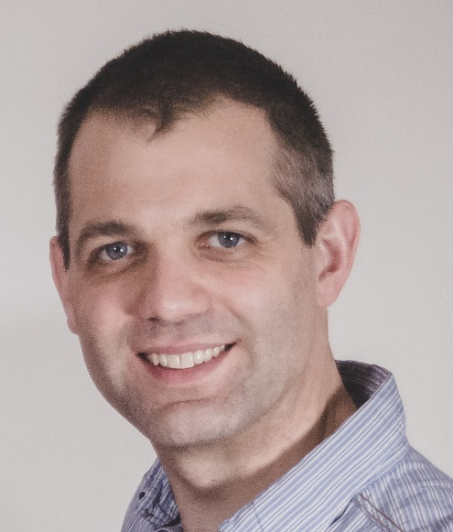
Objectives this week (2)
Invited presentation (bimonthly member enrichment activities)
  Topic: Hybrid sharing on the upper 6 GHz band
  Author: Dr. Steve Leach (Principal, Spectrum Engineering team, Ofcom)
Source: Steve Leach

Slide 98
802.19 WG July 2024 Liaison Report
Date: 2024-7-14
Authors:

Slide 99
IEEE 802.19 Overview
IEEE 802.19 group reviews coexistence assessment documents (CAD) produced by working groups developing new wireless standards for unlicensed devices.
IEEE 802.19 develops standards for coexistence between wireless standards of unlicensed devices.
Group had one meeting on Monday PM2.
Position | Person
Working Group Chair | Tuncer Baykas (Ofinno)
Working Group Vice Chair | Steve Shellhammer (Qualcomm)
Task Group 3a Chair | Ben Rolfe (Blind Creek Associates)
Liaison To/From 802.11 | Tuncer Baykas (Ofinno)
Liaison To/From 802.15 | Ben Rolfe (Blind Creek Associates)

Slide 100
Coexistence Assessment Documents
The 802.19 ballot on the approval of 802.15.4ab Coexistence Assessment (CA) document closed on June 30. The results are:
Yes 11
No 10
Abstain 0
The CA document was not approved.
39 comments were received during the ballot.

Slide 101
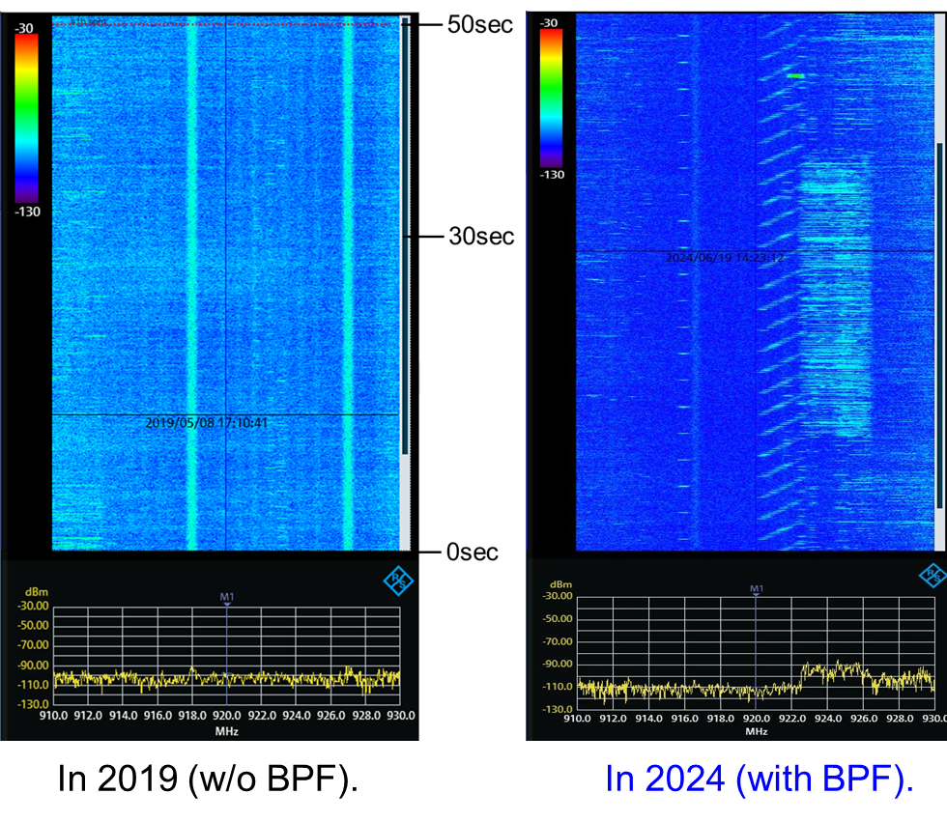
802.19.3a Task Group
Scope of the project: This amendment updates and expands coexistence recommendations to address new market requirements, increasing data traffic, greater device density of devices, and increased potential for congestion based on both IEEE Std 802.11-2020 and IEEE Std 802.15.4 sub-1 GHz standards.
19-24/0024, “Latest measured radio use over 920 MHz band in Kansai area of Japan ”
Kazuni Yato et. al.
https://mentor.ieee.org/802.19/dcn/24/19-24-0024-00-003a-latest-measured-radio-use-over-920-mhz-band-in-kansai-area-of-japan.pptx

Slide 102
802REVc Status July 2024 Update
Date: 2024-07-17
Authors:

Slide 103
Abstract
This document provides a summary of discussions and decision during the 802.11 ARC meetings and the 802.1 802REVc meetings related to comment resolution and technical discussions related to P802REVc.
This document intended to be a status report for the 802.11 WG and the 802.11 ARC SC.

Slide 104
IEEE Std 802-REVc Overview
PAR was approved on 24 March 2022 to create:
802-REVc - “Standard for Local and Metropolitan Area Networks: Overview and Architecture”
A maintenance roll up of the outstanding amendments of IEEE std 802-2014 – 802.c, 802d, 802f
  Assigned to 802.1 Maintenance – Mark Hantel Maintenance TG Chair, Glenn Parsons 802.1 Chair
  Status/documents/comments are available: https://1.ieee802.org/maintenance/802-revc/
  Files available: https://www.ieee802.org/1/files/private/802-REVc-drafts/ (members only, .11 members)
  Editor: James Gilb
Draft Status Overview:
  WG ballot phase has completed.
  SA ballot phase has started:
    Ballot pool established 13 Apr 2024
    P802-REVc D2.0 – SA ballot closed 15 Jul 2024
  Goal: To RevCom – Sep 2024 – Publish Dec 2024

Slide 105
IEEE Std 802-REVc Details
802.11 ARC SC met on 16 Jul AM1 and Discussed:
    802-REVc, Draft 2.0 (members only)
802 - 802REVc met 15 Jul PM1 and 17 JUL AM1
  The SA ballot did not close until after the 15 JUL meeting.
  At the 15 Jul meeting a preliminary comments document was discussed 1-24/0037r0
  At the 17 Jul AM1 meeting the comment document was discussed 1-24/0042r1
  (this document has all comment resolutions agreed to date)

Slide 106
Comment Status
Types |  |  | Status
Editorial | 11 |  | ACCEPTED | 30
Technical | 59 |  | REVISED | 12
General | 7 |  | REJECTED | 7
Total | 77 |  | Closed | 49
MBS | 45 |  | Open | 28

Slide 107
Next Steps
Three 1.5 hours electronic meeting to be scheduled for comment resolution
  Tuesdays 10:00-11:30 h EDT on 20 July, 13 Aug, 20 Aug
802.11 ARC has no plans to meeting prior to the 802.11 September Interim, but will schedule a electronic meeting, if necessary, with 10 days notice.
Status of comment resolution will be provided via the 802.11 WG reflector
When the SA ballot recirculation is started a notice will be sent to the 802.11 WG reflector
If you would like to submit a comment on the upcoming and are not a member of the SA Ballot Pool, please contact Joseph Levy (jslevy@ieee.org).

Slide 108
References

Slide 109
Wi-Fi Alliance (WFA) Liaison July 2024 Update
Date: 2024-07-17
Authors:

Slide 110
Abstract
This presentation contains the Wi-Fi Alliance (WFA) liaison update for July 2024 IEEE 802.11 meeting

Slide 111

Meetings
This year marks the 25th Anniversary of the WFA
Celebration of Wi-Fi past at Austin, TX in the Americas member meeting, May 21-23
  Keynote speeches by many industry pioneers and experts
  Panel discussions on inception, evolution and impact of Wi-Fi technology and the technology’s unforeseen influence
  Meeting reports available for members
The next WFA F2F (Europe) member meeting will
  take place on Oct 15th-17th, 2024, in Malaga, Spain
  Meeting’s focus on what’s next for Wi-Fi as it continues to contribute
    and opens up new horizons

Slide 112
Activities
Technical activity at WFA that has recently led to certification
  Wi-Fi 7
  QoS Management
  EasyMesh
Technical activity at WFA that is expected to lead to certification
  Wi-Fi 7 R2
  6 GHz standard power
  Wi-Fi Direct
  Wi-Fi proximity ranging
Increased use of interoperability events with commercial products after program launches
Consideration of feature releases leading to certification in 2025

Slide 113
Additional Work Areas
Examples of additional WFA technical work
  Security
  Automated Frequency Coordination
  Customer Experience
  EasyConnect
  EasyMesh
  QoS Management
  Wi-Fi HaLow
  Wi-Fi Data Elements
  Wi-Fi Aware
Examples of additional WFA activity that may lead to technical work
  Automotive
  Healthcare
  Internet of things
  Operators
  XR (Augmented / Virtual / Mixed Reality)
Spectrum regulatory

Slide 114
Recent publications
New study: Lack of Wi-Fi® spectrum jeopardizes Europe’s gigabit connectivity goals
Wi-Fi Alliance® AFC specifications and tools streamline standard power device compliance in Canada
Wi-Fi Alliance® congratulates NTIA spectrum team on the National Spectrum Strategy Implementation Plan

Slide 115
Further information
For more information on current areas of work, see http://www.wi-fi.org/who-we-are/current-work-areas
If these sound like interesting topics, please plan to sign up and participate
Further general information at http://www.wi-fi.org/

Slide 116
Wireless Broadband Alliance (WBA) Liaison Report
Date: 2024-07-17
Authors:
Name | Company | Address | Phone | Email
Necati Canpolat | Intel |  |  | necati.canpolat@intel.com

Slide 117
Wireless Broadband Alliance (WBA)
Drives seamless & interoperable services via Wi-Fi
Undertakes programs and activities to address business and technical issues, as well as opportunities, for member companies in order to enable collaboration among service providers, technology companies, cities, venue partners and organizations

Slide 118






WBA ORGANIZATION
WBA IS A NONPROFIT ASSOCIATION WITH THE VISION TO ACCELERATE THE DEVELOPMENT OF
“SEAMLESS AND INTEROPERABLE WI-FI SERVICES”
Seamless, Secure and Interoperable Wi-Fi
Convergence and Coexistence of Wireless Technologies
Accelerate Next Generation Wi-Fi Networks
Established
in 2003
+200 MEMBERSHIP
COMMUNITY
PROJECTS &
PROGRAMS
3 ANNUAL
EVENTS
PROMOTION AND
GO-TO-MARKET
THOUGHT LEADERSHIP &
MARKET RESEARCH

Slide 119


WBA Focus Areas
WBA MEMBERS SOLVE
REAL BUSINESS ISSUES
Fosters success for its members
WBA’s mission is to enable collaboration between service providers, technology companies and organizations to drive positive change and enable opportunities for growth.
Standards & Specifications - Setting the scene, requirements and creating specifications
Testing & Interoperability - Creating test plans to showcase the technology capabilities
End-to-End Trials - Running field trials/ proof of concept on real-world environment
Guidelines & Best Practices – Accelerate deployments of services and technologies
Certification & Plug Fests - Addressing gaps and helping the industry to maximizing biz opportunities
Think Thank & Advocacy – Industry leaders roundtables and targeted verticals analysis

Slide 120






TECHNICAL ACTIVITIES ROADMAP FOR 2024
WBA WORK GROUPS & PROJECTS
5G
Work Group
IoT
Work Group
NextGen
Work Group
Roaming
Work Group
OpenRoaming
Work Group
Testing & Interop
Work Group
Private & 5G Wi-Fi Convergence
IoT & Smart Home
Wi-Fi 7
RADIUS Accounting
Assurance
Federated Onboarding Service for OpenRoaming
Access Network Metrics
Mission Critical
& Emergency Services
Wi-Fi HaLow
for IoT Applications
Wi-Fi Experience
for Moving Networks
Wi-Fi Security Guidelines
OpenRoaming for Private LTE/5G
E2E Wi-Fi QoS & L4S
Enterprise Security
for Private 5G Networks
Wi-Fi Sensing
Operator Managed
Wi-Fi
OpenRoaming for IoT & FIDO Device Onboarding
Wi-Fi User & Device Identification
AIML enablement for Wi-Fi
WBA Tools
& Testing Platforms
Policy & Regulatory Affairs
Work Group
Market
Work Group
OpenRoaming Certification
Innovation Forum
- Led by CTO Group
Connected
Communities Forum
Enterprise Connectivity Forum

Slide 121
Further information
Current work areas https://wballiance.com/wba-program-overview-2024/
WBA resource center https://wballiance.com/resource/
WBA events https://wballiance.com/events-awards/
WBA memberships: https://wballiance.com/membership/
Further WBA information at https://wballiance.com/

Slide 122
IEEE 802.11-IETF Liaison Report
Date: 2024-07-17
Authors:

Slide 123
Abstract
This presentation contains the IEEE 802.11 – IETF liaison report for July 2024.

Slide 124
IETF Meetings
Upcoming Meetings:
  July 20-26 – Vancouver, BC, CA
  November 2-8 – Dublin, IE
http://www.ietf.org
  Newcomer training: https://www.ietf.org/about/participate/get-started/
  April 2016: Wireless Tutorial (Donald Eastlake), 802.11 & 802.15 tutorials (Dorothy Stanley, Charlie Perkins), see 11-16/500, September 2016: Pat Thaler & Juan Carlos – 802.1E (Privacy Considerations) and 802.c (Local MAC address usage) https://datatracker.ietf.org/group/edu/materials/

Slide 125
IETF- IEEE 802 Liaison Activity
Joint meetings, agenda and presentations
  http://www.iab.org/activities/joint-activities/iab-ieee-coordination/
  Proceedings: https://datatracker.ietf.org/iabasg/ietfieee/meetings/
  Coordination topics include: Capability Discovery, Data Center Bridging, use of Local Address in virtualization and IoT, MAC address randomization, DETNET/TSN/RAW, YANG models, pervasive monitoring
  IETF-IEEE 802 coordination teleconferences: June 13, 2024
    “Transfer” of RFC 8110 (Opportunistic Wireless Encryption) to IEEE 802.11 [this item is currently in the IESG’s hands to advance]

Slide 126
IETF protocol use with 802.11 technology
RFC 9575 on “DRIP Entity Tag (DET) Authentication Formats and Protocols for Broadcast Remote Identification (RID)”. Mentions IEEE 802.11 beacons and Wi-Fi Aware (NAN) in the context of UAS.

Slide 127
BOFs at IETF 120 July 20-26, 2024
See https://datatracker.ietf.org/wg/bofs/
diem | Digital Emblems
nasr | Network Attestation for Secure Routing
sconepro | Secure Communication of Network Properties
alldispatch | IETF-Wide "Dispatch" Session
green | Getting Ready for Energy-Efficient Networking

Slide 128
IETF/IRTF groups being (re-)chartered
See https://datatracker.ietf.org/group/chartering/
hrpc | Human Rights Protocol Considerations
ccamp | Common Control and Measurement Plane
grow | Global Routing Operations
mls | Messaging Layer Security
multi | Multiformats
opsawg | Operations and Management Area Working Group

Slide 129
YANG Model Catalog
YANG catalog development
  A YANG model catalog and registry that allows users to find models relevant to their use cases from the large and growing number of YANG modules being published.
  YANG Catalog was developed through a collaboration between the IETF and the Broadband Forum, and contains many data models, including from other Standards Development Organizations (SDOs) such as the IEEE, as well as some vendor-specific data models. Interest and participation from other SDOs, equipment vendors, open source projects and network operators is encouraged.
See https://www.ietf.org/blog/yang-catalog-latest-developments-ietf-100-hackathon/
See https://yangcatalog.org/ and https://1.ieee802.org/yangsters/

Slide 130
IoT-related work
6LO
  Working Group website: http://datatracker.ietf.org/wg/6lo/
  Focus: IPv6 over Networks of Resource-constrained Nodes
Updates
  Revised: Transmission of SCHC-compressed packets over IEEE 802.15.4 networks: https://datatracker.ietf.org/doc/draft-ietf-6lo-schc-15dot4/ (July 2024)
  Revised: Transmission of IPv6 Packets over Short-Range Optical Wireless Communications: https://datatracker.ietf.org/doc/draft-ietf-6lo-owc/ (July 2024)
  In RFC Editor’s queue: IPv6 Neighbor Discovery Multicast and Anycast Address Listener Subscription: https://datatracker.ietf.org/doc/draft-ietf-6lo-multicast-registration/ (May 2024)
    Mentions IEEE 802.11 as one possible Low-power and Lossy Network to which this specification is applicable

Slide 131
IoT-related work (cont.)
ROLL: Working Group website: http://datatracker.ietf.org/wg/roll/
  Focus: Routing over Low Power and Lossy Networks
CORE: (Constrained RESTful Environments) Working Group website: http://datatracker.ietf.org/wg/core/
  Focus: framework for resource-oriented applications intended to run on constrained IP networks.
IoT Directorate:
  Reviews IETF drafts that are IoT related
  See: https://datatracker.ietf.org/group/iotdir/about/

Slide 132
MADINAS WG
See http://datatracker.ietf.org/wg/madinas/
MAC Address Device Identification for Network and Application Services
  This is the IETF’s equivalent of IEEE 802.11bh – how to deal with the implications of the deployment of random and changing MAC addresses.
Updates
  Approved for publication as an Informational RFC: Randomized and Changing MAC Address: https://datatracker.ietf.org/doc/draft-ietf-madinas-mac-address-randomization/ (July 2024)
  Revised: Randomized and Changing MAC Address Use Cases and Requirements: https://datatracker.ietf.org/doc/draft-ietf-madinas-use-cases/ (June 2024)

Slide 133
EAP Method Update (EMU)
See http://datatracker.ietf.org/wg/emu/
  This working group has been chartered to provide updates to some commonly used Extensible Authentication Protocol methods including of EAP-TLS, EAP-AKA, EAP-AKA’ (for 5G), EAP-SIM, etc.
  The group should document any recently gained new knowledge on vulnerabilities or the possible implications of pervasive surveillance or other new concerns.
Updates
  Newly adopted and revised: Using the Extensible Authentication Protocol with Ephemeral Diffie-Hellman over COSE (EDHOC): https://datatracker.ietf.org/doc/draft-ietf-emu-eap-edhoc/ (July 2024)
  Newly adopted: https://datatracker.ietf.org/doc/draft-ietf-emu-eap-fido/ (July 2024)
  In RFC Editor’s queue: Tunnel Extensible Authentication Protocol (TEAP) Version 1: https://datatracker.ietf.org/doc/draft-ietf-emu-rfc7170bis/ (June 2024)
  Newly adopted: The eap.arpa domain and EAP provisioning: https://datatracker.ietf.org/doc/draft-ietf-emu-eap-arpa/ (June 2024)

Slide 134
Operations Area Working Group
http://datatracker.ietf.org/wg/opsawg/
Updates
  Revised: An Information Model for Packet Discard Reporting: https://datatracker.ietf.org/doc/draft-ietf-opsawg-discardmodel/ (July 2024)
Background
  Of interest: RFC 6632, An Overview of the IETF Network Management Protocols, see https://tools.ietf.org/html/rfc6632
  Automated network management, including YANG data models, see https://www.ietf.org/topics/netmgmt/

Slide 135
Internet Area Working Group
https://datatracker.ietf.org/wg/intarea/
Updates
  Erratum reported: RFC 9542: IANA Considerations and IETF Protocol and Documentation Usage for IEEE 802 Parameters: https://www.rfc-editor.org/info/rfc9542/ (May 2024)
    Discusses several aspects of IEEE 802 parameter and their use in IETF protocols, specifies IANA considerations for assignment of points under the IANA OUI, and provides some values for use in documentation.
    Erratum points out place where bits makes more sense than octets when discussing MAC addresses
  Moved to SCHC WG: Protocol Numbers for SCHC: https://datatracker.ietf.org/doc/draft-ietf-intarea-schc-protocol-numbers/ (June 2024)
    Requests an Ethertype for use of native Static Context Header Compression over IEEE 802 networks (for IP and non-IP protocols).

Slide 136
Transport Layer Security (TLS)
See: http://datatracker.ietf.org/wg/tls/
Updates
  Revised: TLS 1.3 Extension for Using Certificates with an External Pre-Shared Key: https://datatracker.ietf.org/doc/draft-ietf-tls-8773bis/ (July 2024)
    Originally an Experimental RFC, the major change here is to change it to Standards Track
  Revised: Deprecating Obsolete Key Exchange Methods in TLS 1.2: https://datatracker.ietf.org/doc/draft-ietf-tls-deprecate-obsolete-kex/ (June 2024)

Slide 137
Deterministic Networking (DETNET)
DETNET: https://datatracker.ietf.org/wg/detnet/
  The Deterministic Networking (DetNet) Working Group focuses on deterministic data paths that operate over Layer 2 bridged and Layer 3 routed segments, where such paths can provide bounds on latency, loss, and packet delay variation (jitter), and high reliability.
  The IEEE 802.11be activities seem like they may fit in with DetNet and there was a joint IEEE-IETF DetNet discussion in Bangkok (November 2018).
  Addresses Layer 3 aspects in support of applications requiring deterministic networking.
  The Working Group collaborates with IEEE 802.1 Time Sensitive Networking (TSN), which is responsible for Layer 2 operations, to define a common architecture for both Layer 2 and Layer 3.
  Example applications for deterministic networks include professional and home audio/video, multimedia in transportation, engine control systems, and other general industrial and vehicular applications being considered by the IEEE 802.1 TSN Task Group.
Updates:
  Revised: Requirements for Reliable Wireless Industrial Services : https://datatracker.ietf.org/doc/draft-ietf-detnet-raw-industrial-req/ (July 2024)
  Revised: Reliable and Available Wireless Architecture: https://datatracker.ietf.org/doc/draft-ietf-raw-architecture/ (July 2024)

Slide 138
Autonomic Networking Integrated Model and Approach (ANIMA)
ANIMA: https://datatracker.ietf.org/group/anima/
  ANIMA designs protocols to allow network operations (e.g., on-boarding) to be carried out without requiring low-level management of individual devices
Updates:
  Revised: Constrained Bootstrapping Remote Secure Key Infrastructure (cBRSKI): https://datatracker.ietf.org/doc/draft-ietf-anima-constrained-voucher/ (July 2024)
  Revised: BRSKI-AE: Alternative Enrollment Protocols in BRSKI: https://datatracker.ietf.org/doc/draft-ietf-anima-brski-ae/ (July 2024)
  Revised: BRSKI with Pledge in Responder Mode (BRSKI-PRM): https://datatracker.ietf.org/doc/draft-ietf-anima-brski-prm/ (July 2024)
  Revised: Discovery for BRSKI variations: https://datatracker.ietf.org/doc/draft-ietf-anima-brski-discovery/ (July 2024)

Slide 139
References
RFC 7241, “The IEEE 802/IETF Relationship” (RFC 4441 update)
  https://datatracker.ietf.org/doc/rfc7241/
IEEE 802 Liaisons list is available
  http://ieee-sa.centraldesktop.com/802liaisondb/FrontPage

