Slide 1
Wireless Broadband Alliance (WBA) Liaison Report
Date: 2024-07-17
Authors:
Name | Company | Address | Phone | Email
Necati Canpolat | Intel |  |  | necati.canpolat@intel.com

Slide 2
Wireless Broadband Alliance (WBA)
Drives seamless & interoperable services via Wi-Fi
Undertakes programs and activities to address business and technical issues, as well as opportunities, for member companies in order to enable collaboration among service providers, technology companies, cities, venue partners and organizations

Slide 3
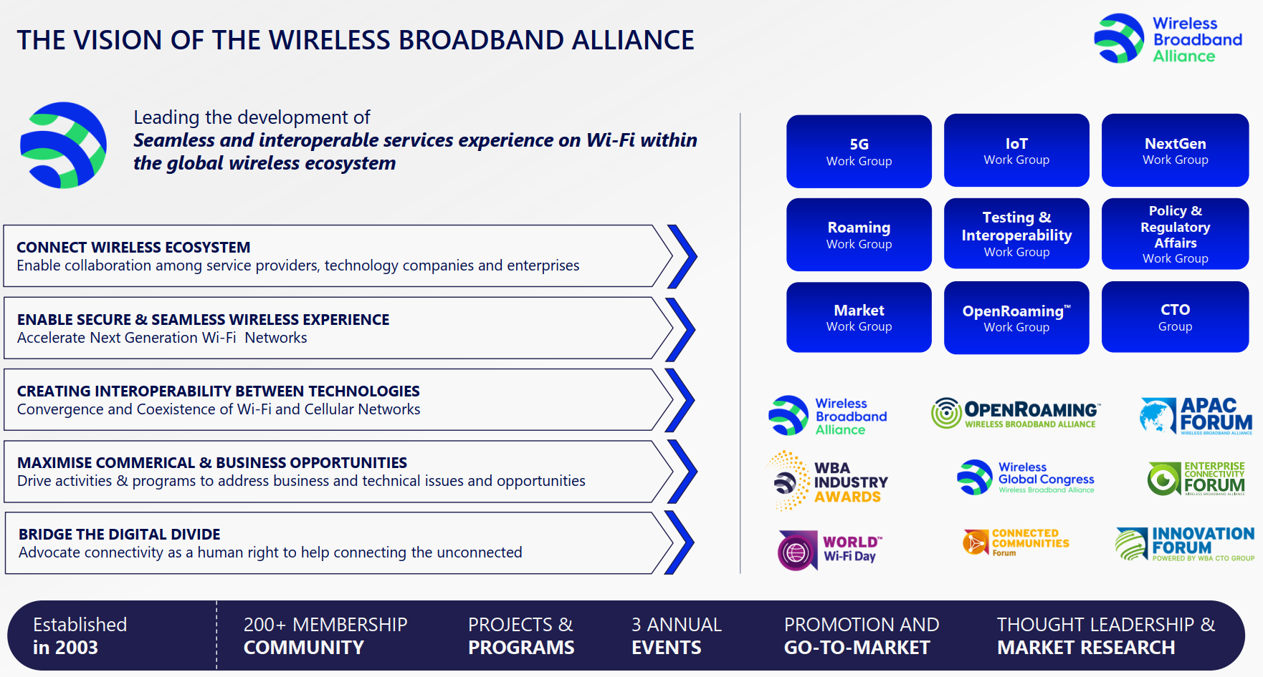
WBA Organization

Slide 4
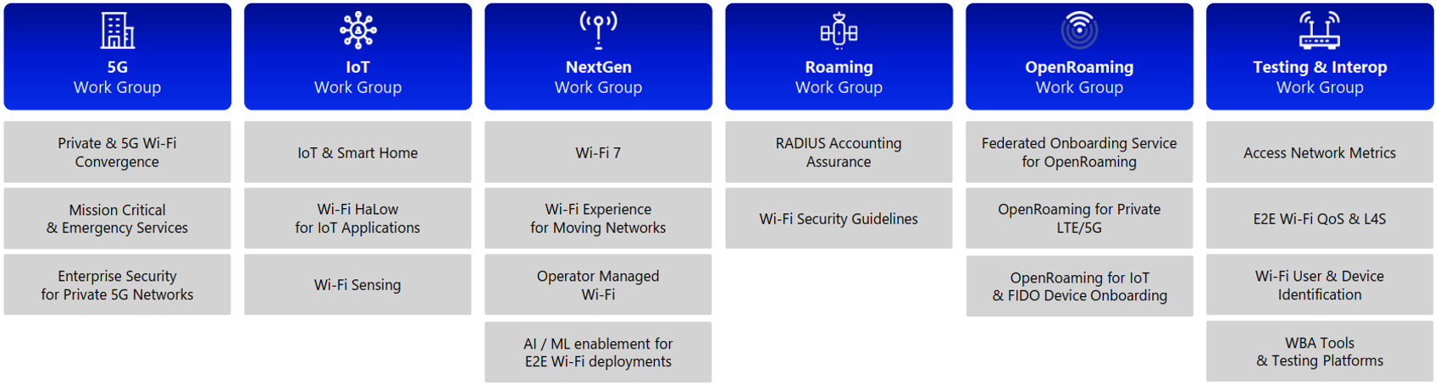
WBA Technical Activities Roadmap for 2024

Slide 5
Further information
Current work areas https://wballiance.com/wba-program-overview-2024/
WBA resource center https://wballiance.com/resource/
WBA events https://wballiance.com/events-awards/
WBA memberships: https://wballiance.com/membership/
If these sound interesting topics, please sign up and participate
Further WBA information at https://wballiance.com/

