Slide 1
802.19 WG July 2024 Liaison Report
Date: 2024-7-14
Authors:

Slide 2
IEEE 802.19 Overview
IEEE 802.19 group reviews coexistence assessment documents (CAD) produced by working groups developing new wireless standards for unlicensed devices.
IEEE 802.19 develops standards for coexistence between wireless standards of unlicensed devices.
Group had one meeting on Monday PM2.
Position | Person
Working Group Chair | Tuncer Baykas (Ofinno)
Working Group Vice Chair | Steve Shellhammer (Qualcomm)
Task Group 3a Chair | Ben Rolfe (Blind Creek Associates)
Liaison To/From 802.11 | Tuncer Baykas (Ofinno)
Liaison To/From 802.15 | Ben Rolfe (Blind Creek Associates)

Slide 3
Coexistence Assessment Documents
The 802.19 ballot on the approval of 802.15.4ab Coexistence Assessment (CA) document closed on June 30. The results are:
Yes 11
No 10
Abstain 0
The CA document was not approved.
39 comments were received during the ballot.

Slide 4
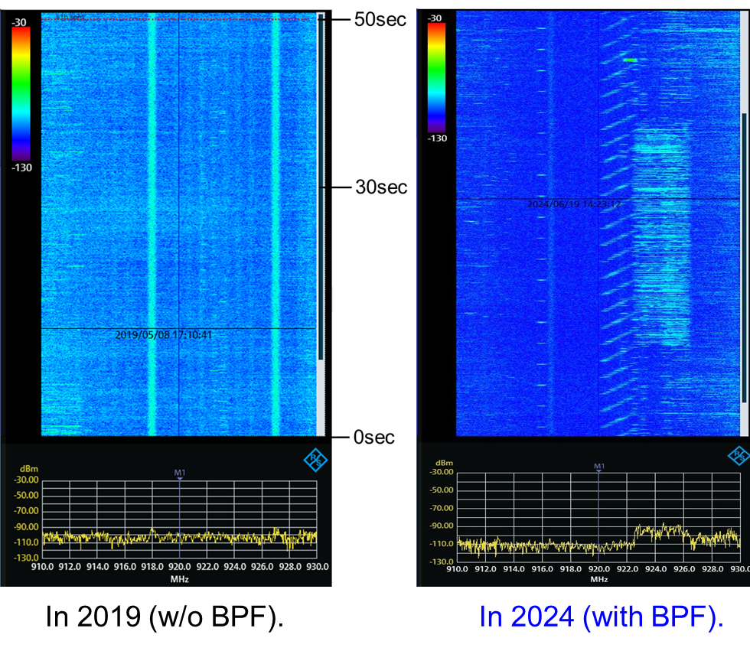
802.19.3a Task Group
Scope of the project: This amendment updates and expands coexistence recommendations to address new market requirements, increasing data traffic, greater device density of devices, and increased potential for congestion based on both IEEE Std 802.11-2020 and IEEE Std 802.15.4 sub-1 GHz standards.
19-24/0024, “Latest measured radio use over 920 MHz band in Kansai area of Japan ”
Kazuni Yato et. al.
https://mentor.ieee.org/802.19/dcn/24/19-24-0024-00-003a-latest-measured-radio-use-over-920-mhz-band-in-kansai-area-of-japan.pptx

