Slide 1
Supporting Rx Interference Mitigation in TGbn
Date: July 9, 2024
Authors:

Slide 2
Introduction
In previous contributions [1-5] we proposed a new transmission scheme, where ‘Interference Mitigation (IM) pilots’ are inserted within the data field, thereby enabling Rx Beamforming/interference mitigation at the receiver side
Mitigation of interference can result in improved performance and reduced latency, thus contributing to the ultra high reliability goal of TGbn
In this contribution we summarize all important aspects, and suggest that TGbn will support an interference mitigation mode in order to reach this ultra high-reliability goal

Slide 3
The Ever-Present Problem of Interference
Random, unexpected interference is one of the main reasons for the limited reliability in WLAN
  After all – we’re operating in unlicensed bands
Interfering signals can occupy any bandwidth – narrowband or wideband – and can originate from several sources, for example:
  Any valid WLAN signal
  3GPP transmissions in the unlicensed bands
  2MHz narrowband-assisted UWB (as part of 802.15.4ab)
  Bluetooth (in the 2.4GHz band)
Interference can rise at any time
How has this problem of interference been addressed so far?
  Reducing MCS so that transmissions are more robust
  Retransmitting dropped packets
  Changing channel (e.g. to a channel with lower load)
But these solutions are not suitable for an ‘Ultra High Reliability’ technology

Slide 4

Coping with Interference - Receive Beamforming
One classical approach to mitigating the interference, at the receiver side, is receive beamforming
  Various algorithms may be employed – one example is MVDR given in [1]
There are several benefits to this approach:
  It is a classical, well known approach (used in various technologies)
  Can be used to handle interference of any bandwidth, both narrowband
  and wideband
  Can be used to handle interference that rises anywhere within the PPDU –
  assuming the receiver can monitor & identify it
How would the receiver be able to identify
and mitigate interference of any bandwidth
and anywhere in time?
  We propose to transmit known pilots – interlaced with the data – as
  shown on the right; these pilots can be transmitted at fixed locations
  across all OFDM symbols
Interference Mitigation Pilot
Data

Slide 5
Interference Mitigation – Simulation Results
In order to evaluate the performance of this approach, we simulated the following:
  SIR = 10dB & 5dB, interference on entire BW (RU = 106-tone)
  Using MCS 6 (with ~20% IM pilots)
  1Tx antenna, 4Rx antennas,
  1 spatial stream, practical CHEST,
  TGn-D NLOS, LDPC
  Compared 2 receiver schemes:
    MRC (w/o and w/ interference)
    MVDR (with interference)
In the presence of interference,
whereas MRC suffers from an
error floor (even with much lower
MCS), Interference Mitigation
(MVDR) enables operation with
high MCS even at SIR = 5 dB!

Slide 6
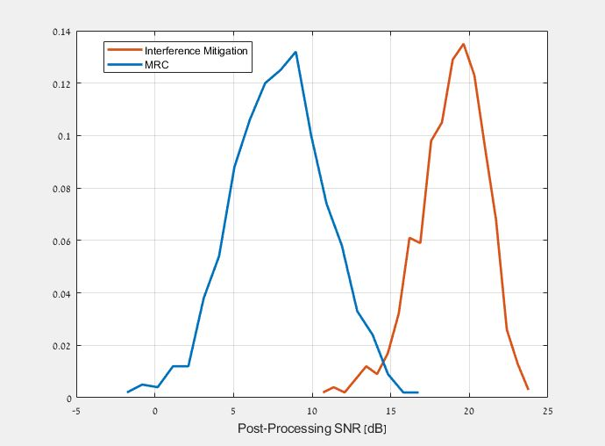
Interference Mitigation – Simulation Results
We can also look at the Post-Processing SNR – experienced at different receivers – as a metric for the impact of applying interference mitigation
Below is a comparison of the average PPSNR of MRC vs. interference mitigation (MVDR), with the following parameters:
  SNR is 20dB
  SIR is Normally distributed
  with 0.5dB STD around 5dB
Whereas MRC yields very broad
PPSNR around an erroneous
mean, with IM we get a more
consistent PPSNR around
the true SNR value
It also means that applying IM
yields more reliable physical
layer measurements
Mean 7.9dB
Mean 18.9dB

Slide 7
Interference Mitigation – Simulation Results
In order to further evaluate the impact of interference mitigation on the performance, we looked at the goodput comparing interference mitigation with MRC
As shown in the figure,
except at low SNR (where
there is no reason to apply
interference mitigation), the
application of IM
significantly improves the
performance, up to (roughly)
tripling the goodput
In spite of the IM pilots
overhead in the MVDR case, it
enables a higher MCS and
therefore much higher goodput

Slide 8
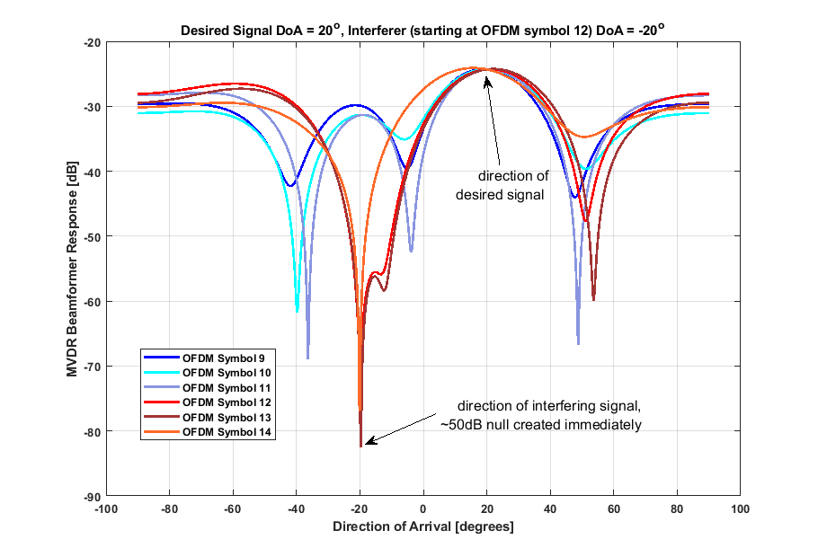
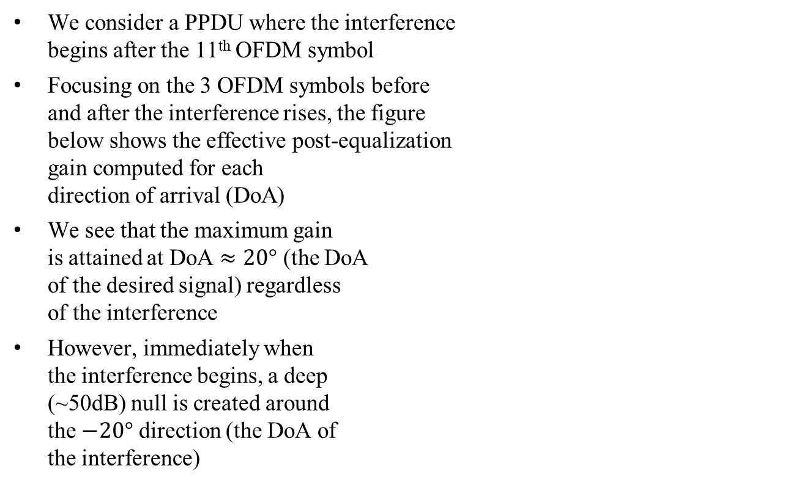
Identifying & Mitigating a Sudden Interference
Interference begins
We consider a PPDU where the interference
begins after the 11th OFDM symbol
Focusing on the 3 OFDM symbols before
and after the interference rises, the figure
below shows the effective post-equalization
gain computed for each
direction of arrival (DoA)
We see that the maximum gain
is attained at DoA $≈20°$ (the DoA
of the desired signal) regardless
of the interference
However, immediately when
the interference begins, a deep
(~50dB) null is created around
the $−20°$ direction (the DoA of
the interference)
OFDM sym #1
OFDM sym #2
OFDM sym #3
OFDM sym #4
OFDM sym #5
OFDM sym #6
OFDM sym #7
OFDM sym #8
OFDM sym #9
OFDM sym #10
OFDM sym #11
OFDM sym #12
OFDM sym #13
OFDM sym #14
OFDM sym #15
OFDM sym #16
time

Slide 9
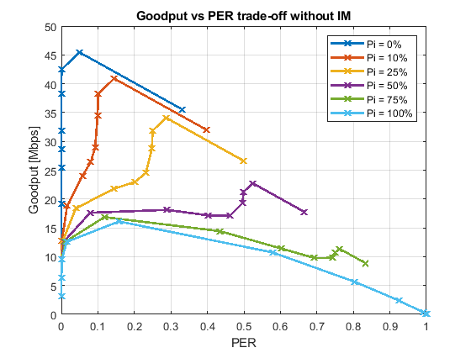
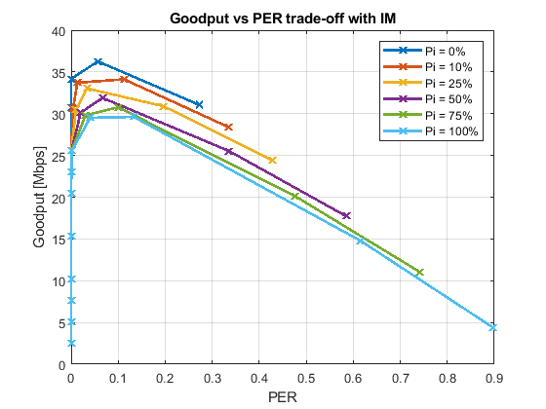
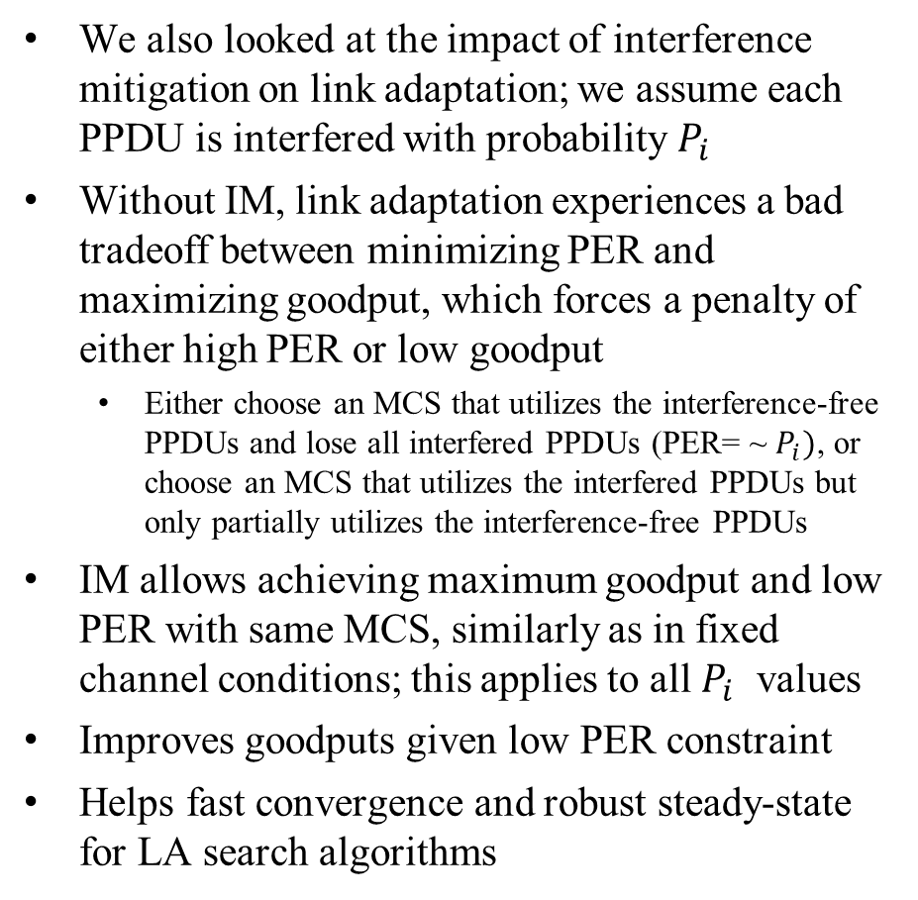
Link-Adaptation Perspective
We also looked at the impact of interference mitigation on link adaptation; we assume each PPDU is interfered with probability $P_{i}$
Without IM, link adaptation experiences a bad tradeoff between minimizing PER and maximizing goodput, which forces a penalty of either high PER or low goodput
  Either choose an MCS that utilizes the interference-free PPDUs and lose all interfered PPDUs (PER= ~ $P_{i})$, or choose an MCS that utilizes the interfered PPDUs but only partially utilizes the interference-free PPDUs
IM allows achieving maximum goodput and low PER with same MCS, similarly as in fixed channel conditions; this applies to all $P_{i}$ values
Improves goodputs given low PER constraint
Helps fast convergence and robust steady-state for LA search algorithms

Slide 10
LA Perspective: IM enabled/disabled selection
How is the selection between IM enabled and IM disabled carried out?
Adaptive approach:
  Treat this selection as another dimension in the link adaptation TX parameters’ search space for goodput maximization along with: MCS, Nss, CP length, etc.
    Combine IM selection with the ACK guided trial-and-error based search. Example concepts:
      During IM disabled: Probe a higher MCS along with IM enabled.
      During IM enabled: Probe current MCS along with IM disabled.
    For trigger based uplink: The receiving AP can apply on-going and link independent monitoring of interference that can further serve the IM selection decision.
  This approach ensures IM pilots are invested
  only when they lead to higher goodput
Fixed approach:
  If link reliability is more important than utilizing maximum throughput, IM enabled can be applied as a fixed configuration.

Slide 11
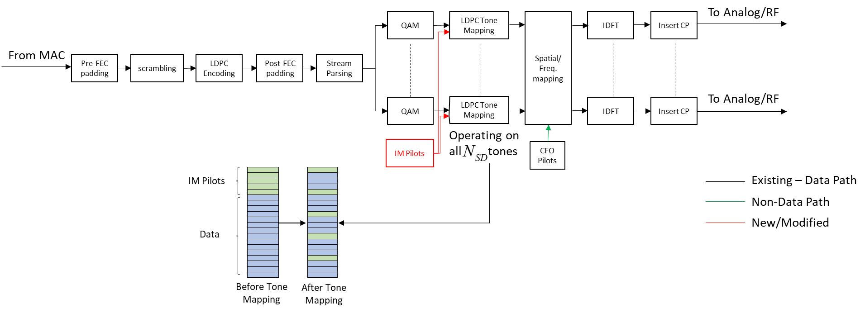
Impact on Tx Block Diagram
Defining IM pilots in an RU, and the remaining data subcarriers as
, the value of doesn’t change:
  In addition to introducing IM pilots, duration/padding/LDPC parameters are based on
  instead of
Tx Block diagram is almost unchanged – no impact on LDPC operation or tone mapping (using same ); applying LDPC Tone Mapping on data+IM Pilots yields IM Pilots which are spread almost evenly in frequency
Based on payload size and
smaller number of tones
( ), determine:
#OFDM Symbols
Padding
LDPC Parameters (e.g. #codewords, puncturing, LDPC extra symbol)

Slide 12
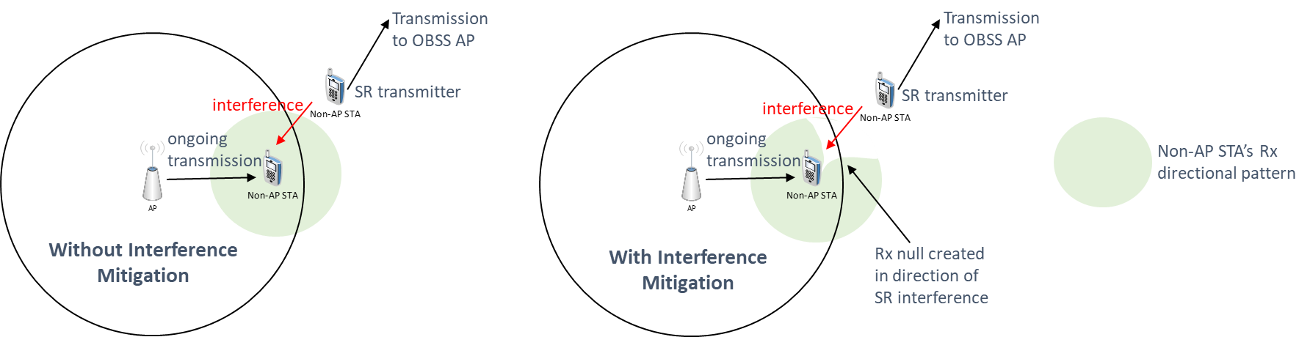
Additional Benefits – Strengthening Spatial Reuse
IM applied at the Rx side can be used to enhance SR performance; with SR an OBSS STA is allowed to transmit while there is an ongoing transmission in the BSS, but it limits its transmit power as a function of the OBSS PD threshold
  In other words, with SR an ongoing BSS transmitter ‘allows’ an OBSS STA to transmit simultaneously such that it doesn’t create too much interference at target BSS receiver
  However, the interference to the ongoing transmission is not fully controlled
Using IM pilots, the ongoing transmission can ensure high reliability at its Rx side, in particular resilience to interference – exactly the aim of SR
  OBSS STA can also use IM pilots to ensure high reliability at its own target receiver side

Slide 13
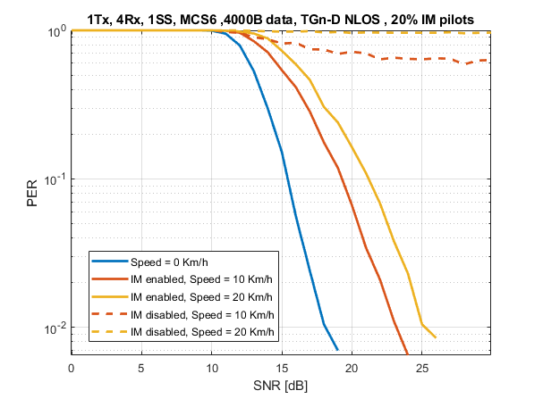
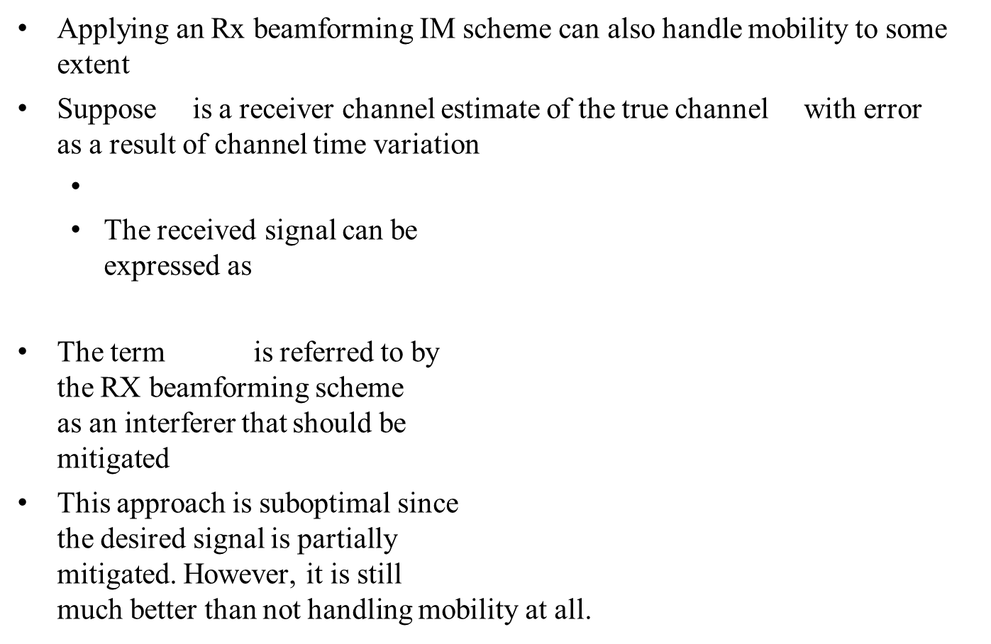
Additional Benefits – Supporting Mobility
Applying an Rx beamforming IM scheme can also handle mobility to some extent
Suppose is a receiver channel estimate of the true channel with error as a result of channel time variation
  The received signal can be
  expressed as
The term is referred to by
the RX beamforming scheme
as an interferer that should be
mitigated
This approach is suboptimal since
the desired signal is partially
mitigated. However, it is still
much better than not handling mobility at all.

Slide 14
Past Q&A
Q: How many IM pilots are needed?
A: As shown in [2,3], the sweet-spot is around ~16-20% resources used for IM pilots
Q: Can’t we use the existing CFO pilots for interference mitigation?
A: Since it is our aim to handle both wideband and narrowband int., and based on our simulation results (see previous Q), the existing CFO pilots are not sufficient
Q: Why not use midambles (defined in 11ax) instead of IM pilots?
A: As shown in [3], using midambles for interference mitigation yields an error floor assuming the interference can rise anywhere within the PPDU (i.e. between midambles, so that certain codewords fail decoding)
Q: Wouldn’t throughput be reduced due to the use of IM pilots?
A: Link/rate adaptation would invoke IM only if it increases the throughput compared with no IM
Q: How does a transmitter choose whether to employ IM pilots or not?
A: The transmitter can let the Link/Rate-Adaptation mechanism choose automatically as we showed in [5]; alternatively, when interference is a major concern, the transmitter can choose to always employ IM pilots

Slide 15
Summary
Interference is one of the major reasons for the limited reliability in the unlicensed bands used for WLAN
In previous meetings we presented the concept of interference mitigation at the receiver side as a means to achieve ultra high reliability
  We focused on several different aspects, including the huge performance benefits in the presence of interference, the minimum impact on Tx design and how it would interact with rate/link-adaptation
Given the aim of achieving ultra high reliability in TGbn, we think interference mitigation should be incorporated into the SFD

Slide 16
Straw Poll #1
Do you agree to add the following to the TGbn SFD?
  11bn will define a mode that enables mitigating interference that rises within the data portion of the PPDU?

Slide 17
Straw Poll #2
Do you agree to add the following to the TGbn SFD?
  11bn will define a mode with additional pilots used for interference mitigation

Slide 18
References
[1] 11-23-1490r0: Physical Layer Reliability Improvements (Shimi Shilo et al)
[2] 11-23-1943r1: Physical Layer Reliability Improvements – Follow Up (Shimi Shilo et al)
[3] 11-24-107r0: PHY Layer Interference Mitigation for Improved Reliability (Shimi Shilo et al)
[4] 11-24-437r0: Interference Mitigation for Improved Reliability – More Insights (Shimi Shilo et al)
[5] 11-24-889r0: Interference Mitigation for Improved Reliability – Link Adaptation Perspective (Rani Keren et al)
Notes:
at least one mode of operation capable of improved support, compared to 802.11be, for applications with stringentworst-case latency and jitter requirementscompared to 802.11be // i.e., avoid “worst-case”

