Slide 1
SP-based Non-Primary Channel Access Follow-Up
Triggering Event
Date: 2024-07-02
Authors:

Slide 2
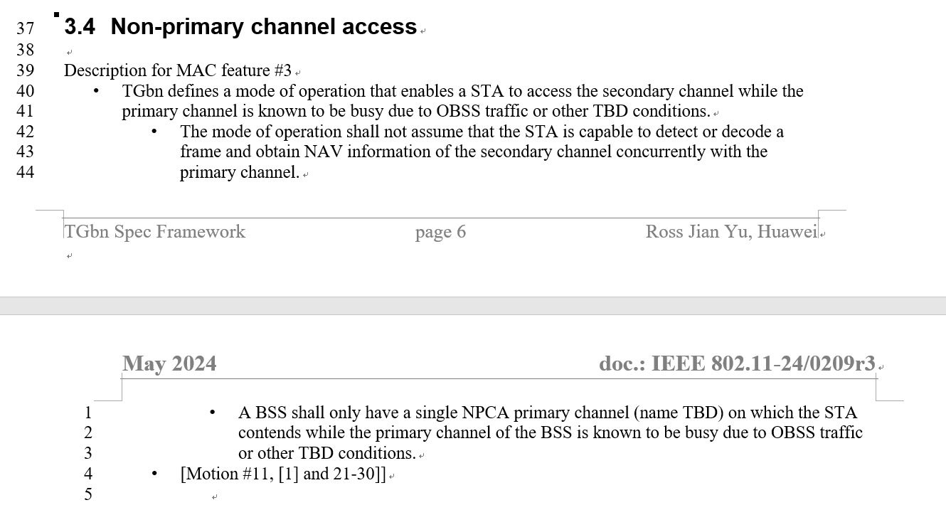
Motivation
To meet throughput and latency requirements mentioned in the UHR PAR [1], non-primary channel access (NPCA) was proposed as a potential method
[1]
The general idea of SP-based NPCA was introduced in [2]

Slide 3
Recap: SP-based NPCA
The main goal is to improve channel utilization for cases where primary channel is frequently occupied by OBSS, e.g., during OBSS TWT SP
  According to the current spec where STAs have to access the medium via the primary channel, it would be less probable for myBSS to access the channel (with more collision), leading to higher delay
  With TXOP-based NPCA where the NPCA STA switches back to the primary channel before NAV for the primary channel expires, there are frequent switching; considering time spent on medium sync recovery and switching delay, time overhead due to frequent switching is not negligible
  ➔ SP-based NPCA: Switch to a non-primary channel without switching back and forth during an OBSS SPs
The basic idea is for myBSS to park on a non-primary channel during the OBSS SP
[2]
frequency
Non-primary channel | myBSS parking |  | myBSS parking
Primary channel | OBSS TWT SP | myBSS parking | OBSS TWT SP | myBSS parking
time

Slide 4
Triggering Event
Within the OBSS TWT SP, if the OBSS PPDU is detected on the primary channel, then switch
  The OBSS PPDU belongs to an OBSS whose ongoing TWT SP is announced by the BSS AP
This is not within any of BSS 2’s TWT agreements announced by BSS 1, so it won’t cause BSS 1 switching if TXOP-based NPCA is not used outside (i.e., out of scope of SP-based NPCA).
TWT 2 SP of BSS 2
BSS 1 announces TWT 2
of BSS 2
BSS 1 could park on the primary channel until BSS 2’s PPDU is detected within TWT 2
BSS 1
(my BSS)
BSS 1 switches to a non-primary channel
BSS 2
(OBSS)
Although BSS 3 is an OBSS, it has no ongoing TWT SP announced by BSS 1 at the time, so this PPDU won’t cause BSS 1 switching
BSS 3
(OBSS)
* for convenience, contention is omitted, frame exchange within a BSS is simplified

Slide 5
If Switching, …
When parking on a non-primary channel, the BSS (i.e., PPDUs transmitted by AP and non-AP in the BSS) is recommended to switch to a non-primary channel that is not adjacent from current OBSS transmission to avoid ACI
  This is an implicit signaling of “I am on a non-primary channel”
Accessing the channel on the non-primary channel until the end of the SP
TWT 2 SP of BSS 2
BSS 1
(my BSS)
BSS 1 announces TWT 2
of BSS 2
Accessing the medium on the non-primary channel until the end of the SP
BSS 2
(OBSS)
BSS 3
(OBSS)
* for convenience, contention is omitted, frame exchange within a BSS is simplified

Slide 6
Example
Scenario:
  BSS 1 announces rTWT 2 and 3;
  BSS 2 announces rTWT 1 and 3;
  BSS 3 announces rTWT 1 and 2;
  rTWT 1,2, and 3 are aligned.
    rTWT 1,2,3 can be a coordinated rTWT, or non-coordinated rTWT with overlapping SPs
    Taking rTWT as an example, the mechanism can be applied to other kinds of TWTs, e.g., TWT for PS
The BSS that transmits the first PPDU within the SP (e.g., BSS 1 in the figure below) claims the primary channel, and the remaining BSSs (e.g., BSS 2 and 3 in the figure) switch to non-primary channel.
SP of rTWT 1, 2, 3
……
BSS 1
BSS 2
Accessing the medium on the non-primary channel until the end of the SP
BSS 1
rTWT 1
BSS 3
Accessing the medium on the non-primary channel until the end of the SP
BSS 2
rTWT 2
BSS 3
rTWT 3
* for convenience, contention is omitted, frame exchange within a BSS is simplified

Slide 7
Comparison During OBSS TWT SP
 | SP-based NPCA | TXOP-based NPCA
PPDU Validation | Time and Source are validated there is an ongoing SP and the PPDU is from the OBSS which has the ongoing SP | Source is validated - The PPDU is from an OBSS
NAV Validation | (not required) | CTS or data after RTS
Type of Triggering PPDU/Frame - HE/EHT/UHR PPDU? | Same
Time When to switch | PPDU is validated (a frame) | NAV is validated (frame exchange)
Stay on NPCA until | The end of the SP on primary | The end of the TXOP on primary
Time Overhead - For medium sync recovery and switching | low | high

Slide 8
Summary
Within OBSS TWT SPs, a BSS (both AP and non-AP STAs)
  Parks on the primary channel until a PPDU from the OBSS is detected,
  switch to a non-primary channel that is not adjacent from current OBSS transmission, and
  Switches back to the primary channel at the end of the OBSS TWT SP
Comparison between SP-based NPCA and TXOP-based NPCA
  Whether to switch is decided at the beginning of a PPDU for SP-based NPCA, whereas the decision is made at least after a frame exchange for TXOP-based NPCA
  Time overhead is lower with SP-based NPCA when primary is frequently occupied by OBSS, e.g., during OBSS TWT SPs
Notes:
TWT rule change: announce the TWT is an OBSS TWT
Legacy: quiet/PS/no legacy allowed/disablement when legacy is associated
Hidden node: impact may be less severe, non-ap could try npc when no response on p from AP side (longer time to try)

Slide 9
References
[1] 11-24/0209r3, “Specification Framework for TGbn,” Ross Jian Yu
[2] 11-24/0538r1, “SP-based Non-Primary Channel Access,” Yue Zhao

