Slide 1
Enhanced Long Range Frame format
Date: 2024-07-08
Authors:
Name | Affiliation | Address | Phone | Email
Junghoon Suh | Huawei | Ottawa, ON Canada |  | junghoon.suh@huawei.com
Yan Xin |  |  |  | Yan.Xin@huawei.com
Osama AboulMagd |  |  |  | Osama.AboulMagd@huawei.com
Sara Norouzi |  |  |  | sara.norouzi1@huawei.com
Mahmoud Hasabelnaby |  |  |  | mahmoud.hasabelnaby@huawei.com

Slide 2
Background
It has been discussed to have a solution on the Long Range/Ultra Reliable packet design in the UHR to meet the PAR
[1] shows an high-level frame format and some design criteria on this Long Range / Ultra Reliable packet transmission, and we want to call it the Enhanced Long Range (ELR) in this application
It is reasonable to set the ELR design criteria as 20 MHz BW, Single Stream only, and low MCS to achieve the high Reliability transmission
We propose the detail ELR frame format in this contribution

Slide 3
Recap: The frame format given in [1]
The Legacy Preamble Portion is to spoof the Legacy devices
There may need an packet detection method of the ELR frame in the Preamble Portion
The detail of the ELR frame is not given in [1], and we propose the detail frame format in this contribution
Legacy Preamble
ELR Preamble
ELR Data

Slide 4
Proposed ELR Frame Format
8 usec
8 usec
4 usec
16 usec / 32 usec
20 MHz
L-STF
L-LTF
L-SIG
ELR-STF
ELR-LTF / ELR-SIG
Data
FCS
64 Sub-carriers
per BW
256 Sub-carriers
per BW
We propose a Legacy portion (L-STF, L-LTF and L-SIG) for spoofing the Non-ELR devices
  The ELR device may ignore the Legacy preamble portion with bypassing the PD done in L-STF
In case the PPDU BW is 20 MHz, the ELR Frame portion is modulated with 256 subcarriers per BW, while the Legacy Preamble Portion is modulated with 64 subcarriers per BW

Slide 5
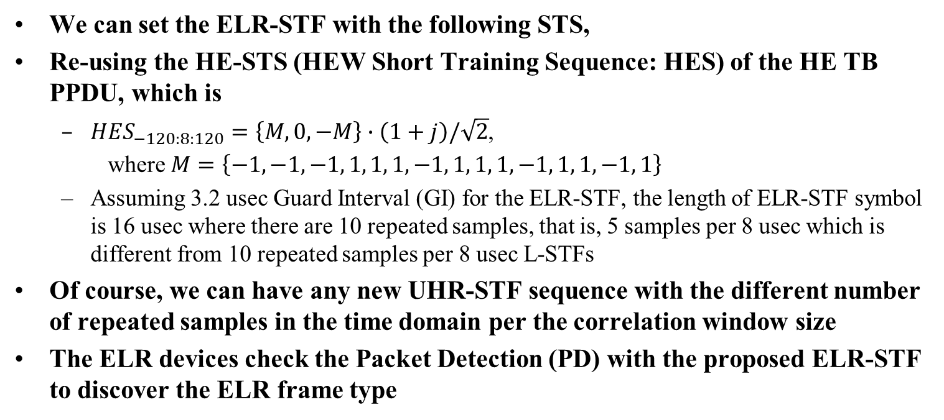
ELR Frame Detection
We can set the ELR-STF with the following STS,
Re-using the HE-STS (HEW Short Training Sequence: HES) of the HE TB PPDU, which is
  ${HES}_{−120:8:120}=\left\{M,0,−M\right\}∙\left(1+j\right)/\sqrt{2}$,
  where $M=\left\{−1, −1, −1, 1, 1, 1, −1, 1, 1, 1, −1, 1, 1, −1, 1\right\}$
  Assuming 3.2 usec Guard Interval (GI) for the ELR-STF, the length of ELR-STF symbol is 16 usec where there are 10 repeated samples, that is, 5 samples per 8 usec which is different from 10 repeated samples per 8 usec L-STFs
Of course, we can have any new UHR-STF sequence with the different number of repeated samples in the time domain per the correlation window size
The ELR devices check the Packet Detection (PD) with the proposed ELR-STF to discover the ELR frame type

Slide 6
PD and Coarse CFO Estimation
If the ELR-STF is designed with the HE TB PPDU STS, there would be 10 repeated samples over the 16 usec period, and the first 6 to 7 repetitions may be used for the PD and the remaining 3 to 4 repetitions can be used for the coarse CFO correction
If we want to give better coarse CFO correction in the ELR-STF, then, we may need another repeated ELR-STF symbol and provide 20 repeated samples over the 32 usec period, which may assign the first 6 to 7 repetition for the PD and leave the remaining 13 to 14 repetitions being used for the averaging the Coarse CFO

Slide 7
Summary
We proposed to assign 256 subcarriers per 20 MHz for the ELR Preamble portion
  ELR-STF can be defined using the HE STS of HE TB PPDU or we can propose a totally new ELR STS
  If we set the ELR-STF with the HE STA of the HE MU PPDU, then, the Double Packet detection may occur, when the ELR device is near enough to the AP to detect both Legacy portion and ELR Preamble portion, because the same number of ELR-STF samples repeats per 8 usec as is repeated by the L-STF samples
Simulation results for the proposal to verify the feasibility and the detail for the ELR-LTF/SIG/Data may follow in the next contributions
Further evaluation points
  ELR vs Relay
  Design Criteria : 1.5 Mbps rate support (?), BF vs No BF, etc
  Pure ELR device vs ELR-supported 802.11 device

Slide 8
References
[1] J. Liu, et. al., “Design Targets and Considerations for Enhanced Long Range”, IEEE 802.11-24/873r0

Slide 9
SP 1
Do you agree to support the ELR Frame which provides the Packet Detection (PD) scheme to distinguish from the PD of the Legacy Frame?
  Yes
  No
  Abs

Slide 10
SP 2
Do you support to design the ELR Preamble with the 256 subcarriers per 20 MHz?
  Yes
  No
  Abs

