Slide 1
ICF and ICR Design For Coex
Date: 2024-07
Authors:

Slide 2
Recap
In [1-7], a TXOP holder (e.g., AP) sends an Initial Control Frame (ICF) to a STA that is experiencing a Coex session to solicit its unavailability info
The STA reports back in an ICR its unavailability information to the AP
The goal is to enhance the performance by reducing data loss and preventing unnecessary transmit rate reduction

Slide 3
ICF Design For Coex
From a client standpoint, in case of Coex session, a client needs to be able to always report back to the AP the Coex unavailability information in an ICR sent in response to an ICF
The ICF needs to open a TXOP for legacy and UHR STAs
  ICF should support EHT EMLSR STAs
The ICF always solicit an ICR that can include Coex unavailability feedback (e.g., unsolicited unavailability info)
  Regardless whether the ICF solicit Common or per User feedback
The ICF needs to solicit ICR in non-HT (Dup) PPDU for single user to provide NAV protection from legacy clients (e.g., 5GHz)
  ICF should be carried in non-HT (dup) format for better NAV protection from legacy as well

Slide 4
ICR Design For Coex
The M-BA is a good candidate as an ICR frame to deliver the Coex Unavailability information
  The M-BA is flexible and can be leveraged to include the unavailability information for Coex

Slide 5
M-BA Design
Defining a special Per AID TID Info for feedback is a good option
M-BA includes a special Per AID TID Info for feedback as follows:
  This Special Per AID TID Info is indicated using a reserved (Ack Type, TID)
    E.g., Ack Type = 0 and a reserved TID value can be used
  Length of the feedback can be indicated in the BA Starting Sequence Control field
    This ensures backward compatibility and allows flexibility for the feedback length to be 0, 4, 8, 16, ….
  The feedback content (unavailability start time, unavailability duration, ..) can be carried in the Block Ack Bitmap field (better to rename it to something else such as feedback info)

Slide 6
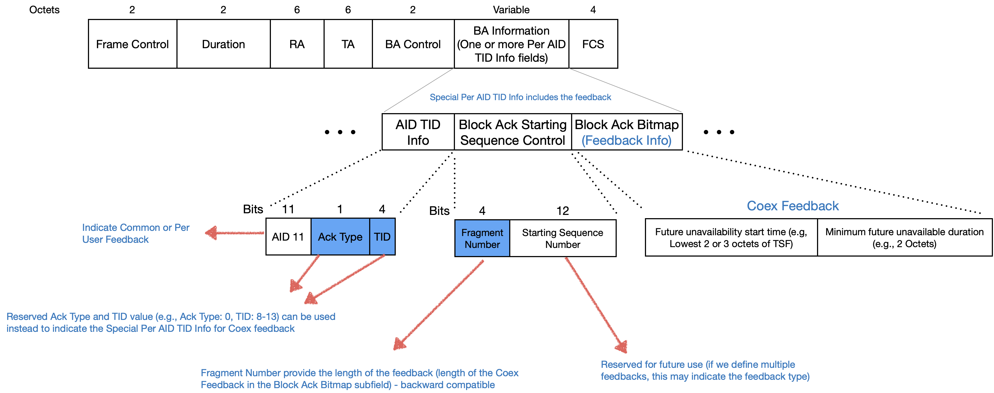
Special Per AID TID Info field For Coex Feedback
Special (Ack Type, TID) combination indicate the Special Per AID TID Info for Feedback:

Slide 7
Summary
In these slides, we provide our thoughts on the ICF and ICR design for Coex

Slide 8
Straw poll #1
Do you support to include the following in the 11bn SFD:
  Do you support that a non-AP STA can request its associated AP to initiate TXOPs/frame exchanges with the STA with an initial control frame that enables the non-AP STA to include unavailability feedback in the initial response frame?

Slide 9
References
[1] 11-24-0094-00-00bn-probe-before-talk-and-unsolicited-unavailability-announcement-for-co-ex-management, Qi Wang Et al.
[2] 11-24-0420-02-00bn-enabling-flexible-coexistence-operation, Guogang Huang Et al.
[3] 11-23-2002-02-00bn-in-device-coexistence-and-interference-follow-up, Laurent Cariou Et al.
[4] 11-23-1964-01-00bn-coexistence-protocols-for-uhr, Alfred Asterjadhi Et al.
[5] 11-23-0816-01-0uhr-enhancements-for-latency-sensitive-traffic-and-in-device-coexistence, Shubhodeep Adhikari Et al.
[6] 11-24-0436-00-00bn-sp-based-in-device-coexistence, Jason Yuchen Guo Et al.
[7] 11-24-0494-02-00bn-in-device-coexistence-follow-up, Liwen Chu Et al.

