Slide 1
Tone distribution in DRU with preamble puncturing - follow up
Date: 2024-07-12
Authors:
Name | Affiliation | Address | Phone | Email
Yan Xin | Huawei Technologies Canada |  |  | yan.xin@huawei.com
Junghoon Suh
Sara Norouzi
Mahmoud Hasabelnaby
Osama Aboul-Magd

Slide 2
Introduction
Distributed RU (DRU) has been proposed [1] to maximize per-subcarrier transmit power. DRU tone plan designs have been outlined in [2, 3].
In 802.11be, the preamble puncturing feature is specified, in which no signal is present in at least one of the 20 MHz subchannels within a PPDU bandwidth larger than or equal to 80 MHz due to unavailability of 20 MHz subchannel(s).
Furthermore, when a 20 MHz subchannel is used by a 20 MHz operation device, this 20 MHz subchannel may not be available for tone distribution in DRU over 80 MHz.
DRU designs in [2, 3] have not considered the cases of preamble puncturing.
When one 20 MHz subchannel is punctured in an 80 MHz PPDU, it implies that subcarriers can be distributed over a maximum 60 MHz spectrum. In [4], it is proposed to distribute subcarriers only over 20 MHz and 40 MHz, resulting in 4.7 dB and 1.7 dB losses in terms of per-tone transmit power for 242-tone DRUs, respectively, when compared to tone distribution over the maximum available 60 MHz.
In [5], preamble puncturing is taken into account in DRU. All subcarriers are distributed over the maximum available spectrum for DRU through interleaving.
This contribution further considers DRU designs for the case when one or two subchannels within the PPDU BW are unavailable for tone distribution.

Slide 3
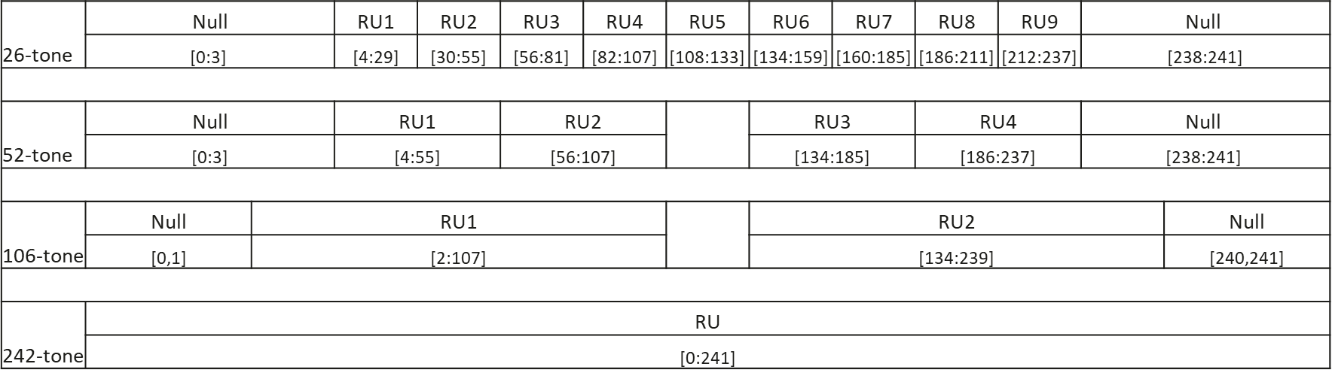
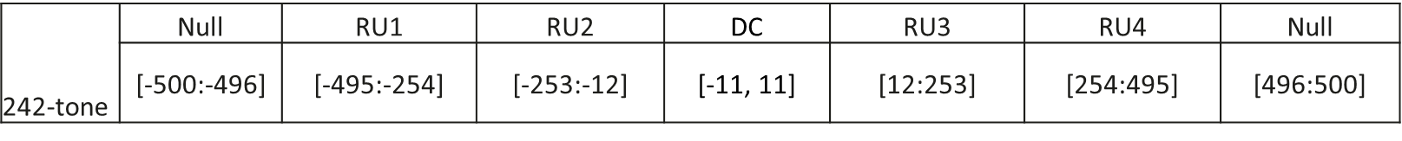
Rearrangement of EHT RRUs
Rearrangement of EHT 26-, 52- and 106-tone RRU indexing per 20 MHz
Rearrangement of EHT 242-tone RRU indexing in an 80 MHz PPDU
Note – These rearrangements are for DRU design only.

Slide 4
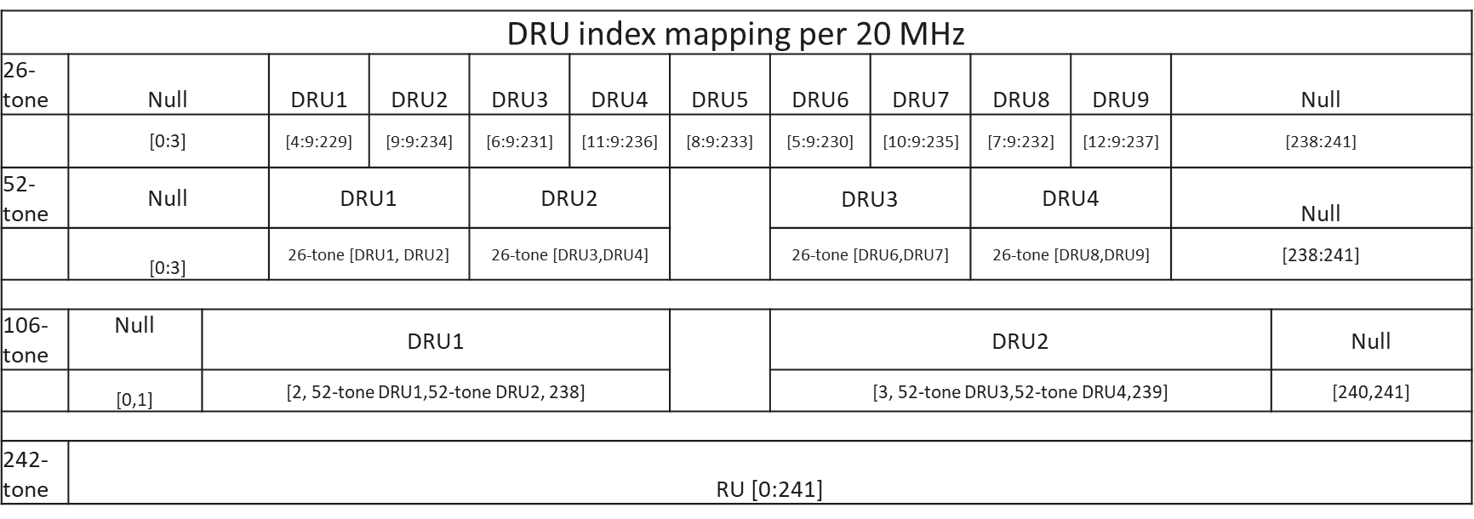
Tone distribution per 20 MHz
Universal one-to-one mapping between 26-, 52- and 106-tone distribution indices and 242-tone indices per 20 MHz

Slide 5
242-tone DRU tone indices in an 80 MHz PPDU with all subchannels available for tone distribution

Slide 6
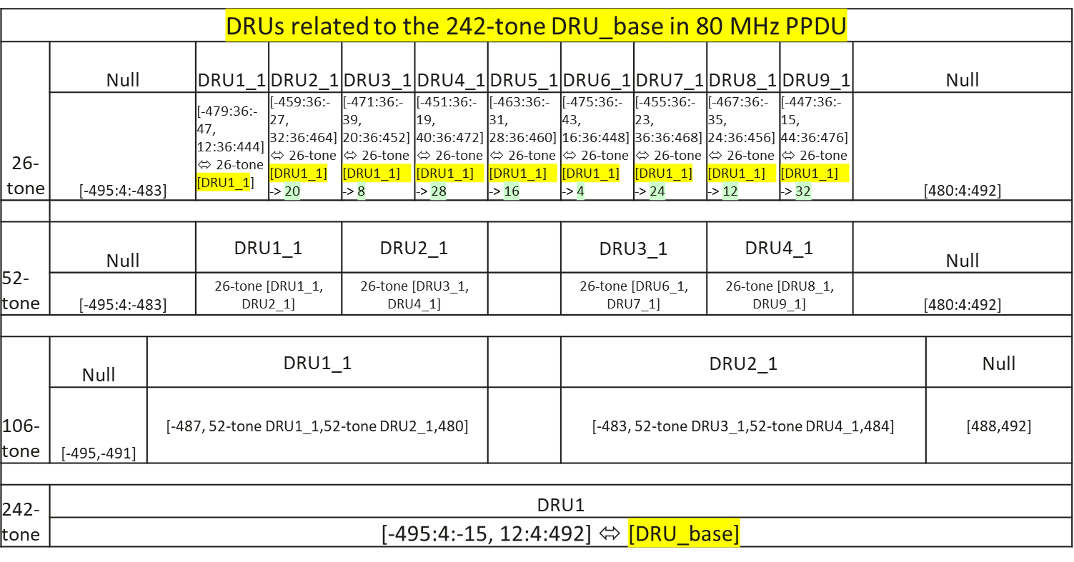
26-, 52- and106-tone distribution related to 242-tone DRU1 in an 80 MHz PPDU
Note:
1) ‘-> j’ denotes an index is right-shifted j positions;
2) index right-shifting is counted one when it is shifted from [-12] to [12];
3) ⬄’denotes an equivalent notation

Slide 7
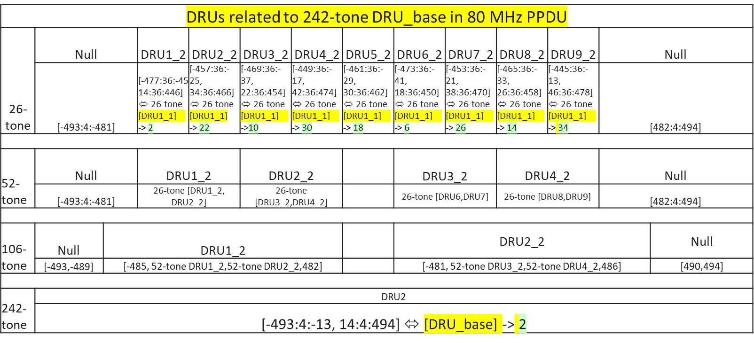
26-, 52- and106-tone distribution related to 242-tone DRU2 in an 80 MHz PPDU

Slide 8
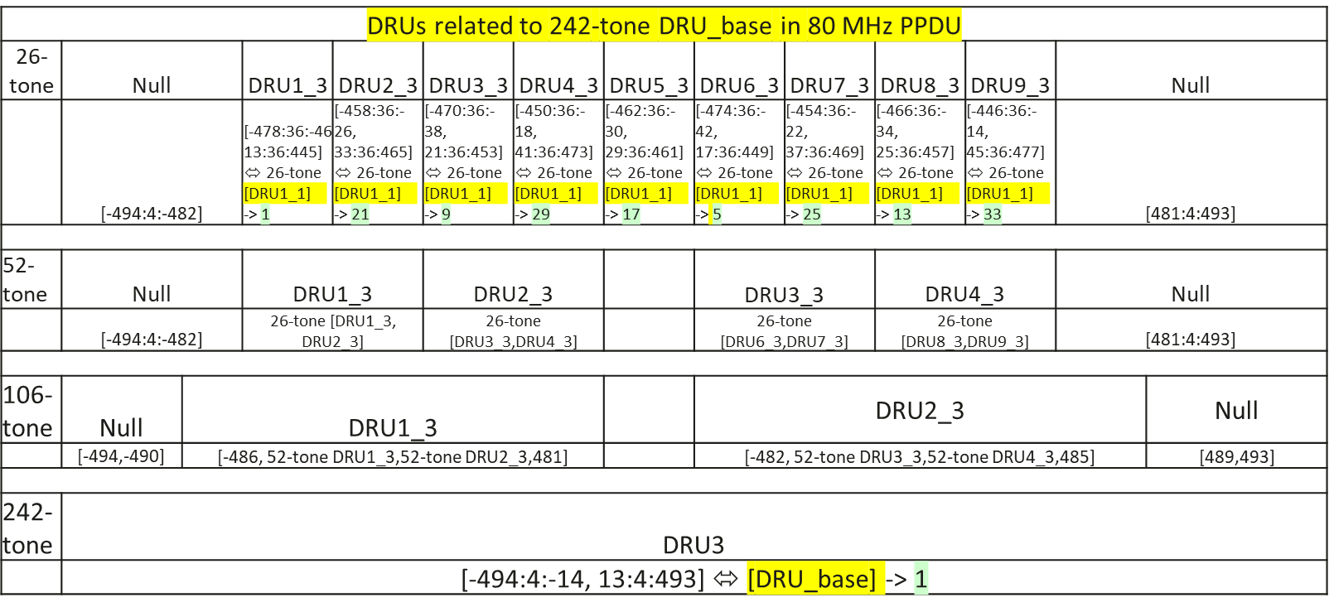
26-, 52- and106-tone distribution related to 242-tone DRU3 in an 80 MHz PPDU

Slide 9
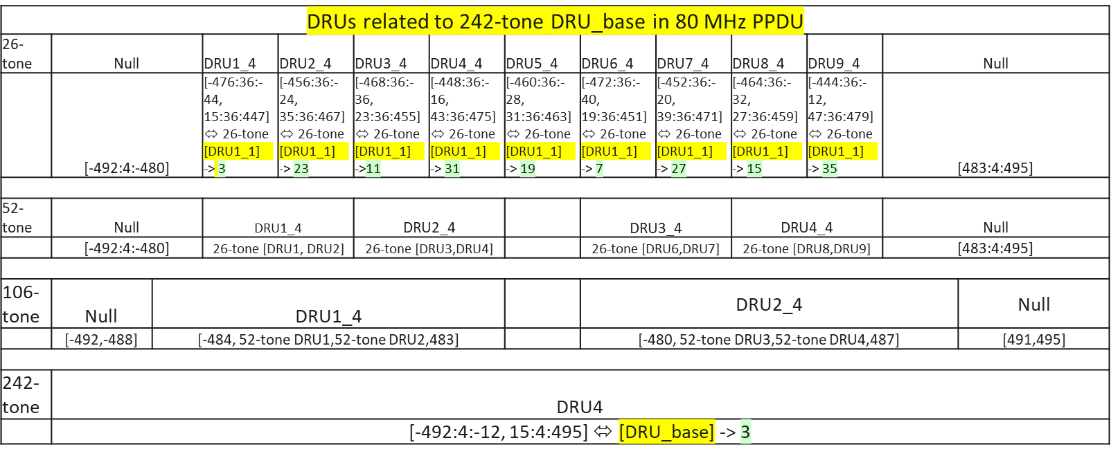
26-, 52- and106-tone distribution related to 242-tone DRU4 in an 80 MHz PPDU

Slide 10
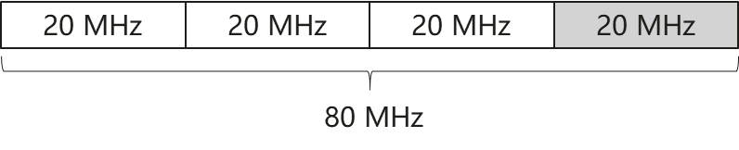
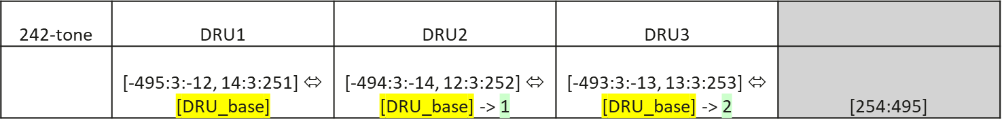
Tone distribution in 242-tone DRUs in an 80 MHz PPDU with the last 20 MHz subchannel unavailable for tone distribution across 20 MHz subchannels
Assume that the last 20 MHz subchannel is unavailable for tone distribution across 20 MHz subchannels
Tone distributions of 242-tone DRU1, DRU2 and DRU3 are:

Slide 11
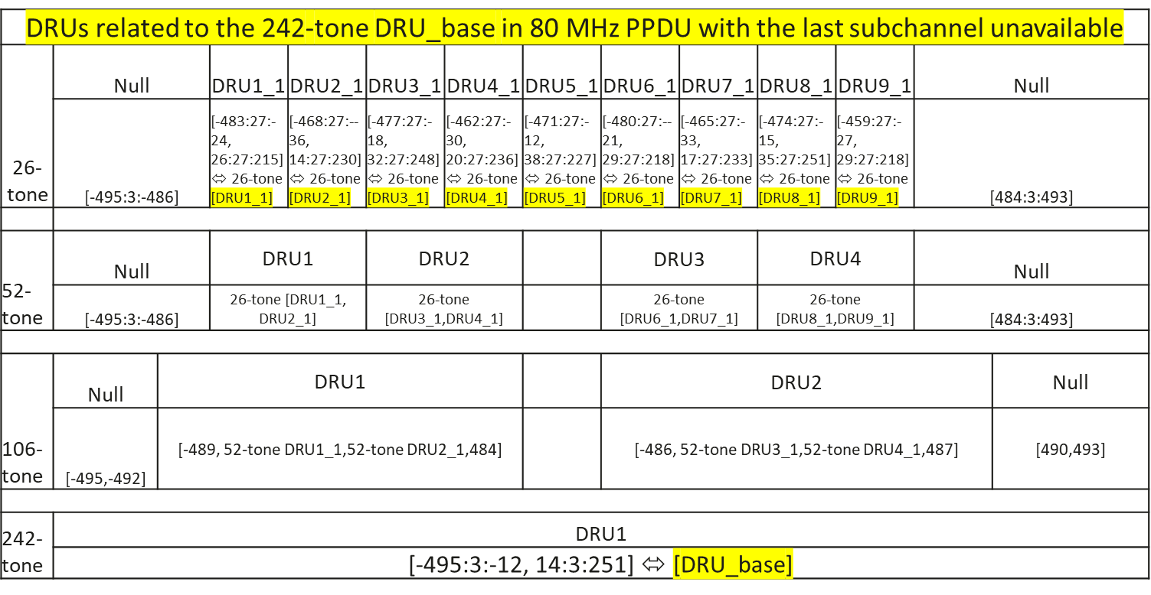
Tone distribution in an 80 MHz PPDU with the last 20 MHz subchannel punctured for tone distribution across 20 MHz subchannels

Slide 12
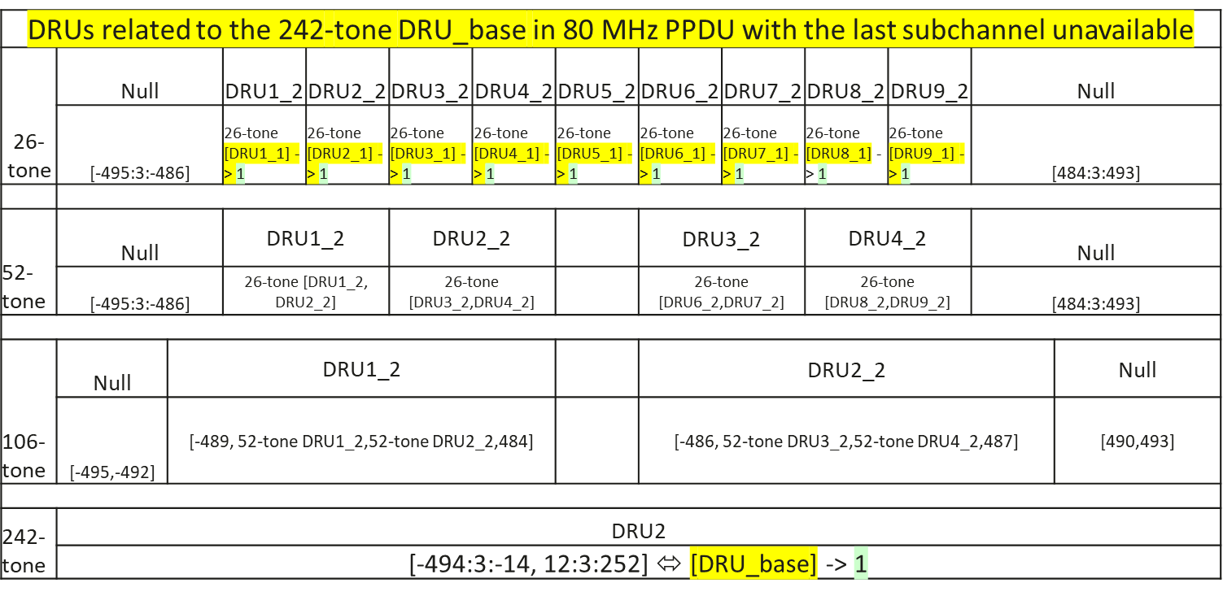
Tone distribution in an 80 MHz PPDU with the last 20 MHz subchannel punctured for tone distribution across 20 MHz subchannels

Slide 13
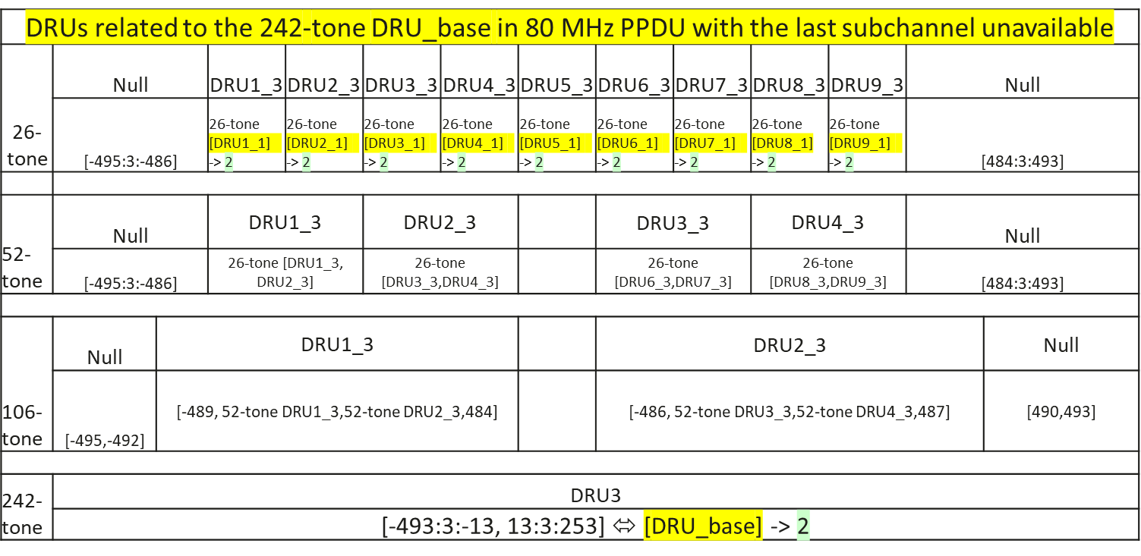
Tone distribution in an 80 MHz PPDU with the last 20 MHz subchannel punctured for tone distribution across 20 MHz subchannels

Slide 14
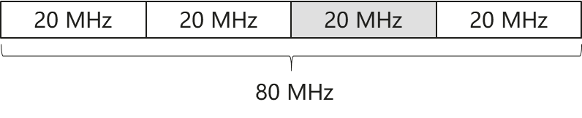
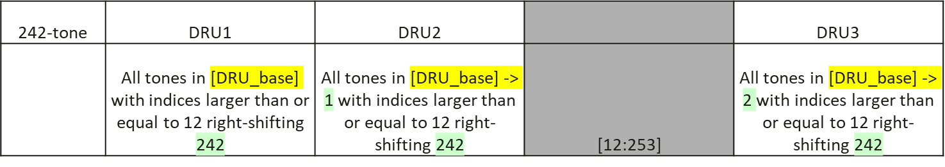
Tone distribution in an 80 MHz PPDU with the second last 20 MHz subchannel unavailable for tone distribution across 20 MHz subchannels
Assume that the second last 20 MHz subchannel is unavailable in tone distribution across 20 MHz subchannels
Tone distributions of 242-tone DRU1, DRU2 and DRU3 are:

Slide 15
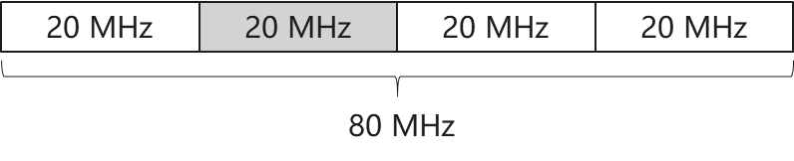
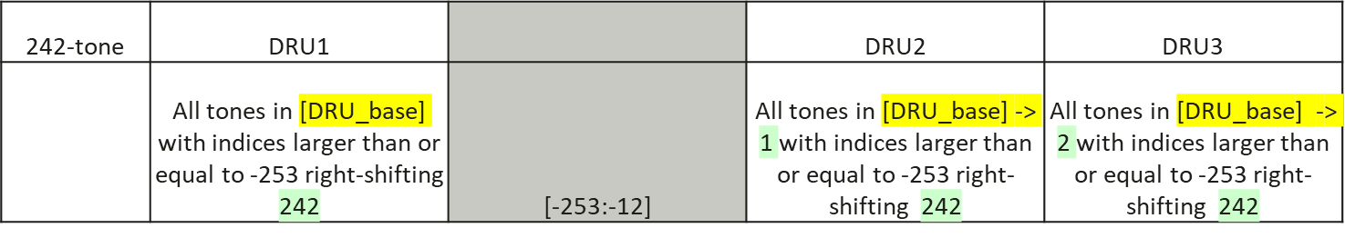
Tone distribution in an 80 MHz PPDU with the second 20 MHz subchannel punctured for tone distribution across 20 MHz subchannels
Assume that the second 20 MHz subchannel is punctured in tone distribution across 20 MHz subchannels
Tone distributions of 242-tone DRU1, DRU2 and DRU3 are:

Slide 16
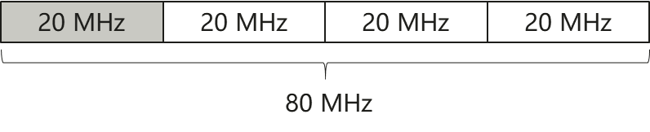
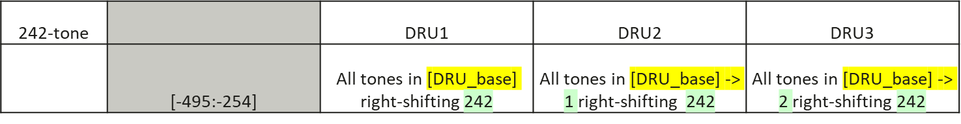
Tone distribution in an 80 MHz PPDU with the first 20 MHz subchannel being unavailable for tone distribution across 20 MHz subchannels
Assume that the first 20 MHz subchannel is unavailable for tone distribution across 20 MHz subchannels
Tone distributions of 242-tone DRU1, DRU2 and DRU3 are:

Slide 17
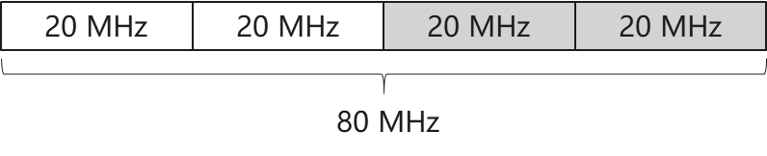
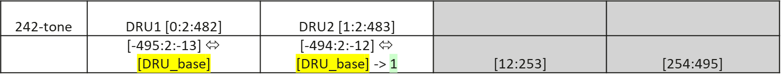
Tone distribution in 242-tone DRUs in an 80 MHz PPDU with the last two 20 MHz subchannels unavailable for tone distribution across 20 MHz subchannels
Assume that the last two 20 MHz subchannels are punctured. Data/pilot tones are distributed over the first two 20 MHz subchannels only.
- Note: This assumption is only for the DRU tone distribution design for the case specified in EHT, i.e., two 20 MHz subchannels in the middle are punctured, without any purpose to introduce of a new puncturing pattern.
Tone distributions of 242-tone DRU1 and DRU2 are:

Slide 18
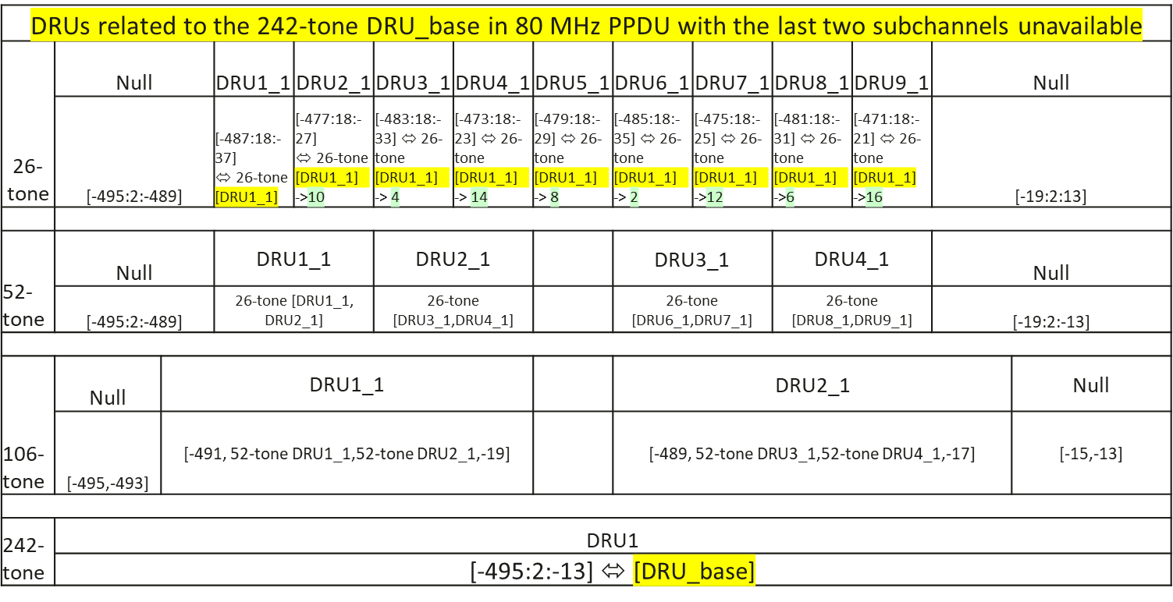
Tone distribution in an 80 MHz PPDU with the last two 20 MHz subchannels unavailable for tone distribution across 20 MHz subchannels

Slide 19
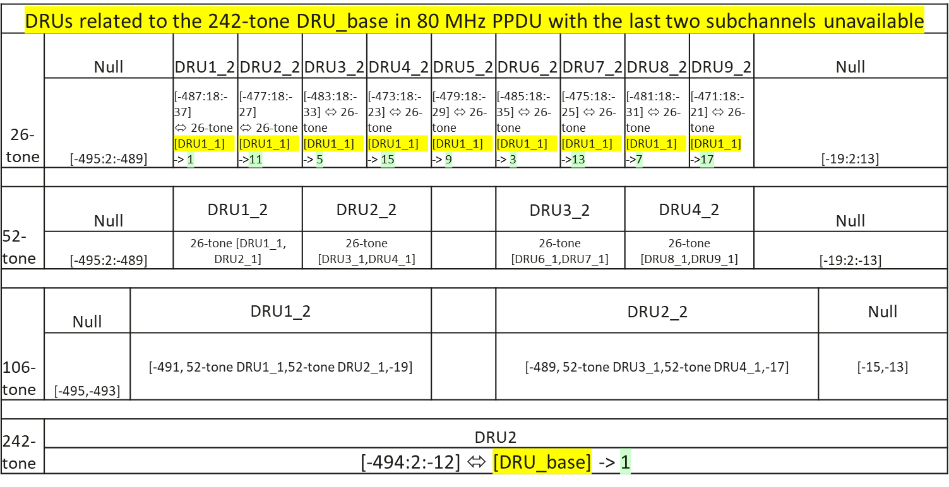
Tone distribution in an 80 MHz PPDU with the last two 20 MHz subchannels unavailable for tone distribution across 20 MHz subchannels

Slide 20
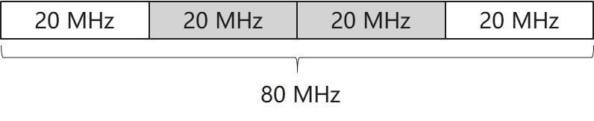
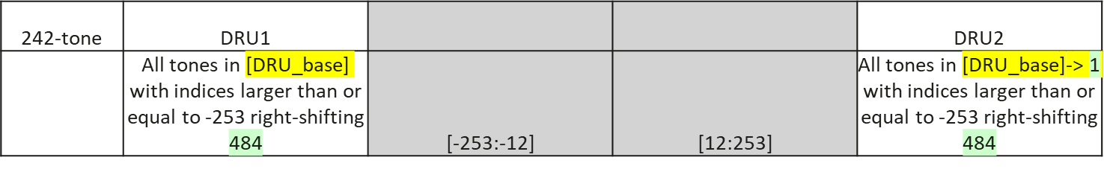
Tone distribution in 242-tone DRUs in an 80 MHz PPDU with the two middle 20 MHz subchannels unavailable for tone distribution across 20 MHz subchannels
Assume that the last 20 MHz subchannel is unavailable for tone distribution across 20 MHz subchannels
Tone distributions of 242-tone DRU1 and DRU2 are:

Slide 21
Summary
This contribution proposes an efficient design method for tone distribution in DRU with preamble puncturing.
Since in EHT, preamble puncturing is 20 MHz-based, distributed tone indices in 26-, 52- and 106-tone DRUs are designed to have universal one-to-one mapping with the indices of a 242-tone DRU.
Tone indices of 242-tone DRUs are specified based on the status of subchannel puncturing, either without puncturing or with one or two subchannels punctured, in an 80 MHz PPDU.
The indices of 26-, 52-, 106- and 242-tone DURs can be simply derived from those corresponding to the based DRU only with index shifting.
Simple group index shifting is applied when one or two subchannels are unavailable for across 20 MHz tone distribution.

Slide 22
Reference
[1] 802.11-23-0037r0, UHR Feature to Overcome PSD Limitations: Distributed-Tone Resource Units, Jan. 2023.
[2] 802.11-23/2021r1, Principle and methodology for DRU tone plan design, Jan. 2024.
[3] 802.11-24/0468r2, DRU tone plan for 11bn, May 2024.
[4] 802.11-24/0726r2, Distribution Bandwidth within 80 MHz for DRU, May 2024.
[5] 802.11-24/814r0, Tone distribution in DRUs, May 2024.

Slide 23
SP1
Do you agree to include the following text in the 11bn SFD?
- A DRU bandwidth of 60 MHz is defined in an 80 MHz PPDU?
Yes
No
Abstain

