Slide 1
SST or DSO Support for Wider Bandwidth OFDMA and A-PPDU
Date: 2024-07-12
Authors:
Name | Affiliations | Address | Phone | email
Ross Jian Yu | Huawei |  |  | ross.yujian@huawei.com
Ming Gan
David Xun Yang

Slide 2
SST for Wider Bandwidth OFDMA in 802.11be
In 11be, an 80 MHz operating non-AP EHT STA shall be able to participate in 160MHz, and 320MHz EHT DL and UL OFDMA transmissions.
Several features are designed accordingly, for example, a receiver only needs to process preambles within its operating 80 MHz channel.
However, there is not enough support to enable wider bandwidth OFDMA. Only HE subchannel selective transmission (SST) is supported.
NOTE 2—As defined in 35.11.4 (CENTER_FREQUENCY_SEGMENT), an 80 MHz operating non-AP EHT STA operates in the primary 80 MHz channel and might operate in the secondary 80 MHz channel that does not include any inactive 20 MHz subchannel when the 80 MHz operating non-AP EHT STA sets dot11HESubchannelSelectiveTransmissionImplemented to true.
SST is not supported in secondary 160 MHz or when preamble puncturing exists in secondary 80 MHz.

Slide 3
Wider Bandwidth OFDMA in 802.11bn
For 802.11bn, SST should be extended to secondary 160 MHz and preamble puncturing case.
For example, one additional octet of bitmap for secondary 160 MHz.
For preamble puncturing, may consider static preamble puncturing as a baseline, and further study dynamic preamble puncturing.
SST is combined with TWT, and doesn’t have tight hardware requirements for the non-AP STA.
Dynamic subband operation (DSO), which moves non-AP STAs to secondary channels at the beginning of a TXOP, may also be applied. However, this requires tighter hardware requirements, and need more evaluation and discussions.

Slide 4
A-PPDU
Frequency domain A-PPDU has been well discussed in 802.11be and also in [4-7] in 802.11bn. A-PPDU can further take advantage of the wider bandwidth channels when there are legacy transmissions.
~2x data rate improvement for 80 MHz → 160 MHz or 160 MHz → 320 MHz transmission, ~4x data rate improvement for 80 MHz → 320 MHz transmissions.
Reduce latency compared with only legacy transmissions in primary channel.
A-PPDU can be supported when there are large bandwidth capable non-AP STAs (e.g. 160 or 320 MHz non-AP STA), without SST or DSO. With SST or DSO support, A-PPDU can also be enabled for bandwidth limited non-AP STAs or smaller bandwidth operating non-AP STAs.
Several A-PPDU combination examples are shown in the following slides. The preferred modes are marked in red. Whilst we are open for specific modes.

Slide 5
A-PPDU Combination Examples
80 MHz
HE PPDU
EHT PPDU
80 MHz
HE PPDU (by UHR STA)
UHR PPDU
(1)
(2)
HE PPDU
EHT PPDU
HE PPDU
160 MHz
UHR PPDU
UHR PPDU
EHT PPDU (by UHR STA)
160 MHz
(a)
(b)
(c)
80 MHz
HE PPDU
EHT PPDU
HE PPDU
80 MHz
HE PPDU (by UHR STA)
EHT PPDU (by UHR STA)
HE PPDU (by UHR STA)
UHR PPDU
UHR PPDU
EHT PPDU (by UHR STA)
160 MHz
(d)
(e)
(f)

Slide 6
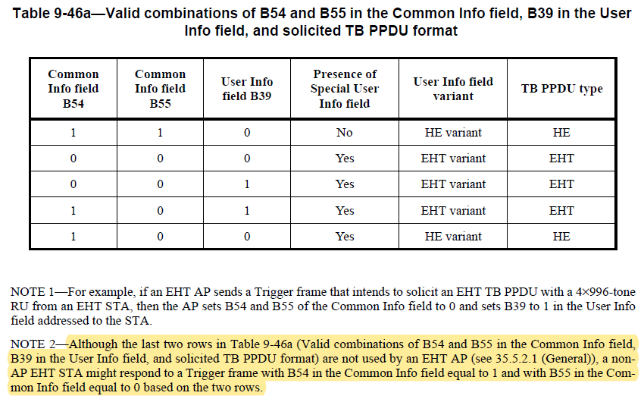
TB A-PPDU in 11be
In 802.11be, the trigger frame can support an A-PPDU of HE TB PPDU and EHT TB PPDU whilst the spec disallows the AP to do that. An EHT non-AP STA might respond if triggered by an AP of later generations.
B54 is set to 1 to indicate HE TB PPDU in P160, B55 is set to 0 to indicate presence of Special User Info field, which indicates EHT TB PPDU exists. Then in User Info field, B39 is set to 0 to indicate P160, which means HE variant User Info field, B39 is set to 1 to indicate S160, which means EHT variant User Info field.
Trigger frame
HE TB PPDU
160 MHz
…
EHT TB PPDU
(BW=320MHz-1/2)
160 MHz
Non-HT Duplicate

Slide 7
TB A-PPDU in 11bn
If we allow a UHR AP can use the last two rows, then TB A-PPDU of HE TB PPDU and EHT TB PPDU is doable with no further efforts. HE non-AP STA and EHT non-AP STA can transmit HE TB PPDU, UHR non-AP STA can transmit EHT TB PPDU. EHT non-AP STA may also participate in EHT TB PPDU if there is no interoperability issue.
Furthermore, if PHY Version Identifier is set to UHR, then TB A-PPDU of HE TB PPDU and UHR TB PPDU is straightly doable.
Other modes need some further works. With DL A-PPDU, the signaling of TB A-PPDU can be further simplified.
Trigger frame
HE TB PPDU
160 MHz
…
UHR TB PPDU
(BW=320MHz-1/2)
160 MHz
Non-HT Duplicate

Slide 8
DL(non-TB) A-PPDU in 11bn
DL A-PPDU is not discussed in detail in 11be.
Within A-PPDU, each PPDU indicates its own bandwidth and parameters.
Moreover, the aggregated bandwidth, or exact bandwidth combinations may also be signaled (needs further study).

Slide 9
Summary
In this contribution, we first discuss the enhancement of SST or DSO, which can support both wider bandwidth OFDMA and A-PPDU.
We further discuss the advantages and some details on A-PPDU, for both TB or non-TB cases.

Slide 10
Straw Poll #1
Do you agree to include the following into the 11bn SFD?
11bn supports subchannel selective transmission for secondary 160 MHz channel.
Y
N
A

Slide 11
Straw Poll #2
Do you agree to include the following into the 11bn SFD?
11bn supports subchannel selective transmission when there exists static preamble puncturing.
Dynamic preamble puncturing case is TBD
Y
N
A

Slide 12
Motion #1
Do you agree to include the following into the 11bn SFD?
11bn defines frequency domain aggregation of aggregated PPDUs. A frequency domain aggregated PPDU consists of multiple PPDUs.
The PPDU format combinations include HE PPDU, other PPDUs are TBD.
The number of PPDUs is TBD.
Y
N
A

Slide 13
Straw Poll #3
Do you agree to include the following into the 11bn SFD?
11bn defines frequency domain aggregation of a 160 MHz HE PPDU and 160 MHz UHR PPDU.
Y
N
A

Slide 14
Straw Poll #4
Do you agree to include the following into the 11bn SFD?
11bn defines frequency domain aggregation of an 80 MHz HE PPDU, 80 MHz HE PPDU and 160 MHz UHR PPDU.
Y
N
A

Slide 15
References
IEEE Std 802.11axTM-2021
Draft P802.11be D6.0
https://mentor.ieee.org/802.11/dcn/21/11-21-0015-00-00be-clarification-of-80-mhz-operation-in-wider-bw-ofdma.pptx
https://mentor.ieee.org/802.11/dcn/23/11-23-1865-01-00bn-discussion-on-sst-and-a-ppdu.pptx
https://mentor.ieee.org/802.11/dcn/24/11-24-0224-02-00bn-discussion-on-a-ppdu-follow-up.pptx
https://mentor.ieee.org/802.11/dcn/23/11-23-1954-00-00bn-two-dimensional-a-ppdu.pptx
https://mentor.ieee.org/802.11/dcn/24/11-24-0001-01-00bn-dl-mu-ext-ppdus.pptx

Slide 16
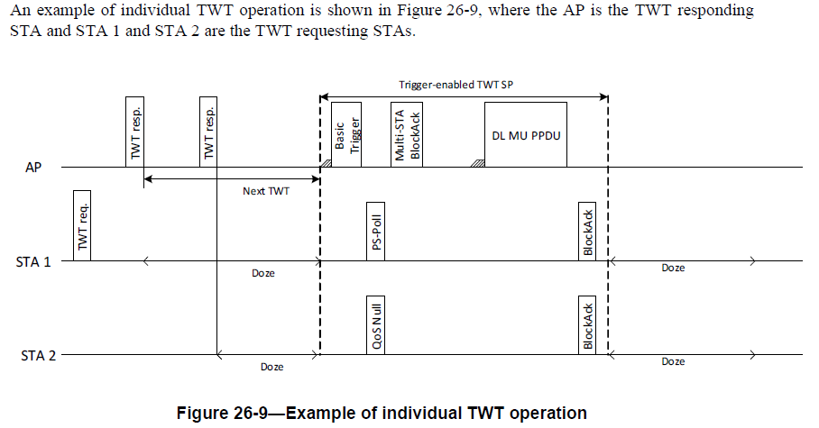
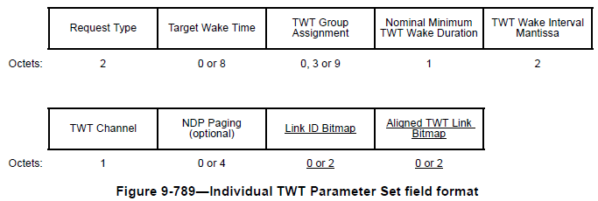
Appendix – Individual TWT Operation

Slide 17
Agreed SPs for “11be R2” [1]

Slide 18
Agreed SPs for “11be R2” [1]

