Slide 1
2x1944 LDPC Codes Performance Evaluation
Date: 2024-July
Authors:

Slide 2
Background
The next generation WiFi is defined for ultra high reliability. This motivates more robust channel coding schemes.
It is known that the performance of LDPC codes improves for longer codeword block length. Currently, the longest codeword block length is 1944 bits.
Contribution 11-24/1985r4 [1] proposed to extend the codeword block length to 2x1944 bits. In their design, considerations are emphasized on reusing existing LDPC core for codeword block length of 1944 bits.
In this study, we show simulation results of those longer LDPC codes under various settings. We also share our views on longer LDPC codes.

Slide 3
Sim Configs
Antenna (Nt x Nr x Nss): 4x2x1, 2x2x1, 4x2x2, 2x2x2, 1x1x1
Channel: DNLOS, BLOS, AWGN (only 1x1x1)
PPDU: EHT SU 80MHz
MCS: 0:1:13
Tx BF: On and Off
Channel estimation: realistic
Equalizer: linear
LDPC decoder: min-sum, max 30 iterations
Packet size varied to budget adequate number of codewords and symbols
Statistics: 1000 channels and 10% PER sensitivity is linear interpolated from two adjacent data points with 0.5dB SNR gap (0.2dB SNR gap in AWGN)

Slide 4
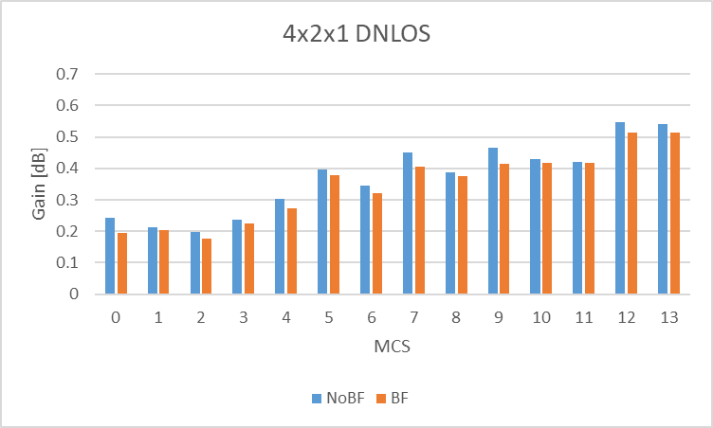
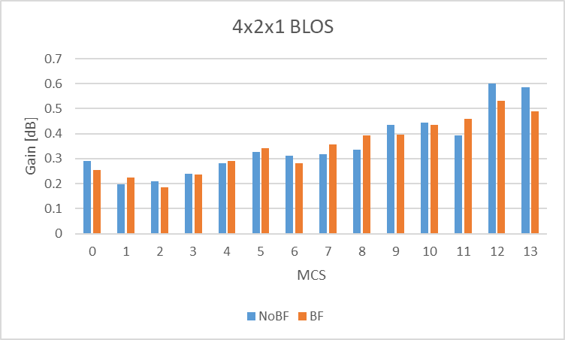
Nt=4 Nr=2 Nss=1
Gain [0.2 ~ 0.5] dB across all MCSs for both channels with/without BF

Slide 5
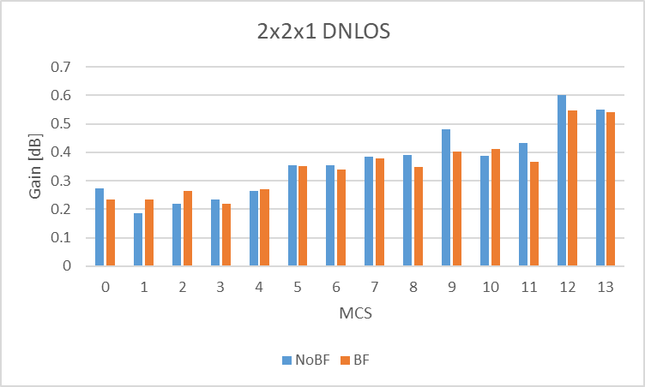
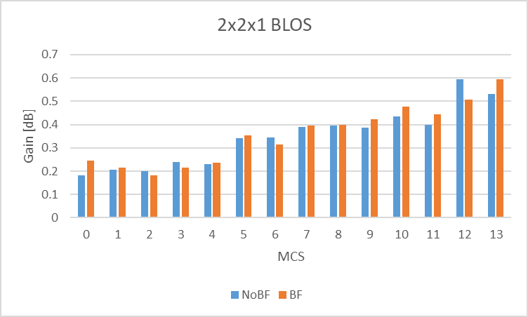
Nt=2 Nr=2 Nss=1
Gain [0.2 ~ 0.5] dB across all MCSs for both channels with/without BF

Slide 6
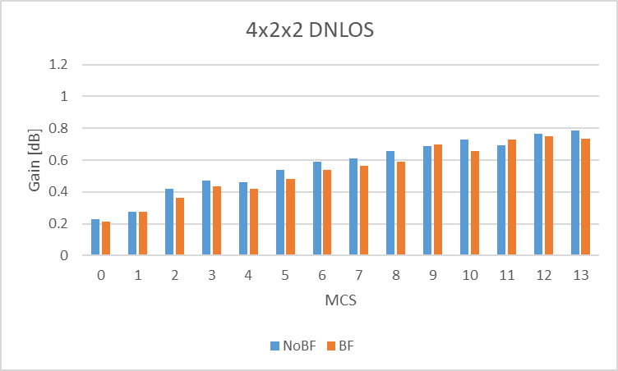
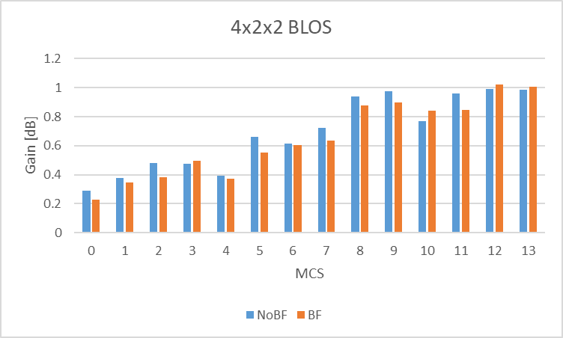
Nt=4 Nr=2 Nss=2
Gain [0.2 ~ 1] dB across all MCSs for both channels with/without BF

Slide 7
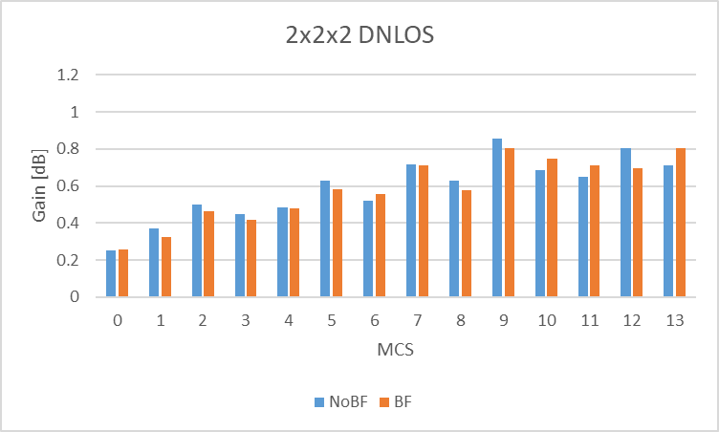
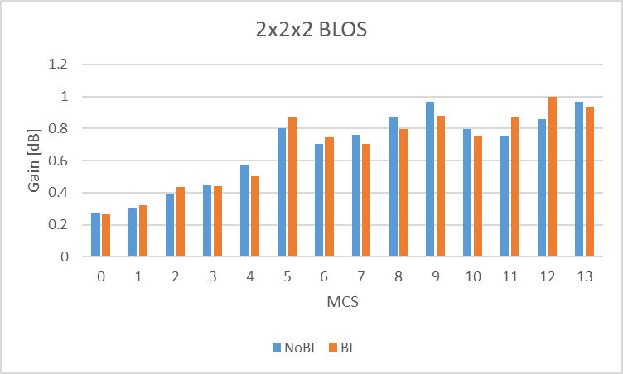
Nt=2 Nr=2 Nss=2
Gain [0.2 ~ 1] dB across all MCSs for both channels with/without BF

Slide 8
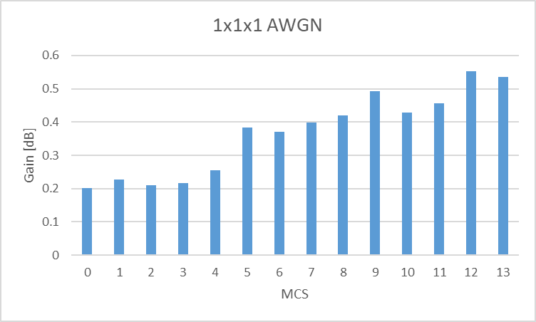
Nt=1 Nr=1 Nss=1
Gain [0.2 ~ 0.5] dB across all MCSs

Slide 9
Summary
Simulations are carried out for longer LDPC codes.
Consistent gains can be observed across all MCSs in various settings.
Affordable HW development efforts, since the code structure allows reusing existing LDPC core for codeword block length of 1944 bits.
Hence, the adoption of longer LDPC codes [1] needs to be considered by 11bn.

Slide 10
Reference
[1]. DCN: 11-24/1985r4 Longer Block-Length LDPC Codes

