Slide 1
Analysis of Frame Anonymization Techniques
Date: 2024-07-16
Authors:

Slide 2
Abstract
This submission presents the simulation analysis of Frame Anonymization Techniques
Goal: Evaluation of the RCM rotation mechanism and study the impact of different frame features that can help to de-anonymize the frame
Tools
Datasets acquired in different scenarios
A simulation model

Slide 3
Concept of Frame Anonymization
Why frame anonymization?
Presence monitoring
Unencrypted fields that facilitate presence monitoring
AID of associated STA
Address 1 (on the downlink) and Address 2 (on the uplink) that contains the MAC address of the associated STA
Sequence Number (SN)
Packet Number (PN)
See doc.: IEEE 802.11-24/0222r2

Slide 4
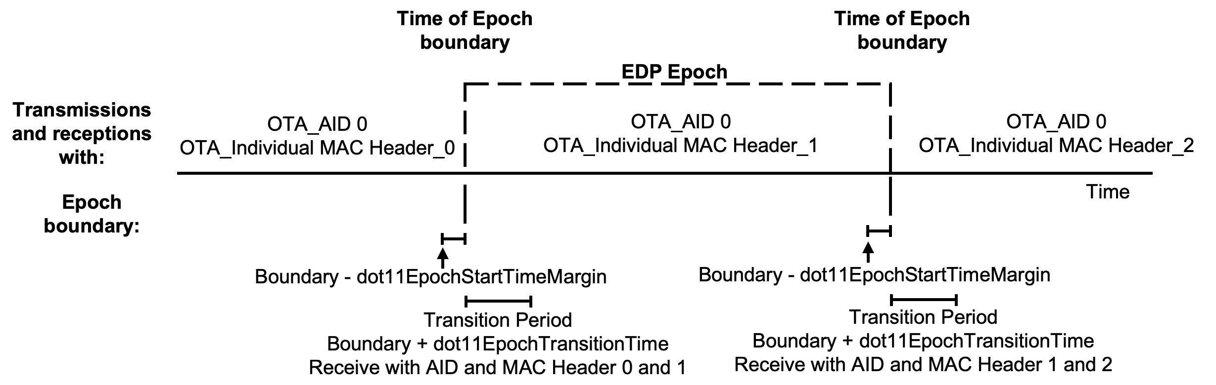
Concept of Frame Anonymization
Approach in 802.11bi
enhanced data privacy (EDP) epoch: time window in which a set of EDP parameters remain constant
Individual EDP Epoch or a Group EDP Epoch
Source: IEEE 802.11-24/0604r10

Slide 5
Focus of the study
Evaluation of the anonymization strategies
Individual vs Group EDP (Mass: A single Group)
Unencrypted fields that facilitate presence monitoring
AID of associated STA
Address 1 (on the downlink) and Address 2 (on the uplink) that contains the MAC address of the associated STA
Sequence Number (SN)
Packet Number (PN)
Study of other fields (L1 and L2)
  11-24/550 proposed also changing PHY parameters, with the intuition that PHY parameters might allow STA tracking

Slide 6
The Datasets
SCENARIO | Band | # STAs | PHY | NOTES
AIRPORT (303.57 FPS) | 5 GHz | 10 | A, VHT | All STAs have similar statistics at L2, e.g., same User Priority, no Protected frames.
CAFETERIA (62.03 FPS) | 2.4 GHz | 8 | B, G, HT | 1 STA has 30% of retransmissions and uses only b and g. 1 STA has 28% of Protected frames.
LIBRARY (32.47 FPS) | 5 GHz | 6 | A, VHT | 1 STA uses a high percentage of a. 2 STAs send frames with User Priority set to Voice.

Slide 7
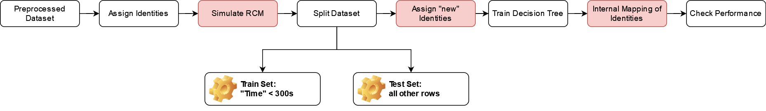
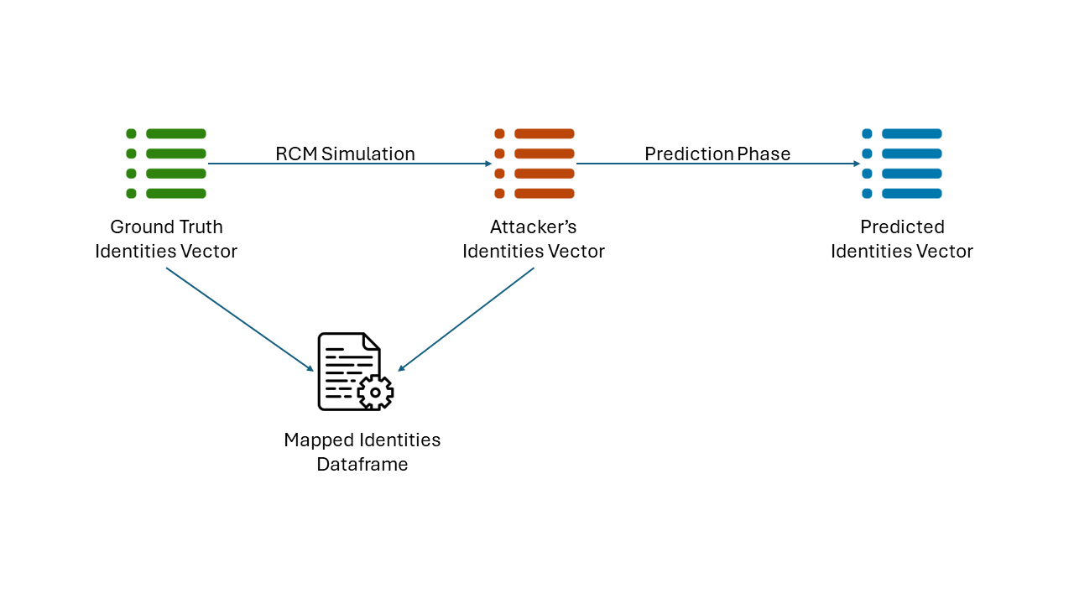
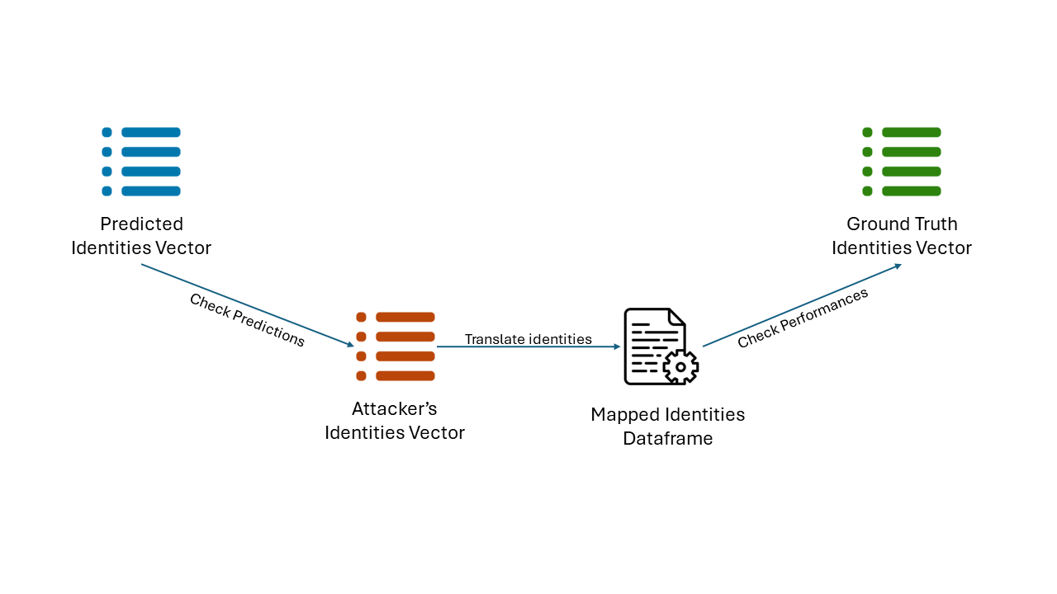
Dataset Simulation Methodology
EPOCHS R.V. U(20, 600) s
Training is done after the rotation simulation !!
Random SN
First 300 s
29000 Frames
Generation of Identities vector
Ground Truth
Attacker Identities
Evaluation of Prediction Performance

Slide 8
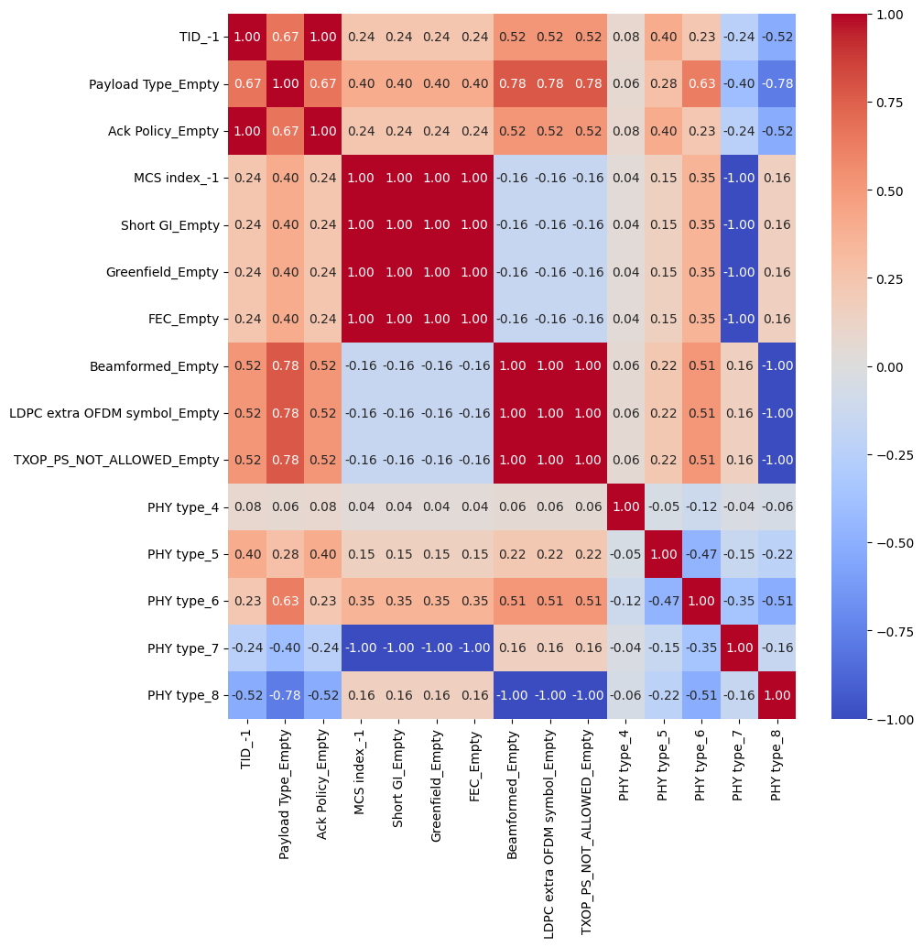
Study on the features selection
HR/DSSS
g
n
VHT

Slide 9
L2 Features
MAC Header
(bit)
16
16
48
48
48
16
48
16
32
0-7951 B
32
Frame
Control
Dur./
ID
Address 1
Address 2
Address 3
Seq.
Control
Address 4
QoS
ctrl
HT
ctrl
Frame Body
CRC
FRAME CONTROL
2
2
4
1
1
1
1
1
1
1
1
Protocol
Version
Type
Subtype
To DS
From DS
More Frag
Retry
Pwr Mgm
More Data
Prot.
Fram
Order
8
1
2
1
1
3
QoS CONTROL
TXOP LIMIT
A-
MSDU
ACK pol.
EOSP
Zero
User Priority
TID

Slide 10
L1+L2 Features
MAC features
PWR MGT
Protected flag ## NO in simulated dataset
TID
PHY features
SNR,
MCS index,
Short GI,
Greenfield,
FEC,
PHY type,
Beamformed,
LDPC extra OFDM symbol,
TXOP_PS_NOT_ALLOWED

Slide 11
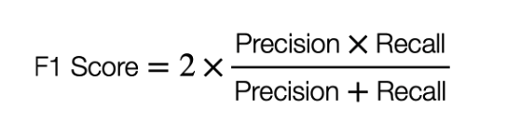
Performance Parameters
Decision Tree Classifier, 25 runs for each scenario
Single Run performance evaluation
Precision = TP/(TP + FP),
Recall (or Sensitivity) = TP/ (TP + FN).
Overall F1: weighted average of F1 calculated for each class.

Slide 12
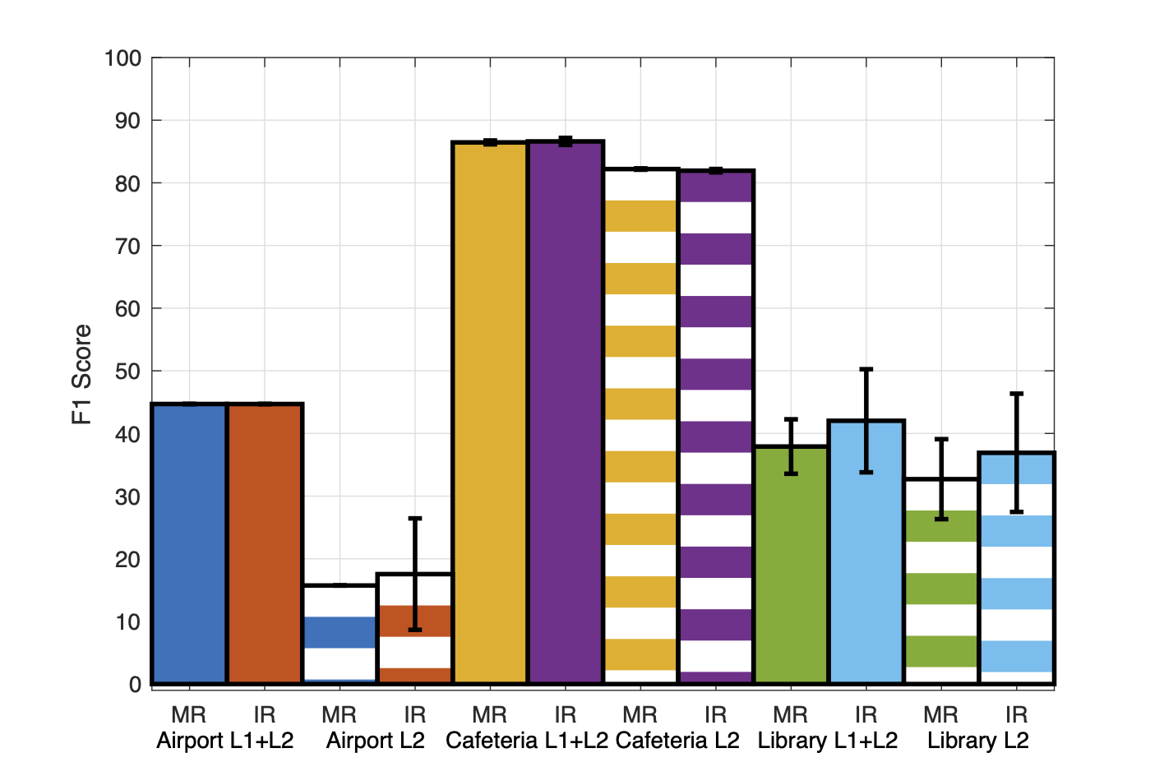
Results - 1
(%)
F1 scores in different environments
Stripped bar: only L2 values are processed by the classifier
Plain colors: both L1 and L2 are considered

Slide 13
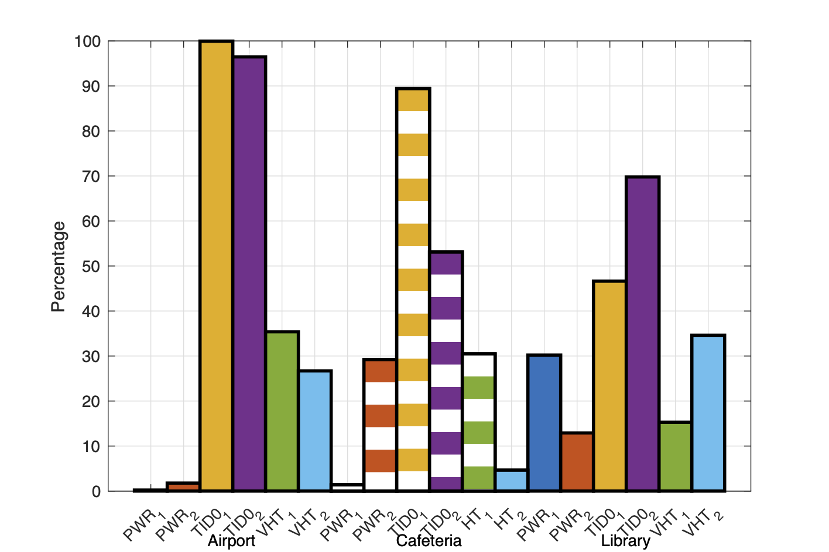
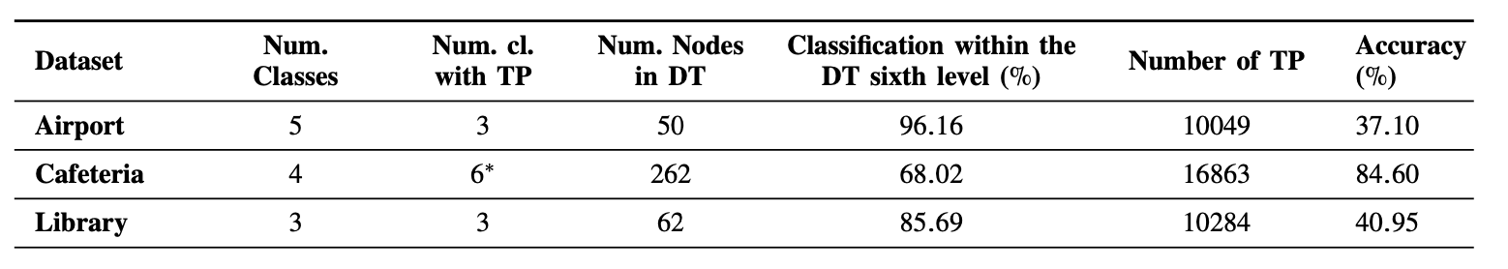
Results - Understanding the differences
For each scenario, and for the STAs ranked first and second in the traffic observed in the test set, the bar shows the percentage of their frames with
Power Mngt True,
TID set to 0
VHT/HT PHY
In each scenario, the two STAs generate about 90% of the Test Set traffic

Slide 14
Take away of dataset analysis
IR and MR strategies have the same performance
L1-generated information, such as SINR and MCS, represents an important fingerprint in some scenarios.
The performance of the anonymization mechanism depends on the network scenario.
  Scenarios with devices having different configurations of L2 and L1 optional functions reduce the effectiveness of anonymization techniques

Slide 15
Simulator – Main features - 1
Configuration of users
Standard: 802.11, 802.11n, and 802.11ac.
  802.11n devices: – Guard Interval (Long or Short) – FEC Type – HT format – MCS Index
  802.11ac devices: Very High Throughput (VHT) fields: – Beamformed
  – LDPC Extra OFDM Symbol – Transmission Opportunity Power Saving Not Allowed – Space Time Block Coding (STBC)
Device Type: – Basic Device – Advanced Device – Mobile Device – IoT Device – Gaming Device – Home Device
  QoS fields generated by the device: Traffic IDentifier (TID), end of service period (EOSP), transmission opportunity limit (TXOP Limit), ack policy and the presence of A-MSDU.
Identity:. each user has a unique identifier

Slide 16
Simulator – Main features - 2
AP-Device Distance
  1: very close to AP. Range [1, 5] meters.
  2: close to AP. Range [5, 15] meters.
  3: moderate far from AP. Range [15, 25] meters
  4: far from AP. Range [25, 40] meters.
  5: very far from AP. Range [40, 60] meters.
Randomization Technique:
  Mass Rotation – Individual Rotation – Wagon Rotation – Multiple MAC Address per Traffic

Slide 17
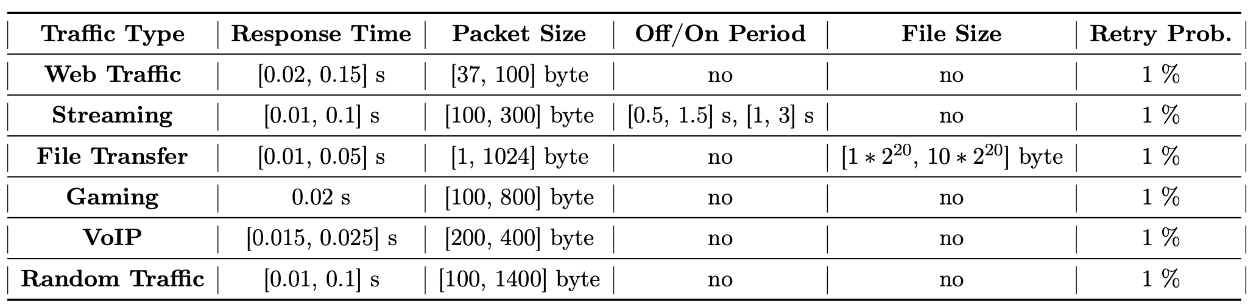
Simulator – Main features - 3
Actions
  Random Traffic – Web Traffic – Streaming Traffic – File Transfer Traffic – Gaming Traffic – VoIP Traffic – Mixed Traffic (that could contain all the before listed types)

Slide 18
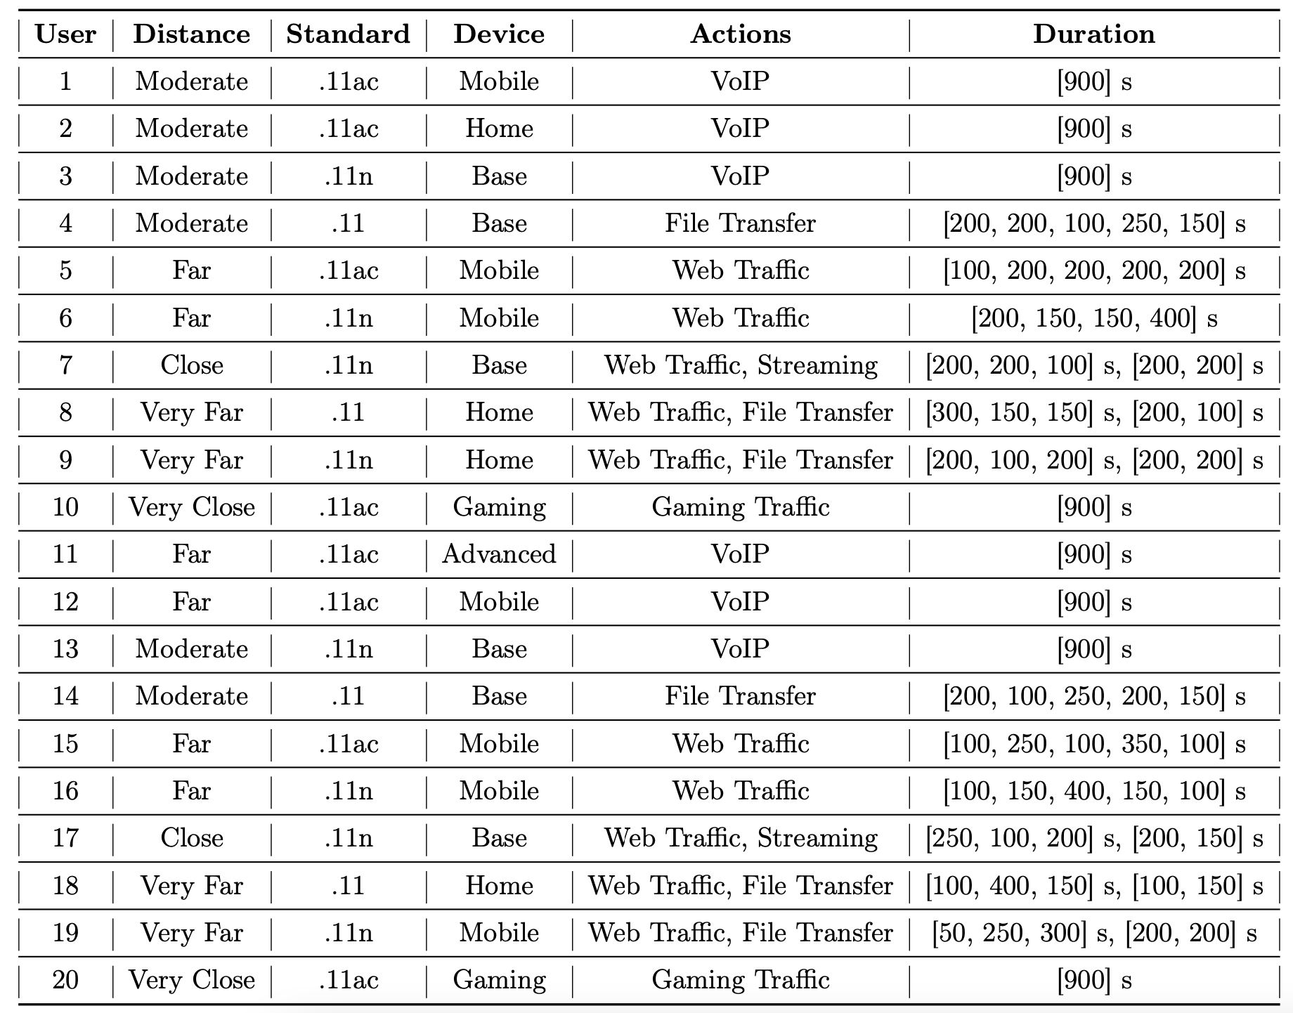
The University dataset – Example 20 STAs

Slide 19
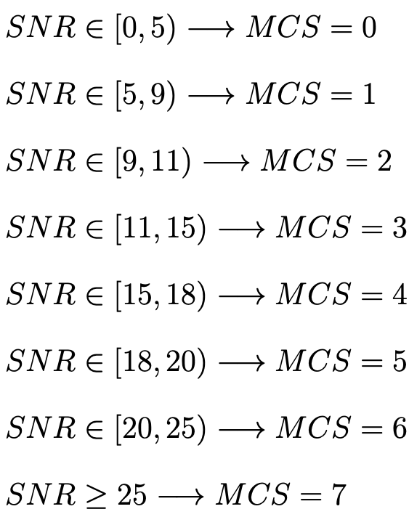
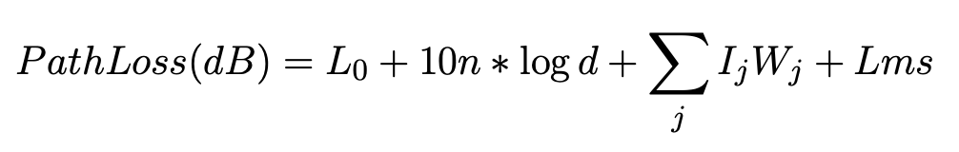
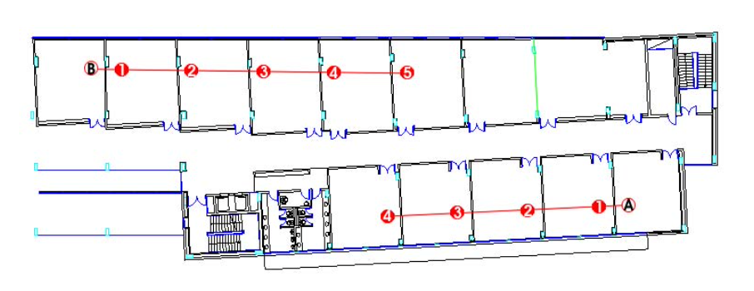
Details of the PHY
Model Parameters
L₀ # power loss at 1 meter in dB (40.2)
n = 2 # Attenuation variation index
d # distance Tx-Rx
Ij # number of walls of type j in the environment
Wj # wall_attenuation_dB = 6 # Office wall attenuation in dB
Lms: # multipath propagation, modelled as Gaussian (0,8), (urban areas)
J. Lloret, J. J. Lopez, C. Turro and S. Flores, "A fast design model for indoor radio coverage in the 2.4 GHz wireless LAN," 1st International Symposium onWireless Communication Systems, 2004, pp. 408-412, doi: 10.1109/ISWCS.2004.1407279.

Slide 20
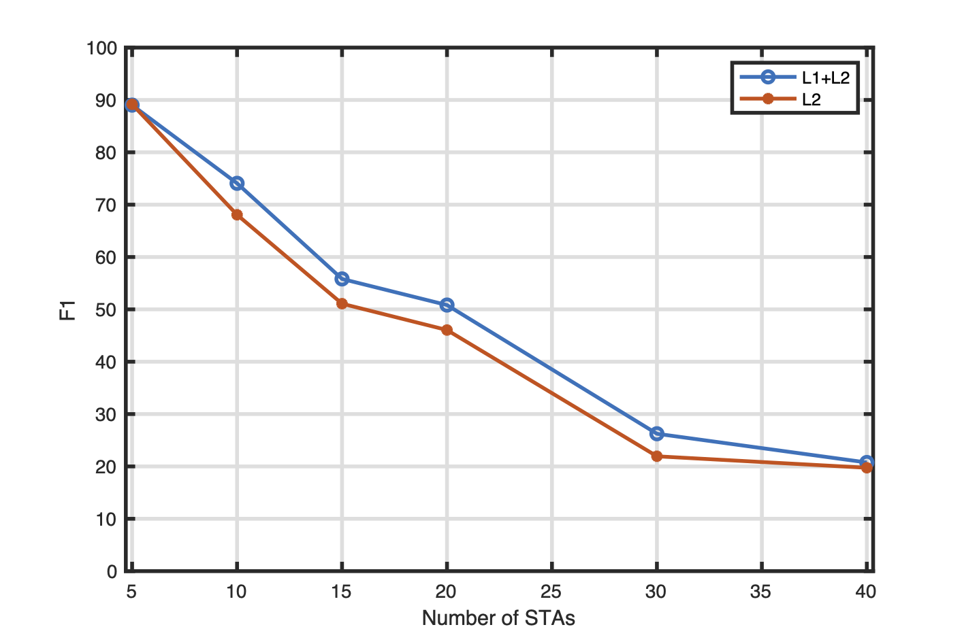
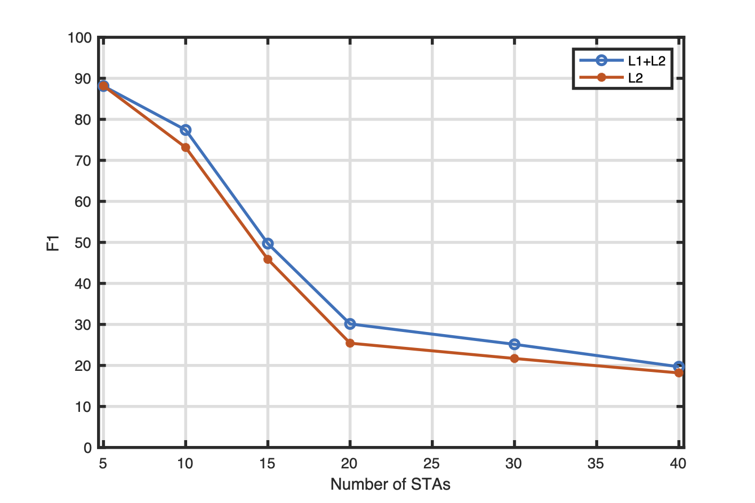
Simulation Results
Individual vs Mass
(%)
(%)
Individual
Mass

Slide 21
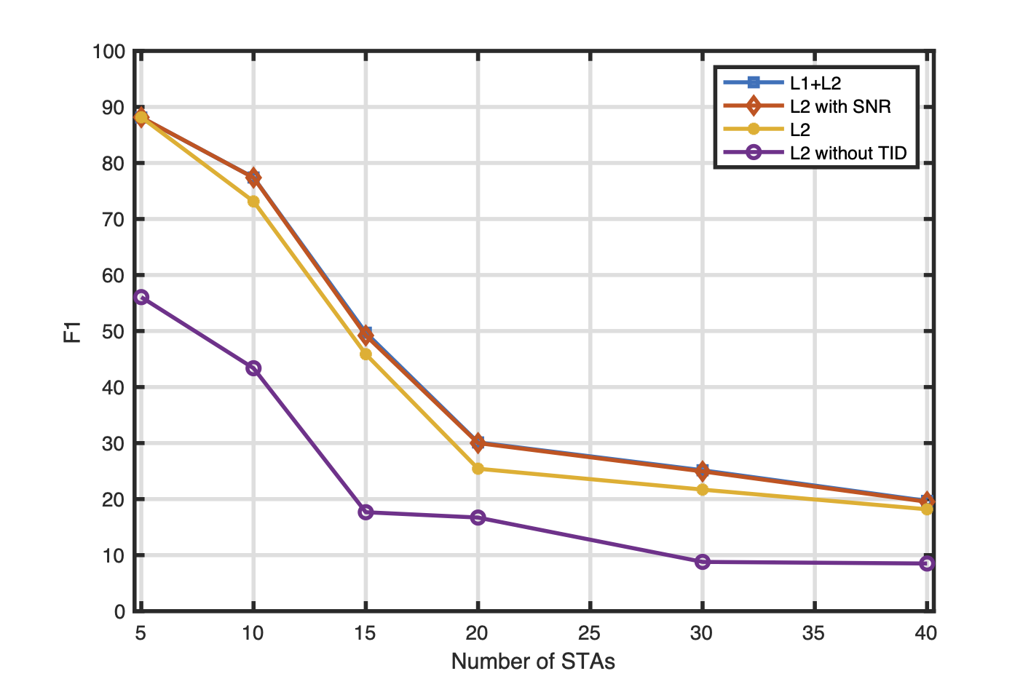
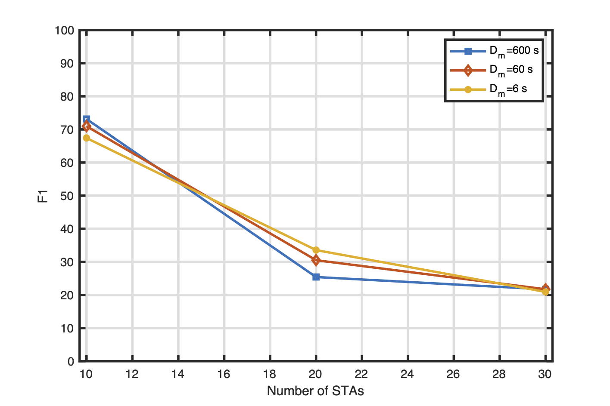
Simulation results
Two More Tests
SNR and TID impact
Epoch Duration Impact
(%)
(%)
Mass rotation

Slide 22
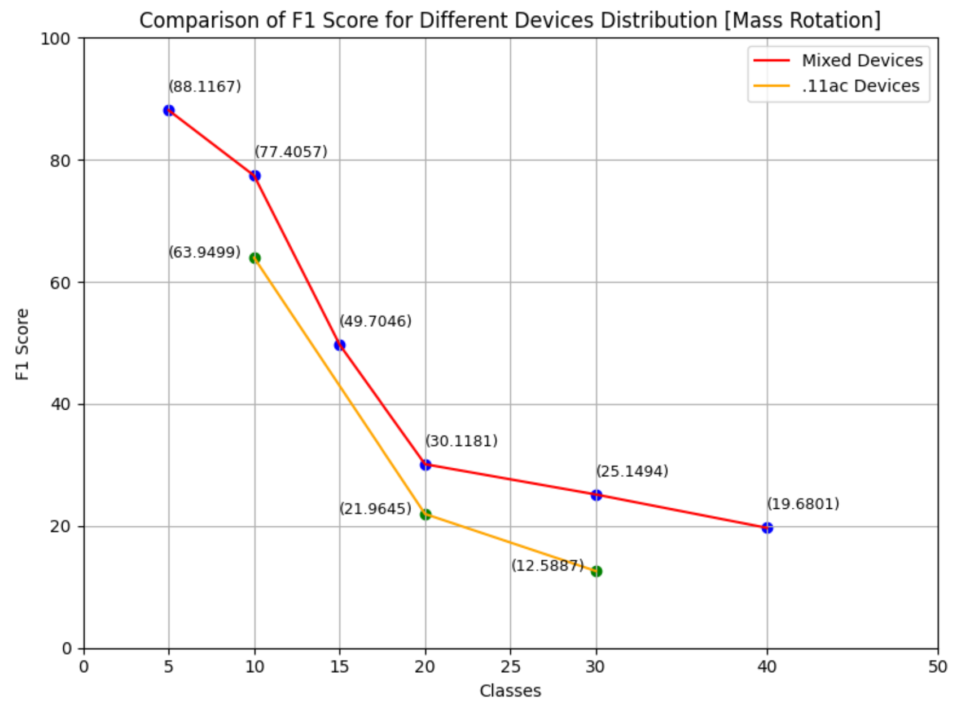
Another test
Performance vs STA Mix
Mixed Devices – Distribution for each Scenario
802.11: 10-classes: 2 20-classes: 4 30-classes: 6
802.11n: 10-classes: 4 20-classes: 8 30-classes: 12
802.11ac: 10-classes: 4 20-classes: 8 30-classes: 12
Mass Rotation
Epoch Range (20,600)s
L1+L2

Slide 23
Summary of Analysis with Simulated Traffic
With SN anonymization and epoch-based RCM
  Identification is challenging (F1< 0.30) in scenarios with more than 30 STAs (also with L1+L2 features)
  With 10 or fewer STAs, F1>0.70
Some Insights ...
Among L2 features, great impact of TID
  TID is fixed for a STA (in the dataset, for some STAs we observed a mix of TID)
Minor Impact of SNR
  is it a simulation model problem? SNR is fixed depending on the STA location
No impact of Epoch Duration settings

