Slide 1
UHR LTFs for DRU and Sounding Operation
Date: 2024-01-01
Authors:

Slide 2
Abstract
Distributed resource units (DRU) uses distributed tones to boost transmit power in PSD limited operating classes.
In this contribution, we present our thoughts regarding the LTF design using DRU.

Slide 3
Channel Estimate Smoothing
Channel smoothing is well known to provide PER performance by 1~2 dB depending on the MCS.
  Lower MCS performance is AWGN noise dominated and has higher PER gains.
For DRU, the performance of channel smoothing may deteriorate due to sparse tone spacing.
  In [1], it was shown that on a 40 MHz PPDU, the channel smoothing gain reduces from 2.16 dB to 1.3 dB for 26-tone DRU vs 52-tone DRU.
With reduced channel smoothing gains, LPI devices may experience lower SNR gains depending on the DRU tone spacing.
  Complicates scheduling and link adaptation decisions by the AP.

Slide 4
Proposal: LTF extension for DRU PPDUs
LTF extensions for DRU PPDU is a simple way to supplement the performance of channel estimation when a DRU allocated to a STA has a large tone spacing between two adjacent tones.
  The AP performs averaging of channel estimates from multiple LTF copies.
We can extend the number of LTFs based on the largest tone spacing within the distribution bandwidth. For example, for an 80 MHz distribution bandwidth (assuming 1 spatial stream) with
  242, 484 Tone DRU - 1 LTF
  52, 106 Tone DRU – 2 LTF
  26 Tone DRU – 4 LTF
Changes in the standard can be as simple as mandating DRU capable stations to support a specific number of LTF extensions for DRU transmissions.

Slide 5
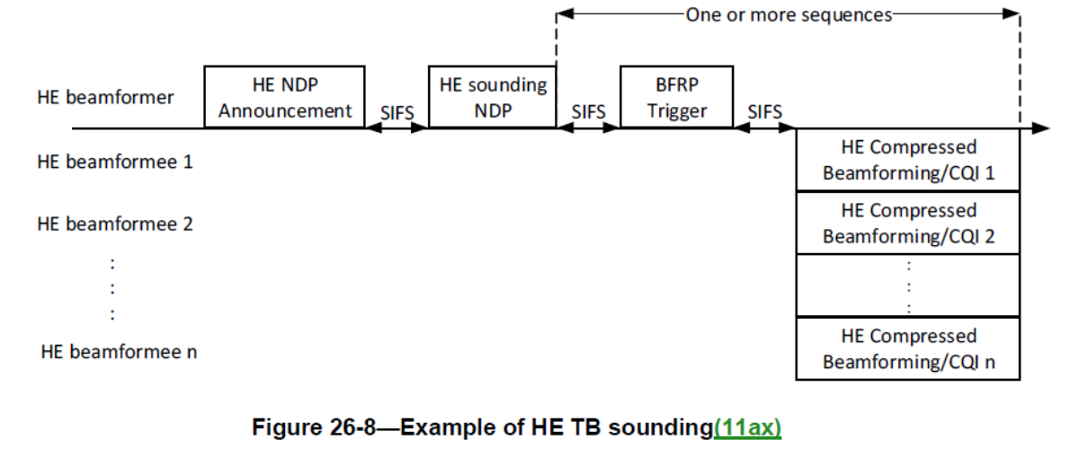
Sounding NDP Transmit Boost for LPI operation
NDP sounding is used to determine the channel state information. The beamformer transmits a sounding NDP and the beamformee sends back an estimate of the channel state. The feedback may be used for MU-MIMO beamforming or OFDMA RU allocation.
NDP is an SU PPDU, and will be transmitted using RRU. Hence due to PSD restrictions in LPI, the channel feedback accuracy may suffer from low SNR.

Slide 6
Compressed Beamforming Report
The Compressed Beamforming Report field carries the average SNR of each spatial stream and compressed beamforming feedback matrices for use by a transmit beamformer to determine steering matrices , as described in 10.33.3 (Explicit feedback beamforming) and 19.3.12.3 (Explicit feedback beamforming).
The Grouping subfield Ng indicates the subcarrier grouping, , used for the compressed beamforming feedback matrix:
  Set to 0 for Ng=4
  Set to 1 for Ng=16
Ng=4
Ng=4 Compressed Beamforming Report

Slide 7
Proposal
Only tones corresponding to Ng=4 are used.
One solution is to only transmit on subcarriers that will be sent as feedback in the compressed beamforming report.
Similar to DRU, a transmit power boost can be obtained without defining an SU PPDU using DRU.
  For Ng = 4 and 20 MHz BW, the NDP transmit power can be 24 dBm (compared to 18 dBm using RRU)
The NDPA frame indicates whether only tones where feedback is sent is used to transmit the NDP.
  avoids backward compatibility issues when a STA assumes all tones are used by the AP (e.g. channel estimate smoothing).
NDPA*
NDP
BFRP
AP
Ng=4
BFR
STA 1
BFR
STA 2
BFR
STA 9
Ng=4 Compressed Beamforming Report

Slide 8
Conclusion
Small size DRUs spread over a high bandwidth may be difficult to smoothen due to the tone spacing. We propose to solve the problem using LTF extensions for noise reduction of the channel estimates.
In addition, NDPs may also gain additional transmit power boost in PSD limited operations by only transmitting at exact tones where feedback is explicitly solicited.

Slide 9
References
[1] https://mentor.ieee.org/802.11/dcn/23/11-23-2031-02-00bn-data-tones-grouping-in-tone-distributed-rus.pptx

