Slide 1
Joint Medium Access and TXOP Sharing
Date: 2024-07-14
Authors:

Slide 2
Abstract
The 802.11 base standard defines mechanisms to access medium for UL/DL/P2P traffic.
There are UHR proposals to extend TXOP sharing for multi-user and UL/DL/P2P traffic.
This submission presents joint medium access and TXOP sharing:
Trigger/polling/ICF initiated by non-AP STA, sent to non-AP STA or AP
TXOP sharing initiated by non-AP STA, shared with non-AP STA or AP
Medium access for DL data initiated by non-AP STA

Slide 3
TXOP for UL/DL/P2P Traffic: Current Definition
There are existing mechanisms for medium access for UL/DL/P2P traffic
Each STA/AP tries to access the medium using CSMA and EDCA.
UL/DL/P2P traffic may be in the same TXOP,
for example, using TXS, RDG and MU cascading.
When AP gets medium access:
it may initiate DL transmissions with certain STA(s).
it may use trigger frame to initiate UL transmissions with certain STA(s).
it may use TXS to allow the non-AP STA (as TXOP responder) to send UL data to AP (sharing mode 1) or send P2P data to another peer STA (sharing mode 2).
When non-AP STA gets medium access:
it may initiate UL transmissions with AP or P2P transmissions with a peer STA.
it may use RDG to initiate DL transmissions with AP, although not widely used.

Slide 4
TXOP for UL/DL/P2P Traffic: UHR Proposals
There are proposals to extend TXOP sharing for multi-user and UL/DL/P2P traffic
When AP gets medium access:
it may share the TXOP with multiple STAs and/or bidirectional traffic: MU-RTS TXS [1], multi-user TXS [2], TXOP for relay [3]
it may send advertisement of recommended P2P channels, e.g., time and channel info, for P2P group [5]
When non-AP STA gets medium access:
it may share the TXOP for P2P and DL/UL traffic [4]
it may share the TXOP with AP: reverse TXOP Sharing [6], non-AP STA initiated TXOP sharing [7, 8]

Slide 5
TXOP for UL/DL/P2P Traffic: This Proposal
The main focus of this submission are:
non-AP STA initiating TXOPs
for a group of STAs, for example, P2P, relay, proxy, mesh, soft AP, multi-AP
for retrieving DL data from AP
AP as TXOP holder for AP-to-AP or P2P traffic
Proposal: joint medium access and TXOP sharing
Trigger/polling/ICF initiated by non-AP STA, sent to non-AP STA or AP
TXOP sharing initiated by non-AP STA, shared with non-AP STA or AP
It enables
medium access initiated by non-AP STA for
retrieving DL data from AP or P2P data from peer STA(s)
DL/UL/P2P transmissions in the same TXOP
medium access as a group for
trigger-based access within a group
TXOP sharing within a group

Slide 6
Proposal: Joint Medium Access and TXOP Sharing
Each STA tries to access the medium by CSMA and EDCA.
Trigger/polling/TXOP sharing initiated by non-AP STA
TXOP is obtained and shared between a group of STAs.
The TXOP is initiated by ICF (initial Control frame).
If a certain STA, e.g., group leader, gets the TXOP, it may send trigger/polling frame and initiate transmissions with peer STA(s).
If a STA other than the group leader gets the TXOP, it may transfer/share the TXOP to group leader to initiate transmissions with peer STA(s).
Medium access initiated by non-AP STA to retrieve data from AP or peer STA
Non-AP STA as TXOP holder for receiving data from other STAs.
Non-AP STA needs to get DL data from the AP based on RX/L2 buffer status and other conditions.
Non-AP STA adds a request/trigger/polling frame in TX queue to get TXOP for DL data.

Slide 7
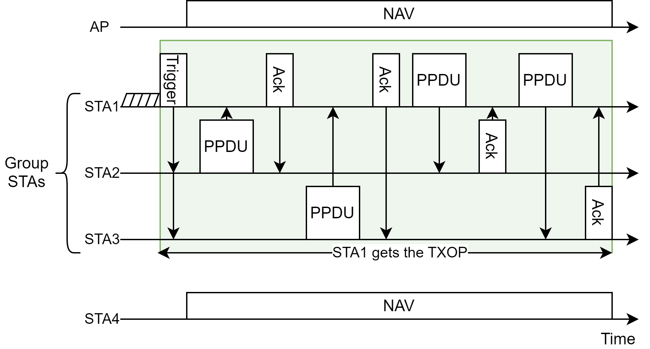
Example 1: Trigger Frame from Non-AP STA
STA1 gets TXOP and sends trigger frame (plus polling if needed) to STA2 and STA3
STA2 and STA3 transmit to STA1 based on the schedule
STA1 sends data to STA2 and STA3
Trigger/polling frame can be initiated by
only group leader,
certain group STAs,
or any group STA. In this case, TXOP sharing is not needed.

Slide 8
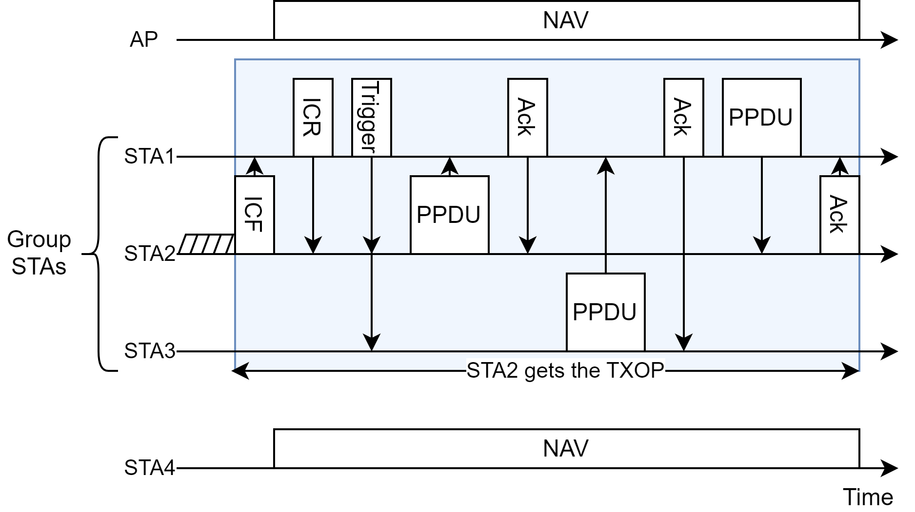
Example 2: TXOP Sharing from Non-AP STA
STA2 gets TXOP and sends initial control frame (ICF) to STA1 to share the TXOP with STA1
STA1 sends trigger frame to STA2 and STA3 to initiate transmissions
TXOP can be shared directly/indirectly with
only group leader,
only group leader and AP,
only certain group STA(s),
or certain group STA(s) and AP

Slide 9
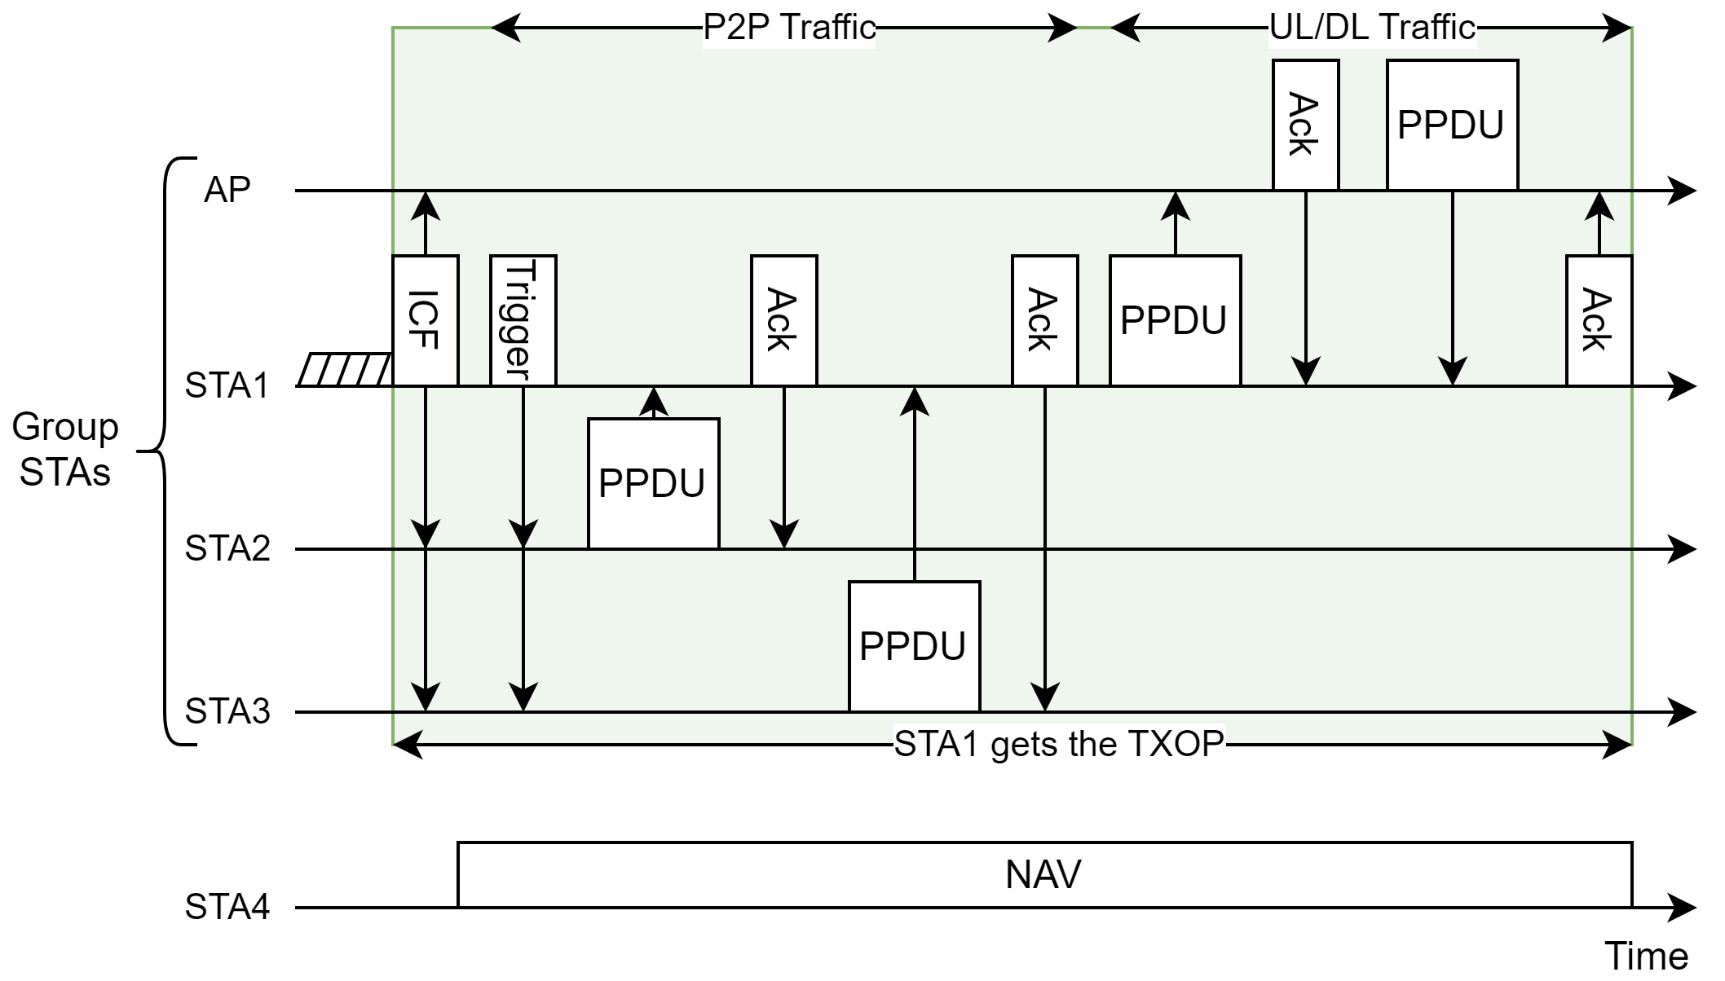
Example 3: Trigger Frame from Non-AP STA and TXOP Sharing for P2P/UL/DL
STA1 gets TXOP and sends ICF to STA2, STA3 and AP
STA1 sends trigger frame to initiate P2P transmissions with STA2 and STA3
STA1 initiates UL/DL transmissions with AP
ICF may be
Unsolicited or solicited
Integrated with other frames, e.g., trigger/polling frame

Slide 10
Conclusion
This contribution presents joint medium access with three different mechanisms:
TXOP sharing initiated by trigger/polling/ICF by non-AP STA
DL data transmissions from AP, initiated by non-AP STA
It allows channel access being done in a semi-distributed way
It does not require initiation by the AP to get the TXOP and does not increase complexity for the AP: there is no need to decide when and how to share the AP’s TXOP.
It avoids in-group contention/backoff and hence avoids potential collisions and wasted TXOPs due to two levels of contention from both inter-group and intra-group STAs.
It provides additional options to get medium access for a group of STAs and can coexist with other options, e.g., EDCA, trigger-based access, TXS, and multi-STA TXOP sharing.

Slide 11
References
[1] 802.11-24/0403r0, Managed on-channel P2P communication, Inaki Val
[2] 802.11-24/0536r0, Multi-user triggered TXOP sharing, Ronny Yongho Kim
[3] 802.11-24/0105r0, TXOP for Relay communication in 11bn, Dongguk Lim
[4] 802.11-24/0668r1, Data Forwarding within TXOP for XR Use Cases, Seongho Byeon
[5] 802.11-24/0393r0, Enhancements on Off-Channel P2P Communications, Rubayet Shafin
[6] 802.11-23/1874r0, Reverse TXOP Sharing, Sindhu Verma
[7] 802.11-24/0686r0, STA initiated TXOP Sharing via Unicast CF-End, Pei Zhou
[8] 802.11-23/1847r0, Non-AP initiated TXOP sharing follow-up, Sanghyun Kim

Slide 12
Straw Poll
SP1: Do you support allowing a non-AP STA initiate TXOP sharing with other non-AP STA(s) in TGbn?
A non-AP STA may send a TBD frame, e.g., trigger frame, to other non-AP STA(s) to initiate trigger-based access.
A non-AP STA may send a TBD frame, e.g., initial control frame, to other non-AP STA(s) to share its TXOP.
SP2: Do you support allowing a non-AP STA initiate downlink transmissions with its associated AP in TGbn?
A non-AP STA may send a TBD frame, e.g., trigger/initial control frame, to its associated AP to initiate downlink transmissions.
SP3: Do you support allowing a non-AP STA initiate downlink/uplink transmissions with its associated AP and P2P transmissions with its peer STA(s) in the same TXOP in TGbn?
A non-AP STA may send a TBD frame, e.g., initial control frame, to its associated AP and peer STA(s) to initiate downlink/uplink/P2P transmissions.

Slide 13
Backup

Slide 14
Trigger/Polling/ICF Initiated by Non-AP STA (1/2)
Medium access is performed in a semi-distributed way, sometimes distributed and sometimes scheduled
Distributed: each STA performs EDCA independently; TXS/control from AP is not needed
Scheduled/Controlled: trigger/polling/ICF to initiate transmissions among a group of STAs
This proposal does not require initiation by AP and does not increase the complexity for AP.
It does not use the AP’s TXOP that is acquired by contending with other STAs.
It does not rely on the AP for some of the non-AP STA’s transmissions.

Slide 15
Trigger/Polling/ICF Initiated by Non-AP STA (2/2)
It avoids in-group contention/backoff and hence avoids potential collisions and wasted TXOPs due to two levels of contention with both inter-group and intra-group STAs.
It can get channel access quicker for high priority STA/traffic and to have grouped DL/UL/P2P traffic in the same TXOP.
It provides additional options to gain medium access for a group of STAs and can coexist with other options, e.g., EDCA, trigger-based access, TXS, and multi-STA/-AP TXOP sharing.
It is scalable for a group of STAs in multi-link/-BSS/-AP scenarios.

Slide 16
Non-AP STA as TXOP Holder for DL Data (1/2)
Non-AP STA needs to retrieve DL data from the AP, based on RX/L2 buffer status at the non-AP STA or more DL data indication from the AP or non-AP STA.
Non-AP STA transmits a TBD frame that contains TXOP information (start time and duration) for DL data. It may be
a short frame, e.g., request to receive frame, similar to RTS or CTS-to-AP
a trigger/polling frame, e.g., as initial control frame
alternatively piggybacking onto UL data frames by modifying the TBD fields of the MAC header
It gives AP the indication of urgency of DL data that the non-AP STA is expecting.

Slide 17
Non-AP STA as TXOP Holder for DL Data (2/2)
After non-AP STA gets the TXOP and sends the request/trigger/polling frame to the AP:
If the AP is ready to transmit, it may send a newly-defined response frame, similar to CTS, or send DL PPDU directly to the non-AP STA.
If the AP is not ready to transmit, it may do nothing or send a response frame to the non-AP STA.
Other STAs set NAV based on the request frame from non-AP STA and/or the response frame/DL PPDU from the AP.
More data indication sent in the obtained TXOP, so AP/non-AP STA can take actions:
If multiple links are active, more data indication can be provided on one link and data is transmitted on another link.
More DL data indication may be in UL data (from non-AP STA) or BA (from AP).
The request/trigger/polling frame may also be sent on other links.

