Slide 1
HTC Extension for UHR Link Adaptation to Support UEQ-MCS/UEQM
July 2024
Date: 2024-xx-xx
Authors:
Name | Affiliation | Address | Phone | Email
Sara Norouzi | Huawei |  |  | sara.norouzi1@huawei.com
Junghoon Suh |  |  |  | junghoon.suh@huawei.com
Yan Xin |  |  |  | Yan.Xin@huawei.com
Osama AboulMagd |  |  |  | Osama.AboulMagd@huawei.com
Mahmoud Hasabelnaby |  |  |  | mahmoud.hasabelnaby@huawei.com

Slide 2
Background
July 2024
Equal MCS/modulation across the streams results in a sub-optimal solution due to the difference in the channel quality of different spatial streams.
Recently, several proposals have investigated the performance improvement of unequal modulation (UEQM) or MCS (UEQ-MCS), in MIMO TxBF in terms of goodput [1-5].
However, the link adaptation (LA) is little discussed in these proposals.
In this presentation, we propose the extension of HT Control field to accommodate the link adaptation parameters for the UHR UEQ-MCS/UEQM.

Slide 3
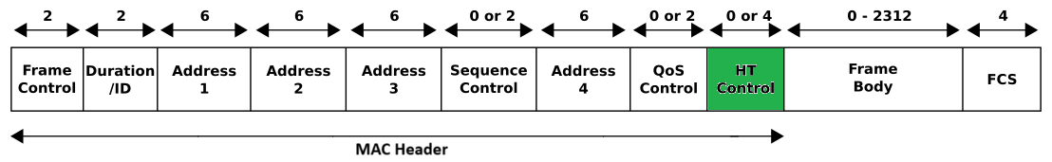
Recap: HE/EHT Link Adaptation (HLA/ELA)
July 2024
HT Control field in HE Variants carries the LA parameters.
Control ID indicates 11 different Control fields, and the remaining 5 Control ID are Reserved for future indications.
Variant | B0 | B1 | B2-B5 | B6-B31
HE/EHT | 1 | 1 | Control ID | Control Information

Slide 4
Control ID subfield values as of TGbe D5.0
July 2024
Control ID value | Meaning | Length of the Control Information subfield (bits) | Content of the Control Information subfield
0 | Triggered response scheduling (TRS) | 26 | See 9.2.4.7.1 (TRS Control)
1 | Operating mode (OM) | 12 | See 9.2.4.7.2 (OM Control)
2 | HE link adaptation (HLA)/EHT link adaptation (ELA) | 26 | See 9.2.4.7.3 (HLA Control)/ 9.2.4.7.11 (ELA Control). (See 9.2.4.7.11 (ELA Control) for dis- ambiguating HLA Control and ELA Control.)
3 | Buffer status report (BSR) | 26 | See 9.2.4.7.4 (BSR Control)
4 | UL power headroom (UPH) | 8 | See 9.2.4.7.5 (UPH Control)
5 | Bandwidth query report (BQR) | 10 | See 9.2.4.7.6 (BQR Control)
6 | Command and status (CAS) | 8 | See 9.2.4.7.7 (CAS Control)
7 | EHT operating mode (EHT OM) | 6 | See 9.2.4.7.8 (EHT OM Control)
8 | Single response scheduling (SRS) | 10 | See 9.2.4.7.9 (SRS Control)
9 | AP assistance request (AAR) | 20 | See 9.2.4.7.10 (AAR Control)
10–14 | Reserved
15 | Ones need expansion surely (ONES) | 26 | Set to all 1s

Slide 5
Recap: HE/EHT Link Adaptation (HLA/ELA)
July 2024
Some Control IDs do not require all the remaining 26 bits for the Control Information.
  The remaining bits not used for Control Information shall be padded with zero
Control ID, “0010” indicates the HLA/ELA Control field where 26 bits are allocated for Control Information.
UEQ-MCS/UEQM is not taken into account in this format.
B0
B1
B2
B4
B5
B8
B9
B16
Unsolicited MFB | MRQ/UL EHT TB PPDU MFB | Nss | EHT-MCS | RU Allocation
Bits:
1
1
3
4
8
B17
B18
B20
B21
B23
B24
B25
PS160 | BW | MSI/Partial PPDU Parameters | TX Beamforming | HLA/ELA
Bits:
1
3
3
1
1
Control Information Subfield

Slide 6
Proposal: Control ID for HTC Extension
July 2024
We propose HTC extension to make room for UEQ-MCS/UEQM.
We can set one of the remaining Control ID values, e.g. 15 (all ones) or one of the Reserved values like 10 to 14, in slide 4 to the HTC Extension Field.
  HTC Extension Field comes immediately after the HT Control Field in the MAC Header.
  The length of the HTC Extension field can be 2 byte, but not limited to 2 byte. It can be any length such as 4 or 8 byte.
Octets:
2
2
6
0 or 6
0 or 6
0 or 2
0 or 6
0 or 2
0 or 4
0, 2, 4 or 8
variable
4
Frame Control | Duration / ID | Address 1 | Address 2 | Address 3 | Sequence Control | Address 4 | QoS Control | HT Control | HTC Extension | Frame Body | FCS
MAC Frame

Slide 7
HTC Extension Type
July 2024
We propose to indicate the type of the corresponding extension using first m bits, so-called HTC Extension Type subfield.
  For example, we can assume that m is equal to 3 and 000 in this subfield represents UHR LA Extension.
Remaining bits, depending on the length of the HTC Extension field, may indicate required information according to the corresponding HTC Extension Type.
  For instance, if the HTC Extension Type subfield indicates UHR LA Extension, the remaining bits may specify the UHR LA related parameters.
  The Parameters for the MU-MIMO were discussed in [6], and these additional MU-MIMO parameters can be determined after the UHR consensus.
  The HTC Extension Type may come to the first subfield of Control Information field.
HTC Extension Type | TX Beamforming for SU-MIMO | Nss for MU-MIMO | MCS for MU-MIMO | UEQM/MCS Pattern Index
HTC Extension Field

Slide 8
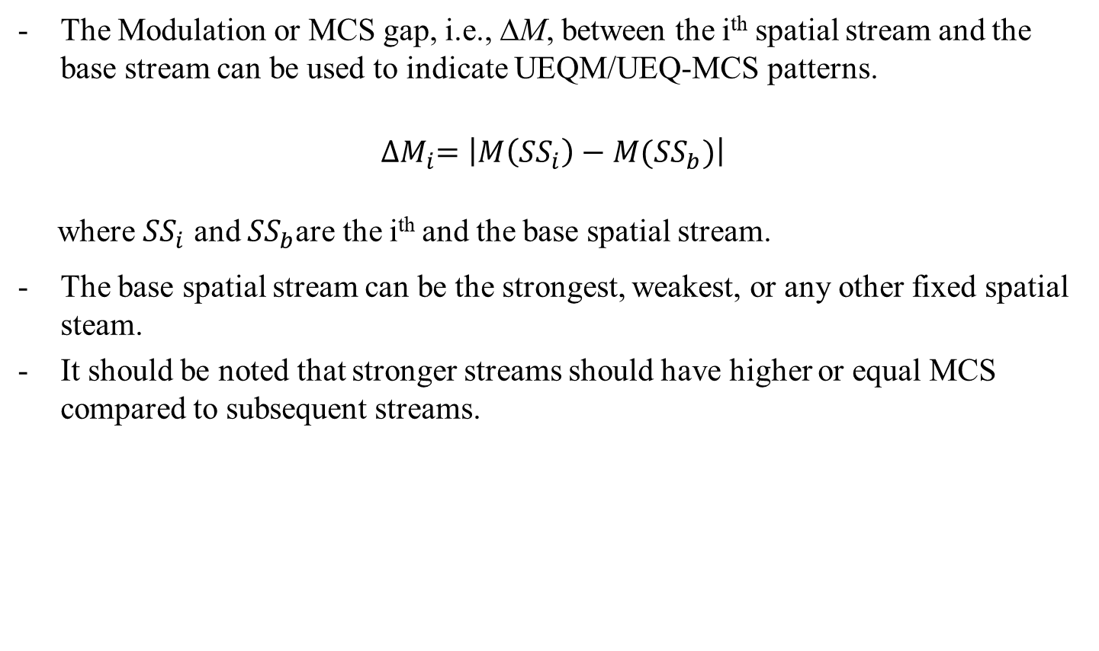
Option 1 : UEQ-MCS/UEQM Pattern Index
July 2024
The Modulation or MCS gap, i.e., ∆M, between the i^{th} spatial stream and the base stream can be used to indicate UEQM/UEQ-MCS patterns.
$${∆M}_{i}=\left|M\left({SS}_{i}\right)−M({SS}_{b})\right|$$
where ${SS}_{i}$ and ${SS}_{b}$are the i^{th} and the base spatial stream.
The base spatial stream can be the strongest, weakest, or any other fixed spatial steam.
It should be noted that stronger streams should have higher or equal MCS compared to subsequent streams.

Slide 9
Option 1 : UEQ-MCS/UEQM Pattern Index
July 2024
We can prepare tables of common patterns or combinations of ∆M with high probability for different number of spatial streams.
We can consider an index for each of the combinations which can be represented by n bits in the UHR LA Extension.
  In this case, the number of streams and MCS for the base stream can be indicated in B2-B4 and B5-B8 of the Control Information of the existing LA subfield, respectively.
  According to the number of streams indicated in the Control Information of the existing LA subfield, the table and indices in the table can be used to demonstrate UEQM/UEQ-MCS pattern and the associated modulations for each stream.
  The first stream in the table below represents the base stream
Index | ∆M
 | 1st Stream | 2nd Stream
0 | 0 | 0
1 | 0 | 1
2 | 0 | 2
3 | 0 | 3
Example table for common ∆M Patterns for 2 spatial streams.

Slide 10
Option 2: UHR LA Extension Format
July 2024
Assume that the HTC Extension Type is set to the UHR LA Extension.
The MCS for the base stream can be indicated in B5-B8 of the Control Information of the existing LA subfield.
We propose to indicate the MCS of other spatial streams in the HTC extension.
In this case, if “TX Beamforming for SU-MIMO” subfield is set to 1, the rest of the bits can be used to show the MCS for the other spatial streams.
The length of the HTC Extension field and each subfields in it are TBD.
HTC Extension Type | TX Beamforming for SU-MIMO | MCS for the 2nd SS | … | MCS for the 8th SS
HTC Extension Field

Slide 11
Summary
July 2024
We proposed another way for an HTC Extension field.
We proposed to indicate the UEQ-MCS/UEQM pattern Index in the UHR LA Extension field.
We proposed to prepare tables of common ∆M patterns with high probability for different number of spatial streams.
  The Modulation or MCS gap, i.e., ∆M, can be adopted to show UEQ-MCS/UEQM patterns.
  The MCS for a base SS is indicated in the existing LA subfield, so is the Number of Spatial Streams.
  The MCS for the remaining SS can be indicated using the MCS of the base SS and ∆M indicated by the table according to the number of SS.

Slide 12
References
July 2024
[1] 11-24-0433-00-00bn-analysis-on-ueqm-and-ueq-mcs
[2] 11-24-0176-01-00bn-unequal-modulation-over-spatial-streams
[3] 11-24-0117-01-00bn-improved-tx-beamforming-with-ueqm
[4] 11-24-0113-01-00bn-unequal-modulation-in-mimo-txbf-in-11bn
[5] 11-24-0016-01-00bn-uhr-mimo-rvr-enhancement-with-unequal-modulation
[6] 11-21-0102-05-00be-considerations-on-capabilities-and-operation-mode-mu-mimo

Slide 13
SP 1
July 2024
Do you agree that we may need a Link Adaptation (LA) indication method for the UEQ-MCS (or UEQM) where the different MCS (or Modulation) can be applied to the different streams in a SU-MIMO transmission?
Y/N/A

Slide 14
SP 2
July 2024
Do you agree that we have a Link Adaptation (LA) indication for the UEQ-MCS/UEQM with the base stream MCS indicated in the MCS parameter subfield of the Control Information?
Y/N/A

Slide 15
SP 3
July 2024
Do you agree that we have a Link Adaptation (LA) indication for the UEQ-MCS/UEQM with the other streams excluding the base stream indicated in the MCS/Modulation difference from the MCS of the base stream ?
Y/N/A

Slide 16
SP 4
July 2024
Do you agree that we have a separate table for the Index of MCS/Modulation gap according to the number of Spatial Streams indicated in the number of Spatial Streams parameter of LA ?
  MCS/Modulation gap is the difference from the MCS of the base stream
Y/N/A

