Slide 1
2.4 GHz Downlink AMP PPDU Follow Up
July 2024
Date: 2024-07-18
Authors:
Name | Affiliations | Address | Phone | Email
Bin Qian | Huawei | Shenzhen, China |  | qianbin14@huawei.com
Lei Huang |  | Singapore
Panpan Li |  | Singapore
Wei Lin |  | Shenzhen, China
David, Xun Yang |  | Shenzhen, China
Notes:
September 2012

Slide 2
Abstract
July 2024
This contribution continues the discussion on the AMP DL PPDU format in the 2.4 GHz frequency band

Slide 3
Recap: Structure of AMP DL PPDU
July 2024
In [1], we propose some initial thoughts on the AMP DL PPDU format in the 2.4 GHz frequency band
The AMP DL PPDU consists of the OFDM based wideband portion and the On-Off Keying (OOK) based narrowband portion
The NB portion of AMP DL PPDU consists of AMP-Sync field, AMP-SIG field, and AMP-Data field

Slide 4
Consideration on AMP-Data field
July 2024
The AMP DL may support a wider range of data rates than that of WUR
There are different types of AMP STAs [2]
Some AMP STAs have clock accuracy of less than 1k ppm, others have clock accuracy of 10k – 100k ppm
Different types of AMP STAs may have different sensitivity
The higher data rate leads to shorter PPDU duration to provide better coexistence
The lower data rate is helpful to improve the DL reliability of the low-capability AMP STAs
The lower data rate could be used to compensate the DL-UL imbalance shown in [3]

Slide 5
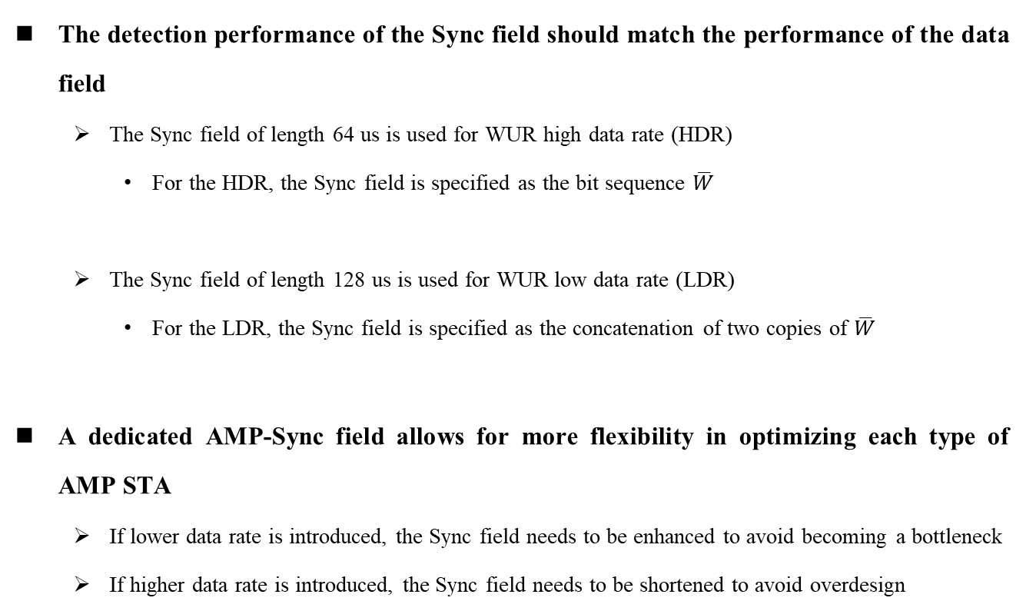
Consideration on AMP-Sync field
July 2024
The detection performance of the Sync field should match the performance of the data field
The Sync field of length 64 us is used for WUR high data rate (HDR)
For the HDR, the Sync field is specified as the bit sequence $\overline{W}$
The Sync field of length 128 us is used for WUR low data rate (LDR)
For the LDR, the Sync field is specified as the concatenation of two copies of $\overline{W}$
A dedicated AMP-Sync field allows for more flexibility in optimizing each type of AMP STA
If lower data rate is introduced, the Sync field needs to be enhanced to avoid becoming a bottleneck
If higher data rate is introduced, the Sync field needs to be shortened to avoid overdesign

Slide 6
Consideration on AMP-SIG field
July 2024
In WUR PPDU, the WUR-Sync field carries the data rate information. However, adding more data rates could exhaust the available unique patterns of Sync field, degrading the reliability of the Sync field
A specific AMP-SIG field could easily support a wider range of data rates and additional parameters such as AMP data length, PHY version identifier, UL/DL, BSS color
These parameters are critical for the receiver to correctly interpret and decode the payload
Ensuring a more reliable SIG field is beneficial for the overall DL performance

Slide 7
Summary
July 2024
We further discuss the necessity to include specific AMP-Sync field and AMP-SIG field in the AMP DL PPDU format in the 2.4 GHz frequency band

Slide 8
References
July 2024
[1] 11-24-0847-00-00bp-initial-thought-on-2.4-ghz-dl-amp-ppdu-design
[2] 11-24-0853-00-00bp-design-target-and-device-capabilities-for-amp-iot
[3] 11-24-0075-00-0amp-follow-up-on-amp-link-budgets

Slide 9
SP 1
July 2024
Do you support that the AMP DL PPDU in 2.4 GHz frequency band consists of the OFDM based wideband portion and the On-Off Keying (OOK) based narrowband portion?
The bandwidth of the wideband portion is 20 MHz while the bandwidth of the narrowband portion is TBD.
Yes:
No:
Abstain:

Slide 10
SP 2
July 2024
Do you support to include an AMP-Sync field in the narrowband portion of the AMP DL PPDU in 2.4 GHz frequency band?
The AMP-Sync field format is TBD
Yes:
No:
Abstain:

Slide 11
SP 3
July 2024
Do you support to include an AMP-SIG field in the narrowband portion of the AMP DL PPDU in 2.4 GHz frequency band?
The AMP-SIG field format is TBD
Yes:
No:
Abstain:

