Slide 1
Discussions on AMP Channel access
Date: 12 July 2024
Name | Affiliation | Address | Phone | Email
Rojan Chitrakar | Huawei | Singapore |  | rojan.chitrakar@huawei.com
Lei Huang
Shuqiao Chen
Ian Bajaj
Notes:
Jul 12, 2010
Page 1

Slide 2
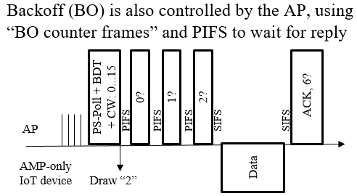
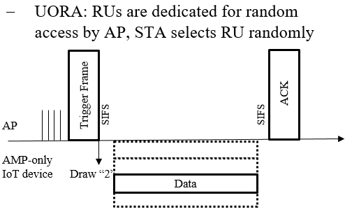
Recap
Unlike regular 802.11 STAs, most AMP STAs will not be able to use the existing 802.11 medium access protocols such as EDCA.
[1] introduces two types of AP-driven random access: 1) time-based 2) frequency based.
Access mode 2 in [2] expands on the time-based random access.

Slide 3
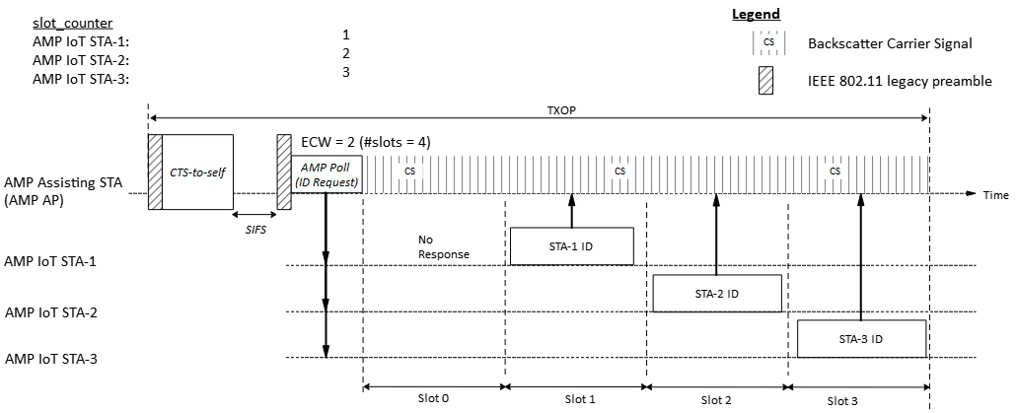
Time-slot based random access
We think time based random access is more suitable for AMP STAs however we would like to highlight potential challenges for time-slot based random access and possible work arounds.
A potential time-slot based random access scheme:
AMP AP gains access to wireless medium and transmits an AMP Poll frame to starts a random access session with 2^{ECW} time slots.
Upon receiving the AMP Poll frame, eligible AMP STAs randomly choose a slot and transmit in the slot.
Example 1 with ECW = 2 and three backscattering AMP STAs contending:

Slide 4
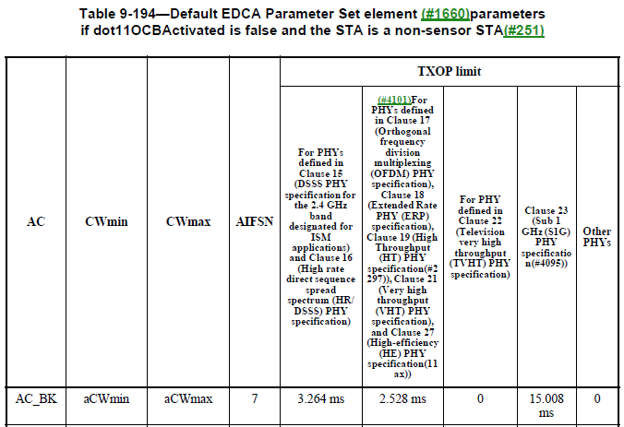
Time-slot based random access
The duration of the TXOP obtained by the AMP AP may limit the available slots for random access.
For example, @250kbps data rate, a 20 octets AMP PPDU will require 0.64ms. With the default TXOP limit for AC_BK (2.528ms), at most 3 random access slots can be allocated per TXOP for responders.
The number of random access slots per TXOP will likely be small.
Since the number of slots available for random access directly impacts the collision probability, a random access session should not be limited to a single TXOP.

Slide 5
TXOP aware Time-slot based random access
A first AMP frame (AMP Poll) initiates a random access session and indicates:
Session ID
Duration of each slot
the total number of random access slots = 2^{ECW}.
The range of slots allocated in the TXOP.
A second AMP frame (AMP Re-Poll) continues the random access session in a different TXOP and indicates:
Session ID
The range of slots allocated in the TXOP.
The AMP AP can flexibly allocate random access slots based on available TXOP limit and expected number of contending AMP STAs.

Slide 6
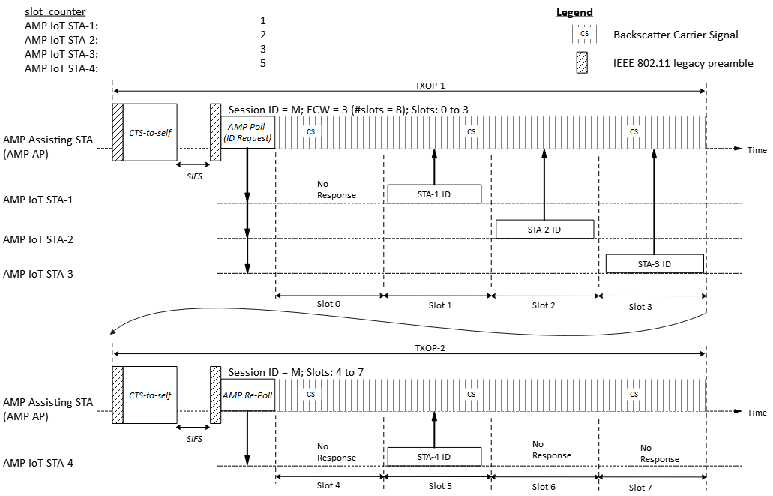
Time-slot based random access
Example 2 with eight random access slots (ECW = 3) spread across two TXOPs and four backscattering AMP STAs contending:

Slide 7
Further Considerations
Further thoughts on time based random access for AMP:
The efficiency of time-slot based random access mechanism will depend on factors such as AMP STA density, AMP link data rate etc., and further considerations are needed for collision mitigation and recovery mechanism.
While time-slot based random access mechanism is simple and may be the only possible option for simple AMP STAs that do not support channel sensing (e.g., CCA), more efficient methods may be possible. E.g.,
Backoff based random access (similar to CSMA/CA) for AMP STAs that support channel sensing. Instead of using fixed sized time slots, short backoff slots can be used to mitigate contention among STAs.

Slide 8
Conclusion
In this contribution we highlighted potential challenges for time-slot based random access and suggested a TXOP aware time-slot based random access.
We also shared that more efficient random access methods, such as backoff based random access should also be investigated.

Slide 9
SP 1
Do you agree to add the following text to TGbp SFD?
802.11bp shall support a time-based random access mechanism.

Slide 10
SP 2
Do you agree to add the following text to TGbp SFD?
A time-based random access session may span multiple TXOPs.

Slide 11
References
[1] 23/827r0, AMP IoT Medium Access (Sebastian Max et. al.).
[2] 24/421r0, AMP link access (Solomon Trainin et. al.).

