Slide 1
Thoughts on the AMP WPT protocol
Date: 12 July 2024
Name | Affiliation | Address | Phone | Email
Ian Bajaj | Huawei | Singapore |  | ian.bajaj@huawei.com
Lei Huang
Shuqiao Chen
Rojan Chitrakar
Notes:
Jul 12, 2010
Page 1

Slide 2
Introduction
Wireless power transfer (WPT) is a key feature for the 802.11bp standard, as part of the AMP PAR [1]:
  At least one mode of wireless power transfer in the sub-1 GHz band is defined to support RF energy harvesting.
Previous AMP contributions have discussions on:
  A proactive WPT design (or on-demand WPT) where the WPT process is controlled by the AP or the Energizer [2][3]
  Integrated AP-energizer or separate devices (so as not to be limited by the energizer link budget) [2][4]
This contribution serves to highlight some initial thoughts on the requirements for the AMP WPT protocol.

Slide 3
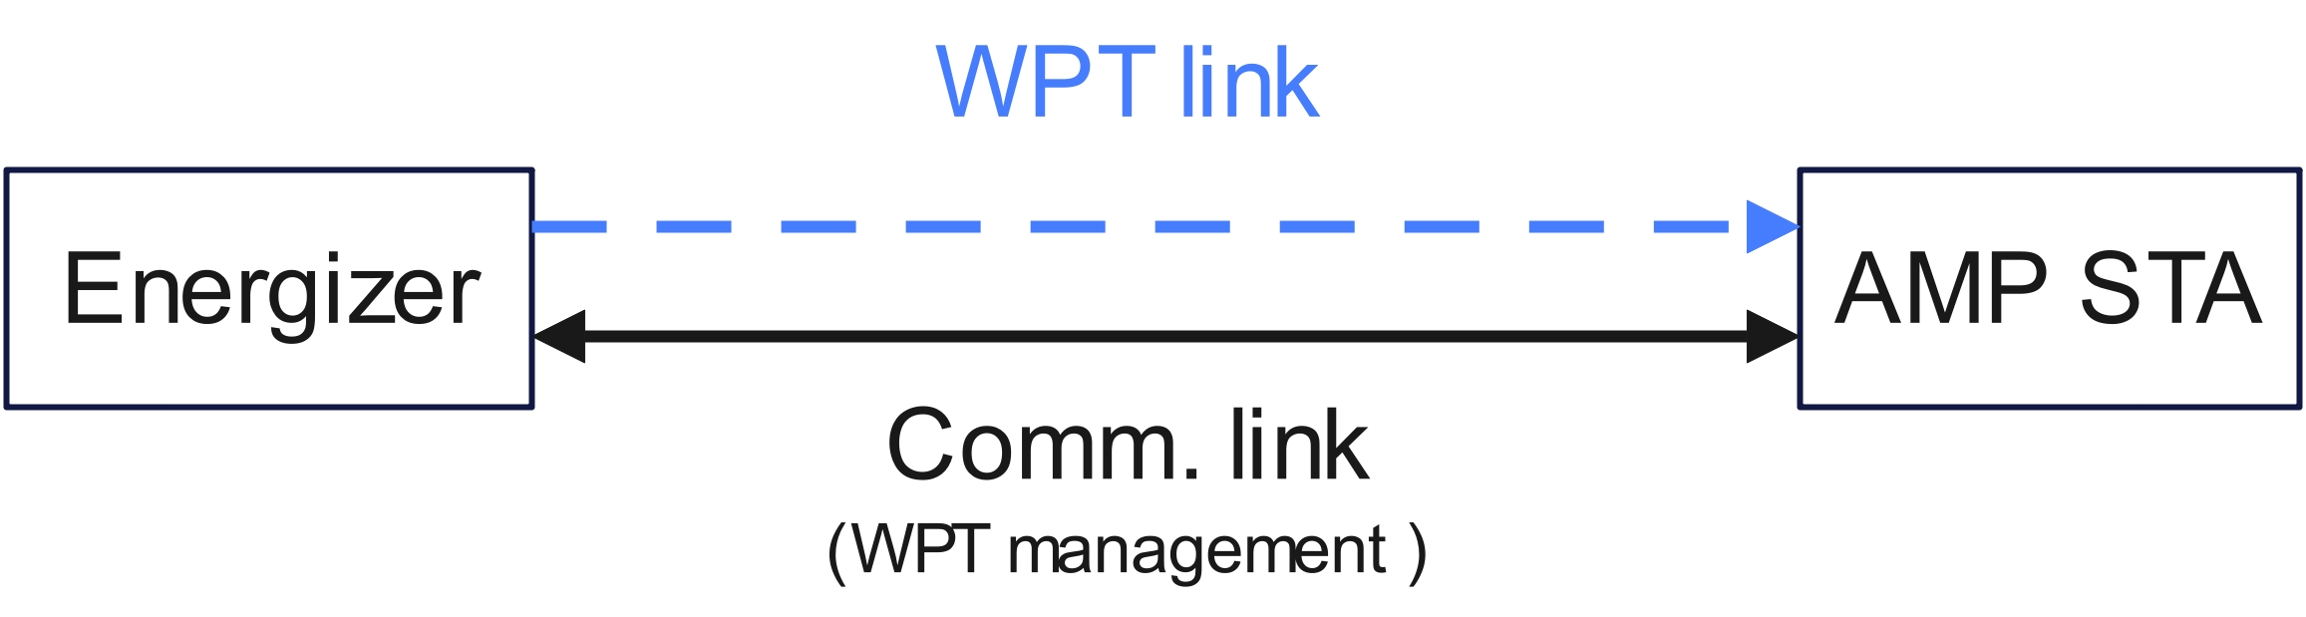
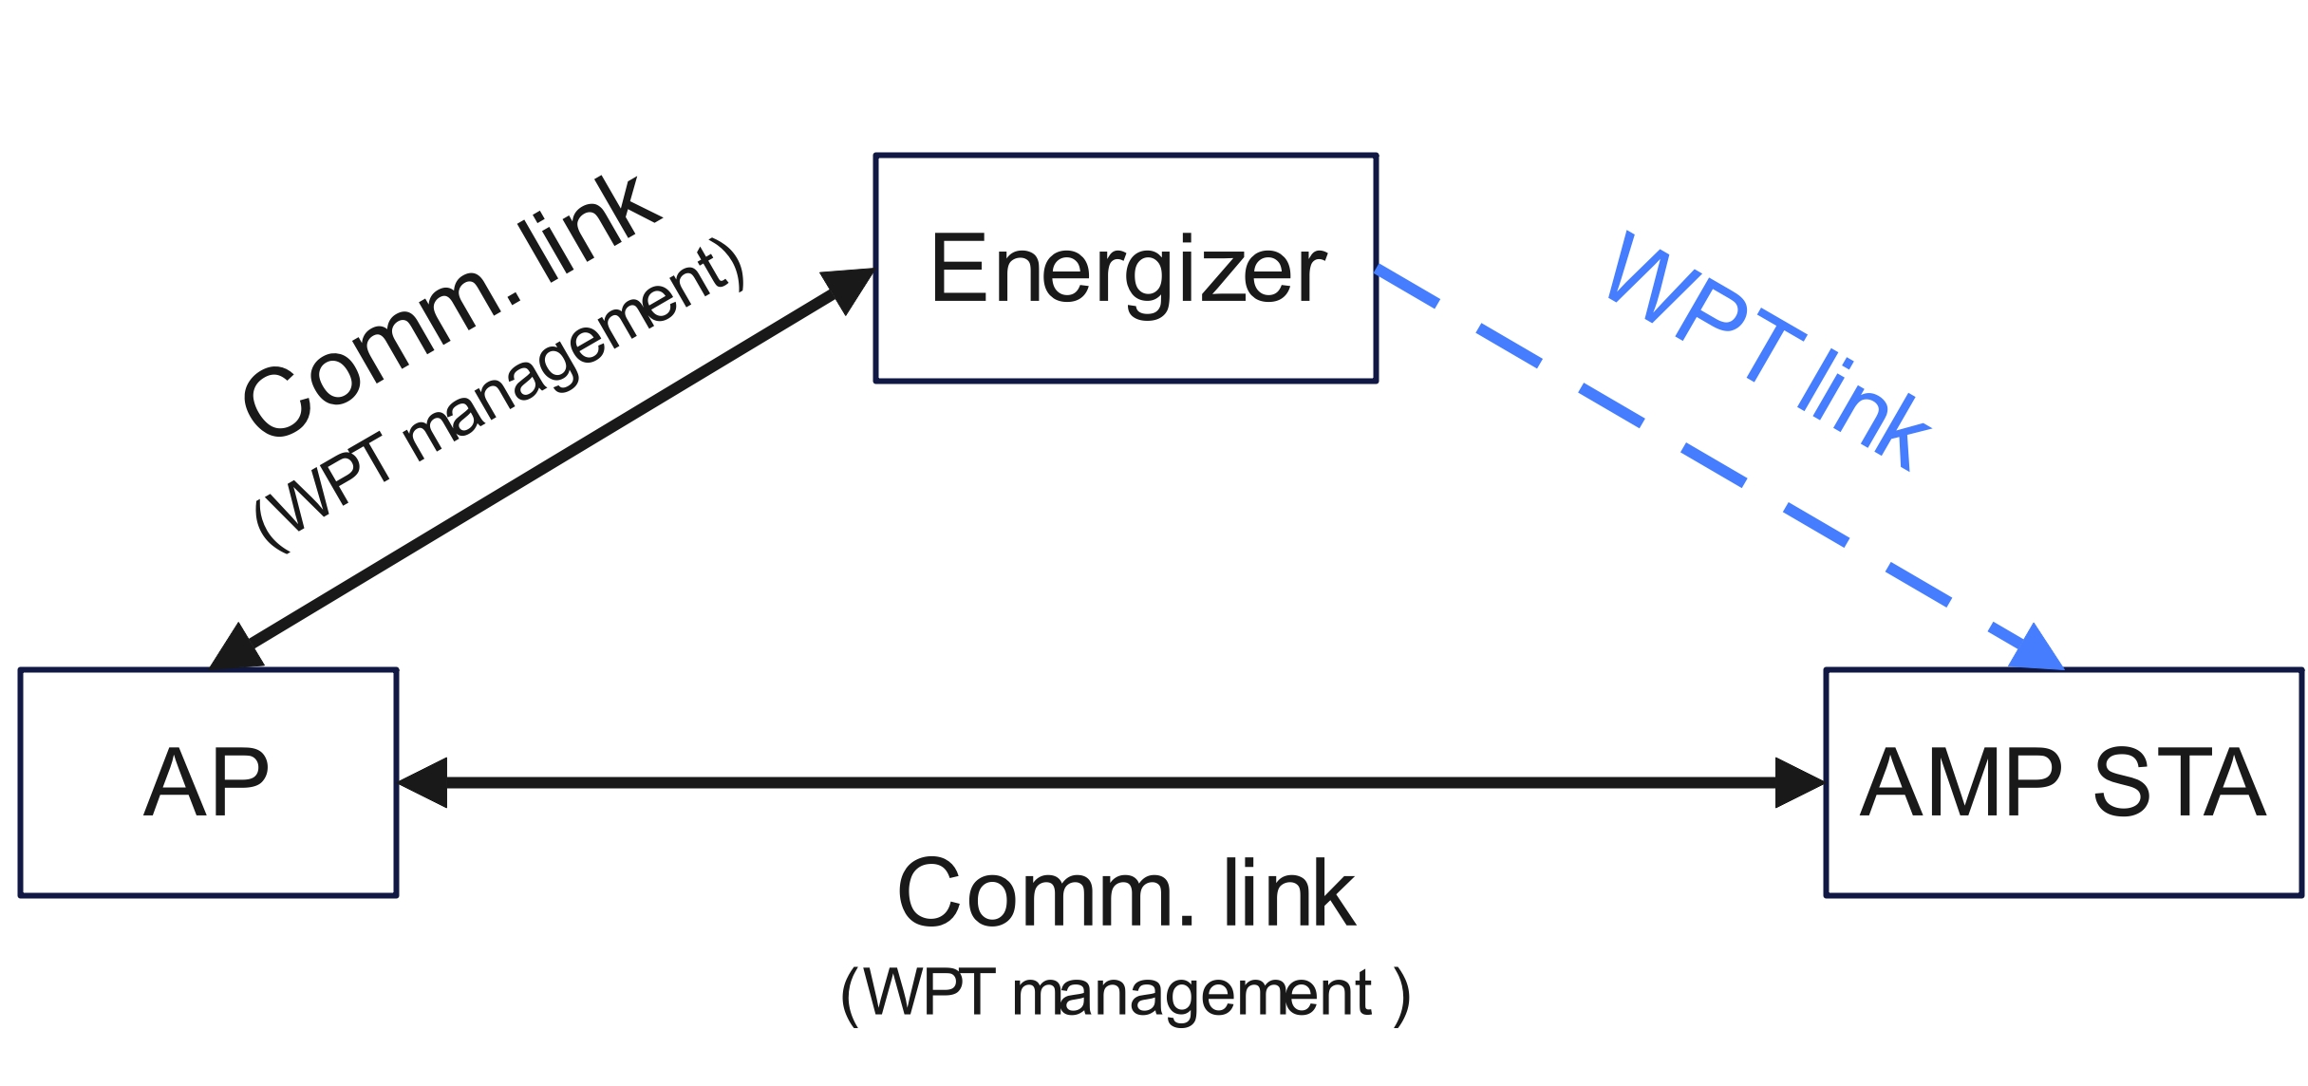
Proposed WPT Modes
Three types of WPT modes are suggested, based on previous contributions:
WPT Mode 0 (Default Mode)
  WPT Receiver acts as a passive energy harvester
WPT Mode 1
  WPT management information exchange is directly performed between the Energizer and AMP STA to support WPT on the WPT link between the Energizer and AMP STA
WPT Mode 2
  WPT management information exchange is coordinated through the AP and is carried out with an associated Energizer and AMP STA to support WPT on the WPT link between the Energizer and AMP STA
Mode 1
Mode 2

Slide 4
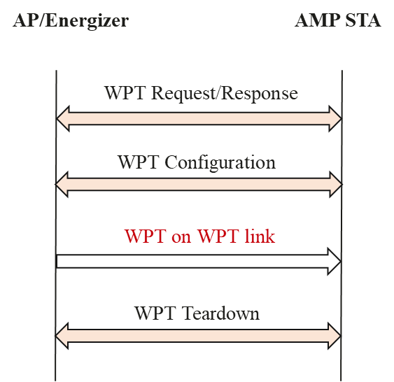
AMP WPT protocol for WPT Mode 1
The AMP WPT Mode 1 protocol includes 3 main procedures:
WPT Request/Response
  Frame exchange for WPT capability information (energy level, energy capacity, frequency bands, etc.) required for WPT Configuration
WPT Configuration
  WPT parameter settings (WPT Transmission Info., Frequency Band, etc.) and/or acknowledgment
WPT Teardown
  AP/Energizer may send a WPT Teardown frame to teardown WPT Configuration
  AMP STA may return back to default Mode 0 after receiving the teardown frame
Note: An optional WPT Report procedure maybe enabled to allow reporting of WPT status

Slide 5
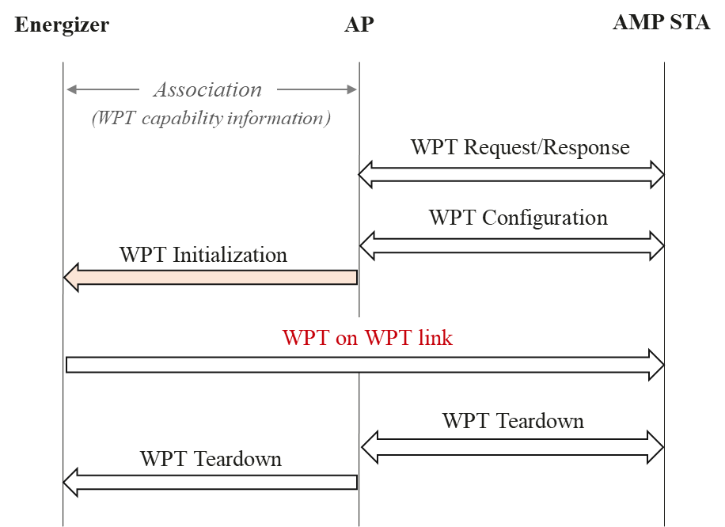
AMP WPT protocol for WPT Mode 2
The AMP WPT Mode 2 protocol includes 4 main procedures:
WPT Request/Response/Configuration/ Teardown
  Same procedure as Mode 1
  Teardown procedure can be sent from the AP to the Energizer, to teardown WPT settings at the Energizer
WPT Initialization
  AP sends an initialization frame with instructions (WPT Transmission Info., Frequency Band, etc.) to the Energizer to carry out WPT

Slide 6
Prior Assumptions on AMP STAs
AMP STAs may operate on a transaction-based message exchange, responding to unicast/groupcast addressed frames or broadcast frames from the AMP AP, with a response frame [5]
AMP STAs may be low complexity devices with limited functionality
  The AMP STAs may be unaware of their own duty cycle/reporting rate, and wait for instructions from the AP
  The AMP STAs may not be able to determine the power needed for certain operations or how long it can maintain certain energy states (transmission, reception, memory retention, etc.)
AMP STAs may have very limited energy storage (uF capacitor) [6] or no energy storage capacity at all
Certain AMP STA devices might have access to non-volatile memory [7] to retain information during a sleep state

Slide 7
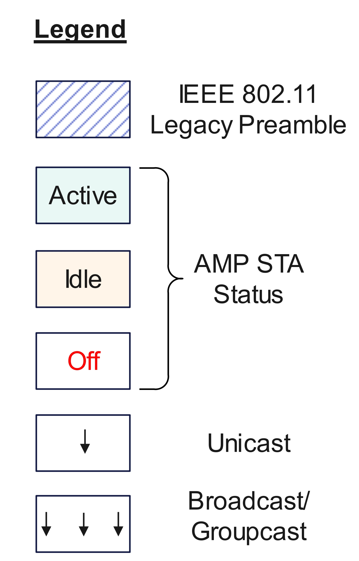
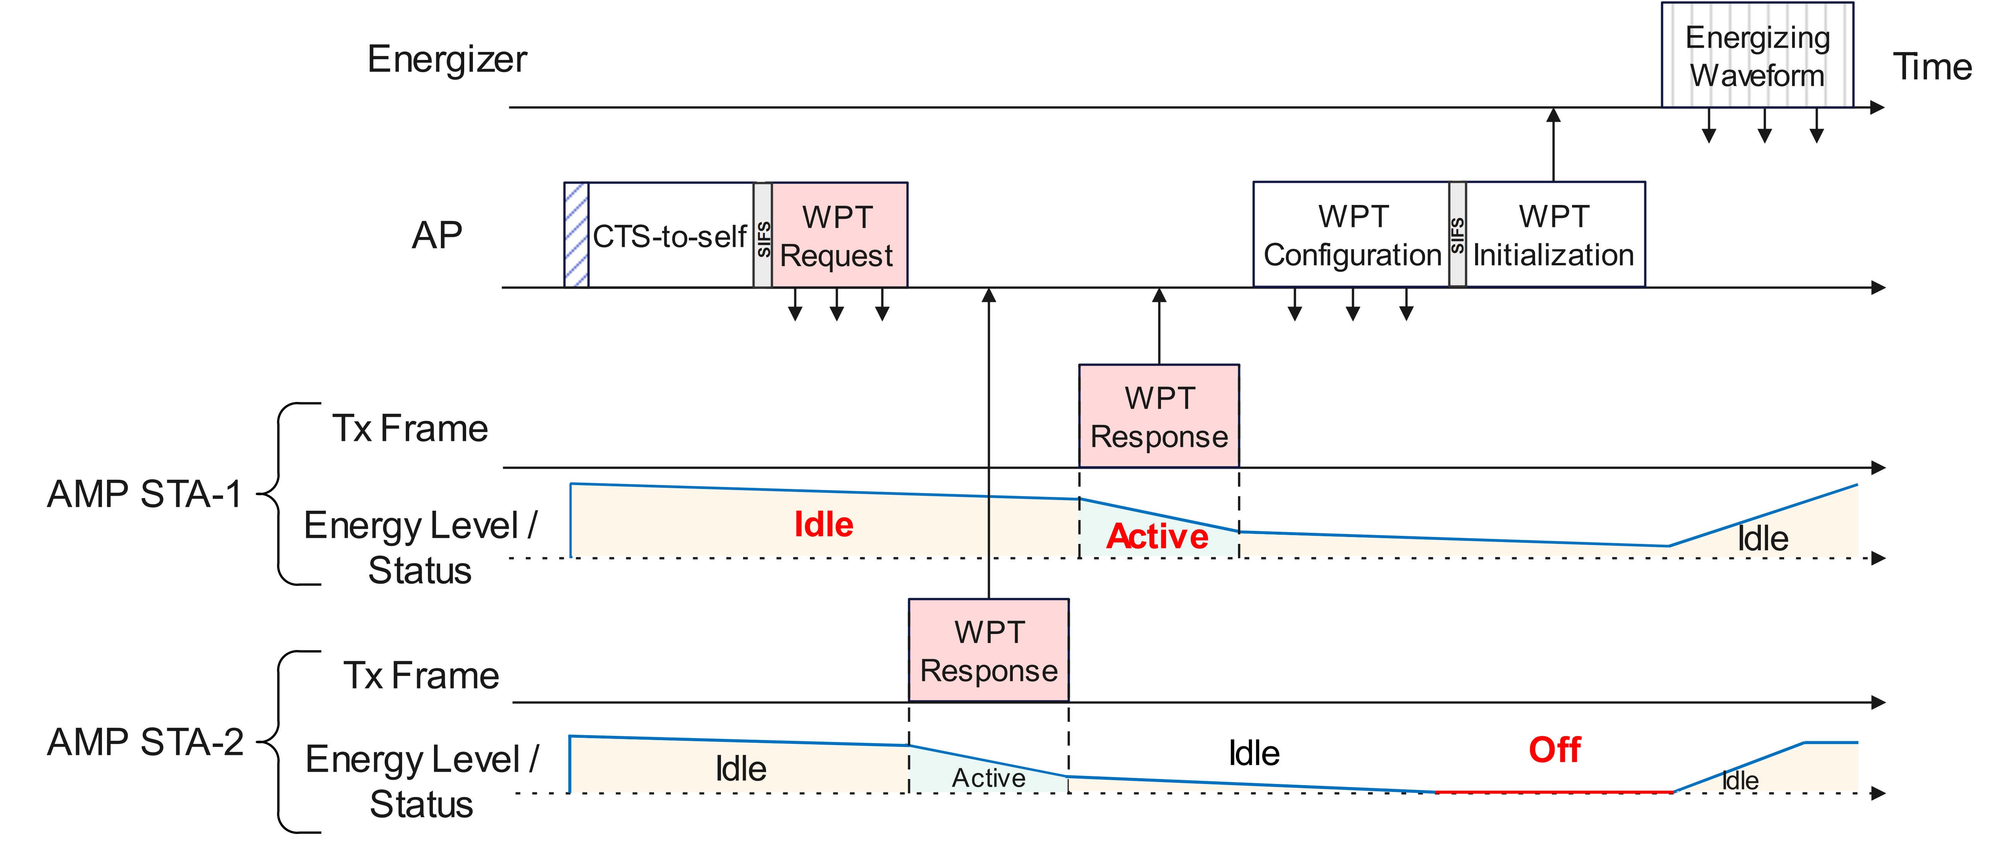
Example frame exchange for AMP WPT Protocol (1/2)
The AMP STA can support different activity at each of its energy states:
  Active – transmission (high energy consumption)
  Idle – memory retention, sensing, receiving (low energy consumption)
  Off – powered off/doze state (no energy left)
The AP can send out a WPT Request to illicit a WPT Response from the AMP STAs with WPT capability information required for the WPT Configuration frame. This can include STA ID, STA’s current energy level, energy storage capacity, UL data buffer size, frequency bands, etc.
Future WPT broadcast frames can also be unicast to those STAs that have shared their ID and WPT capability information

Slide 8
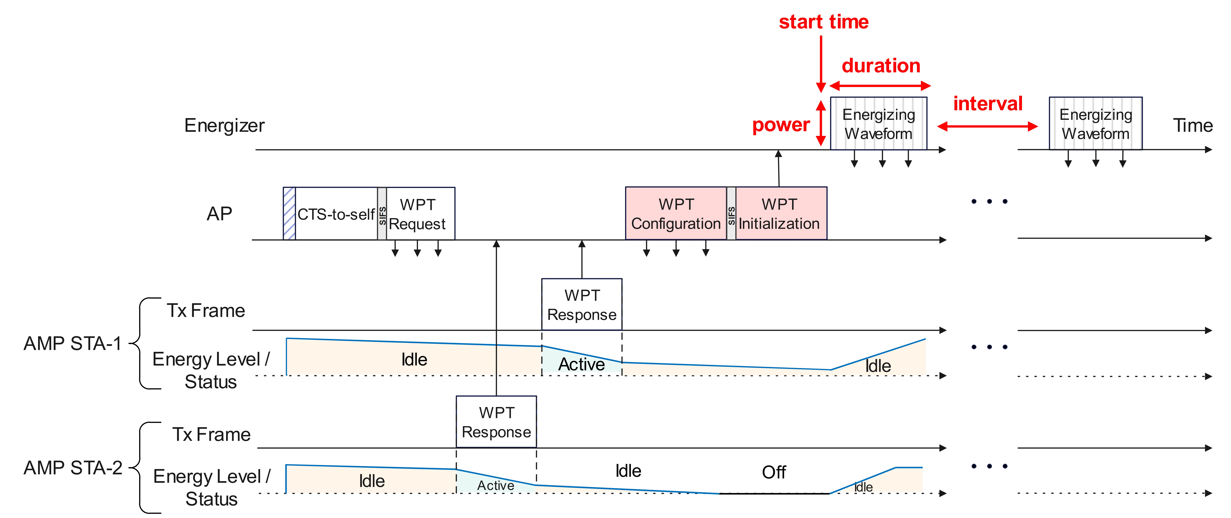
Example frame exchange for AMP WPT Protocol (2/2)
The WPT Configuration frame can be sent by the AP to indicate the WPT parameter settings based on the WPT Responses received from the AMP STAs. The WPT Configuration frame can include WPT Transmission Info., Frequency Band, etc.
The WPT Initialization frame is sent from the AP to the Energizer with the WPT parameter settings, such as the WPT Transmission Info., which can include the start time, duration, interval/ repetition frequency, power, etc. for the WPT transmission
The WPT interval can be used to schedule periodic energizing waveform (such as duty-cycle based WPT)

Slide 9
Summary
Three modes of WPT have been proposed, namely Mode 0, Mode 1, and Mode 2.
The AMP WPT protocol for Mode 1 has 3 main procedures, namely, WPT Request/Response, WPT Configuration, and WPT Teardown, with an additional procedure of WPT Initialization for a non-integrated Energizer device (Mode 2)
The AP determines the WPT parameter settings based on the WPT Responses from the AMP STAs (energy level, energy capacity, UL data buffer size, etc.)
  This offloads the computing power for WPT to the AP
  The WPT Response is an indication of the AMP STAs ability to participate in TXOPs, or maintain a particular energy state
The AP can send a WPT Initialization frame to inform a non-integrated Energizer (Mode2) of the WPT Transmission Info. such as the WPT start time, duration, power, and interval
  The WPT interval can be used to support duty-cycle based WPT

Slide 10
References
[1] 11-24/0575r1, P802.11bp PAR.
[2] 11-23/1356r0, Discussion on AMP Power link (Weijie Xu et. al., OPPO)
[3] 11-23/2042r0, Further Discussion on AMP PAR (Yinan Qi et. al., OPPO)
[4] 11-23/1195r0, Thoughts on AMP IOT and PAR (Bin Tian et. al., Qualcomm)
[5] 11-24/0421r0, AMP Link Access (Solomon Trainin et. al., Wiliot)
[6] 11-22/1560r0, Ambient powers and energy storage (Shengjiang Cui et. al., OPPO)
[7] 11-23/1140r0, Considerations for AMP Devices (Amichai Sanderovich et. al., Wiliot)

Slide 11
SP1
Do you agree that 11bp shall support WPT Mode 0?
Mode 0 - WPT Receiver acts as a passive energy harvester

Slide 12
SP2
Do you agree that 11bp shall support WPT Mode 1?
Mode 1 - WPT management information exchange is directly performed between the Energizer and AMP STA to support WPT on the WPT link between the Energizer and AMP STA

Slide 13
SP3
Do you agree that 11bp shall support WPT Mode 2?
Mode 2 - WPT management information exchange is coordinated through the AP and is carried out with an associated Energizer and AMP STA to support WPT on the WPT link between the Energizer and AMP STA

