Slide 1
Analysis and Simulations on Coordinated Spatial Reuse
Date: 2024-05-06
Authors:
Name | Affiliations | Address | Phone | email
Jason Yuchen Guo | Huawei Technologies |  |  | guoyuchen@huawei.com
Yunbo Li
Guogang Huang
Ming Gan
Yue Zhao
Maolin Zhang
Hassan Omar

Slide 2
Introduction
Coordinated Spatial Reuse (CSR) has been proposed to improve system throughput and latency performance in multi-AP scenario [1-12].
The motion for defining CSR in TGbn has passed:
  Move to add the following text to the TGbn SFD:
  • Define a multi-AP Coordinated Spatial Reuse at TxOP-level with power control
  • Define multi-AP Coordinated Beamforming
  • Other multi-AP coordination modes are TBD
In this contribution, we discuss several aspects of design details of CSR, including:
  How to identify the shared APs
  The processing delay of CSR Trigger frame

Slide 3
Recap
CSR transmission procedure
  Sharing AP obtains TXOP
  Sharing AP transmits a CSR Trigger frame to shared APs, the transmission duration and the transmit power of the APs are specified by the CSR Trigger frame
  All the APs transmit in parallel to their associated STAs
AP1
(sharing AP)
Co-SR Trigger Frame
DL Data Frame
AP2
(shared AP)
DL Data Frame
STA1
(Associated with AP1)
BA
STA2
(Associated with AP2)
BA
Note: how to transmit the BA is TBD

Slide 4
Identification of the shared APs
The identification of the shared APs depends on how many shared APs do we want to support in a single CSR transmission
  Opt1: only one shared AP is allowed in one CSR transmission
  Opt2: two or more shared APs are allowed in one CSR transmission
In opt1, we can use the MAC address of the shared AP as the identifier of the shared AP in the CSR Trigger frame, i.e., using the RA field
In opt2, we need a procedure for the sharing AP to assign a short AP ID to each of the shared APs
  This can be done during the setup procedure, each AP can assign an AP ID to its peer AP.

Slide 5
Processing delay of CSR Trigger frame
After receiving a CSR Trigger frame, the shared AP may need some time to process the CSR Trigger frame before transmitting data to its associated STA.
There are several methods to handle this issue.
  Method 1: add padding to the CSR Trigger frame
  Method 2: allow the shared AP to start data transmission later than the sharing AP
In method 1, we need a way for the shared AP to tell the sharing AP how much padding delay does it need
  This can be done during the setup procedure, each AP can indicate to its peer the needed padding delay
In method 2, shared AP’s associated STA may start receiving the sharing AP’s DL packet, and may capture the shared AP’s DL packet later (if the SIR is high enough).
  if the shared AP intends to use method 2, it can indicate a zero padding delay during the setup procedure.

Slide 6
Conclusion
We propose several aspects of design details for CSR, including
  The number of shared APs
  The identification of shared APs
  The processing delay of CSR Trigger frame

Slide 7
References
[1] 11-19-0103-01-0eht-ap-coordination-in-eht
[2] 11-20-0576-01-00be-coordinated-spatial-reuse-protocol
[3] 11-20-0107-01-00be-multi-ap-coordination-for-spatial-reuse
[4] 11-22-1512-00-0uhr-Multi-AP Coordination for UHR
[5] 11-22-1516-00-0uhr-Considerations on Multi-AP Coordination
[6] 11-22-1822-00-0uhr-Recap on Coordinated Spatial Reuse Operation
[7] 11-23-0058-00-0uhr-Spatial Reuse in Coordinated M-AP for UHR
[8] 11-23-1037-00-0uhr-performance-of-coordinated-spatial-reuse
[9] 11-23-0776-01-0uhr-performance-of-c-bf-and-c-sr
[10] 11-23-1023-02-0uhr-coordinated-spatial-reuse-in-a-4-ap-topoplogy
[11] 11-23-0616-00-0uhr-overhead-analysis-of-coordinated-spatial-reuse
[12] 11-23-1868-02-00bn-coordinated-spatial-reuse-design

Slide 8
SPs
SP1:Do you support to include in the 11bn SFD:
In Coordinated Spatial Reuse:
  An AP can transmit a CSR Trigger frame to initiate concurrent transmissions of two or more APs on the same frequency resource within its obtained TXOP;
  The transmission duration and the transmit power of the APs are specified by the CSR Trigger frame;
  The details of the CSR Trigger frame are TBD.

Slide 9
SPs
SP2: How many shared APs do you support in a single CSR transmission:
  One;
  Two or more;
  Abstain.
SP2a: Do you support to include in the 11bn SFD:
In Coordinated Spatial Reuse:
  The number of shared APs that participate in a single CSR transmission is one
SP2b: Do you support to include in the 11bn SFD:
In Coordinated Spatial Reuse:
  The number of shared APs that participate in a single CSR transmission can be larger than one

Slide 10
SPs
SP3: Do you support to include in the 11bn SFD:
In Coordinated Spatial Reuse:
  AP can assign an AP ID to its peer AP during the setup procedure

Slide 11
SPs
SP4: Do you support to include in the 11bn SFD:
In Coordinated Spatial Reuse:
  AP can indicate its required CSR padding delay during the setup procedure, which is the minimum padding duration to be added in the CSR Trigger frame if the AP is identified by a CSR Trigger frame.

Slide 12
Appendix

Slide 13
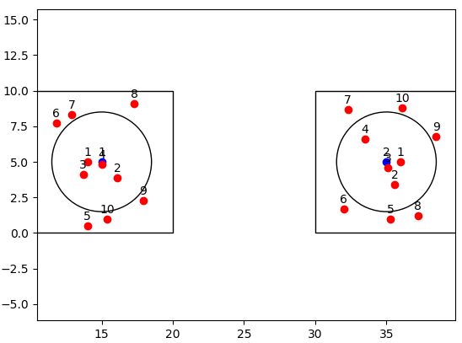
Simulation Settings
Topology
  BSS：10m×10m，inter-AP distance: 20m,
  STA number: 10 per BSS (4 inner STAs, 6 outer STAs)
We perform system level simulation to compare the performance of the following 3 schemes
  Scheme A: TXOP based CSR with TPC. Choose appropriate TX power and MCS for the shared AP to maximize the sum rate in CSR transmission.
  Scheme B: TXOP based CSR without TPC. Only adjust the MCS for the shared AP to maximize the sum rate in CSR transmission. Full power is used for both APs.
  Scheme C: SP based CSR. CSR is only initiated within overlapping SPs to serve inner STAs, full power is used for both APs, MCS is reduced for both sharing AP and shared AP. Outer STAs are served outside of the SPs.
    SP Duration is 8ms, SP interval is 20ms
Traffic: DL
Scheduling: round robin
Inner STAs are randomly placed within a circle with 3.5m radius
Inner STA ratio = (3.14 * 3.5 * 3.5) / (10*10) = 38.5%

Slide 14
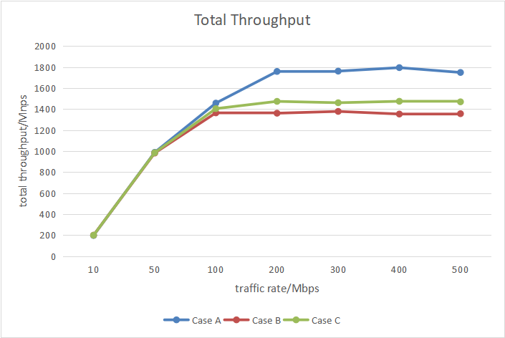
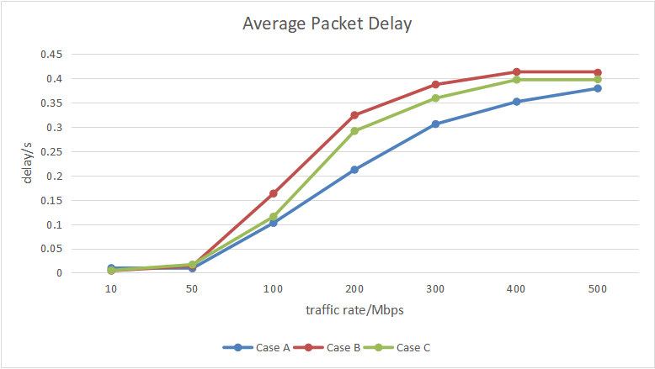
Simulation Results
Scheme A outperforms other schemes in terms of both throughput and delay
  When the target STA of the sharing AP is an inner STA (or a STA far from the shared AP), since the SINR of the target STA is high, there’s no big difference between the three schemes
  When the target STA of the sharing AP is an outer STA, scheme A can still initiate CSR since the power of the shared AP can be controlled to guarantee the performance of the target STA; scheme B can not initiate CSR, otherwise the performance of the target STA will get harmed.

Slide 15
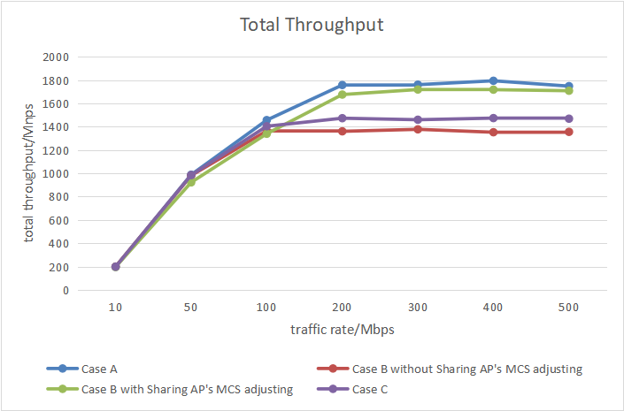
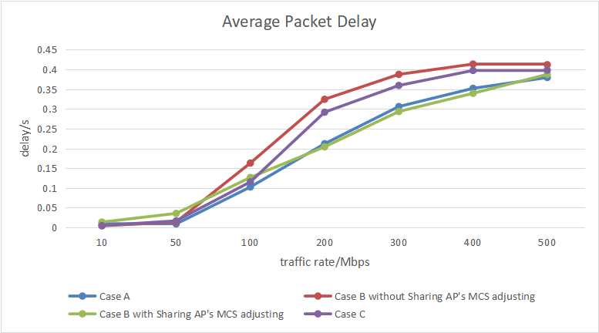
Simulation Results
If we allow the performance of the target STA to be harmed
  In scheme B, when the target STA of the sharing AP is an outer STA, we allow the sharing AP to sacrifice its own performance by decreasing its own MCS, in order to initiate CSR.
  Allow 4 levels of MCS degradation (MCS11 → MCS7)
  The throughput of scheme B increases, at the expense of harming the sharing AP
  Scheme A still performs best
Throughput increases

