Slide 1
Analysis and Simulations on Coordinated Spatial Reuse
Date: 2024-05-06
Authors:
Name | Affiliations | Address | Phone | email
Jason Yuchen Guo | Huawei Technologies |  |  | guoyuchen@huawei.com
Yunbo Li
Guogang Huang
Ming Gan
Yue Zhao
Maolin Zhang
Hassan Omar

Slide 2
Introduction
Coordinated Spatial Reuse (CSR) has been discussed in many contributions [1-14].
Two types of CSR are proposed
  TXOP based CSR [1-12]: sharing AP triggers shared AP to perform CSR transmission within an obtained TXOP
  SP based CSR [13]: two APs negotiate certain time periods during which the two APs only serve inner STAs
CSR with and without power control are also discussed in [14].
In this contribution, we provide analysis and simulation results on the above variants of CSR

Slide 3
Recap on TXOP based CSR
TXOP based CSR is performed in an opportunistic way:
  Sharing AP has pending data for at least one target STA, and then obtains TXOP
  The sharing AP finds there’s a shared AP suitable for CSR transmission, satisfying
    The shared AP does not cause strong interference to the target STA
  The sharing AP triggers the shared AP to perform CSR transmission
    Max TX power of the shared AP is indicated by the sharing AP to maintain sharing AP’s performance
    Preferably, PPDUs from the sharing AP and the shared AP are aligned
AP1
(sharing AP)
Co-SR Trigger Frame
DL Data Frame
AP2
(shared AP)
DL Data Frame
STA1
(Associated with AP1)
BA
STA2
(Associated with AP2)
BA

Slide 4
Recap on SP based CSR
In the SP based CSR, classify the clients as “inner” or “outer clients” (on a semi static basis)
Two types of SPs are scheduled in a long term manner:
  Reuse SP: overlapping in time, two APs only serve inner STAs, transmissions can happen in parallel
  Orthogonal SP: APs serve outer STAs

Slide 5
TXOP based CSR VS SP based CSR
 | TXOP based CSR | SP based CSR
Pros | Opportunistic: only use it when the conditions satisfy, no negative impact Flexible: more adaptive to real time conditions, performance is better | Simple: no dynamic scheduling needed
Cons | Some computation complexity | Pre-scheduled: use it as planned, not adaptive to real time conditions, will cause delay, may cause performance loss Legacy impact: Legacy STAs may still contend the channel within SPs (No guarantee that center STAs are served)

Slide 6
CSR with TPC VS without TPC
Transmit Power Control (TPC) is applied in traditional Spatial Reuse
  STA needs to reduce its transmit power when the CCA level is increased, with the same amount of dBs, which causes equivalent impact to an on going transmission comparing with legacy EDCA
CSR should also allow TPC, which preserves the performance of the TXOP holder (corresponds to the on going transmission)
Otherwise, if the interference from the shared AP is not negligible, the TXOP holder needs to
  Either reduce the MCS of its own transmission
  Or choose not to initiate CSR transmission
With TPC, the TXOP holder has more choices, it can do any of the following
  Reduce is own MCS for a more balanced rate for the shared AP (managed scenario, balanced traffic status)
  Reduce the shared AP’s power to ensure its own performance (when the sharing AP’s target STA has high QoS requirement, or when the sharing AP has more traffic than the shared AP)
  Choose not to initiate CSR

Slide 7
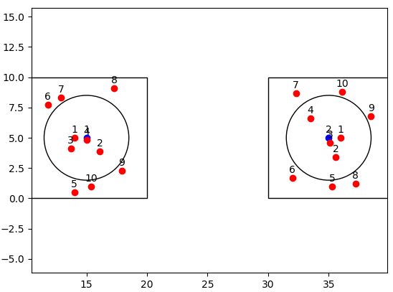
Simulation Settings
Topology
  BSS：10m×10m，inter-AP distance: 20m,
  STA number: 10 per BSS (4 inner STAs, 6 outer STAs)
We perform system level simulation to compare the performance of the following 3 schemes
  Scheme A: TXOP based CSR with TPC. Choose appropriate TX power and MCS for the shared AP to maximize the sum rate in CSR transmission.
  Scheme B: TXOP based CSR without TPC. Only adjust the MCS for the shared AP to maximize the sum rate in CSR transmission. Full power is used for both APs.
  Scheme C: SP based CSR. CSR is only initiated within overlapping SPs to serve inner STAs, full power is used for both APs, MCS is reduced for both sharing AP and shared AP. Outer STAs are served outside of the SPs.
    SP Duration is 8ms, SP interval is 20ms
Traffic: DL
Scheduling: round robin
Inner STAs are randomly placed within a circle with 3.5m radius
Inner STA ratio = (3.14 * 3.5 * 3.5) / (10*10) = 38.5%

Slide 8
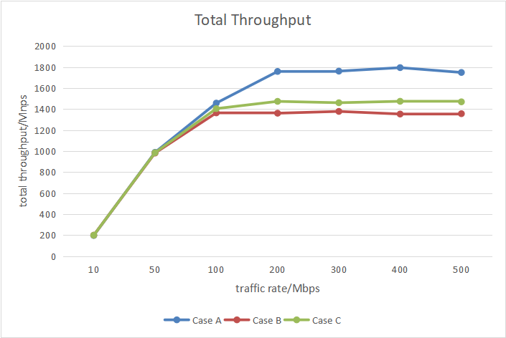
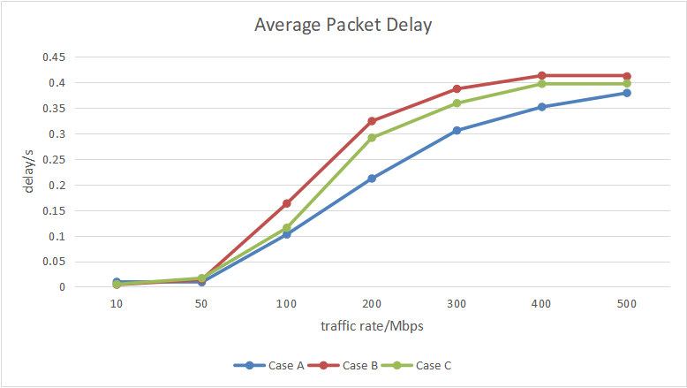
Simulation Results
Scheme A outperforms other schemes in terms of both throughput and delay
  When the target STA of the sharing AP is an inner STA (or a STA far from the shared AP), since the SINR of the target STA is high, there’s no big difference between the three schemes
  When the target STA of the sharing AP is an outer STA, scheme A can still initiate CSR since the power of the shared AP can be controlled to guarantee the performance of the target STA; scheme B can not initiate CSR, otherwise the performance of the target STA will get harmed.

Slide 9
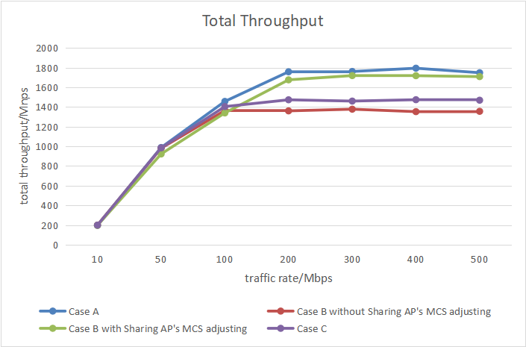
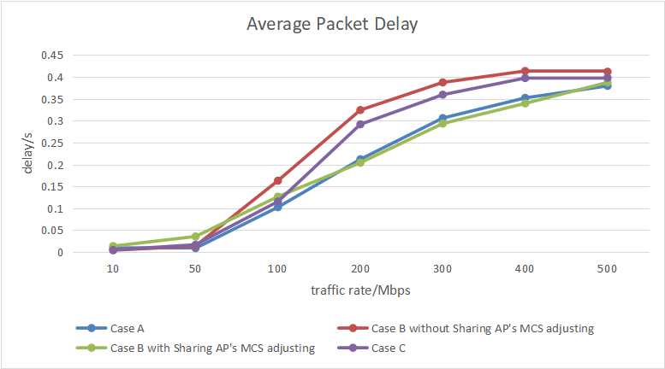
Simulation Results
If we allow the performance of the target STA to be harmed
  In scheme B, when the target STA of the sharing AP is an outer STA, we allow the sharing AP to sacrifice its own performance by decreasing its own MCS, in order to initiate CSR.
  Allow 4 levels of MCS degradation (MCS11 → MCS7)
  The throughput of scheme B increases, at the expense of harming the sharing AP
  Scheme A still performs best
Throughput increases

Slide 10
Conclusion
TXOP based/SP based CSR schemes with and without TPC are compared and simulated using network simulator
TXOP based CSR is more flexible, able to handle more dynamic scenarios, e.g. traffic, channel conditions
SP based CSR is simpler, but the performance is not as good as the TXOP based CSR in some scenarios
TPC is needed to preserve the performance of the TXOP holder, it keeps the logic of SR – no negative impact to the ongoing transmission
A simple TPC algorithm is used: the sharing AP uses fixed power while the shared AP reduces its power to maintain sharing AP’s MCS level
Simulation results show that the TXOP based CSR with TPC has best performance in the simulated scenario.

Slide 11
Q&A
Q: TPC will introduce more hidden nodes for the shared AP.
  A: The reduction of transmit power may (but not necessarily) increase the probability of a hidden node problem. However, there are various standard schemes that also employ a reduction in transmit power, such as the IEEE 802.11ax SR feature, as well as the trigger-based channel access (where an AP may limit the transmit power of triggered non-AP STA based on the value of the UL Target Receive Power field). Both examples may result in a potential increase in the probability of a hidden terminal problem, which is acceptable in order to achieve another gain. Additionally, even when a ‘shared’ AP obtains an SR opportunity with a reduced transmit power and is interfered by a hidden terminal transmission, there is no significant loss, because the shared AP gets this transmission opportunity for free. Besides, the shared AP can apply more robust MCS to transmit to prevent the risk of hidden nodes.
Q: it is difficult to make last moment scheduling for the shared AP
  A: After receiving a CSR trigger frame, a shared AP mainly needs to adjust its transmission parameters, such as the transmit power and MCS. This adjustment is possible (e.g., by padding the CSR trigger frame), similar to the current 802.11ax trigger-based (TB) transmissions.

Slide 12
Q&A
Q: STA’s measurement and report consumes power
  A: The measurement of OBSS AP’s signal strength can be made optional. If a non-AP STA chooses not to support OBSS measurement, the AP may apply a vendor-specific method to estimate the interference at this non-AP STA. The worst case is that the sharing AP will not invoke CSR when this non-AP STA is scheduled.
Q: Link adaptation and TPC algorithms are complicated
  A: The complexity of the algorithms for link adaptation (required mainly for a ‘shared’ AP) and TPC (required only for a ‘sharing’ AP) depend on the vendor that develops these algorithms, they are not inherently complex. In other words, a vendor may limit the C-SR employment to specific cases and scenarios, in order to simplify the corresponding TPC and MCS selection algorithms.

Slide 13
References
[1] 11-19-0103-01-0eht-ap-coordination-in-eht
[2] 11-20-0576-01-00be-coordinated-spatial-reuse-protocol
[3] 11-20-0107-01-00be-multi-ap-coordination-for-spatial-reuse
[4] 11-22-1512-00-0uhr-Multi-AP Coordination for UHR
[5] 11-22-1516-00-0uhr-Considerations on Multi-AP Coordination
[6] 11-22-1822-00-0uhr-Recap on Coordinated Spatial Reuse Operation
[7] 11-23-0058-00-0uhr-Spatial Reuse in Coordinated M-AP for UHR
[8] 11-23-1037-00-0uhr-performance-of-coordinated-spatial-reuse
[9] 11-23-0776-01-0uhr-performance-of-c-bf-and-c-sr
[10] 11-23-1023-02-0uhr-coordinated-spatial-reuse-in-a-4-ap-topoplogy
[11] 11-23-0616-00-0uhr-overhead-analysis-of-coordinated-spatial-reuse
[12] 11-23-1868-02-00bn-coordinated-spatial-reuse-design
[13] 11-24-0577-00-00bn-thoughts-on-coordinated-spatial-reuse-c-sr
[14] 11-24-0114-01-00bn-thoughts-on-power-control-for-csr

