Slide 1
Coordinated Beamforming for 11bn
Date: 2024-07-15
Authors:
Name | Affiliation | Address | Phone | Email
Insik Jung | LG Electronics | 19, Yangjae-daero 11gil, Seocho-gu, Seoul 137-130, Korea |  | insik0618.jung@lge.com
Eunsung Park |  |  |  | esung.park@lge.com
Dongguk Lim |  |  |  | dongguk.lim@lge.com
Jinyoung Chun |  |  |  | jiny.chun@lge.com
Jinsoo Choi |  |  |  | js.choi@lge.com

Slide 2
Introduction
Coordinated beamforming (C-BF) is one of multi-AP transmission technologies which can improve the throughput and latency.
  In [1], full nulling based C-BF has throughput gain compared to single-AP system
  Also, it has been shown in [2]-[5] that partial nulling can be beneficial compared to full nulling in terms of throughput
In this contribution, we revisit the performance of C-BF and propose further improvement by a precoding with partial nulling for C-BF

Slide 3




Coordinated Beamforming
C-BF intentionally allows concurrent transmission of both AP
  Null precoding is applied from each AP to eliminate OBSS interference
  We can make the null precoder based on the OBSS channel measurement
AP 1
AP 2
$$H_{12}$$
$$H_{21}$$
$$H_{11}$$
$$H_{22}$$
STA 1
STA 2

Slide 4
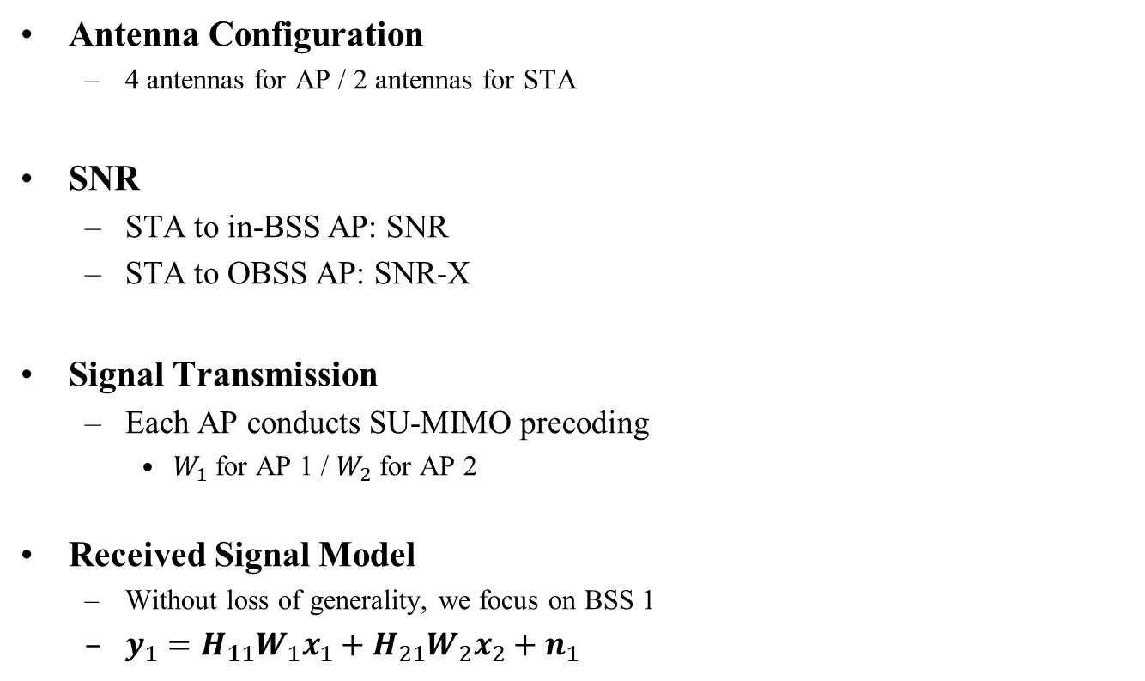




System Model
Antenna Configuration
  4 antennas for AP / 2 antennas for STA
SNR
  STA to in-BSS AP: SNR
  STA to OBSS AP: SNR-X
Signal Transmission
  Each AP conducts SU-MIMO precoding
    $W_{1}$for AP 1 / $W_{2}$for AP 2
Received Signal Model
  Without loss of generality, we focus on BSS 1
  $y_{1}=H_{11}W_{1}x_{1}+H_{21}W_{2}x_{2}+n_{1}$
AP 1
AP 2
$$H_{12}$$
$$H_{21}$$
$$H_{11}$$
$$H_{22}$$
STA 1
STA 2

Slide 5
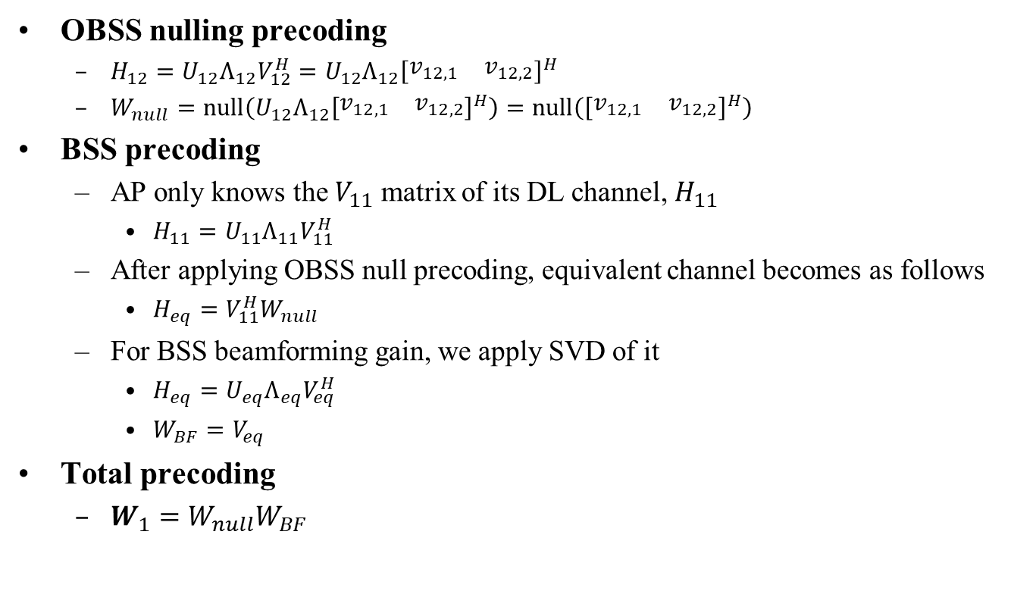
Precoding Matrix for Full Nulling
OBSS nulling precoding
  $H_{12}=U_{12}Λ_{12}V_{12}^{H}={U_{12}Λ_{12}\left[\begin{matrix}v_{12,1} & v_{12,2}\end{matrix}\right]}^{H}$
  $W_{null}=null\left({U_{12}Λ_{12}\left[\begin{matrix}v_{12,1} & v_{12,2}\end{matrix}\right]}^{H}\right)=null\left({\left[\begin{matrix}v_{12,1} & v_{12,2}\end{matrix}\right]}^{H}\right)$
BSS precoding
  AP only knows the $V_{11}$ matrix of its DL channel, $H_{11}$
    $H_{11}=U_{11}Λ_{11}V_{11}^{H}$
  After applying OBSS null precoding, equivalent channel becomes as follows
    $H_{eq}=V_{11}^{H}W_{null}$
  For BSS beamforming gain, we apply SVD of it
    $H_{eq}=U_{eq}Λ_{eq}V_{eq}^{H}$
    $W_{BF}=V_{eq}$
Total precoding
  $W_{1}=W_{null}W_{BF}$

Slide 6
Simulation Environment
Bandwidth
  80MHz
Data size
  100 bits
Channel Model
  TGnD
Channel Coding
  BCC
Antenna Configuration
  AP: 4 antennas / STA: 2 antennas
Receiver
  MMSE
Baseline
  SU-MIMO. Especially when only one BSS is transmitting data(i.e., simply assuming one BSS can transmit at a time like C-TDMA(no interference/collision assumed)).

Slide 7
Simulation Result
Goodput
  SU-MIMO: (1-FER)*NSD*NSS*mod_order*code_rate/symbol_duration
  C-BF: 2*(1-FER)*NSD*NSS*mod_order*code_rate/symbol_duration
  C-BF has a region to show better goodput(in mid-high SNR) when the OBSS interference level is intermediate
  When interference level is too high, residual interference from quantization error and the loss of beamforming gain from nulling degrade the performance
  ➔ Coordinated beamforming can bring benefits but we may need to further improve the gain

Slide 8
Partial Nulling
At early stage, null precoder has been considered to eliminate entire OBSS interference
  However, as shown in [2]-[5], the performance gain of full nulling can be limited since the condition number is not good enough
Instead, it has been shown that partially eliminating OBSS interference provides better goodput
  Rather than fully eliminate OBSS interference, we can concentrate more on in-BSS beamforming

Slide 9
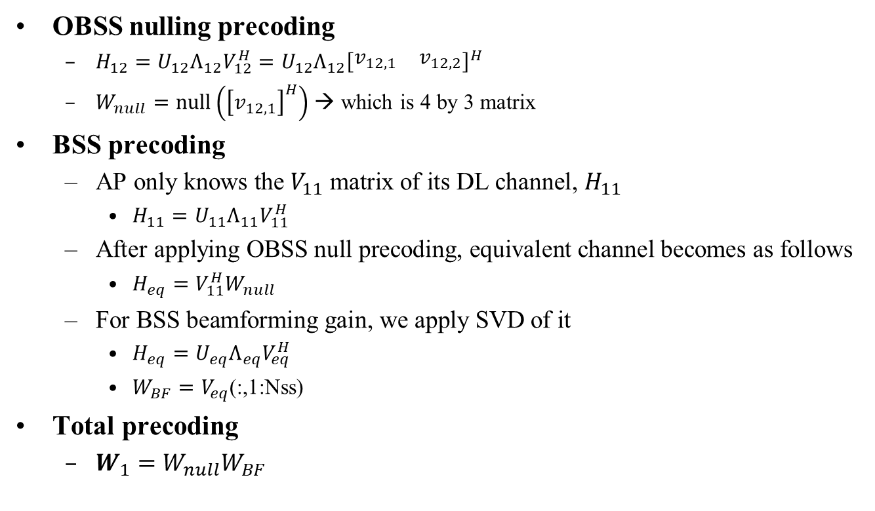
Proposed Precoding Matrix for Partial Nulling
OBSS nulling precoding
  $H_{12}=U_{12}Λ_{12}V_{12}^{H}={U_{12}Λ_{12}\left[\begin{matrix}v_{12,1} & v_{12,2}\end{matrix}\right]}^{H}$
  $W_{null}=null\left({\left[v_{12,1}\right]}^{H}\right)$ → which is 4 by 3 matrix
BSS precoding
  $\text{AP} \text{only} \text{knows} \text{the} V_{11} \text{matrix} \text{of} \text{its} \text{DL} \text{channel}\text{, }H_{11}$
    $H_{11}=U_{11}Λ_{11}V_{11}^{H}$
  $\text{After} \text{applying} \text{OBSS} \text{null} \text{precoding}\text{, }\text{equivalent} \text{channel} \text{becomes} \text{as} \text{follows}$
    $H_{eq}=V_{11}^{H}W_{null}$
  $\text{For} \text{BSS} \text{beamforming} \text{gain}\text{, }\text{we} \text{apply} \text{SVD} \text{of} \text{it}$
    $H_{eq}=U_{eq}Λ_{eq}V_{eq}^{H}$
    $W_{BF}=V_{eq}$(:,1:Nss)
$\text{Total} \text{precoding}$
  $W_{1}=W_{null}W_{BF}$
We only eliminate this dimension, which has dominant interference

Slide 10
Simulation Result (1/3)
Residual Interference (X=0dB)

Slide 11
Simulation Result (2/3)
Frame Error Rate (FER), MCS1
  When X=0dB, full null outperforms partial null since effect of interference nulling is higher than the beamforming gain
  When X>= 10dB, partial null outperforms full null since the effect of interference nulling is smaller than the BSS beamforming gain

Slide 12
Simulation Result (3/3)
Goodput
  SU-MIMO: (1-FER)*NSD*NSS*mod_order*code_rate/symbol_duration
  C-BF: 2*(1-FER)*NSD*NSS*mod_order*code_rate/symbol_duration
  When X is too small, SU-MIMO with higher MCS might be better than C-BF
  When X is intermediate, C-BF outperforms SU-MIMO in most region.
  When X is intermediate, Partial Nulling outperforms Full Nulling.

Slide 13
Conclusion
We investigated the performance of C-BF and showed C-BF can potentially provide a good throughput gain
We also checked if the C-BF can be further improved by partially nulled precoding way
  Eliminating only dominant interference can provide better goodput compared to eliminating all the interference in certain scenario when OBSS interference level is intermediate
We propose C-BF as a candidate Multi-AP scheme in 11bn

Slide 14
References
[1] 11-19-0772-01, Multi-AP Collaborative BF in IEEE 802.11
[2] 11-23-0776-01, Performance of C-BF and C-SR
[3] 11-23-1998-00, Zero-MUI Coordinated Beamforming
[4] 11-24-0011-00, Coordinated Spatial Nulling (C-SN) Concept
[5] 11-24-0012-00, Coordinated Spatial Nulling (C-SN) Simulations

Slide 15
Straw Poll #1
Do you agree to support coordinated beamforming for 11bn?
Y/N/A: //

Slide 16
Straw Poll #2
Do you agree to support partial nulling precoding for coordinated beamforming in 11bn?
  Partial nulling precoding denotes that AP makes a null precoder using only part of the column vectors of its compressed OBSS channel matrix
Y/N/A: //

