Slide 1
Authentication and Security transaction for AMP
July 2024
Doc.: IEEE 802.11-24/1203r0
Date: 2024-07-15
Authors:
Name | Affiliation | Address | Phone | Email
Chuanfeng He | OPPO |  |  | hechuanfeng@oppo.com
Weijie Xu |  |  |  | xuweijie@oppo.com
Yinan Qi |  |  |  | v-qiyinan@oppo.com

Slide 2
Abstract
Doc.: IEEE 802.11-24/1203r0
In this contribution, we discuss authentication and security aspects for AMP communication.

Slide 3
July 2024
Doc.: IEEE 802.11-24/1203r0
Legacy Authentication and Security transaction
  Authentication and Security
    Open System authentication
      Two-message authentication transaction sequence
        Open System authentication request and response
      No 4-way handshake
    Authentication using a password
      PSK authentication
      SAE authentication
      4-way handshake to derive PTK
Slide 3
Chuanfeng He (OPPO)

Slide 4
July 2024
Doc.: IEEE 802.11-24/1203r0
Authentication and Security transaction for AMP
  AMP STA need to have sufficient power to finish authentication and security transaction sequences.
  In some use case, e.g. logistics, very small volume data exchange is needed. Strong security may not be always necessary for AMP communication.
  legacy authentication and security options can be discussed as starting points, as list in following solution 1.
  Solution 1: legacy authentication and security options.
    With authentication
      Open System authentication
        Simplest access control
        With no 4-way handshake and data encryption
Slide 4
Chuanfeng He (OPPO)

Slide 5
July 2024
Doc.: IEEE 802.11-24/1203r0
Authentication and Security transaction for AMP
      PSK authentication
        PSK after Open System authentication is used as PMK for 4-way handshake
        With data encryption
      SAE authentication
        Derive PMK based on PSK for 4-way handshake
        With data encryption
Slide 5
Chuanfeng He (OPPO)

Slide 6
July 2024
Doc.: IEEE 802.11-24/1203r0
Integrated Security and data transaction for AMP
  Authentication, Security and data transaction can be further simplified to address the limited power supply of AMP STA. Integrated security and data transaction without authentication is shown in following solution 2.
  Solution 2: Integrated security and data transaction
    Without authentication
      Shared key between regular STA and AMP STA, like PSK or PMK.
    Generate PTK for data encryption based on the shared Key.
    Data encryption and delivery during security transaction sequence
      Message 1: Regular STA -> AMP STA
        ANonce, Supported cipher
        AMP STA
          Generate SNonce
          derive PTK based on selected cipher, shared key, ANonce and SNonce
          Data encryption with PTK
Slide 6
Chuanfeng He (OPPO)

Slide 7
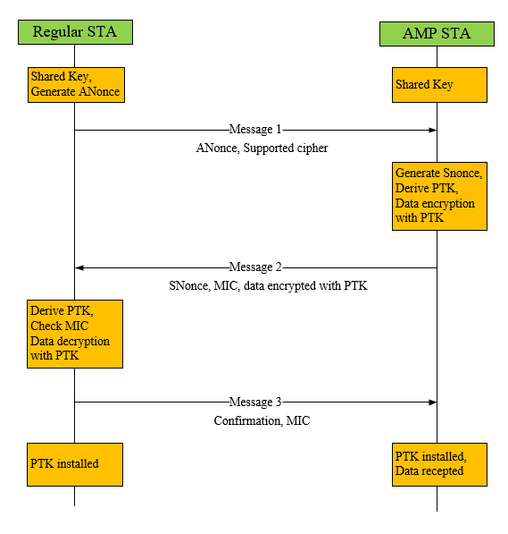
July 2024
Doc.: IEEE 802.11-24/1203r0
Integrated Security and data transaction for AMP
      Message 2: AMP STA -> Regular STA
        SNonce, MIC, data encrypted with PTK
        Regular STA
          Derive PTK based on shared key, Anonce and Snonce
          Check MIC
          Decrypt data based on the derived PTK
      Message 3: Regular STA -> AMP STA
        Confirmation for Key install and data reception, MIC
Slide 7
Chuanfeng He (OPPO)

Slide 8
July 2024
Doc.: IEEE 802.11-24/1203r0
Summary
  In this submission, authentication and security aspects for AMP communication are discussed. Solutions on authentication and security are raised
    Solution 1: legacy authentication and security options
      Open System authentication
      PSK authentication
      SAE authentication
    Solution 2: Integrated security and data transaction
      Without authentication: Shared Key
      Integrated security and data transaction based on shared and derived Key
Slide 8
Chuanfeng He (OPPO)

