Slide 1
Time and frequency synchronization for AMP
July 2024
Doc.: IEEE 802.11-24/1201r0
Date: 2024-07-09
Authors:
Name | Affiliation | Address | Phone | Email
Jinyu zhang | OPPO |  |  | zhangjinyu@oppo.com
Wang Ke
Weijie Xu
Chuanfeng He
Shengjiang Cui
Yinan QI
Zhisong zuo

Slide 2
Abstract
Doc.: IEEE 802.11-24/1201r0
For AMP DL communication link, the common consensus is to use a new air-interface with WUR-like (i.e. MC-OOK) design, including WUR-Sync field.
In this submission, the feasibility to achieve timing and frequency synchronization based on WUR-Sync is evaluated.

Slide 3
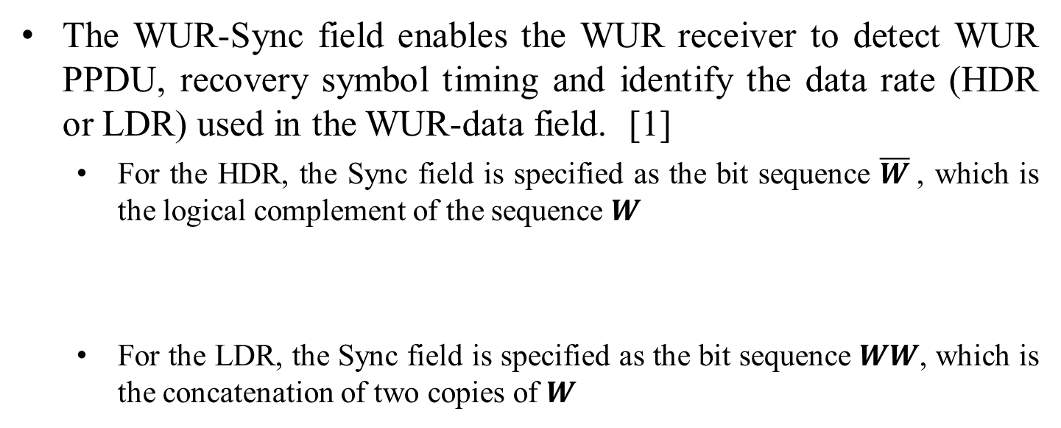
July 2024
Doc.: IEEE 802.11-24/1201r0
Background: WUR-Sync field
  The WUR-Sync field enables the WUR receiver to detect WUR PPDU, recovery symbol timing and identify the data rate (HDR or LDR) used in the WUR-data field. [1]
    For the HDR, the Sync field is specified as the bit sequence $\overline{W}$, which is the logical complement of the sequence 𝑾
    For the LDR, the Sync field is specified as the bit sequence 𝑾𝑾, which is the concatenation of two copies of 𝑾
Slide 3
Jinyu Zhang

Slide 4
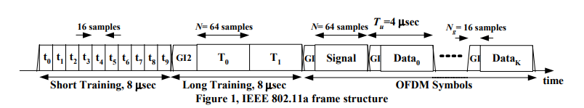
July 2024
Doc.: IEEE 802.11-24/1201r0
Initial analysis based on WUR-Sync field
  Timing synchronization can be achieved by a simple sync sequence correlator.
    With OOK waveform and envelop detection, the complexity and power consumption at Rx side could maintain quite low.
  Frequency offset is generally estimated with the following two methods :
    Option 1: Blind frequency offset search with multiple frequency offset assumptions, which will increase the complexity and power consumption at Rx side.
    Option 2: Estimate the frequency offset by the phase changes between repetitive short training sequences, such as L-STF and L-LTF. [2]
    Both options require I/Q operation, which is power consuming and challenging for AMP STA.
Slide 4
Jinyu Zhang

Slide 5
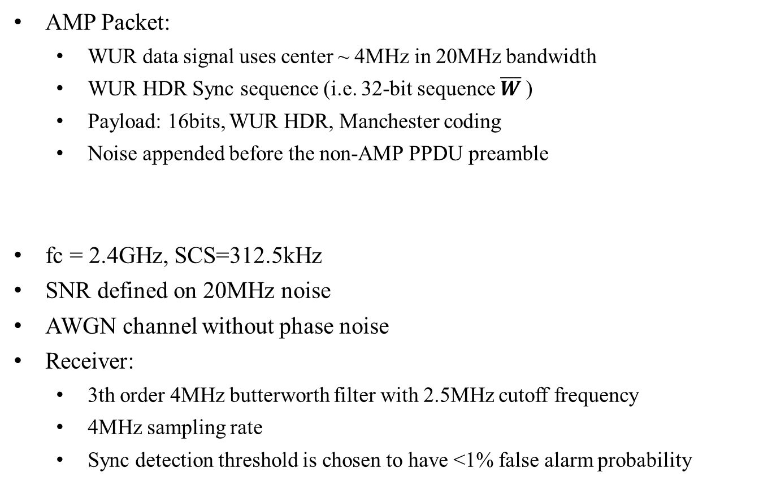
July 2024
Doc.: IEEE 802.11-24/1201r0
Simulation Assumption
  AMP Packet:
    WUR data signal uses center ~ 4MHz in 20MHz bandwidth
    WUR HDR Sync sequence (i.e. 32-bit sequence $\overline{W}$)
    Payload: 16bits, WUR HDR, Manchester coding
    Noise appended before the non-AMP PPDU preamble
  fc = 2.4GHz, SCS=312.5kHz
  SNR defined on 20MHz noise
  AWGN channel without phase noise
  Receiver:
    3th order 4MHz butterworth filter with 2.5MHz cutoff frequency
    4MHz sampling rate
    Sync detection threshold is chosen to have <1% false alarm probability
Slide 5
Jinyu Zhang

Slide 6
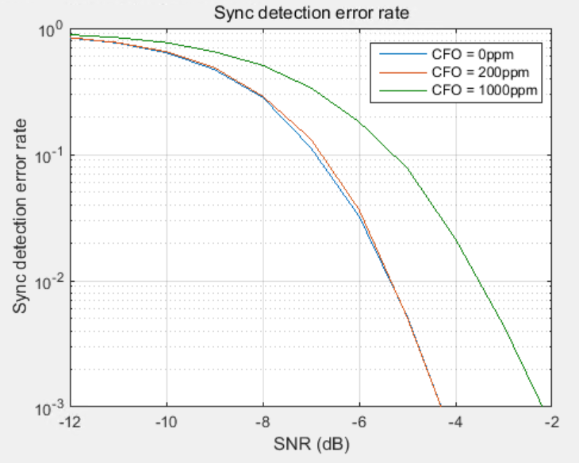
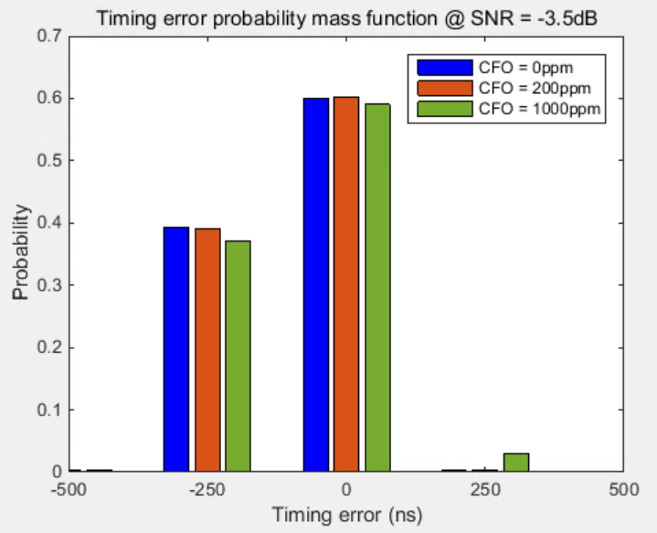
July 2024
Doc.: IEEE 802.11-24/1201r0
Simulation Results for timing synchronization
    1% Sync field detection error rate could be achieved at SNR=-3.5dB even with CFO=1000ppm.
    > 90% probability to achieve abs(timing error) <= 250ns when Sync field is successfully detected at SNR=-3.5dB.
    About 2dB performance loss between CFO=1000ppm and CFO=0/200ppm
Slide 6
Jinyu Zhang
Notes:
加1000ppm

Slide 7
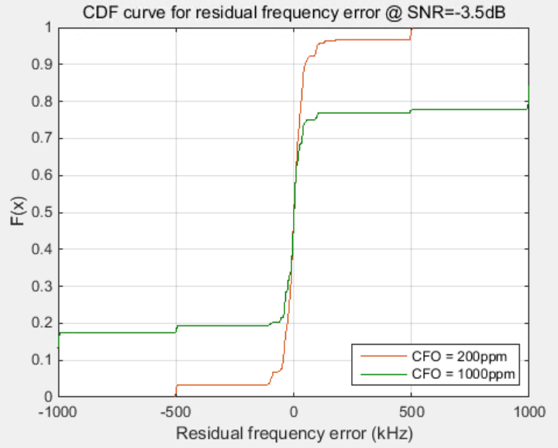
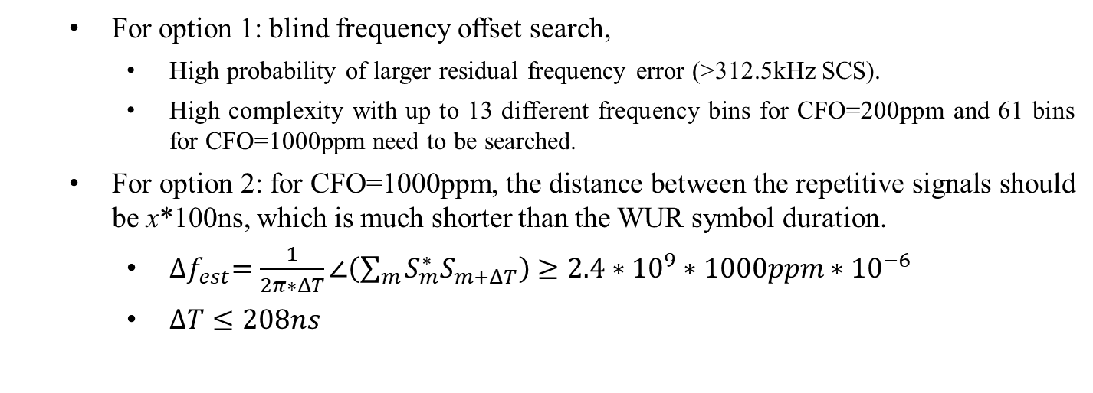
July 2024
Doc.: IEEE 802.11-24/1201r0
Simulation Results for frequency synchronization
    For option 1: blind frequency offset search,
      High probability of larger residual frequency error (>312.5kHz SCS).
      High complexity with up to 13 different frequency bins for CFO=200ppm and 61 bins for CFO=1000ppm need to be searched.
    For option 2: for CFO=1000ppm, the distance between the repetitive signals should be x*100ns, which is much shorter than the WUR symbol duration.
      ${∆f}_{est}=\frac{1}{2π∗ΔT}∠\left(\sum_{m}{S_{m}^{∗}S_{m+ΔT}}\right)≥2.4∗{10}^{9}∗1000ppm∗{10}^{−6}$
      $ΔT≤208ns$
Slide 7
Jinyu Zhang

Slide 8
July 2024
Doc.: IEEE 802.11-24/1201r0
Summary
  In this submission, the feasibility to achieve timing and frequency synchronization based on AMP-Sync field (similar as the existing WUR-Sync field) is discussed. We have the following observations :
    Timing synchronization based on AMP-Sync field is feasible.
    Frequency synchronization with AMP-Sync field is challenging for AMP device.
  Propose to support AMP operation without Frequency calibration based on AMP-Sync filed.
Slide 8
Jinyu Zhang

Slide 9
Reference
July 2024
Doc.: IEEE 802.11-24/1201r0
[1] 11-23-0452-00-0 amp-overview-of-the-802-11ba-phy.
[2] E. Sourour, H. El-Ghoroury and D. McNeill, "Frequency offset estimation and correction in the IEEE 802.11a WLAN," IEEE 60th Vehicular Technology Conference, 2004. VTC2004-Fall. 2004, Los Angeles, CA, 2004, pp. 4923-4927 Vol. 7, doi: 10.1109/VETECF.2004.1405033.

